Slide 1
Ce que nous avons vu la semaine dernière
Tunning hyperparameters
KNeighborse k Nearest Neighbors
Find the k Nearest Neighbors
RandomForestRegressor
LinearRegression
OpenClassrooms

Slide 2
Ce que j'ai fait cette semaine
Outliers
Multicollinearity
Tunning hyperparameters
LinearRegression / PolynomialFeatures
KNeighborse k Nearest Neighbors
Find the k Nearest Neighbors
Lasso
SVR
RandomForestRegressor
GradientBoostingRegressor
OpenClassrooms

Slide 3
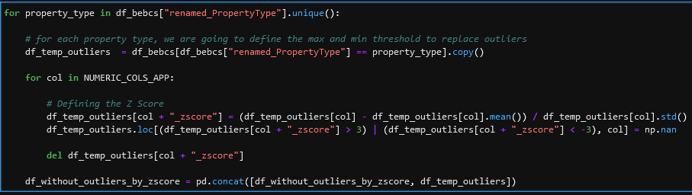
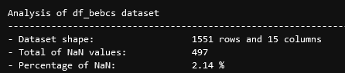

Outliers
OpenClassrooms

Slide 4
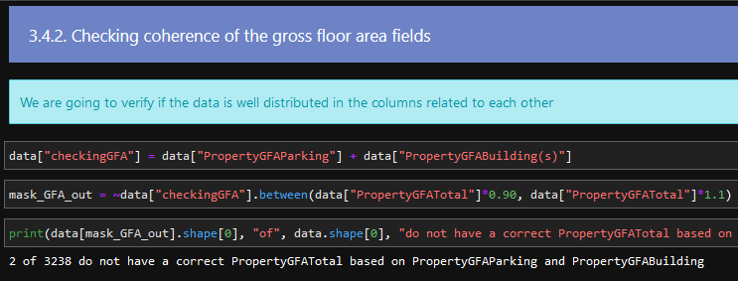
Multicollinearity
OpenClassrooms

Slide 5
LinearRegression / PolynomialFeatures
OpenClassrooms

Slide 6
KNeighbors
OpenClassrooms

Slide 7
Lasso
OpenClassrooms

Slide 8
Epsilon-Support Vector Regression (SVR)
OpenClassrooms

Slide 9
RandomForestRegressor
OpenClassrooms

Slide 10
GradientBoostingRegressor
OpenClassrooms

Slide 11
Ce que je vais faire.
DummyRegressor
Présentation
Continuer los vidéos cours pour bien comprendre les méthodes ensembliste et non linéaires
OpenClassrooms

