Slide 1
Ce que nous avons vu la semaine dernière
Tunning hyperparameters
KNeighborse k Nearest Neighbors
Find the k Nearest Neighbors
RandomForestRegressor
LinearRegression
OpenClassrooms

Slide 2
Ce que j'ai fait cette semaine
EDA
Outliers
Multicollinearity
Non-linear dataset
Tunning hyperparameters
LinearRegression / PolynomialFeatures
KNeighborse k Nearest Neighbors
Lasso
SVR
RandomForestRegressor
GradientBoostingRegressor
OpenClassrooms

Slide 3
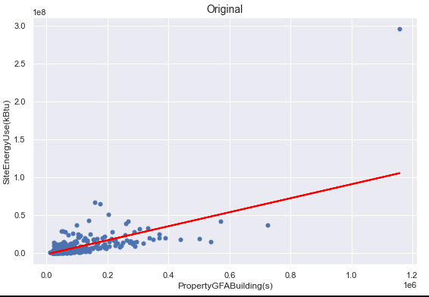
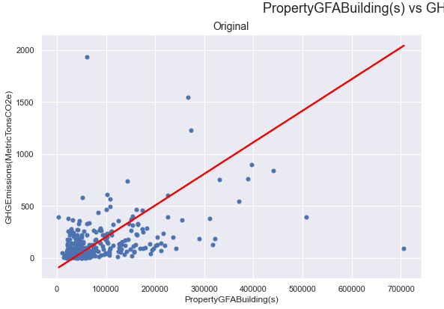
Non-linear dataset
OpenClassrooms

Slide 4
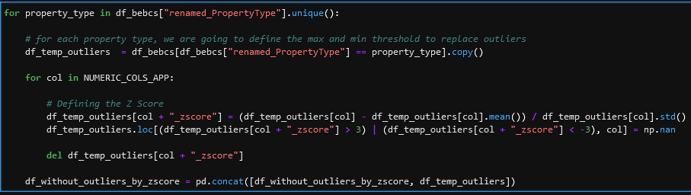
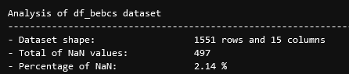

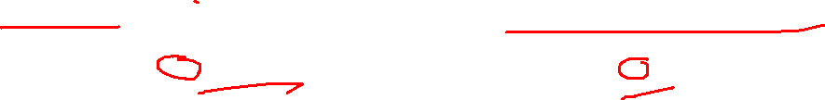
Outliers
OpenClassrooms

Slide 5
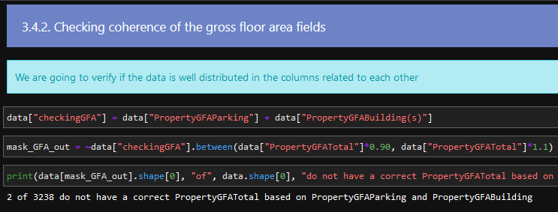
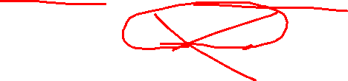
Multicollinearity
OpenClassrooms

Slide 6
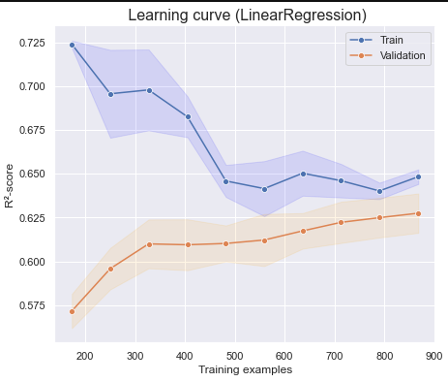
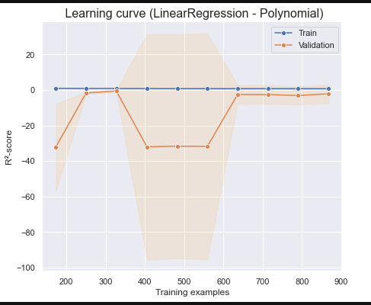
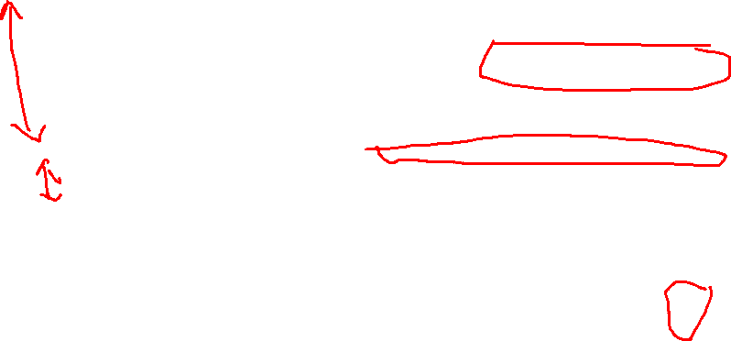
LinearRegression / PolynomialFeatures
OpenClassrooms

Slide 7
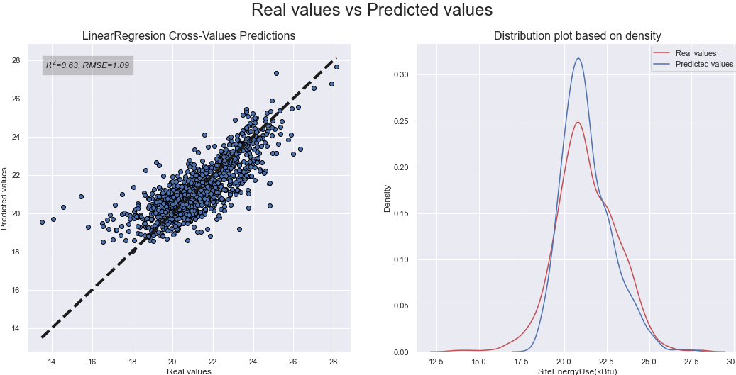
LinearRegression / PolynomialFeatures
OpenClassrooms

Slide 8
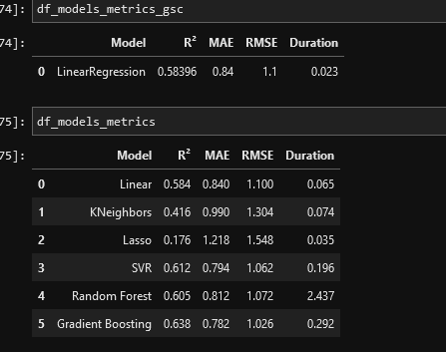
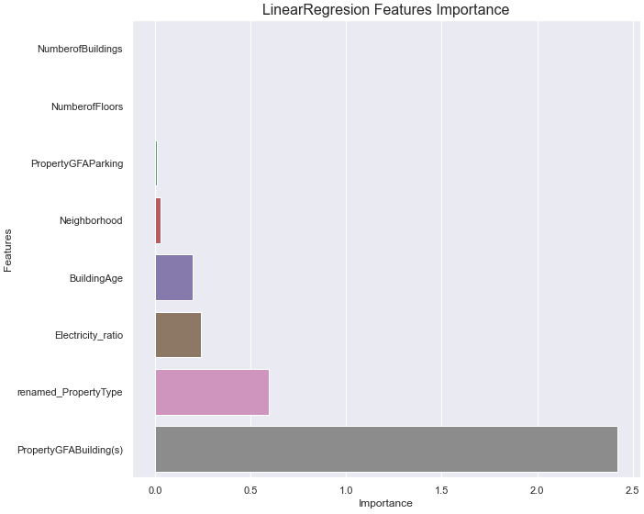
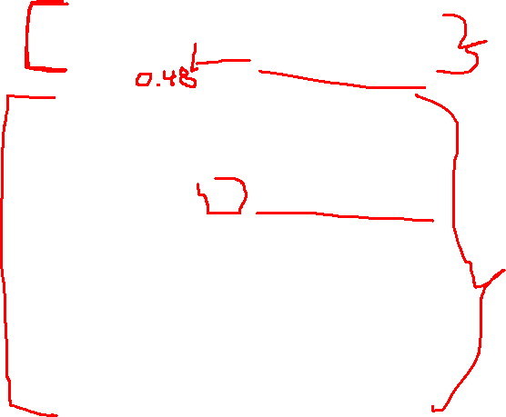
LinearRegression / PolynomialFeatures
OpenClassrooms

Slide 9
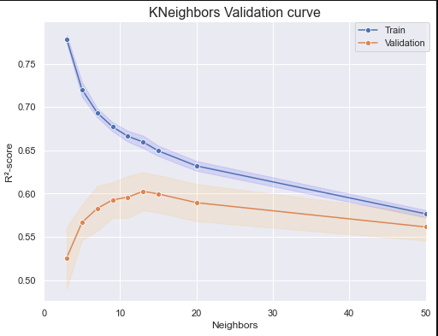
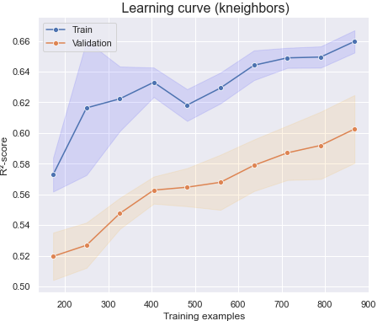
KNeighbors
OpenClassrooms

Slide 10
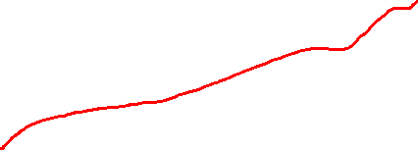
KNeighbors
OpenClassrooms

Slide 11
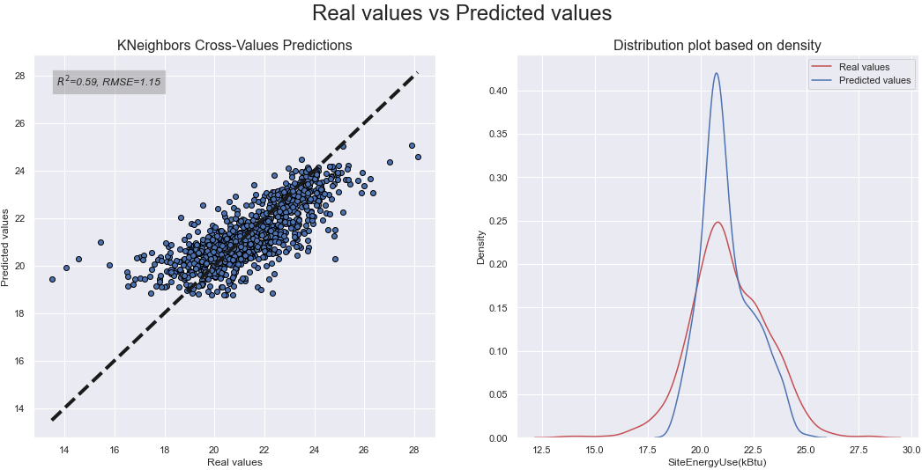
KNeighbors
OpenClassrooms

Slide 12
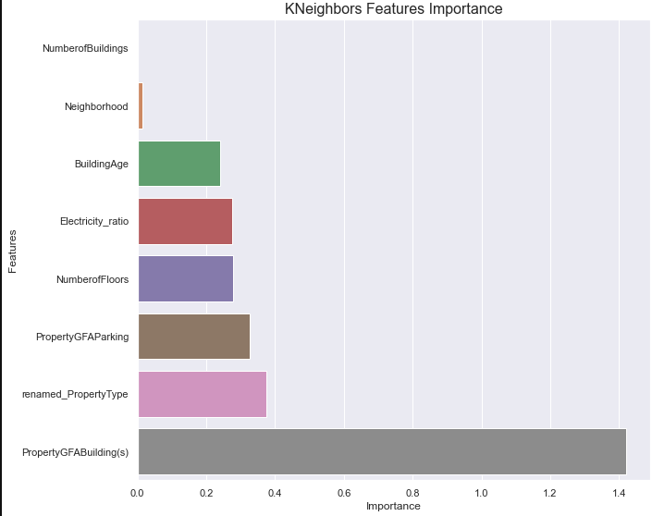
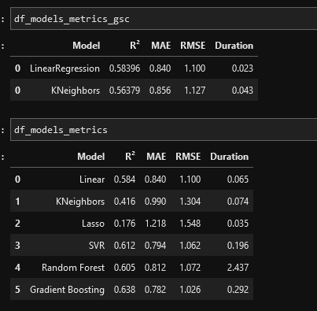

KNeighbors
OpenClassrooms

Slide 13
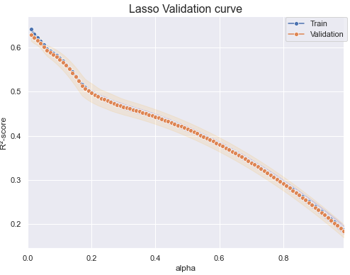
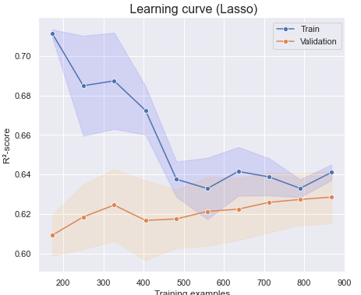
Lasso
OpenClassrooms

Slide 14
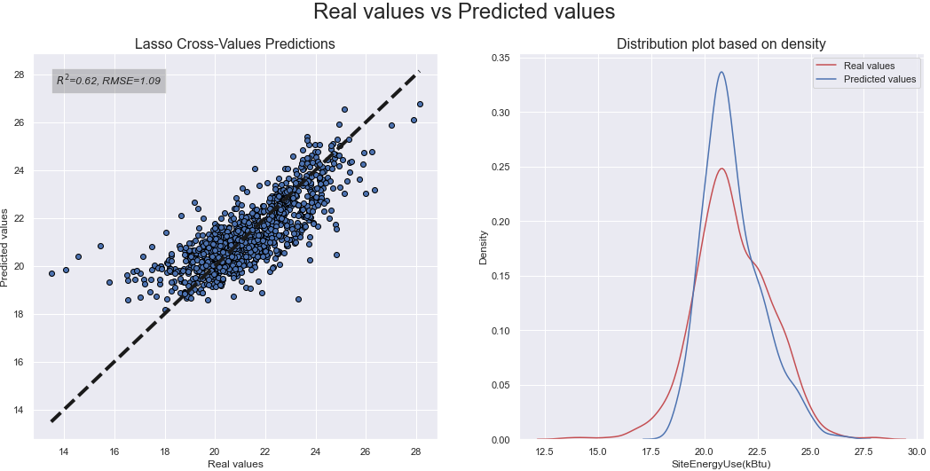
Lasso
OpenClassrooms

Slide 15
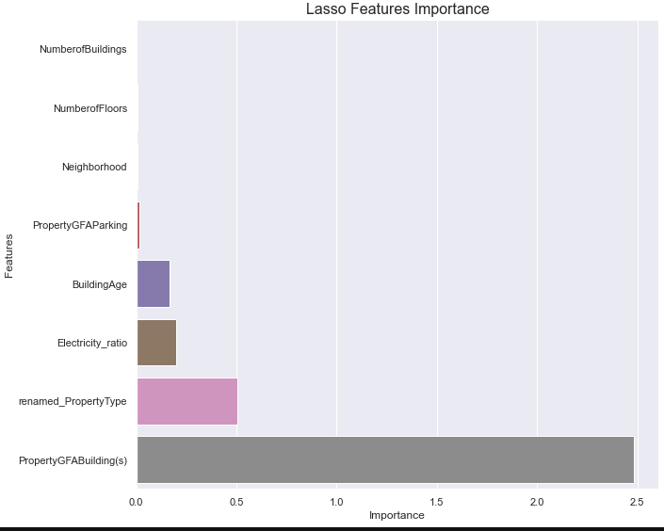
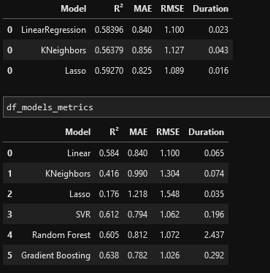
Lasso
OpenClassrooms

Slide 16
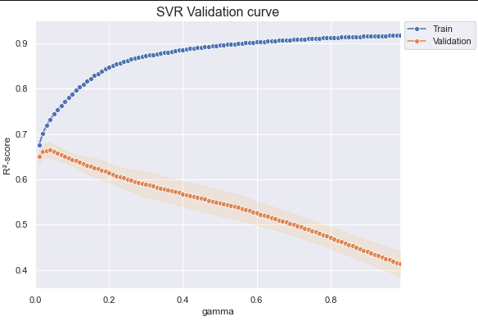
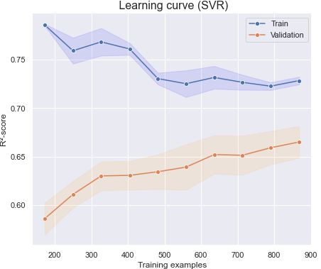

Epsilon-Support Vector Regression (SVR)
OpenClassrooms

Slide 17
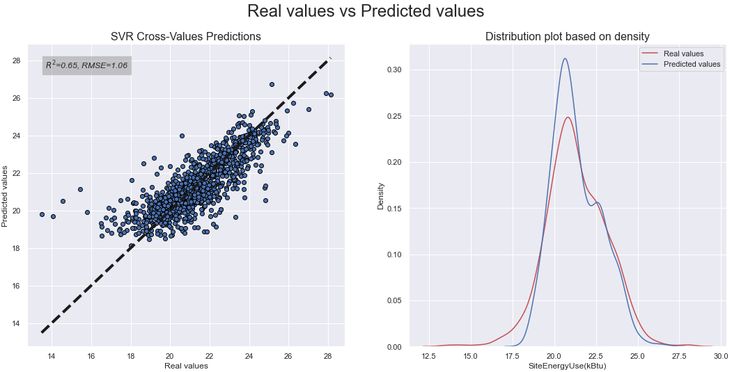
Epsilon-Support Vector Regression (SVR)
OpenClassrooms

Slide 18
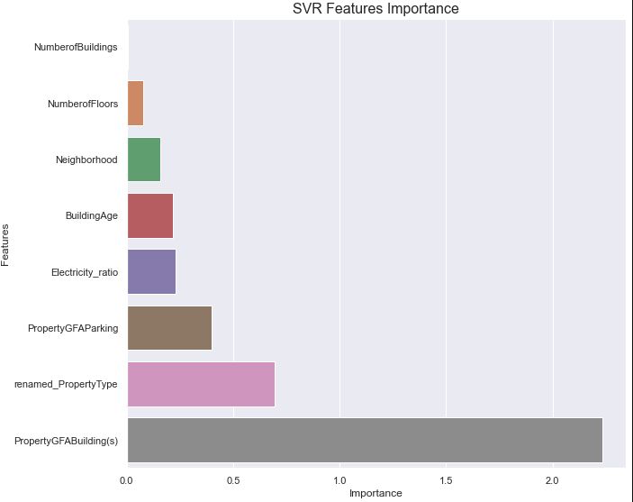
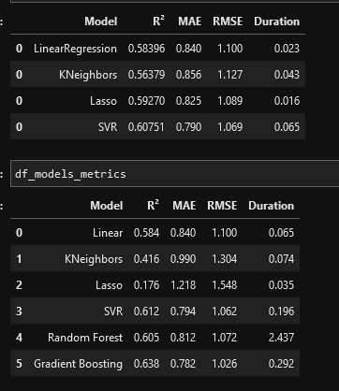
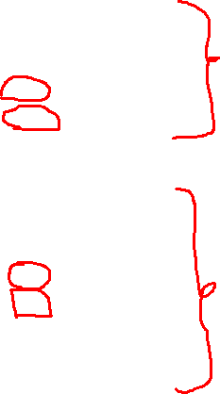
Epsilon-Support Vector Regression (SVR)
OpenClassrooms

Slide 19
RandomForestRegressor
OpenClassrooms

Slide 20
GradientBoostingRegressor
OpenClassrooms

Slide 21
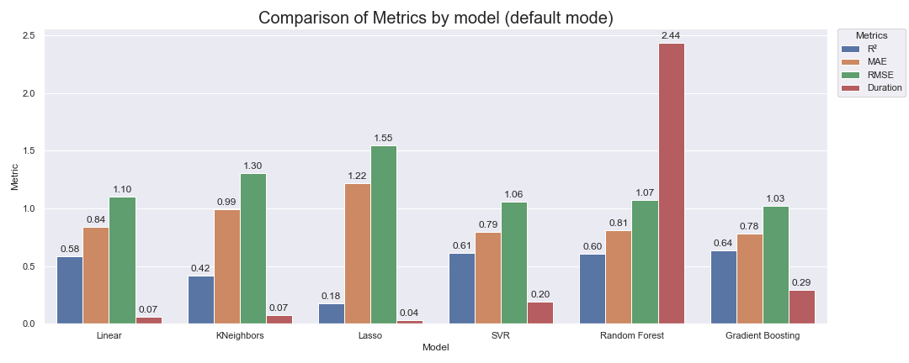
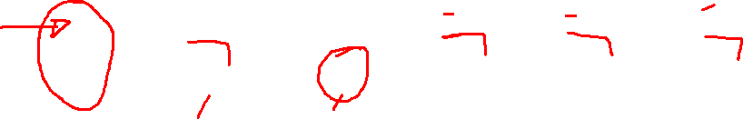
Comparaison
OpenClassrooms

Slide 22
Ce que je vais faire.
DummyRegressor
Présentation
Continuer los vidéos cours pour bien comprendre les méthodes ensembliste et non linéaires
Treatment de valeur manquante
Aficher R2 inverse (1-R2)
OpenClassrooms

