Slide 1
Ce que nous avons vu la semaine dernière
EDA
Outliers
Multicollinearity
Non-linear dataset
Tunning hyperparameters
LinearRegression / PolynomialFeatures
KNeighborse k Nearest Neighbors
Lasso
SVR
RandomForestRegressor
GradientBoostingRegressorc
OpenClassrooms

Slide 2
Ce que j'ai fait cette semaine
Sélection des features
Feature engineering
Traitement des valeurs manquantes
Mis à jour Data preprocessing
Tunning hyperparameters (refactoring)
LinearRegression / PolynomialFeatures
KNeighborse k Nearest Neighbors
Lasso
SVR
Random Forest
Gradient Boosting
Baseline Dummy Regressor
Refactoring notebook
OpenClassrooms

Slide 3
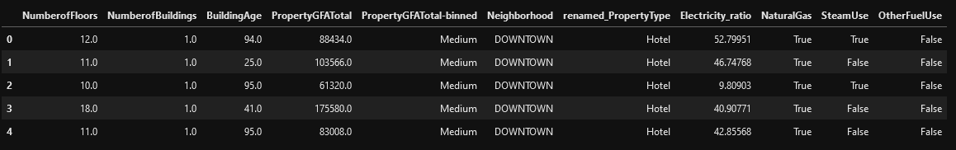
Sélection des features
OpenClassrooms

Slide 4
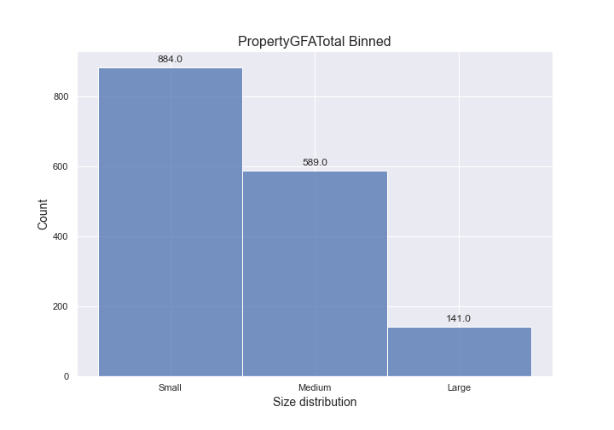
Feature engineering
OpenClassrooms

Slide 5
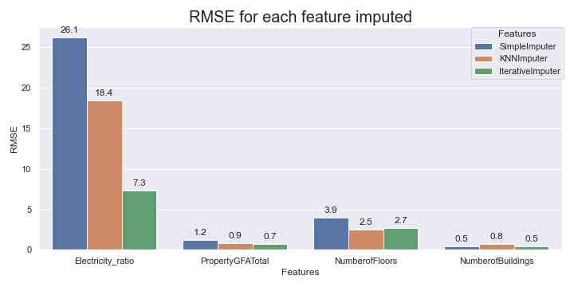
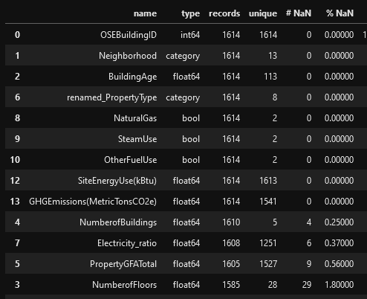
Traitement des valeurs manquantes
OpenClassrooms

Slide 6
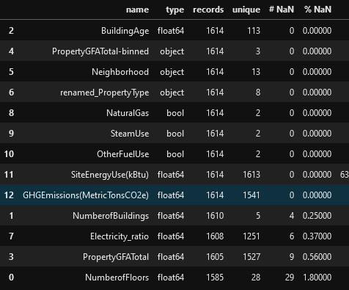
Mis à jour Data preprocessing
OpenClassrooms

Slide 7
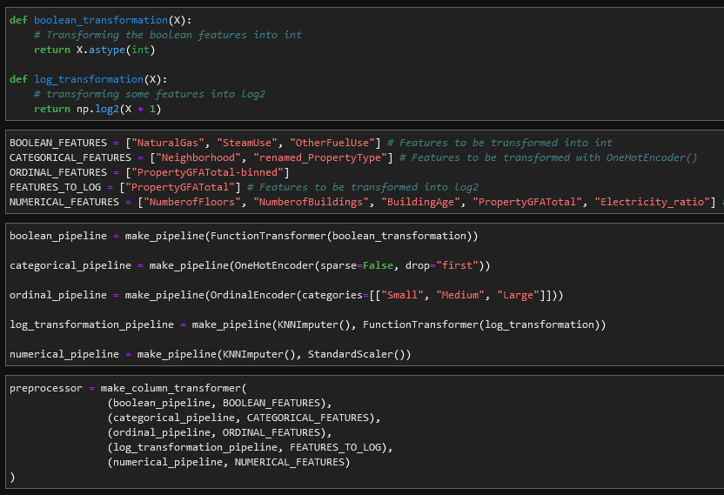
Mis à jour Data preprocessing
OpenClassrooms

Slide 8
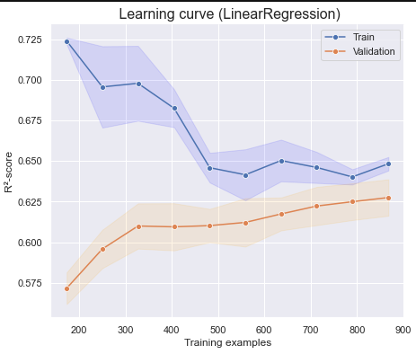
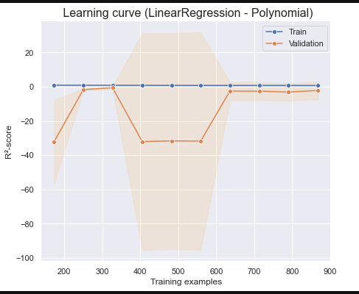
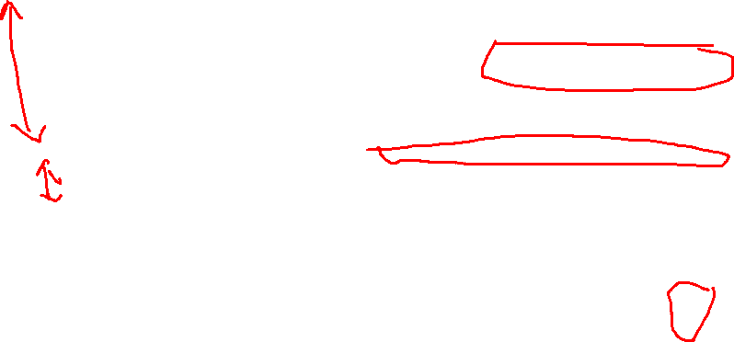
OLD
LinearRegression / PolynomialFeatures
OpenClassrooms

Slide 9
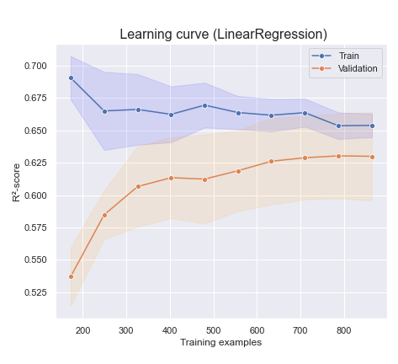
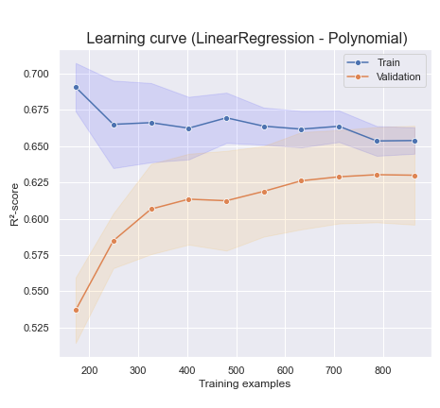
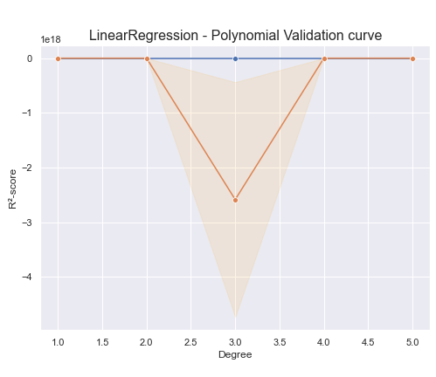
LinearRegression / PolynomialFeatures
OpenClassrooms

Slide 10
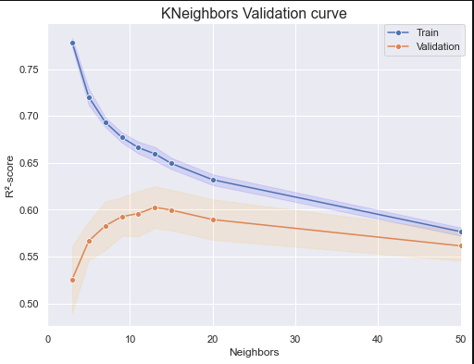
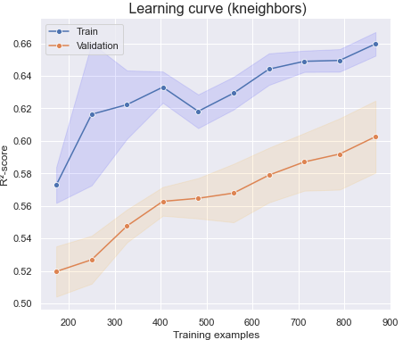
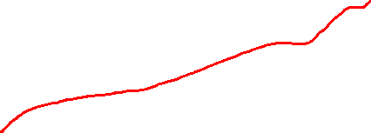
OLD
KNeighbors
OpenClassrooms

Slide 11
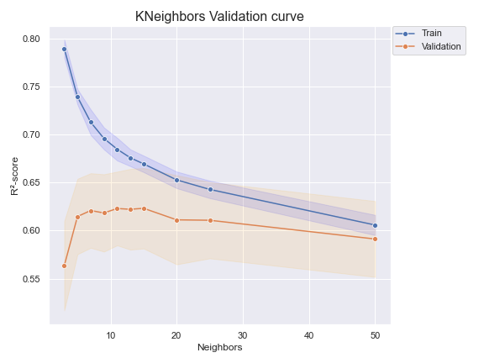
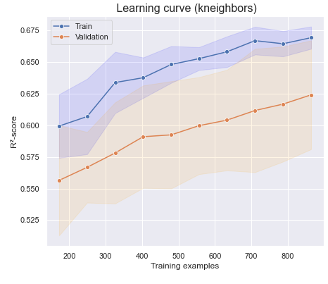
KNeighbors
OpenClassrooms

Slide 12
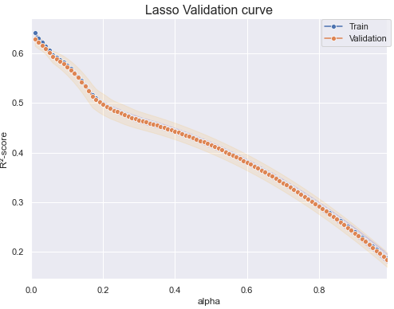
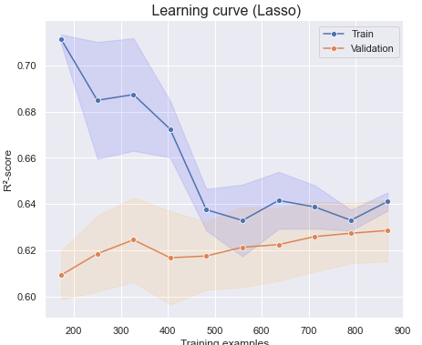
OLD
Lasso
OpenClassrooms

Slide 13
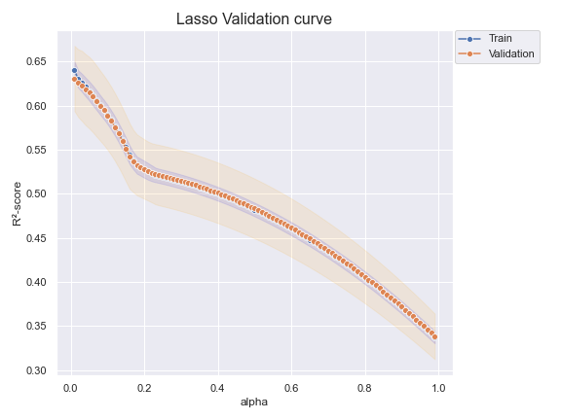
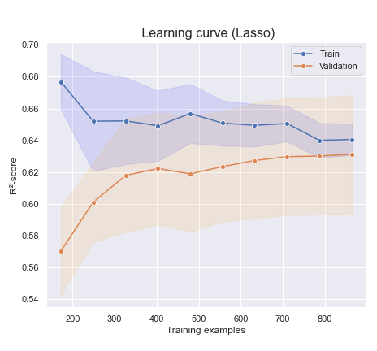
Lasso
OpenClassrooms

Slide 14
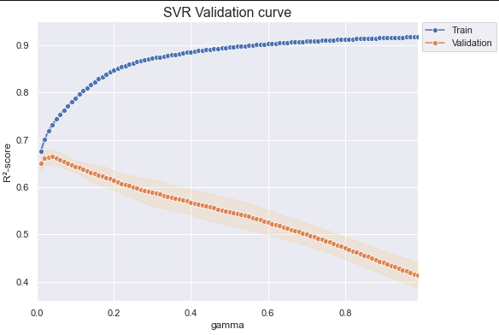
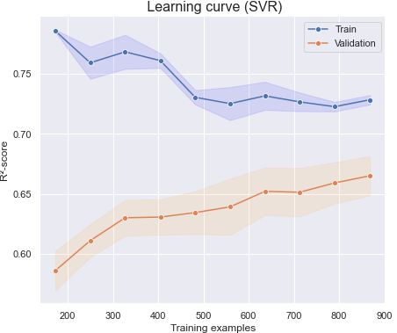

OLD
Epsilon-Support Vector Regression (SVR)
OpenClassrooms

Slide 15
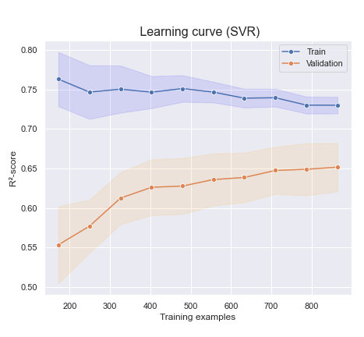
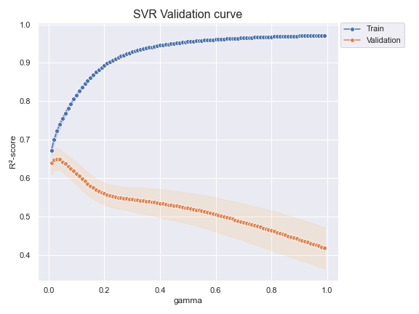
Epsilon-Support Vector Regression (SVR)
OpenClassrooms

Slide 16
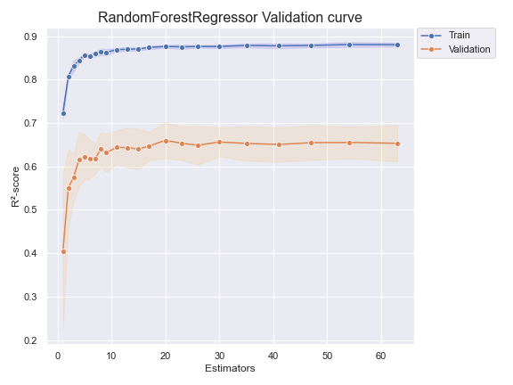
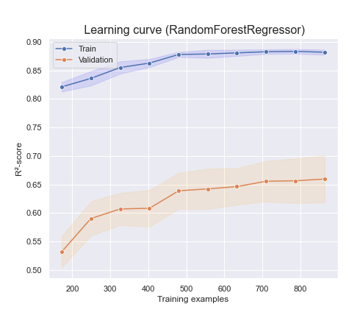
Random Forest
OpenClassrooms

Slide 17
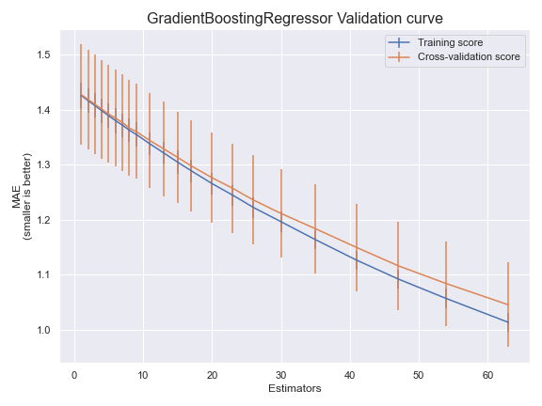
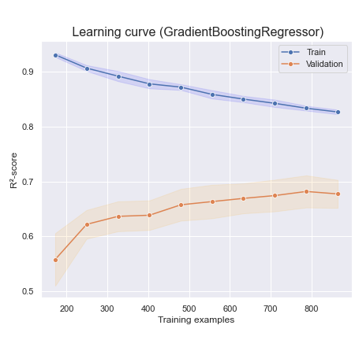
Gradient Boosting
OpenClassrooms

Slide 18
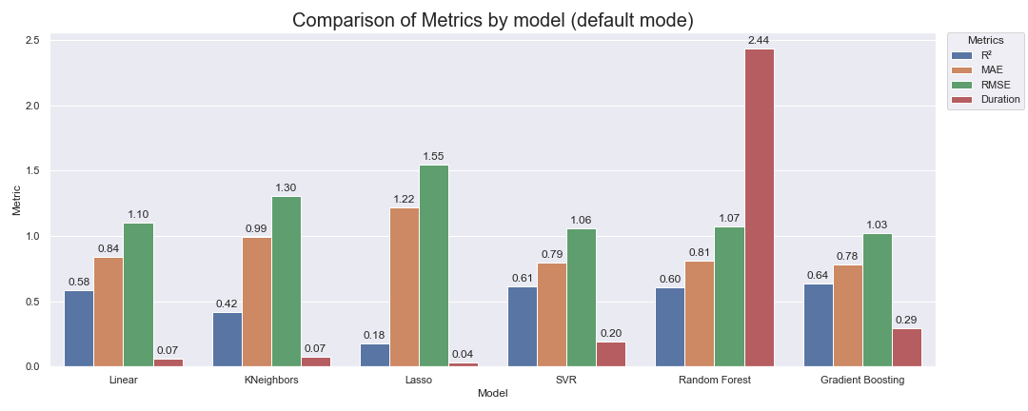
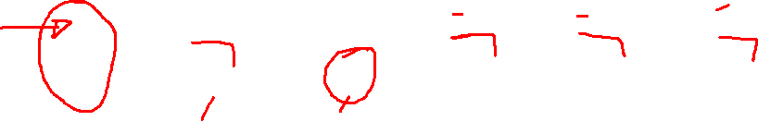
Comparaison
OLD
OpenClassrooms

Slide 19
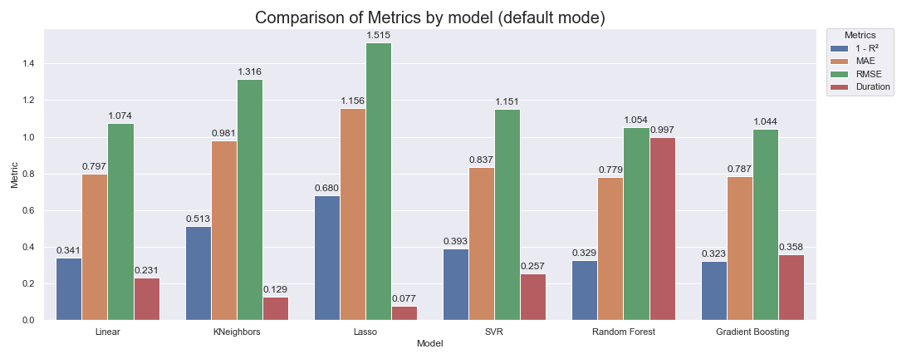
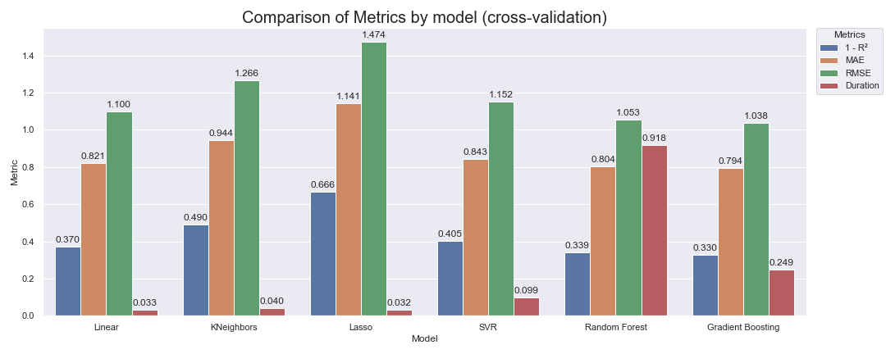
Comparaison
OpenClassrooms

Slide 20
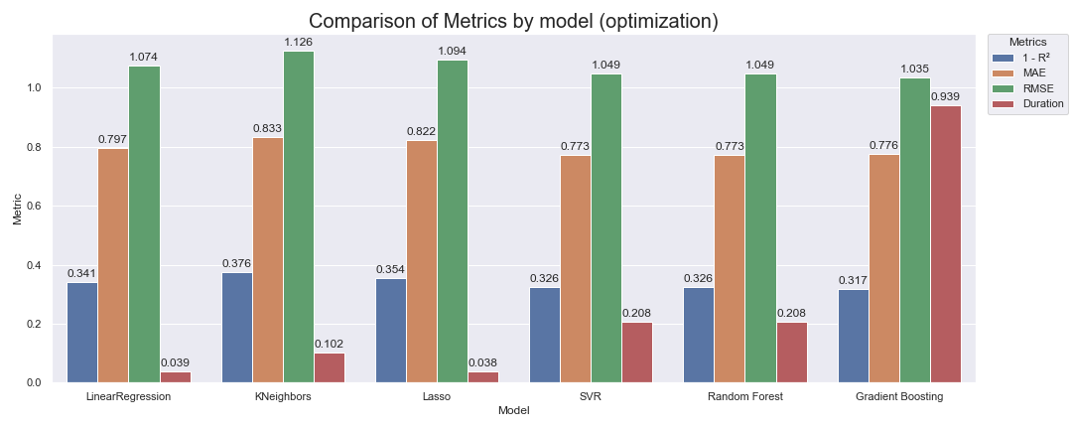
Comparaison
OpenClassrooms

Slide 21
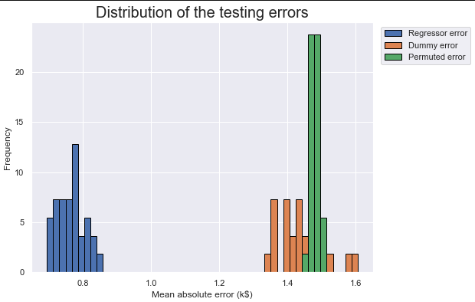
Baseline Dummy Regressor
OpenClassrooms

Slide 22
Ce que je vais faire.
Présentation
Continuer l’apprentissage de différents models
Démarrer le prochaine projet??
OpenClassrooms

