Slide 1
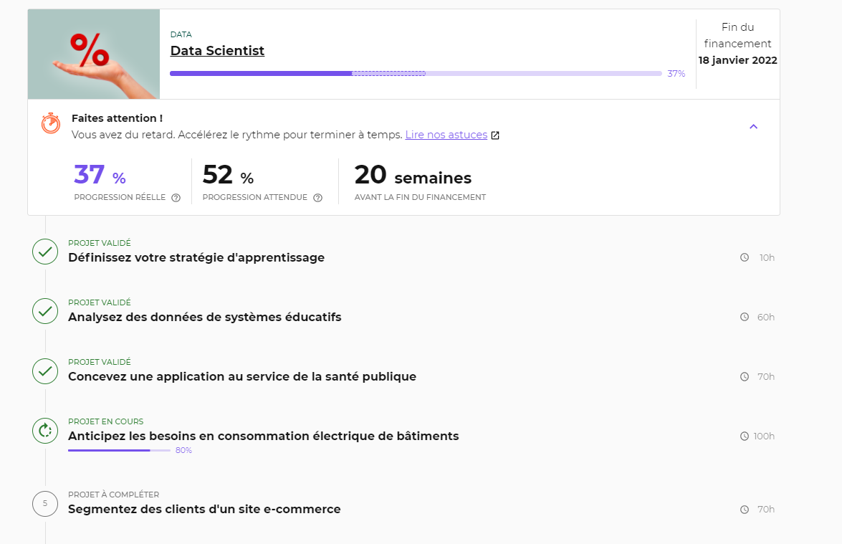
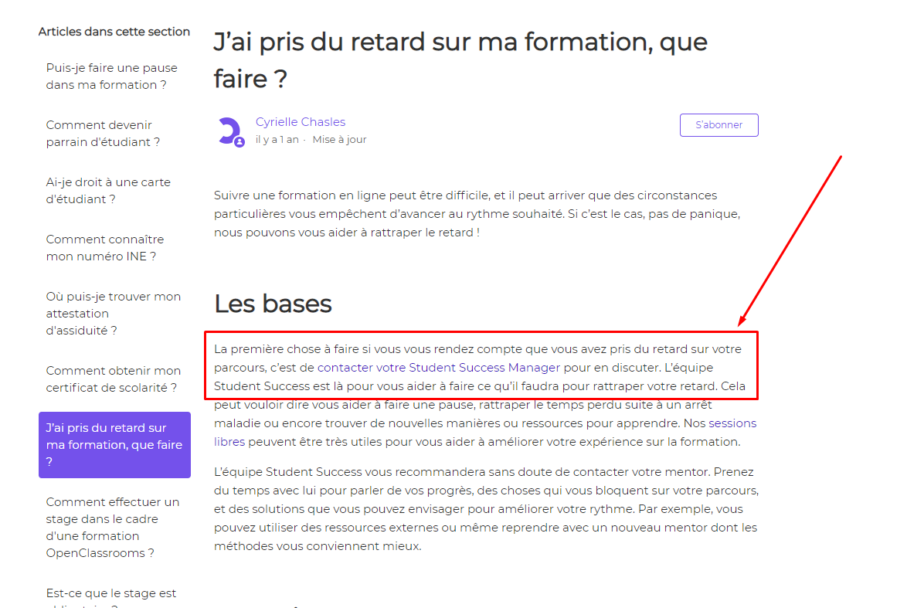
Contacter votre Student Success Manager
OpenClassrooms

Slide 2
Ce que nous avons vu la semaine dernière
EDA
Outliers
Multicollinearity
Non-linear dataset
Tunning hyperparameters
LinearRegression / PolynomialFeatures
KNeighborse k Nearest Neighbors
Lasso
SVR
RandomForestRegressor
GradientBoostingRegressorc
OpenClassrooms

Slide 3
Ce que j'ai fait cette semaine
Sélection des features
Feature engineering
Traitement des valeurs manquantes
Mis à jour Data preprocessing
Tunning hyperparameters (refactoring)
LinearRegression / PolynomialFeatures
KNeighborse k Nearest Neighbors
Lasso
SVR
Random Forest
Gradient Boosting
Baseline Dummy Regressor
Refactoring notebook
OpenClassrooms

Slide 4
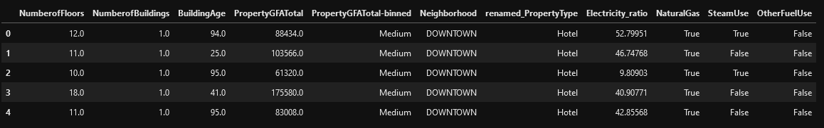
Sélection des features
>>> from sklearn.feature_selection import SelectKBest
>>> from sklearn.feature_selection import chi2
>>> from sklearn.feature_selection import VarianceThreshold
>>> from sklearn.feature_selection import SelectFromModel
OpenClassrooms

Slide 5
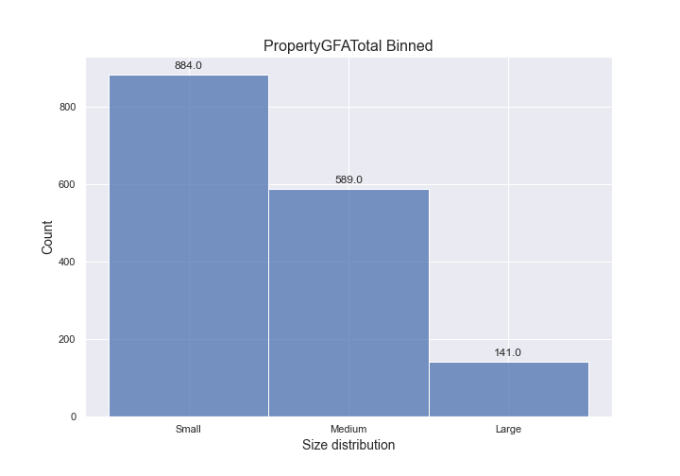

Feature engineering
OpenClassrooms

Slide 6
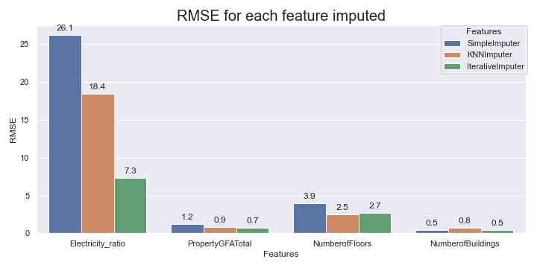
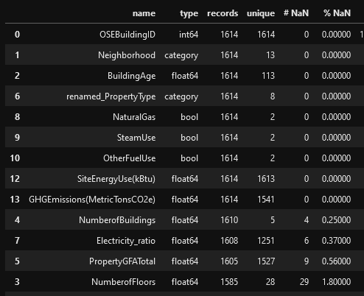

Traitement des valeurs manquantes
OpenClassrooms

Slide 7
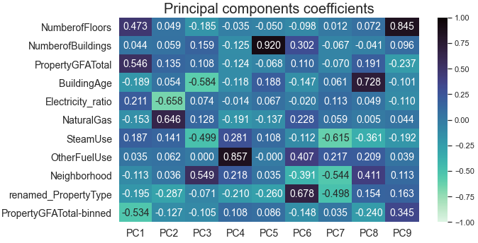
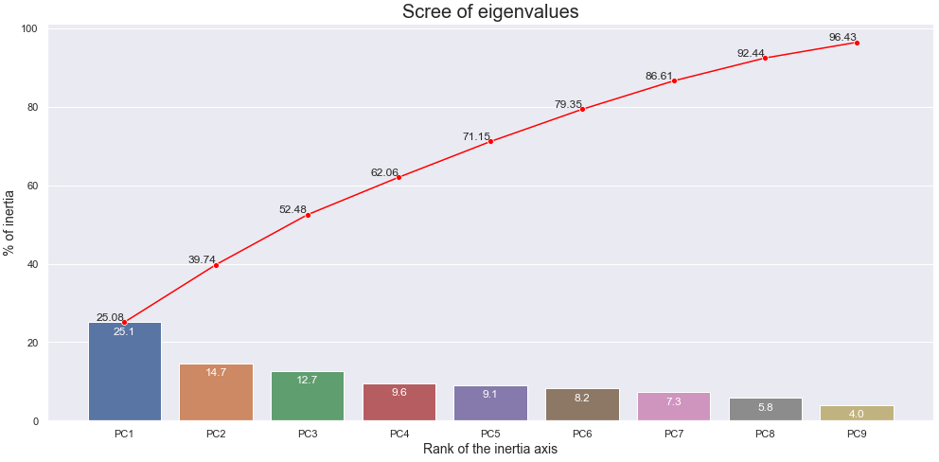

PCA
OpenClassrooms

Slide 8
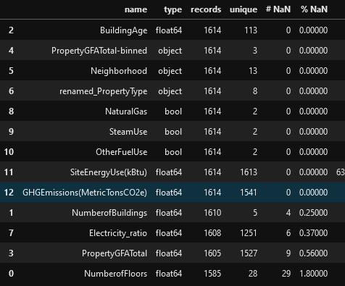

Mis à jour Data preprocessing
OpenClassrooms

Slide 9
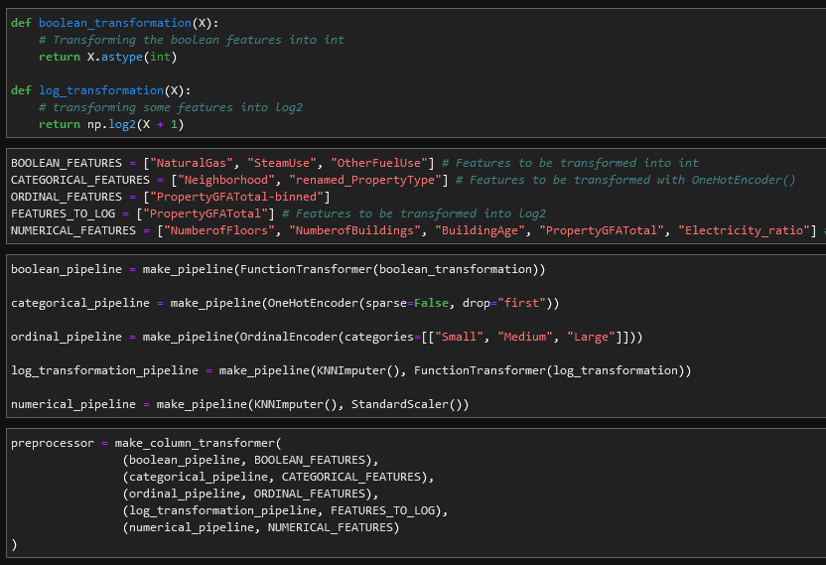

Mis à jour Data preprocessing
OpenClassrooms

Slide 10
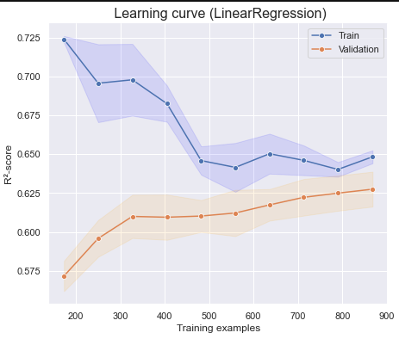
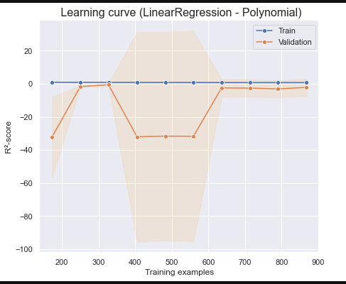

OLD
LinearRegression / PolynomialFeatures
OpenClassrooms

Slide 11
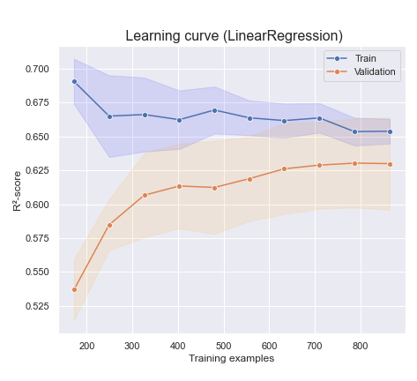
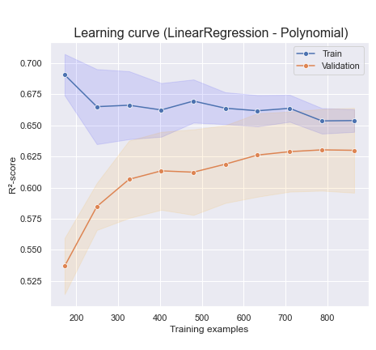
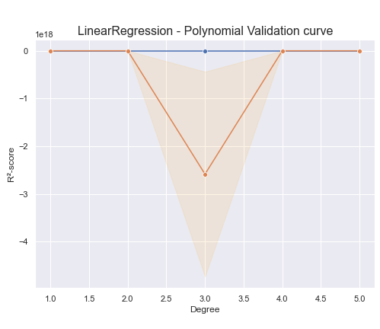
LinearRegression / PolynomialFeatures
OpenClassrooms

Slide 12
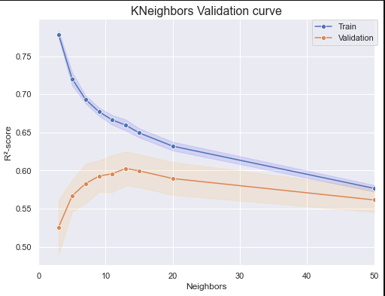
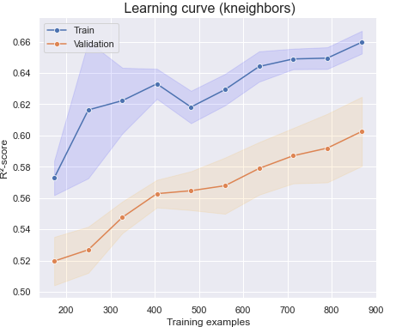
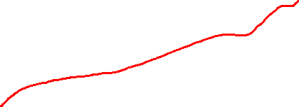
OLD
KNeighbors
OpenClassrooms

Slide 13
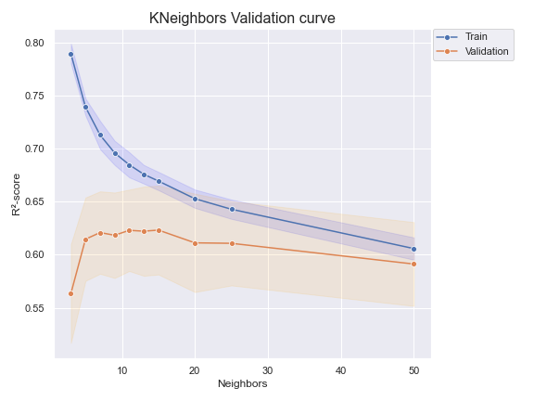
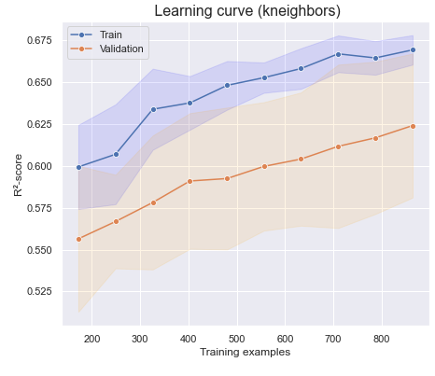
KNeighbors
OpenClassrooms

Slide 14
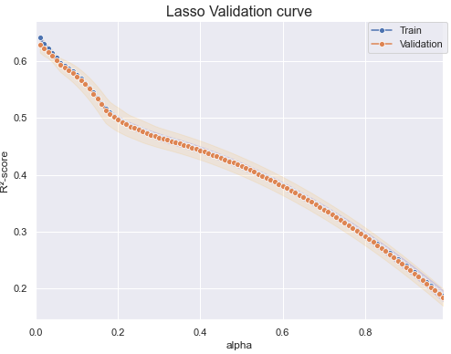
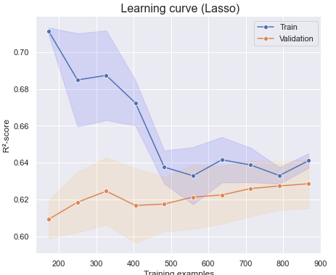
OLD
Lasso
OpenClassrooms

Slide 15
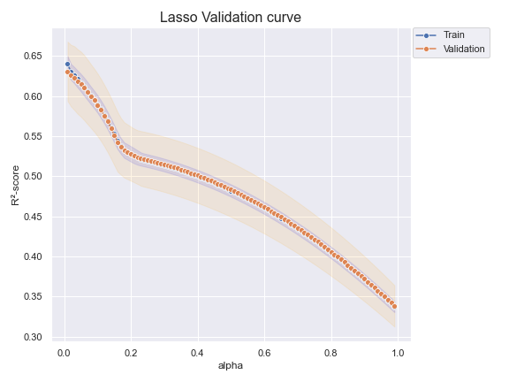
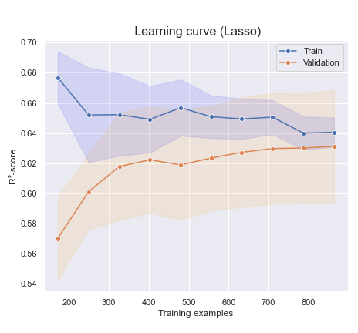
Lasso
OpenClassrooms

Slide 16
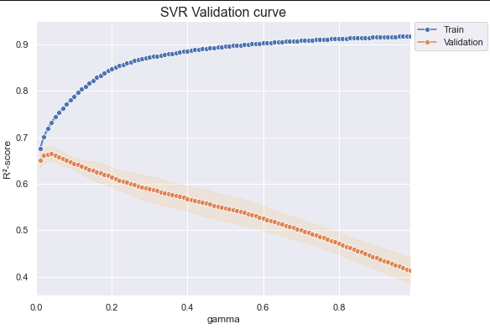
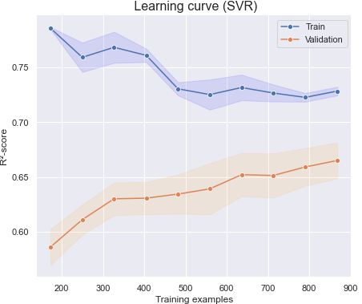

OLD
Epsilon-Support Vector Regression (SVR)
OpenClassrooms

Slide 17
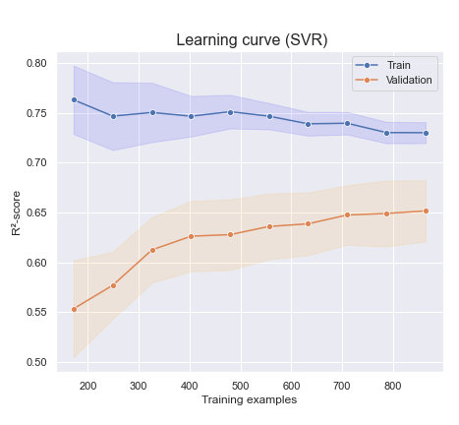
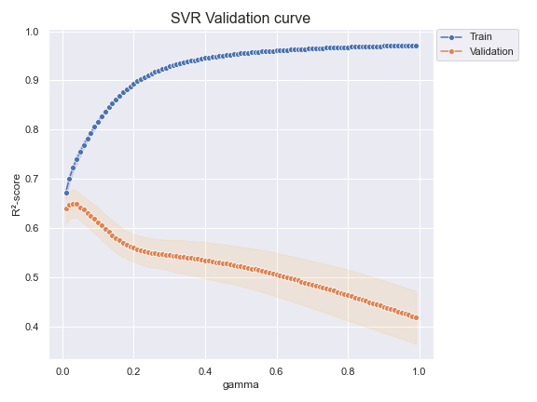
Epsilon-Support Vector Regression (SVR)
OpenClassrooms

Slide 18
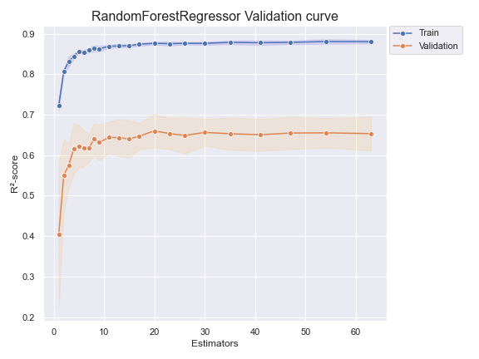
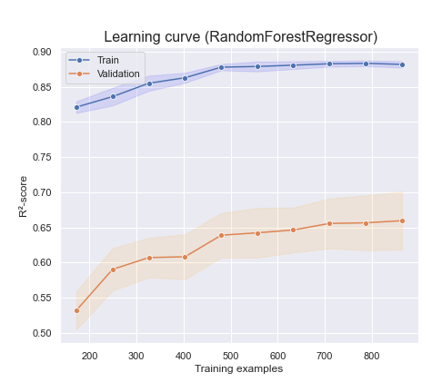

Random Forest
OpenClassrooms

Slide 19
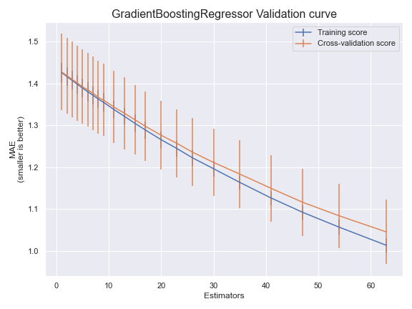
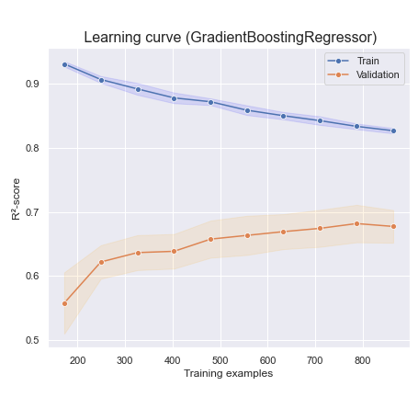

Gradient Boosting
OpenClassrooms

Slide 20
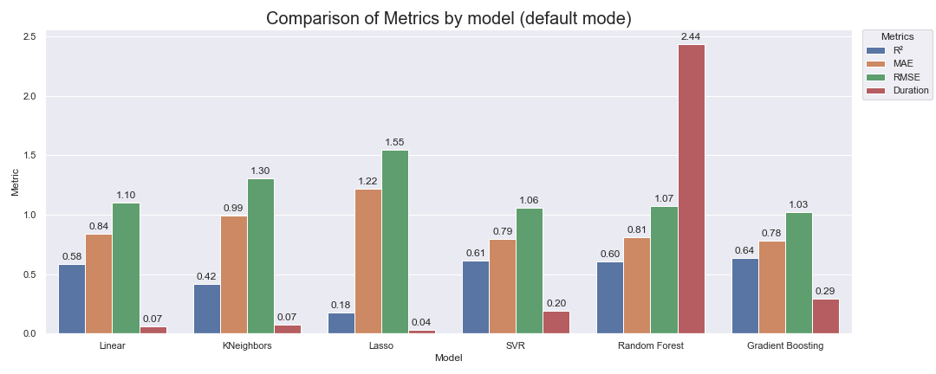

Comparaison
OLD
OpenClassrooms

Slide 21
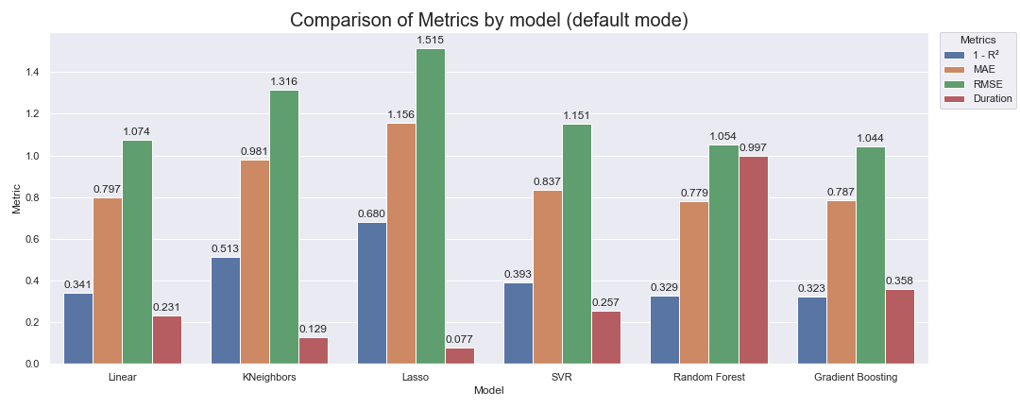
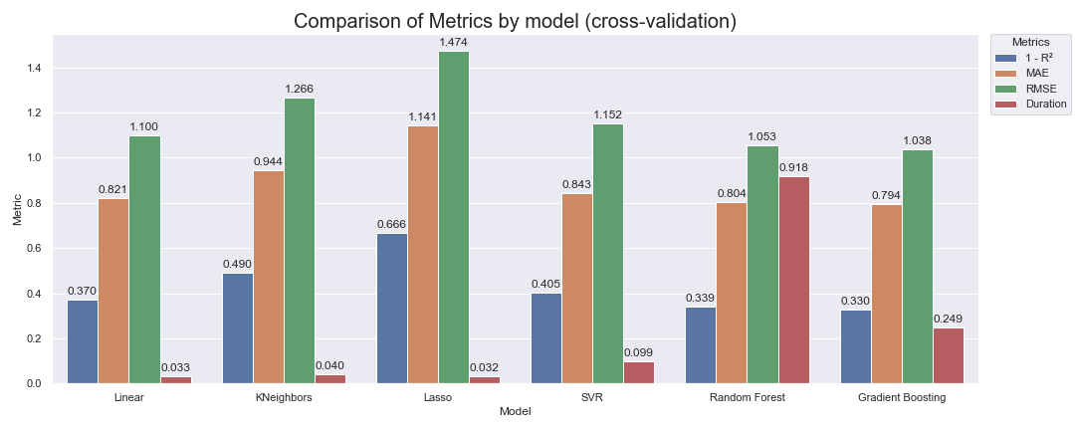

Comparaison
OpenClassrooms

Slide 22
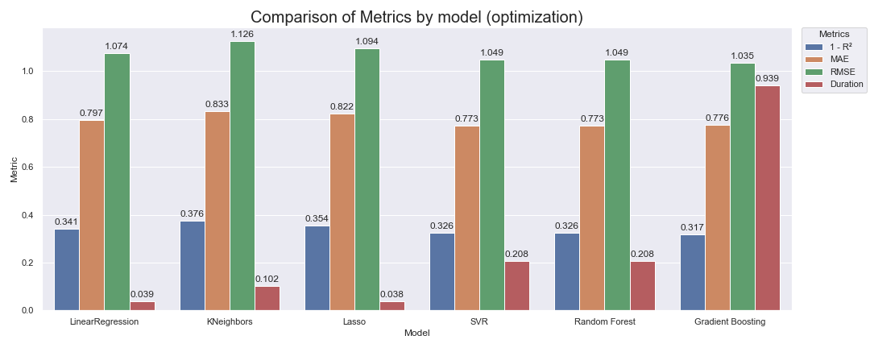

Comparaison
OpenClassrooms

Slide 23
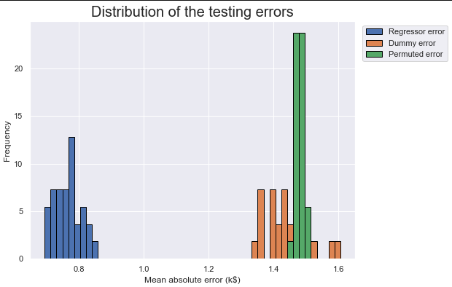
Baseline Dummy Regressor
OpenClassrooms

Slide 24
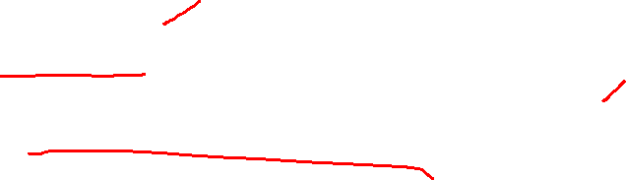
Ce que je vais faire.
Présentation
GHGEmissions(MetricTonsCO2e)
Continuer l’apprentissage de différents models
Démarrer le prochaine projet??
OpenClassrooms

