Slide 1
Implémentez un modèle de scoring
Memory usage
Missing values
Smote oversampling
Model optimization

Slide 2
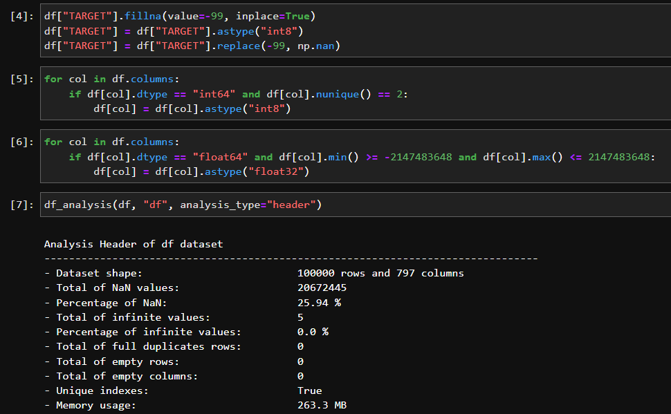
Optimizing memory usage

Slide 3
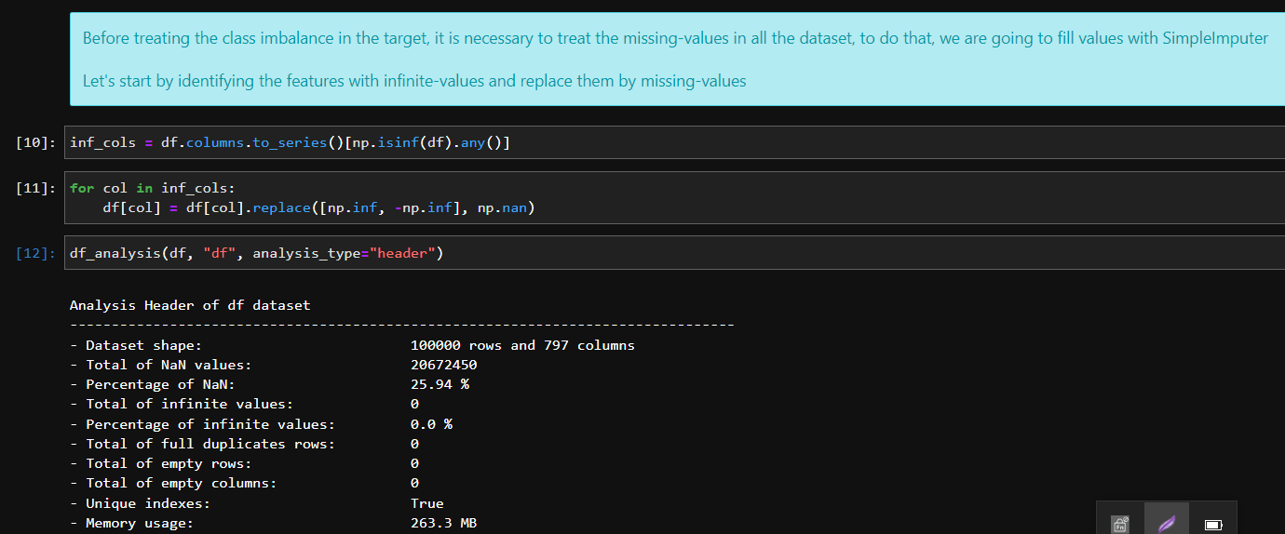
Missing values

Slide 4
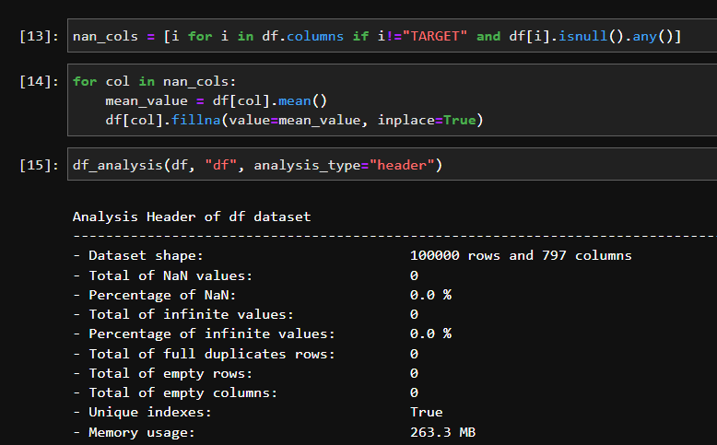
Missing values

Slide 5
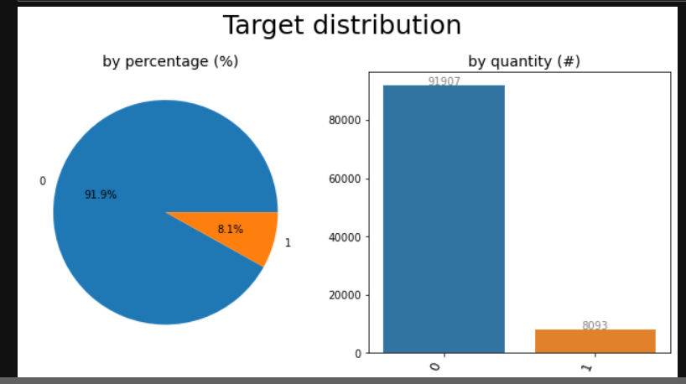
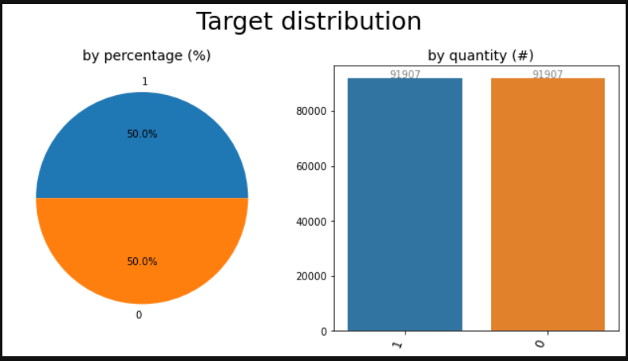
SMOTE - oversampling

Slide 6
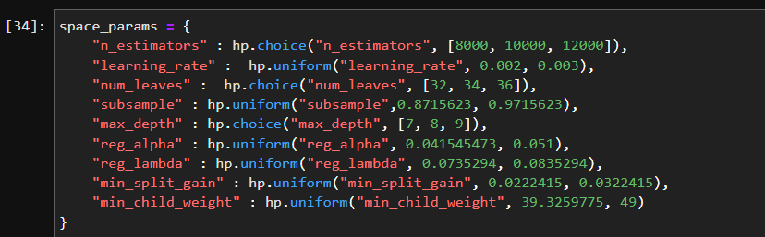
Model optimization
Unbalanced dataset
Balance dataset

Slide 7
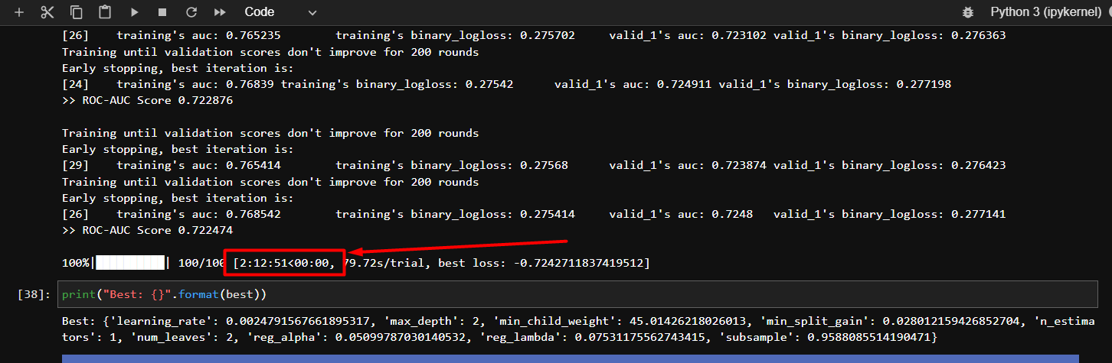
Unbalanced dataset

Slide 8
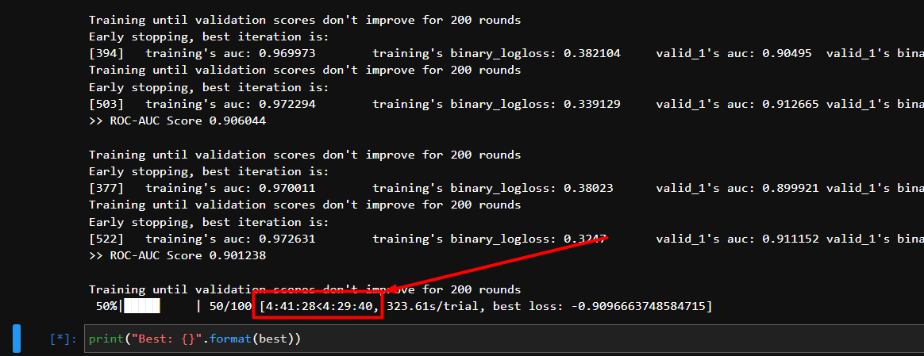
balanced dataset

