Slide 1

Ideal Team Mix Selection Team 6

Slide 2

Project analysis slide 3
Project Overview
Project definition
Dataset Description & Data Preparation
Descriptive analysis
Modeling
Results and Recommendations
Overview of NBA
Problem Definition
Approach and Assumptions
Datasets used
Data Merging
Data Cleaning
5-point summary major parameters
By Position –performance metrics
Correlation parameters
Composition of a team
Best Subset Selection
Regression Model
Clustering Model
Recommend players by position
Optimized team selection
Decision Framework
Notes:
Distribution graph –
Scatter plot
Box plot

Slide 3
Project analysis slide 10
Overview of NBA
The National Basketball Association is a men's professional basketball league in North America
Composed of 30 teams.
It is one of the four major professional sports leagues in the United States and Canada
Widely considered to be the premier men's professional basketball league in the world
There are an average of 14 players in a team playing in any of the 5 positions rotationally

Slide 4
Project analysis slide 10
Problem Statement
Indiana Pacers is an NBA team based out of Indianapolis, Indiana.
Playing in the league since 1967, is currently owned by Herbert Simon, real estate developer, billionaire.
The upper management wishes to dissolve the team and draft a new team.
They will retain the top 5 performing players and from a set annual spend budget, draft a list of remaining 9 players
Recommend an analytics-based solution to support their decision on team selection

Slide 5
Project analysis slide 10
Approach
and Assumptions
Assumptions:
Management wishes to retain the existing player count and position-wise player mix
The budget for the team’s cumulative salary is $120 Mn
Approach:
‘PER’ (player efficiency rating) is the performance metric that determines a player’s influence on the match and his value as a player for the team
The salary budget is divided among the five positions and then best performing player, whose salary lies within the budget is selected

Slide 6
Project analysis slide 4
Dataset 1: Season Stats
Description
The data-set contains aggregate individual statistics for 67 NBA seasons. from basic box-score attributes such as points, assists, rebounds etc., to more advanced money-ball like features such as Value Over Replacement
Overview of the key parameters*
Parameter | Description | Parameter | Description
2P | 2-Point Field Goals | GS | Games Started
2P% | 2-Point Field Goal Percentage | MP | Minutes Played
3P | 3-Point Field Goals | ORB | Offensive Rebounds
3P% | 3-Point Field Goal Percentage | ORB% | Offensive Rebound Percentage
Age | Age | OWS | Offensive Win Shares
AST | Assists | PER | Player Efficiency Rating
AST% | Assist Percentage | PF | Personal Fouls
BLK | Blocks | PTS | Points
BLK% | Block Percentage | STL | Steals
BPM | Box Plus/Minus | STL% | Steal Percentage
DRB | Defensive Rebounds | Tm | Team
DRB% | Defensive Rebound Percentage | TOV | Turnovers
DWS | Defensive Win Shares | TOV% | Turnover Percentage
eFG% | Effective Field Goal Percentage | TRB | Total Rebounds
FG | Field Goals | TRB% | Total Rebound Percentage
FG% | Field Goal Percentage | TS% | True Shooting Percentage
FGA | Field Goal Attempts | Usg% | Usage Percentage
FT | Free Throws | VORP | Value Over Replacement Player
FT% | Free Throw Percentage | WS | Win Shares
G | Games | Year | Year that the season occurred- the year given is the last year for that season
Data Parameters
The dataset includes info on 72 parameters including Age, Points Scored, Year, etc.
The data ranges from 1951-2017: However, we are concerned with the data points from 2013 onward only
Data Munging
Filter the dataset to include data from 2013 to 2017 only
Aggregate the parameters using “player” and ”year” as the key – to account for player transfers between teams
Separate the “Indiana Pacers” team from the training set to avoid overfitting
*(Non-exhaustive list)

Slide 7
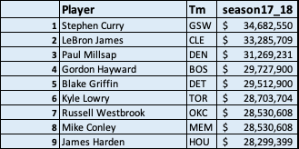
Project analysis slide 4
Dataset 2: Salary
Description
The data-set simply contains information about all NBA players’ salary in 2017-2018 Season.
Overview of the Parameters
Parameter | Description
Player | NBA players’ name
Tm | Team name each player belongs to at the beginning of the 2017-2018 season
Season17_18 | Salary price for 2017-2018 season (USD)
Data Parameters
The data-set shows players’ salary amount about 573 NBA players in 2017-2018 NBA season.
Along with the salary amount, it also includes players’ name and their team
First Multi-lines of the Data-set
Data Munging
This database is clearly enough for data-merging later

Slide 8
Project analysis slide 4
Dataset Manipulation
2013-16 data is used as the ‘training set’ to build the model to evaluate player performance score
Dataset 1: 2013-16
Dataset 1:
Season_Stats
Used as the test dataset to calculate the “PER” score
Dataset 1:
2017
Consolidated Dataset
Descriptive Statistics
Descriptive Statistics
Modeling
Interpretation and results
Left Merge on
‘Player name’
Salary dataset merged with the player stats to manage team budget
Dataset 2: Salary

Slide 9
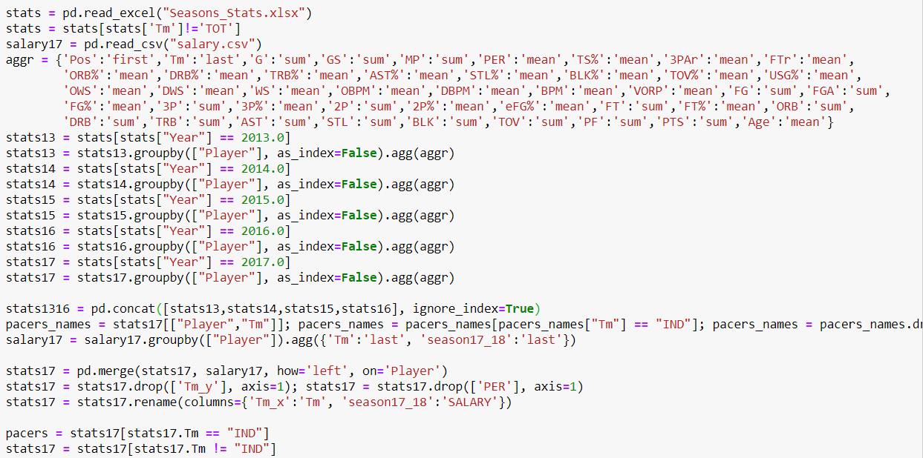
Dataset: Data Munging (algorithm)
We used “Pandas” for data manipulation and preparation

Slide 10
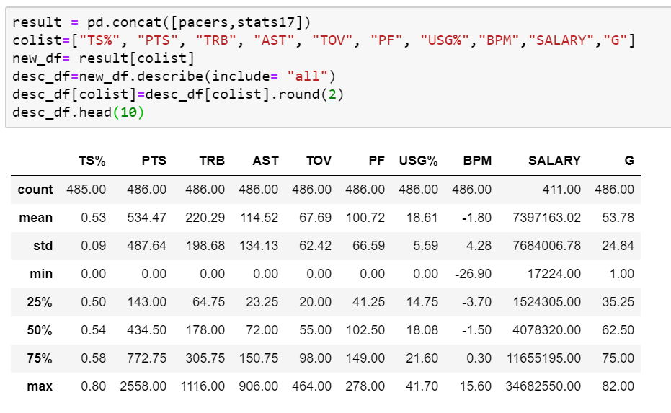
Project analysis slide 6
5 point summary
of performance metrics

Slide 11
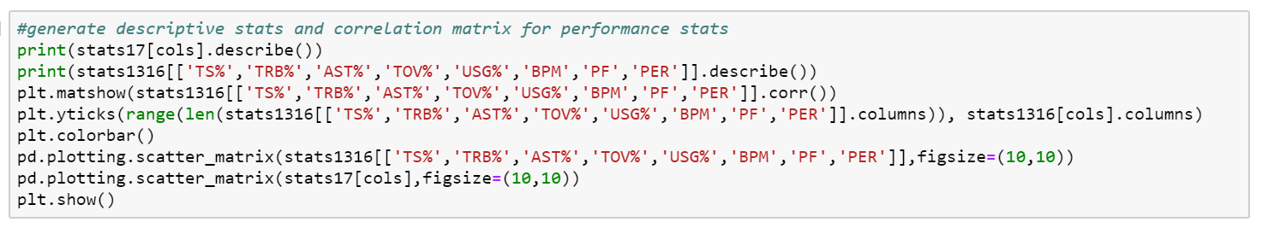
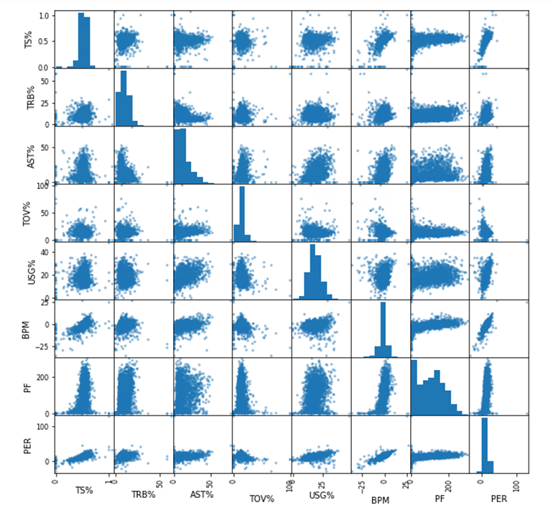
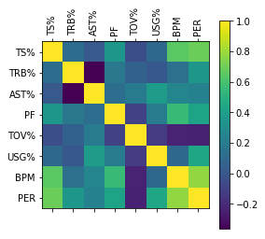
Project analysis slide 6
Correlation heatmap

Slide 12
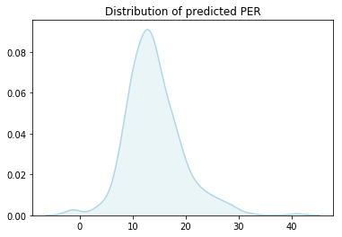
Project analysis slide 6
Distribution of
predicted PER
PER summarizes a player's statistical accomplishments in a season into a single number. This allows us to unify the disparate data on each player we try to track in our heads
Mean PER is 13..28 with STD of 5.91
The predicted performance ratings are normally distributed about the mean

Slide 13
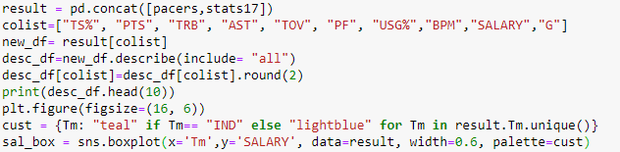
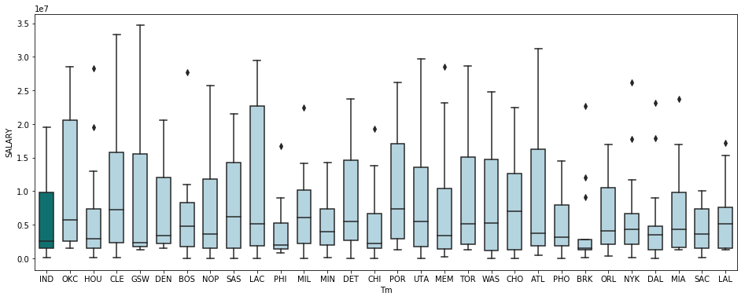
Project analysis slide 6
Salary distribution
of players in a team
Salaries distribution of player is highly uneven across teams
Based on several factors different teams have different caps on budgets and pay varied salaries

Slide 14
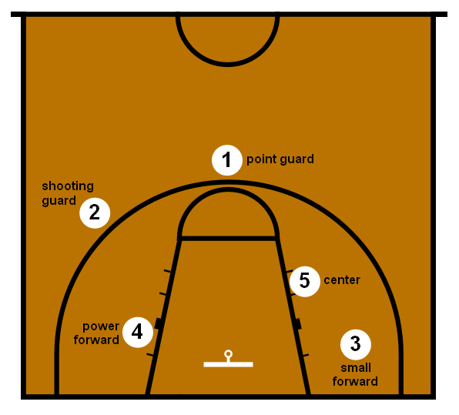
Overview of Positions

Slide 15
Project analysis slide 6
Basketball positions
The point guard (PG), also known as the one, is typically the team's best ball handler and passer. Therefore, they often lead their team in assists and are able to create shots for themselves and their teammates.
Average salary - $6.33mn
The shooting guard (SG) are mostly prolific from the three-point range. Besides being able to shoot the ball, shooting guards tend to be the best defender on the team, as well as being able to move without the ball to create open looks for themselves
Average salary - $5.31mn
The small forward (SF) is considered to be the most versatile of the main five basketball positions. Perform duties of both SG and PF
Average salary - $7.13mn
The power forward (PF), also known as the four, often plays a role similar to that of the center, being able to score close to the basket while also beinag able to shoot mid-range jump shots from 12 to 18 feet from the basket.
Average salary - $5.64mn
The center (C), usually plays near the baseline or close to the basket. They are usually the tallest players on the floor. They are typically skilled at gathering rebounds, contesting shots and setting screens on plays.
Average salary - $7.22mn

Slide 16
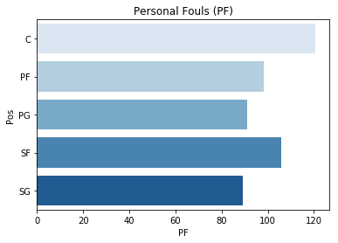
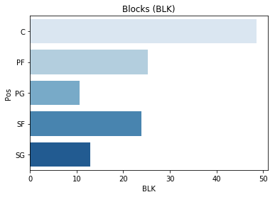
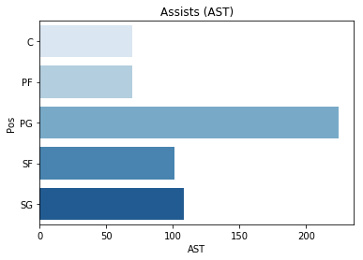
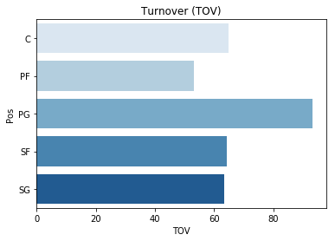
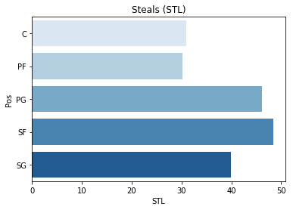
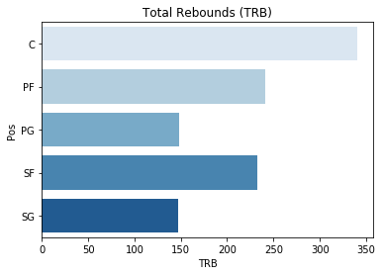
Project analysis slide 6
Position comparison
performance metrics

Slide 17
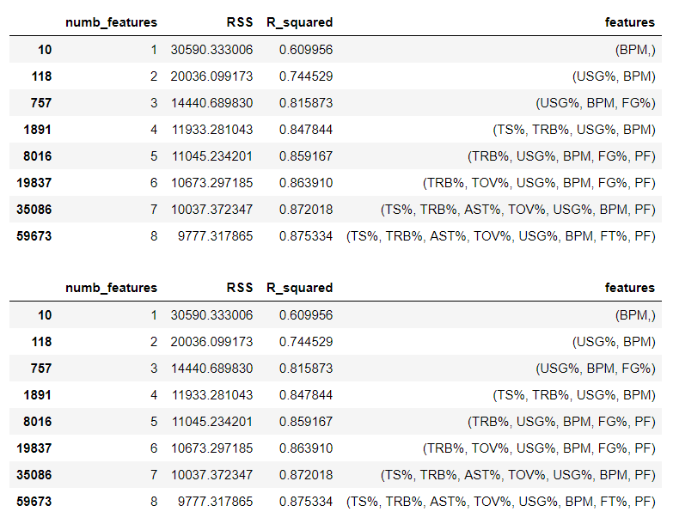
Parameter Selection
(Best subset selection)
We restrict ourselves to 7 parameters as the incremental explanation from adding the 7th variable is negligible
Output from the best subset algorithm¹ highlighting top features
Total: 72 parameters
17 parameters
7 parameters
Identified collinear and redundant parameters such as ‘2P’, ‘OWS’, ‘DWS’
Shortlist 17 parameters that could impact the performance value
Applied best sub-set selection¹ on the shortlisted parameters
Ridge regression provided the highest R2 value
Using this 3-step approach, we arrived at the 7 most optimal parameters for regression viz.,
'TS%’, 'TRB%’, 'AST%’, 'TOV%’, 'USG%’, 'BPM’, ‘PF’

Slide 18
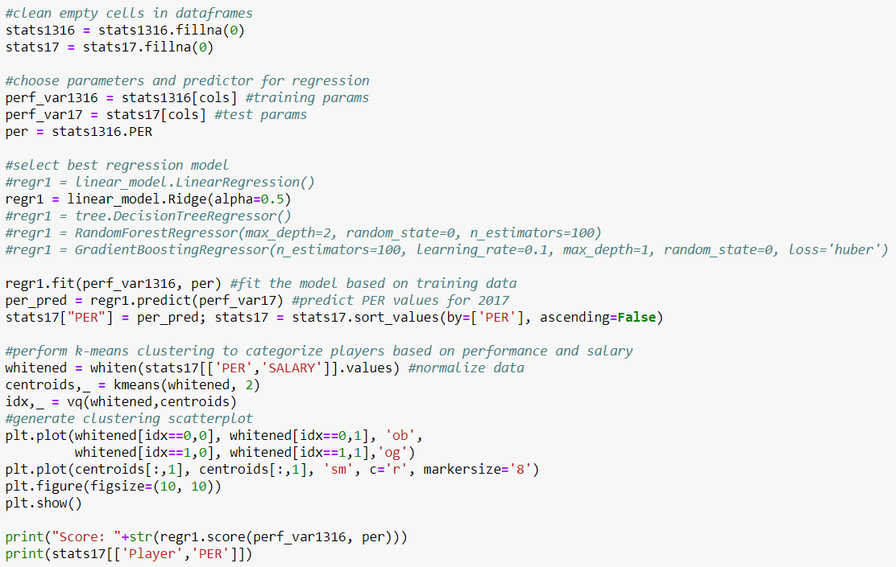
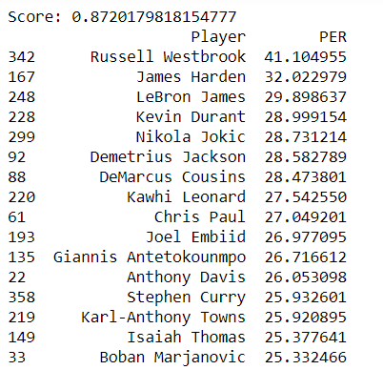
Regression Model
Regression Code
Sample Output
We tried the following regression models (from Sklearn library):
Linear Regression
Ridge
Decision Tree Regressor
Random-Forest Regressor
Gradient Boosting Regressor
Ridge model gave the best R² value

Slide 19
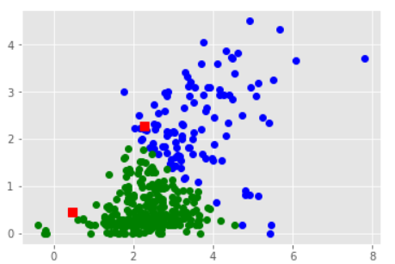
Clustering Model
Clustering Code
Sample Output

Slide 20
Players to be retained

Slide 21
Budget allocation framework

Slide 22
Recommended Player Roster

Slide 23
Tools and Libraries covered

Slide 24
Thank You

Slide 25
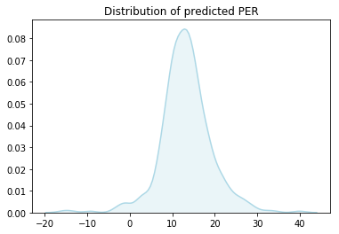
Project analysis slide 6
Box-plot
To be updated
PER summarizes a player's statistical accomplishments in a season into a single number. This allows us to unify the disparate data on each player we try to track in our heads
Mean PER is 13..28 with STD of 5.91
The predicted performance ratings are normally distributed about the mean

