Slide 1

Stock Market Prediction

Slide 2




Project Overview
Introduction
Executive Summary
Process Flow
Visualization
Team Introduction
Problem Statement
Datasets
Data extraction and EDA
Data model
Final Predictions
Trends
Notes:
Moving forward

Slide 3





Team introduction
Samir Husain
Roli Gupta
Saumya Bharti
Gajendra Saharan
Zaid Ahmed

Slide 4

Problem Statement
What are we aiming for?
Provide stock traders with a directional prediction of the opening and the closing stock values of Walt Disney Co.
Why Walt Disney Co.?
Considering the meteoric rise and the opening of different avenues within the company it is important to preemptively predict the stock values
Notes:
© Copyright Showeet.com – Free PowerPoint Templates

Slide 5
Executive Summary
Approach
Key Expected Outcomes
Data sources and data type
Static Data:
NYSE dataset from Kaggle
Zip file containing multiple files
Data from 01/01/2010-12/01/2019
Dynamic Data
Yahoo finance data
Data until the previous day
Provide accurate predictions for the opening and closing prices of Walt Disney Co. stocks
Data Extraction and EDA
Data Extraction: Hive and python scrappers were used to extract the static and dynamic data respectively
Exploratory Data Analytics: Tableau would be used to provide stock trends across years to provide an understanding of stock everyday behavior and the final predictions
Provide a decision support system to traders by providing stock trends with historic data
Long Short-Term Memory (LSTM) Neural Network
What: Special kind of recurrent neural network that is capable of learning long-term dependencies
Why: Can process entire sequences of data and well suited for time series predictions

Slide 6
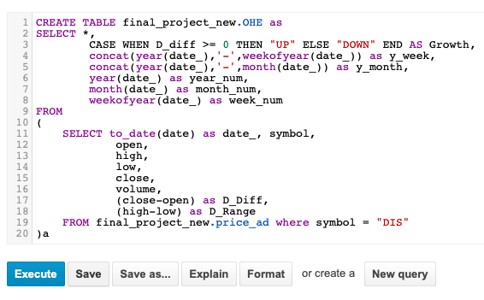
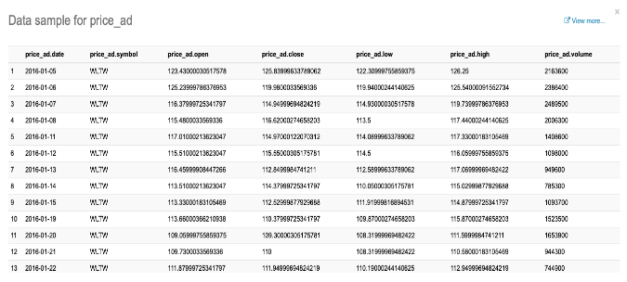
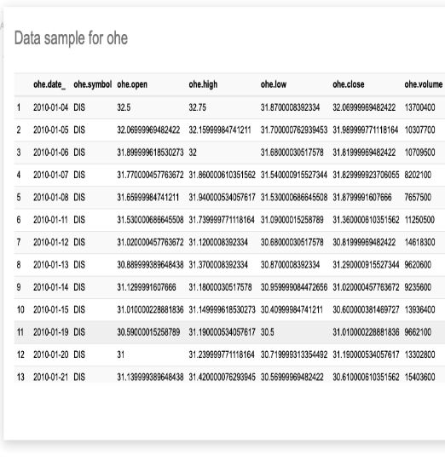
Process flow
Filter Data in Hive, create columns for visualization and load to python for data modelling
Load data into LSTM data model
Load Data from Kaggle for historic static data set
Extract dynamic data from Yahoo Finance using daily API
Load Final gSheet into Tableau
Manually triggered activity
Scheduled run

Slide 7
Data Model – Append-Load Implementation
The LSTM model runs daily with previous day’s stock prices added to the training data.
The learning process never stops.
Day 0
Use the static data obtained from Hue to train LSTM neural model.
Predict the stock price for day 1.
Day 1
Re-train the LSTM with Day 0’s stock prices added to the static data.
Predict stock price for day 2.
Day 2
Re-train the LSTM with Day 1’s stock prices added to Day 0’s training data.
Predict stock price for day 3.
The next day’s predictions can provide trader’s with directional hint of stock price movement. However,
stock prices are volatile and dependent on a large number of external variables.

Slide 8
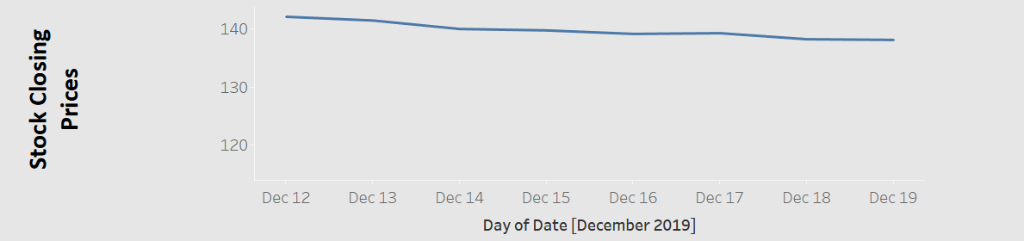
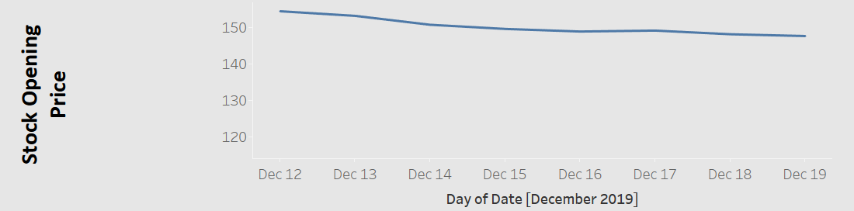
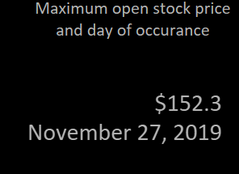
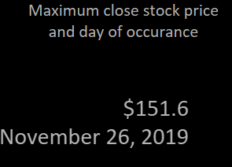
Visualization – Latest predictions and Observations
Latest Predictions
Predictions for the closing and opening prices:
Observation
Maximum stock prices historically were for
Opening price: November 27, 2019 - $152.3
Closing price: November 26, 2019 - $151.6
These dates coincide with the launch of Disney+

Slide 9
Thank You

