Slide 1
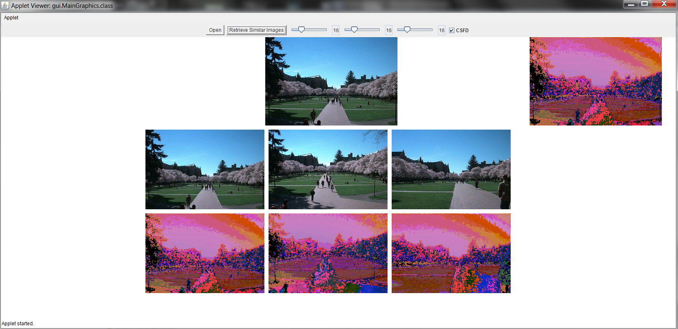
Novel Color Feature Representation and Matching Technique for Content-based Image Retrieval
Raunaq Kumar
Samir Sheriff

Slide 2
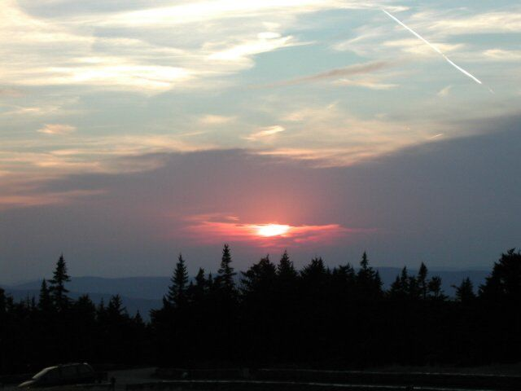
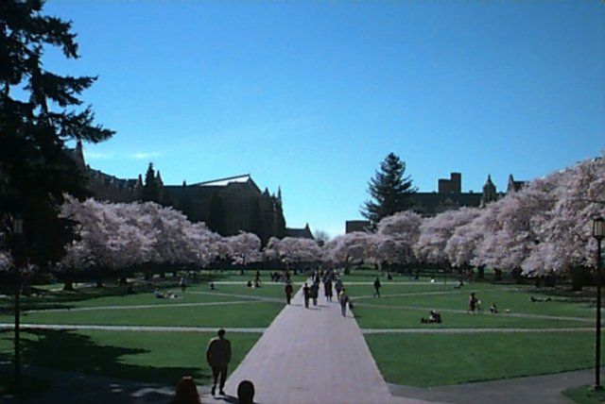
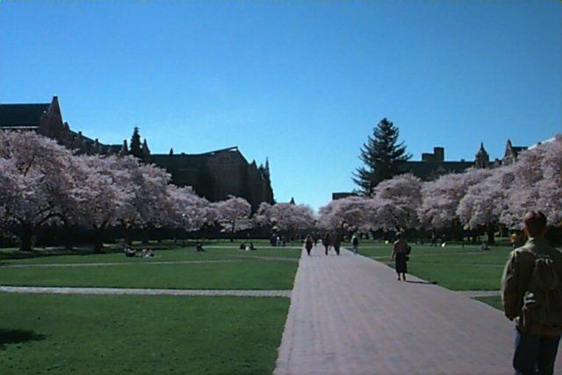

Slide 3
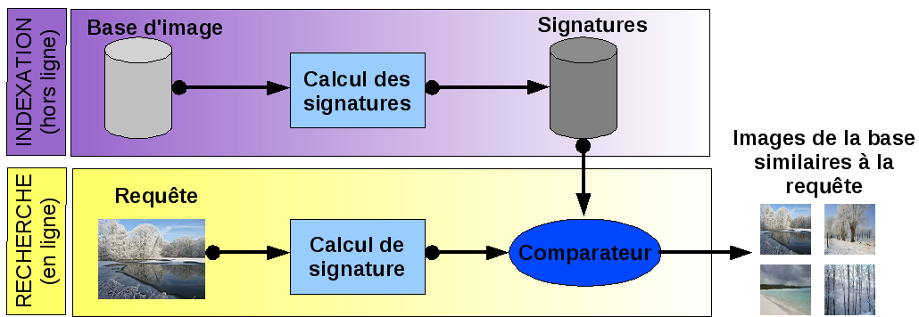
Concept
"Content-based" means that the search will analyze the actual contents of the image rather than the metadata such as keywords, tags, and/or descriptions associated with the image. The term 'content' in this context might refer to colors, shapes, textures, or any other information that can be derived from the image itself.

Slide 4
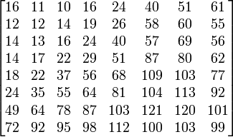
Color Histogram Method – Step 1
For every image: Quantization of colors in the RGB model, to make later computations easier.
In our application, the user can select the quantization value for Red, green and blue separately.

Slide 5
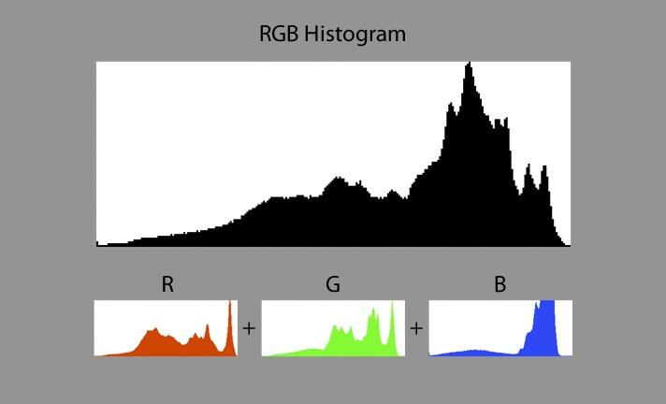
Color Histogram Method – Step 2
For every quantized image: Calculate a color histogram, which is a frequency distribution of quantized RGB values of each pixel of an image.

Slide 6

Color Histogram Method – Step 3
For the query image: Repeat the 2 steps shown previously to get a color histogram of the query image

Slide 7
Color Histogram Method – Step 4
Compare the histogram of the query image with the histograms of every image of the retrieval system.
Similar images can be found based on Euclidean distance, which is: For all possible quantized RGB values: rgbBin: euclideanDistance += Math.abs(image.getValueFromHistogram(rgbBin) - queryImage.getValueFromHistogram(rgbBin));
Smaller the distance between two images → Greater the similarity between them

Slide 8

Disadvantage
The high dimensionality of feature vectors results in high computation cost and space cost.

Slide 9
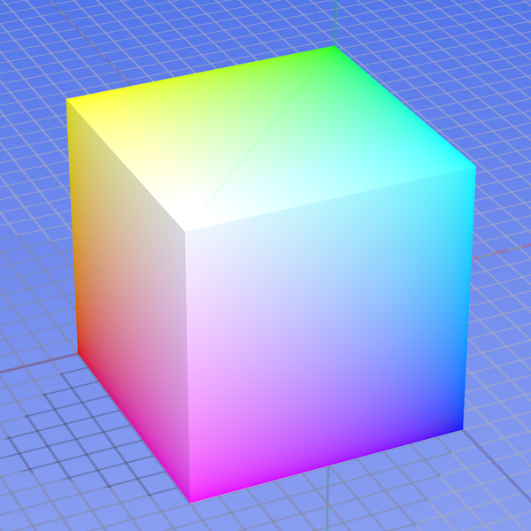
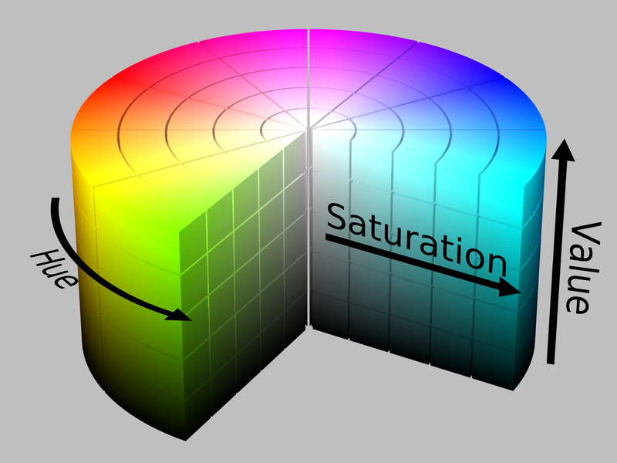
Novel Color Feature Representation and Matching Technique – Step 1
Convert the image from the RGB Model to the HSV Model

Slide 10
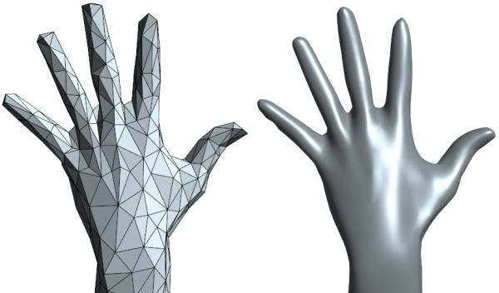
Novel Color Feature Representation and Matching Technique – Step 2
Use only a subset of all colors present.

Slide 11
Novel Color Feature Representation and Matching Technique – Step 3
For every quantized image: Calculate a color histogram, which is a frequency distribution of quantized RGB values of each pixel of an image. The values are ordered alphabetically by their RGB strings. (0, 0, 0) is followed by (0, 0, 1)

Slide 12
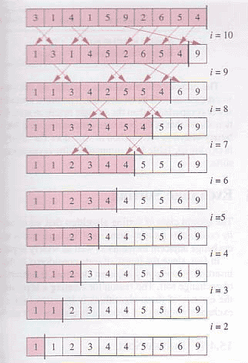
Novel Color Feature Representation and Matching Technique – Step 4
Take the color histogram of each image and sort it in descending order of frequency

Slide 13

Novel Color Feature Representation and Matching Technique – Step 5
Repeat all the aforementioned steps for the query image

Slide 14
Novel Color Feature Representation and Matching Technique – Step 6
Each image now has 2 histograms:
One sorted by color sequence – Call this P
One sorted by color frequency – Call this Q
This is how the CFSD algorithm derives its name: Color Frequency Sequence Difference.

Slide 15
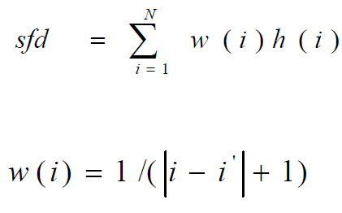
Novel Color Feature Representation and Matching Technique – Step 7
For every color combination x in the first histogram, calculate:
i is the index of x in histogram Q and i’ is the index of x in histogram P.
h is a function of the frequency of x in the image.
w is a function of the difference between the indices i and i’.

Slide 16
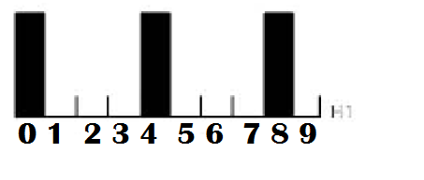
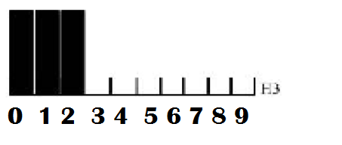
SFD Calculation for one image
w(0) = 1 / |0 – 0| + 1 = 1
w(1) = 1 / |1 – 4| + 1 = 0.25
w(2) = 1 / |2 – 8| + 1 = 0.1428
w(3) = 1 / |3 – 1| + 1 = 0.333
w(4) = 1 / |4 – 2| + 1 = 0.333
w(5) = 1 / |5 – 3| + 1 = 0.333
w(6) = 1 / |6 – 5| + 1 = 0.5
w(7) = 1 / |7 – 6| + 1 = 0.5
w(8) = 1 / |8 – 7| + 1 = 0.5
w(9) = 1 / |9 – 9| + 1 = 1
Sfd = 1(1) + 0.25(1) + 0.1428(1) +
0.333(0) + 0.333(0) + 0.333(0) +
0.5(0) + 0.5(0) + 0.5(0) + 1(0) =
1.3928
Ordered by Color Sequence
h(0) = 1
h(1) = 1
h(2) = 1
h(3) = 0
h(4) = 0
h(5) = 0
h(6) = 0
h(7) = 0
h(8) = 0
h(9) = 0
Ordered by Color Frequency

Slide 17
Novel Color Feature Representation and Matching Technique – Step 8
Compare the SFD of the query image with the SFDs of every image of the retrieval system.
Similar images can be found based on differences between SFDs.
Smaller the difference between two images → Greater the similarity between them

Slide 18
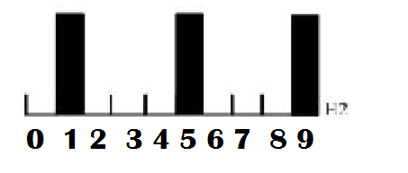
The two images on top are similar since their sfd values are quite close. This similarity cannot be detected by the normal color histogram method.
sfd = 1.3928
sfd = 1.20353
sfd = 0.85707

