Slide 1
How to label a graph edge-gracefully?
Prof. Sin-Min Lee,
Department of Computer Science,
San Jose State University

Slide 2

A graph with p vertices and q edges is graceful if there is an injective mapping f from the vertex set V(G) into{0,1,2,…,q} such that the induced map f*:E(G)→{1,2,…,q}
defined by f*(e)= |f(u)-f(v)| where e=(u,v), is surjective.
Graceful graph labelings were first introduced by Alex Rosa (around 1967) as means of attacking the problem of cyclically decomposing the complete graph into other graphs.

Slide 3
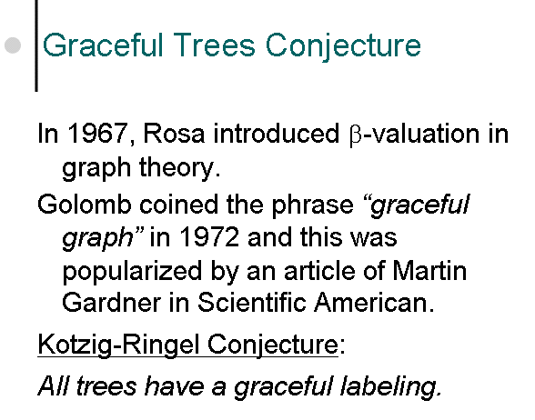

Slide 4
Edge graceful graphs
Let f be an edge labeling of G where f: E(G)→ {1,2,...,q}, q=|Ε(G)| is one-to-one and f induces a label on the vertices f(v)=Σ _{υϖ∈ Ε(G)} f(uv) (mod n), where n is the number of vertices of G. The labeling f is edge-graceful if all vertex labels are distinct modulo n in which case G is called an edge-graceful graph.
S.P. Lo, On edge-graceful labelings of graphs, Congressus Numerantium, 50 (1985)., 231-241.

Slide 5
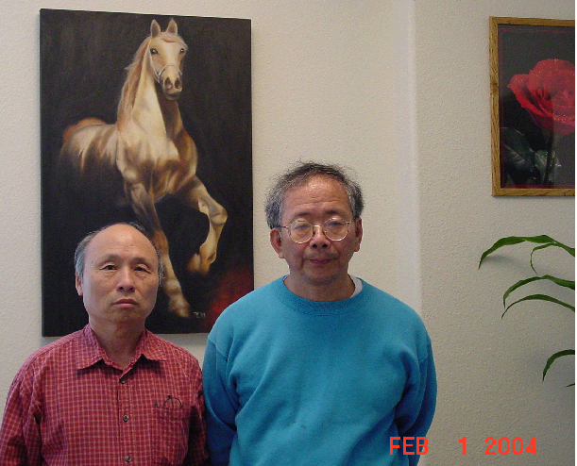
Sheng-Ping Lo and Sin-Min Lee

Slide 6
A necessary condition of edge-gracefulness is
q(q+1)≡ p(p-1)/2(mod p) (1)
This latter condition may be more practically stated as q(q+1) ≡0 or p/2 (mod p) depending on whether p is odd or even. (2)

Slide 7
"On edge-graceful complete graphs--a solution of Lo's conjecture," (with L.M. Lee and Murthy), Congressus Numerantium, 62"(1988), 225-233
Theorem A complete graph K_{n} is edge-graceful if and only if n ≠ 2 (mod 4)
Theorem. All graphs G with n ≡2 (mod 4) are not edge-graceful.

Slide 8
Lee proposed the following tantalizing conjectures:
Conjecture 1: The Lo condition (2) is sufficient for a connected graph to be edge-graceful.
A sub-conjecture of the above has also not yet been proved:
Conjecture 2: All odd-order trees are edge-graceful.
S-M. Lee, "A conjecture on edge-graceful trees", SCIENTIA, Series A: Math. Sciences, 3(1989), pp.45-57.

Slide 9
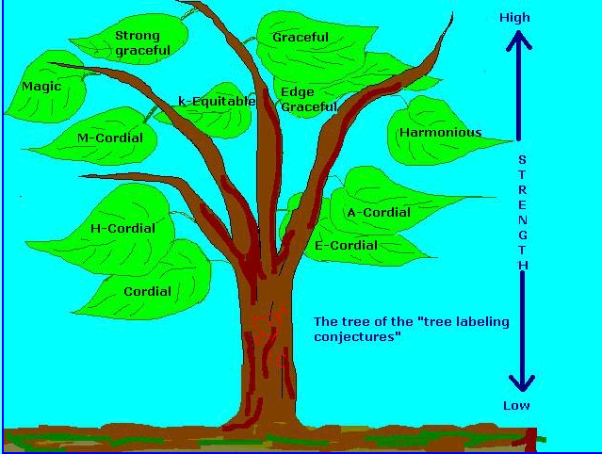

Slide 10
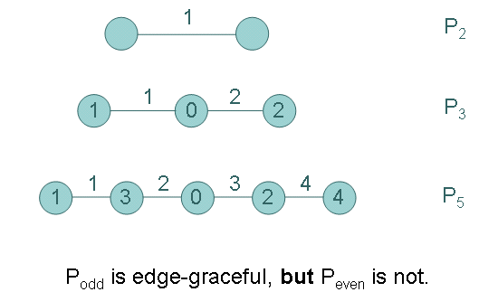

Slide 11
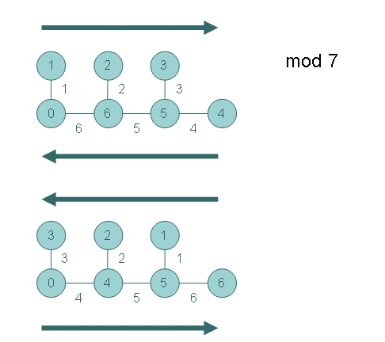

Slide 12
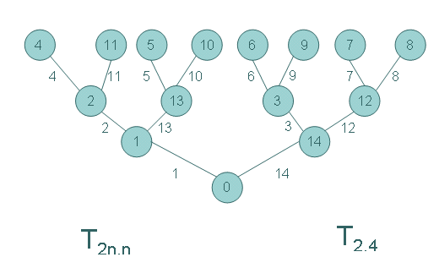

Slide 13
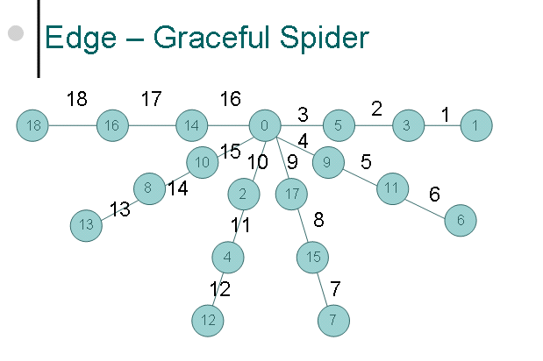

Slide 14
Definition of super-edge graceful
J. Mitchem and A. Simoson (1994) introduced the concept of super edge-graceful graphs which is a stronger concept than edge-graceful for some classes of graphs. A graph G=(V,E) of order p and size q is said to be super edge-graceful if there exists a bijection
f: E→{0, +1,-1,+2,-2,…,(q-1)/2, -(q-1)/2} if q is odd
f: E→{ +1,-1,+2,-2,…,(q-1)/2, -(q-1)/2} if q is even
such that the induced vertex labeling f* defined by f*(u)= Σf(u,v): (u,v) ε E }has the property:
f*: V→{0,+1,-1,…,+(p-1)/2,-(p-1)/2} if p is odd
f*: V→{+1,-1,…,+p/2,-p/2} if p is even
is a bijection

Slide 15
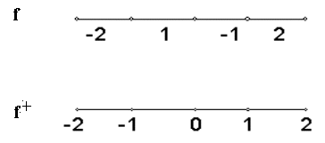
P₅ is super edge-graceful
J. Mitchem and A. Simoson, On edge-graceful and super-edge-graceful graphs. Ars Combin. 37, 97-111 (1994).

Slide 16
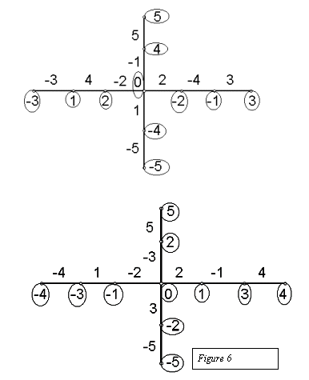

Slide 17
Mitchem and A. Simoson (1994) showed that
Theorem. If G is a super-edge-graceful graph and
q≡ ⎧ -1 (mod p) , if q is even
⎩ 0 (mod p) , if q is odd
then G is also edge-graceful.

Slide 18
P₈ is super edge-graceful
-3
-4
1
2
-2
-1
4
3
-3
-1
2
0
-2
1
3

Slide 19
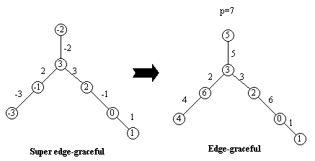

Slide 20
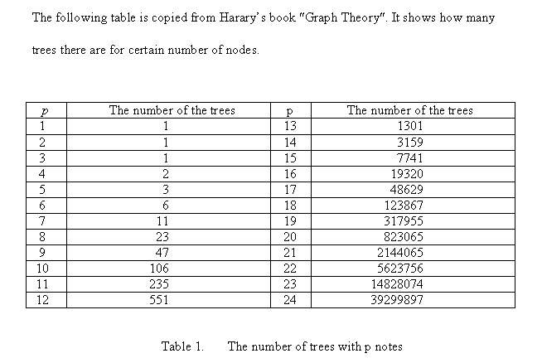
Enumeration of trees

Slide 21
Verify all trees of 17 vertices are super edge-graceful by computer
Theorem All trees with order 17 vertices are super edge-graceful.
There is a computer program that can generate at least one super edge-graceful labeling for every tree with order 17 vertices.

Slide 22
Mitchem and Simoson showed that
Growing Tree Algorithm. Let T be a super-edge-graceful tree with 2n edges.
If any two vertices are added to T such that both are adjacent to a common vertex of T, then the new tree is also super-edge-graceful.

Slide 23
Tree Reduction Algorithm: Given any odd ordered tree T.
Step 1. Make a list D₁ of all vertices of T with degree one.
Step 2. Count the number of elements in D_{1.}
If |D₁| = 1, stop and return T as a key named T’.
If |D₁| ≥ 2, go to step 3.
Step 3.Take the first vertex from the list D₁ call it v_{1.}
Step 4.Find v₁‘s parent and label it v_{p.}
Step 5.Is v_{p} adjacent to any other element v₂ in the list D₁?
If yes, delete v₂ and v₁ from the list D₁ and T, rename the resulting sub-graph T and go to step 1.
If no, delete v₁ from D₁ return to Step 2.

Slide 24
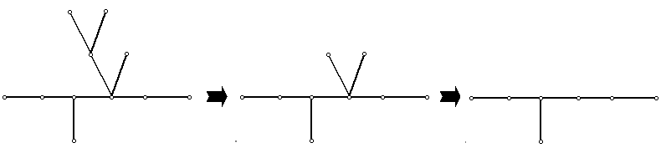

Slide 25
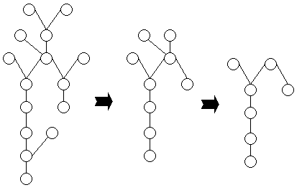

Slide 26
Theorem. All odd trees with only one vertex of even order is super edge-graceful reducible.
Proof. A tree of odd order with only one vertex of even order is in Core (K₁) which is super edge-graceful reducible.
In particular, we have
Corollary. All complete k-ary trees of even k are super edge-graceful reducible.

Slide 27
An atlas of graphs compiled a complete collection of odd order trees with eleven or fewer vertices.
The tree reduction algorithm was applied to each of the two hundred and ninety eight trees in the collection. All odd ordered trees, with eleven or fewer vertices, reduce to fifty-four irreducible trees. Once an irreducible tree is labeled, it becomes a key. All fifty-four irreducible trees of odd order, less than or equal to eleven, are super-edge-graceful; and therefore, all trees of this type are edge-graceful.

Slide 28
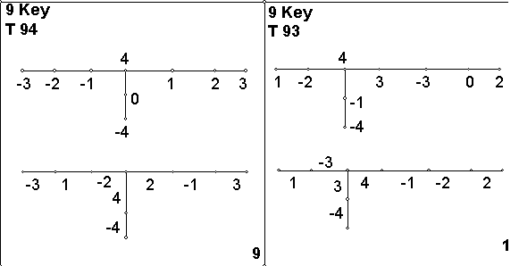

Slide 29
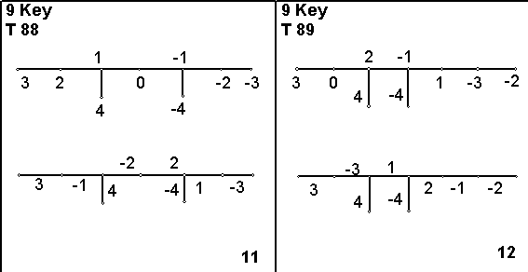

Slide 30
Theorem. All trees of odd order at most 17 are super edge-graceful.
Conjecture All trees of odd orders are super edge-graceful.

Slide 31
Sin-Min Lee, J. Mitchem, Q. Kuan and A.K. Wang,
"On edge-graceful unicyclic graphs" Congressus Numerantium , 61(1988), 65-74.
Conjecture . A unicyclic graph G is edge-graceful if and only if G is of odd order.
If Odd trees Conjecture is true then the above conjecture is true.

Slide 32
Let
{+-1, …, +- q/2 }, if q is even,
Q={
{0, +-1, …, +- ( q-1 /2) }, if q is odd,
{+-1, …, +- p/2 }, if p is even,
P={
{0, +-1, …, +- (q-1 /2) }, if p is odd,
Dropping the modularity operator and pivoting on symmetry about zero, define a graph G as a super-edge-graceful graph if there is a function pair (l, l*) such that l is onto Q and l* is onto P, and
l*(v)= ∑ l(uv)
uv ∈ E(G)

Slide 33
1
2
-2
-1
-1
2
0
-2
1
P₅
1
2
3
-3
-2
-1
P₇
2
-1
3
0
-3
1
-2

Slide 34
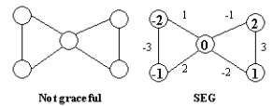

Slide 35
3
3
4
2
2
4
0
6
1
6
1
5
Graceful
Not edge-graceful and
super-edge-graceful

Slide 36
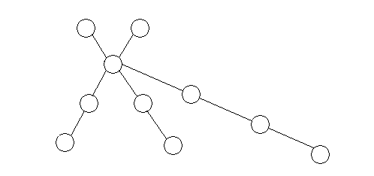
S_{p} (1, 1, 2, 2, 3)

Slide 37
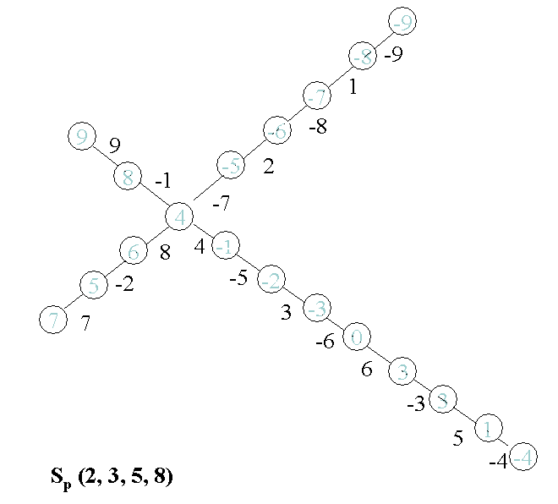

Slide 38
Theorem: All three legged spiders of odd orders are edge-graceful.
Theorem: All four legged spiders of odd orders are edge-graceful.
Andrew Simoson, “Edge Graceful Cootie”Congressus Numerantum 101 (1994), 117-128.

Slide 39
Theorem: Let G be a spider with 2p legs satisfying the following conditions:
(1) The leg lengths are {2m_{i} : i=1, …, p} and { 2n_{i} : i=1, … , p }
(2) m_{i} > Σ ^{i-1}_{j = 1} m_{j} and n_{i} > Σ ^{i-1} _{j = 1} n_{j} for all i with 1< i < p
Then G is edge-graceful.

Slide 40
The Shuttle Algorithm
J. Mitchem and A. Simoson, On edge-graceful and super-edge-graceful graphs. Ars Combin. 37, 97-111 (1994
Consider the regular spider with 6 legs of length 7. Arrange the necessary edge lables as the sequence:
S= {21, -1, 20, -2, 19, -3, …, 2, -20,1, -21}

Slide 41
The Shuttle Algorithm Cont.
Index the legs as L₁ to L₆. Represent the edges of each leg, with exterior vertices on the left and the core on the right.
L₁ = {21 -1 20 -2 19 -3 18}
L₂ = {-7 15 -6 16 -5 17 -4}
L₃ = {14 -8 13 -9 12 -10 11}
L₄, L₅, L₆ being the inverses of L₃, L₂, L₁ (L₄ =- L₃)

Slide 42
The Shuttle Algorithm Cont.
18
0
-18
15
4
-15
-4
11
-11
-3
13
1
-1
-13
3
16
17
-10
10
-17
-16
19
12
2
-2
-12
-19
17
-5
12
-12
5
-17
-2
11
3
-3
-11
2
18
16
-9
9
-16
-18
20
10
4
-4
-10
-20
19
-6
13
-13
6
-19
-1
9
5
-5
-9
1
20
15
-8
8
-15
-20
21
8
6
-6
-8
-21
21
21
-7
14
-14
7
-21
-7
14
-14
7

Slide 43
If G is super edge-graceful unicyclic graph of odd order then it is edge-graceful.
p=7
p=5

Slide 44
All unicyclic graphs of odd order at most 17 are edge-graceful.

Slide 45
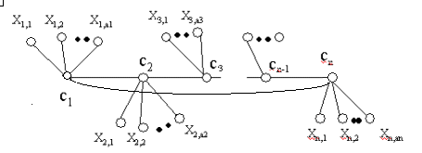
Ring-worm

Slide 46
Ring-worm Examples:
2
2
-1
0
2
-4
0
2
-4
5
-5
-5
-1
0
-1
0
4
4
6
6
-1
-2
-1
-6
-2
-6
-2
-3
-2
-3
1
3
1
1
3
1
U₄(1,0,0,0)
U₄(3,2,0,4)

Slide 47
2
2
2
2
-3
1
3
-3
1
2
-1
1
-2
1
-2
-1
-2
-3
-1
2
3
-3
-1
3
-3
-2
3
1
-1
-3
-2
3
1
-1
-2
3

Slide 48
Not super-edge-graceful

Slide 49
3
3
3
3
2
1
1
-2
-2
-2
-3
-3
-3
-1
-1
-1
1
2
2
2
Not super-edge-graceful
1
-2
-1
-3

Slide 50
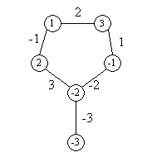
New classes of super edge-graceful unicyclic graphs.
Example of an unicyclic graph of order 6 which is super edge-graceful but not edge-graceful.

Slide 51
Let G be a super edge-graceful unicylic graph of even orders. If any two edges are appended to the same vertex of G, then the new unicyclic graph is super edge-graceful.

Slide 52
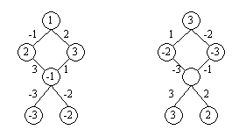
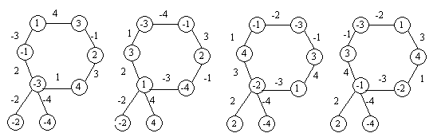
Examples:

Slide 53
All cycles of odd orders are super edge-graceful.
3
3
2
0
-1
2
2
1
-3
1
0
-1
2
-3
-2
0
-2
0
-2
1
-1
1
-2
-1

Slide 54
The unicyclic graph U_{2k+1} (a₁,a₂,…,a_{2k+1}) is super edge-graceful for all even ai and k>1

Slide 55
If G is unicyclic graph with super edge-graceful labeling f and f⁺(u)=0 for u in V(G), and T is tree with super edge-graceful labeling g⁺(v)=0.
Then Amal(G,H,(u,v)) is a super edge-graceful unicyclic graph.

Slide 56
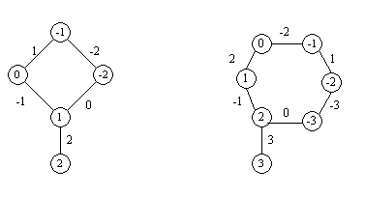
The unicyclic graph U_{2k}( 1,0,0,……,0) is super edge-graceful for all k>2.

Slide 57
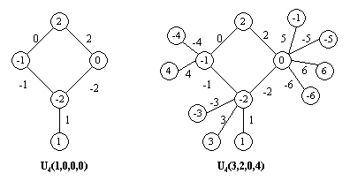
For any k >1, the unicyclic graph
U_{2k}( a₁,a₂,…,a_{2k}) is super edge-graceful. for all i, ai even except one is odd.

Slide 58
Super edge-graceful reducibility of graphs.
Algorithm:
1) If an unicyclic graph G is super edge-graceful Then Return True.
2) Delete any and all sets of even number of leaves incident with the same vertex. Call the new graph G*. Continue with the deletion process until no such sets of even number of leaves can be found.

Slide 59
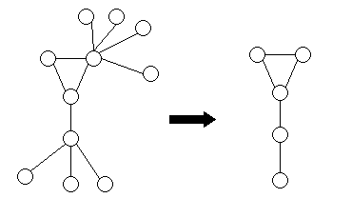
Example:

Slide 60
-1
-2
0
-1
1
-2
2
1
0
-2
1
-2
-1
0
-1
-3
1
2
0
-3
2
3
2
3

Slide 61
-1
-2
-1
-2
-1
1
2
0
1
-2
1
2
0
-2
-1
0
1
-3
-4
2
-3
-4
2
3
4
0
3
4

Slide 62
-3
-4
-1
-3
-4
1
-2
3
4
0
0
-2
3
4
-1
0
1
2
2

Slide 63
1
-1
-1
2
1
-2
2
3
-2
-3
3
1
-3
-1
-1
1
-3
-2
3
2
-3
-2
3
2

Slide 64
y₁
x₄
2
x₅
0
1
3
3
-3
-1
y₂
y₃
1
3
-3
x₃
2
-1
x₆
1
-1
2
-2
3
-2
y₄
1
y₅
-1
y₆
2
-2
y₇
x₂
-2
-3
-3
x₁

Slide 65
x₄
2
x₅
1
3
-1
1
2
-1
x₃
x₆
3
-2
x₂
-2
-3
x₁
-3
0
y₁
0
6
-6
y₂
y₃
3
-3
Σ(G,T,(x_{1,} y₁))
4
-4
5
-5
y₄
1
y₅
-1
y₆
2
-2
y₇

Slide 66
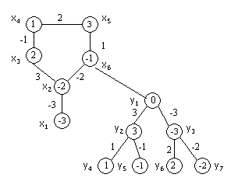
0
Σ(G,T,(x_{6,} y₁))

Slide 67
-1
2
2
-3
-3
-1
3
3
1
3
3
1
1
-2
-2
-3
2
1
-1
2
-2
-3
-2
-1
Not super-edge-graceful

Slide 68
2
2
1
-1
2
3
1
2
1
2
3
-1
2
-3
-1
3
1
-3
1
-2
-1
-1
3
-2
-3
-2
-3
-3
3
-2
-3
1
-1
3
-2
-2

Slide 69
2
2
2
2
-3
1
3
-3
1
2
-1
1
-2
1
-2
-1
-2
-3
-1
2
3
-3
-1
3
-3
-2
3
1
-1
-3
-2
3
1
-1
-2
3

Slide 70
Not super-edge-graceful

Slide 71
3
3
3
3
2
1
1
-2
-2
-2
-3
-3
-3
-1
-1
-1
1
2
2
2
Not super-edge-graceful
1
-2
-1
-3

Slide 72
y₁
y₁
-1
-1
-1
-1
x₁
x₁
3
4
3
1
4
1
x₄
-2
-3
2
1
-2
y₄
-4
3
1
-2
2
x₃
x₂
-4
x₂
-3
-2
3
2
y₂
y₂
2
x₃
-3
-3
y₃

Slide 73
-5
6
-1
4
-1
-4
-1
-5
6
-1
4
-4
-6
5
3
-6
4
5
3
1
5
-5
4
1
-2
-3
2
1
-2
-4
3
1
-2
2
-4
-3
-5
-2
3
2
2
5
7
-7
-3
7
-3
-7

Slide 74
C(3,4) not -edge-graceful
Sin-Min Lee, E. Seah and S.P. Lo , On edge-graceful 2-regular graphs, The Journal of Combinatoric Mathematics and Combinatoric Computing, 12, 109-117,1992.

Slide 75
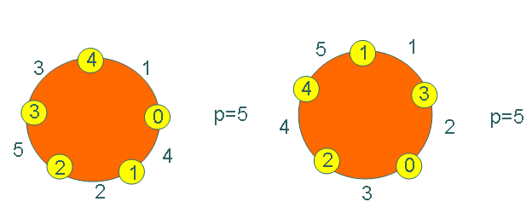
Edge-graceful 2-regular graphs

Slide 76
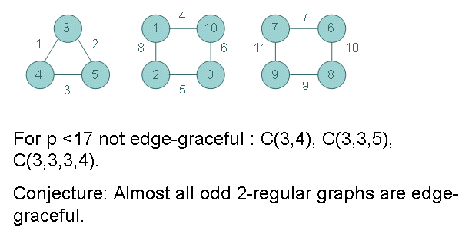

Slide 77
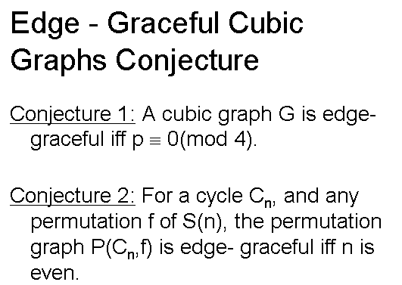

Slide 78
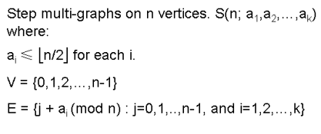

Slide 79
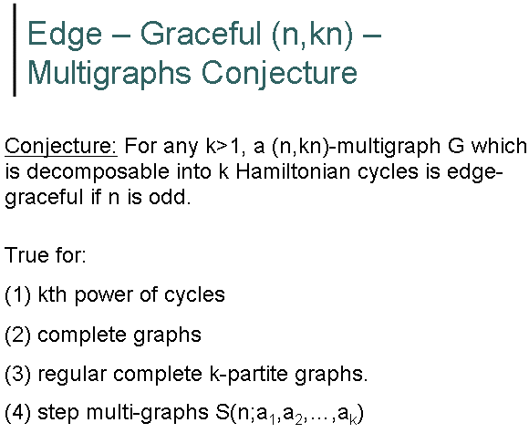

Slide 80
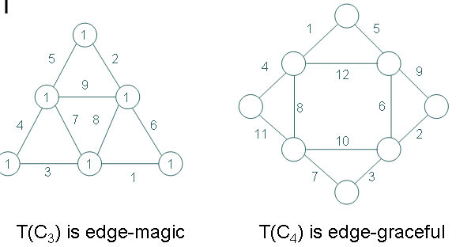
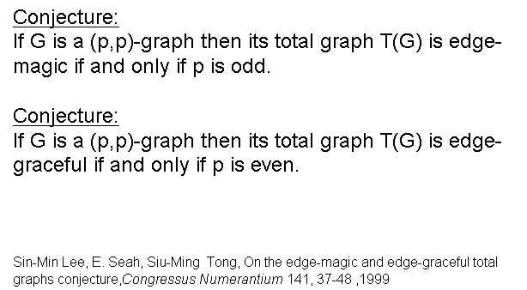

Slide 81
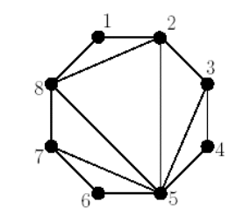
Sin-Min Lee, Medei Kitagaki , Joseph Young and William Kocay
If G is a maximal outerplanar graph with n vertices, n≥3, then
(i) there are 2n-3 edges, in which there are n-3 chords;
(ii) there are n-2 inner faces. Each inner face is triangular;
(iii) there are at least two vertices with degree 2;
Edge-graceful maximal outerplanar graph

Slide 82
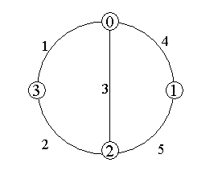
The maximal outerplanar graph with 4 vertices is edge-graceful.

Slide 83
Theorem. The maximal outerplanar graph with 12 vertices are edge-graceful.
v₁₂
v₁
v₁₂
v₁
7
2
v₂
6
1
v₂
1
5
v₁₁
20
3
v₁₁
20
2
9
0
9
11
13
10
10
10
9
13
5
21
v₃
4
21
v₃
11
10
v₁₀
11
v₁₀
7
8
12
6
12
1
8
17
6
17
15
16
7
15
6
v₄
7
v₄
4
16
4
v₉
v₉
5
19
19
3
3
3
8
5
v₅
8
v₅
v₈
14
9
2
4
v₈
14
1
0
2
v₇
18
v₆
v₇
18
v₆
M₂
M₁

Slide 84
v₁
v₁₂
v₁
v₁₂
7
6
v₂
6
5
v₂
2
7
v₁₁
3
v₁₁
20
2
9
20
9
4
3
10
10
8
13
0
13
3
v₃
7
21
v₃
11
11
v₁₀
v₁₀
5
11
9
8
11
12
15
2
12
17
15
16
17
1
7
v₄
6
v₄
6
4
4
v₉
1
19
v₉
19
5
9
3
5
10
v₅
8
16
v₅
v₈
14
2
v₈
0
1
14
1
10
4
v₇
18
v₆
v₇
18
v₆
M₄
M₃

Slide 85
v₁₂
v₁
v₁₂
v₁
7
0
6
v₂
3
7
1
2
v₂
v₁₁
20
4
3
9
v₁₁
20
0
10
13
10
9
10
5
21
v₃
8
11
11
3
21
13
v₃
v₁₀
10
7
8
v₁₀
8
15
12
5
6
17
16
2
15
12
v₄
17
4
11
2
6
7
v₄
v₉
19
2
1
v₉
3
1
1
19
9
v₅
16
9
v₈
14
4
6
v₅
8
5
v₈
5
v₇
18
v₆
14
4
11
M₅
v₇
18
v₆
M₆

Slide 86
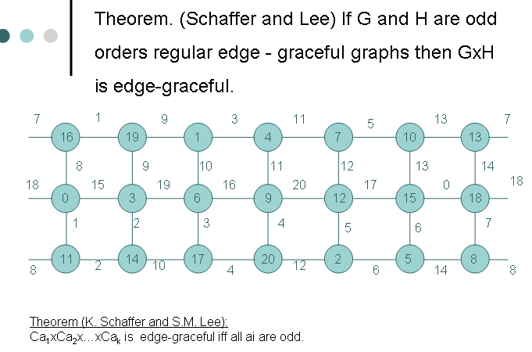

Slide 87
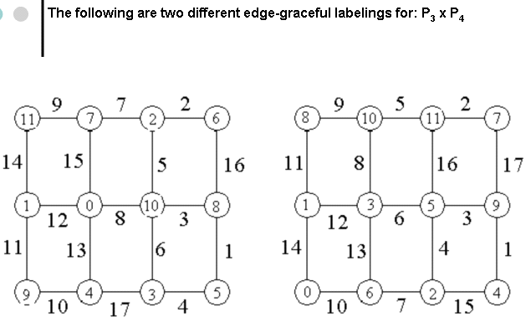

Slide 88
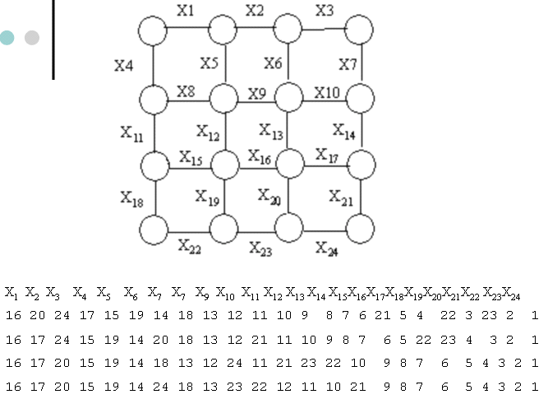

Slide 89
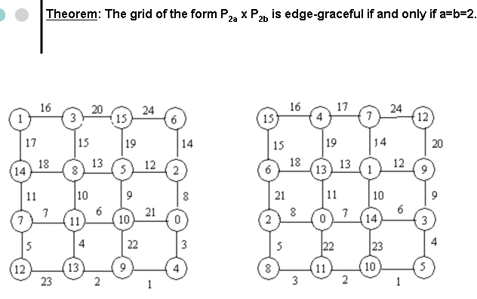

Slide 90
Unsolved Problems
Every one can learn and do research.
“Seek and you will find”

Slide 91
Lo’s condition
p= 3, q= 2, 3.
p= 4, q= 5, 6.
p= 5, q= 4, 5, 9, 10.
p= 7, q= 6, 7, 13, 14, 20, 21.
p= 8, q= 11, 12, 19, 20, 27, 28.
p= 9, q= 8, 9, 17, 18, 26, 27, 35, 36.
p= 11, q= 10, 11, 21, 22, 32, 33, 43, 44, 54, 55.
p= 12, q= 14, 17, 18, 21, 26, 29, 30, 33, 38, 41, 42, 45, 50, 53, 54, 57, 62, 65, 66.
p= 13, q= 12, 13, 25, 26, 38, 39, 51, 52, 64, 65, 77, 78.

Slide 92
2
-1
-3
2
-3
-1
1
-5
-4
1
-4
0
5
-2
4
3
-2
4
3
Super edge-graceful
Not Super edge-graceful

Slide 93
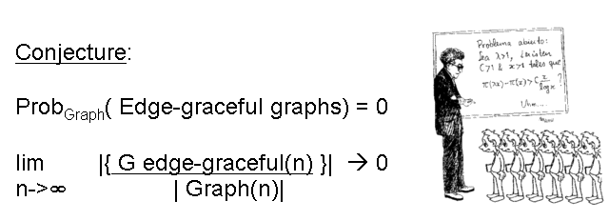

Slide 94
The dual concept of edge-graceful graphs was introduced in 1992.
Let G be a (p,q) graph in which the edges are labeled 1,2,3,...q so that the vertex sums are constant, mod p. Then G is said to be edge-magic..
Sin-Min Lee, E. Seah and S.K. Tan , On edge-magic graphs, Congressus Numerantium 86 (1992), 179-191.

Slide 95

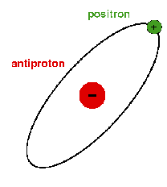

"And all things have We created in pairs in order that you may reflect on it." (Quran 51:49)
Duality in nature is amazingly beautiful, for it is the way nature was created.
Duality in nature is simply mysterious, for it is the way that nature exists.
It is beautiful because all things were originally created in a splendid harmonious world.
It is mysterious because different creatures have different patterns of duality.
If we are not confused very often about the duality of natural phenomena,
we do not really understand what it is.
This may be the way that we exist
----Lao Tze

Slide 96
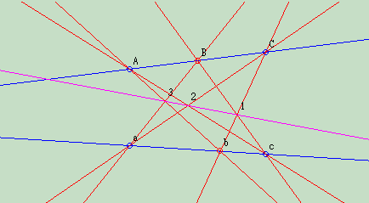
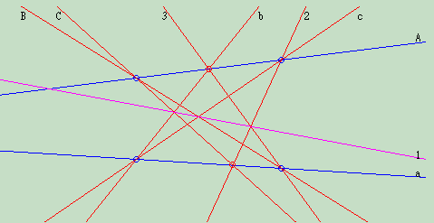
One of the most exciting things about projective planes is that for any statement that is true for a given projective plane, the dual of that statement must also be true. We define a dual statement as being created by interchanging the words "point" and "line" in a given statement.

Slide 97
Duality Principle: For any projective result established using points and hyperplanes, a symmetrical result holds in which the roles of hyperplanes and points are interchanged: points become planes, the points in a plane become the planes through a point, etc.
For example, in the projective plane, any two distinct points define a line (i.e. a hyperplane in 2D). Dually, any two distinct lines define a point (their intersection).

Slide 98
