Slide 1
IMDB REVIEW Sentiment Analysis
Samir Karmacharya
CS410
Fall 2018
Notes:
The title of my project is IMDB review sentiment analysis. This program will train a model using the training dataset and predict the sentiment on the testing dataset.

Slide 2
Dataset
Dataset for this project has been gathered from: Source: http://ai.stanford.edu/~amaas/data/sentiment/
The dataset contains 50,000 reviews from IMDB which are divided evenly into 25K training and 25K testing dataset. On the entire collection, no more than 30 reviews are allowed per movie. Any movie with a rating score of <=4 is considered as negative and >=7 as positive. Neutral ratings (rating 5 and 6) are not considered.

Slide 3
Files
There are two main directories (train/ and test/) which corresponds to training and testing dataset. They include both positive and negative reviews.

Slide 4
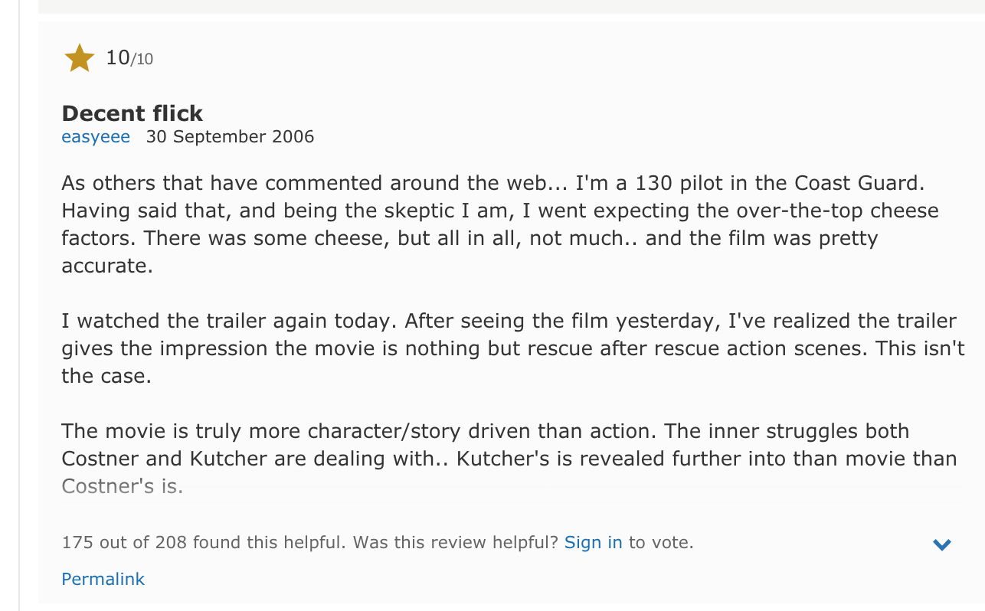
Sample positive review:

Slide 5
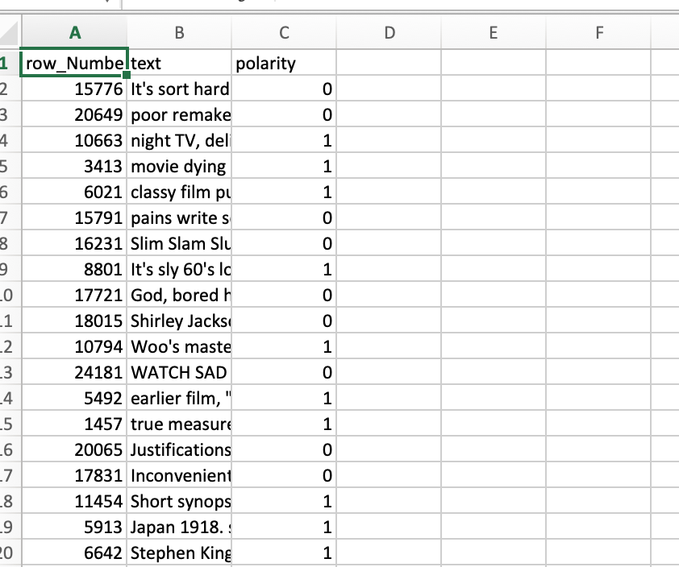
Step 1: Reading and preprocessing the data:
Download the data from mentioned source and unzip.
Training dataset is created as part of preprocessing where the stop words are removed and stored in training dataset path:
training_dataset = "./aclImdb/train/" # source data

Slide 6
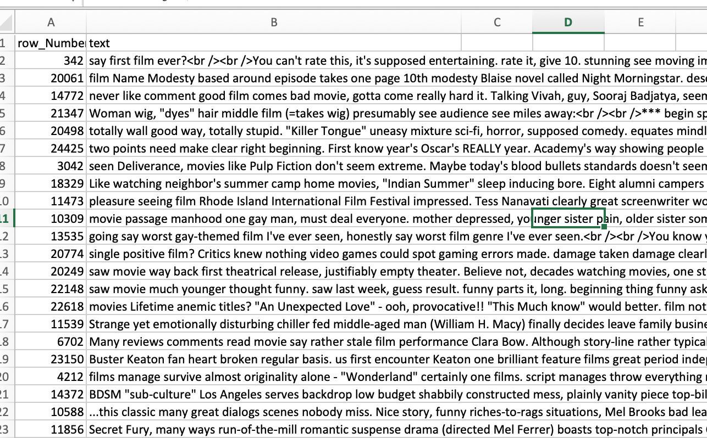
Testing dataset is created as part of preprocessing where the stop words and polarity are removed and stored in testing dataset path:
testing_dataset = "./aclImdb/test/"

Slide 7
Step 2- Algorithms used:
For the purposed of this project unigram, bigram and tfidf algorithms are used to analyze the data.

Slide 8
Step 3- Classifier
Stochastic Gradient Descent classifier is used in this project to minimize the processing expense instead of gradient descent, as gradient descent tends to be expensive on large dataset.

Slide 9
Step 4-Analysis on training data:
Accuracy of unigram model is 92.604
Accuracy for the Bigram Model is 93.952
Accuracy for the Unigram TFIDF Model is 88.344
Accuracy for the Bigram TFIDF Model is 86.16

Slide 10
Step 5- Applying the classifier on testing data:
Four files are outputted:
bigram.output.csv
bigramtfidf.output.csv
unigram.output.csv
unigramtfidf.output.csv

Slide 11
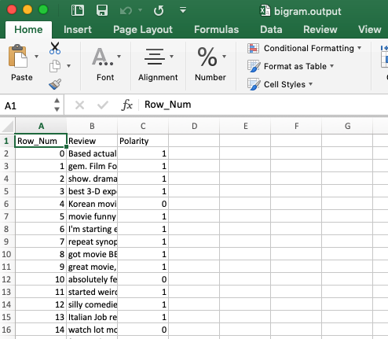
Step 6- Reviewing the results:
Sample from bigram.output.csv, where the polarity has been predicted based on the testing data.

Slide 12
Step 7: The code file and performance:
Code file:
https://github.com/samirk927/CS410/blob/master/IMDBSentimentAnalysis.py
Performance:
In my testing with 25K training and 25K testing dataset, the code ran for ~100 seconds.

