Slide 1

Chapter 3 Decision Support Systems: An Overview
Turban, Aronson, and Liang Decision Support Systems and Intelligent Systems, Seventh Edition

Slide 2
Learning Objectives
Understand DSS configurations.
Learn characteristics and capabilities of DSS.
Understand DSS components.
Describe structure of DSS components.
Understand how DSS and the Web interact.
Learn the role of the user in DSS.
Understand DSS hardware and integration.
Learn DSS configurations.

Slide 3
Decision Support Systems
Systems designed to support managerial decision-making in unstructured problems
More recently, emphasis has shifted to inputs from outputs
Mechanism for interaction between user and components
Usually built to support solution or evaluate opportunities

Slide 4
Decision Support Systems
The early definitions of a DSS identified it as a system intended to support managerial decision-makers in semi structured decision situations.
DSS were meant to be an adjunct to decision-makers to extend their capabilities but not to replace their judgment.

Slide 5
DSS
A DSS is a methodology that supports decision-making.
It is:
Flexible;
Adaptive;
Interactive;
GUI-based;
Iterative; and
Employs modeling.

Slide 6
A DSS APPLICATION
A DSS is usually built to support the solution of a certain problem or to evaluate an opportunity. As such it is called a DSS application.

Slide 7
Components of DSS
Subsystems:
Data management
Managed by DBMS
Model management
Managed by MBMS
User interface
Knowledge Management and organizational knowledge base

Slide 8
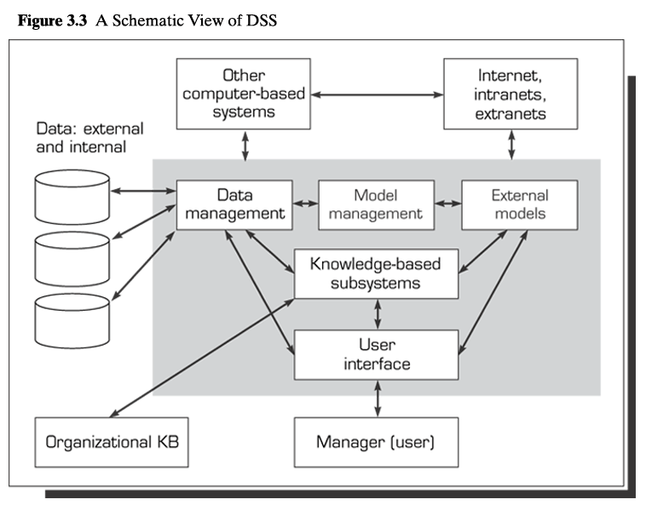

Slide 9
Data Management Subsystem
Components:
Database
Database management system
Data directory
Query facility

Slide 10
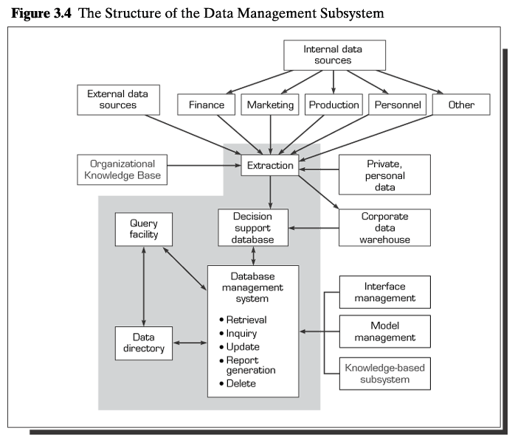

Slide 11
Database
Interrelated data extracted from various sources, stored for use by the organization, and queried
Internal data, usually from TPS
External data from government agencies, trade associations, market research firms, forecasting firms
Private data or guidelines used by decision-makers

Slide 12
Database Management System
Extracts data
Manages data and their relationships
Updates (add, delete, edit, change)
Retrieves data (accesses it)
Queries and manipulates data
Employs data dictionary

Slide 13
Data Directory
Catalog of all data
Contains data definitions
Answers questions about the availability of data items Source
Meaning
Allows for additions, removals, and alterations

Slide 14
Model Management Subsystem
Components:
Model base
Model base management system
Modeling language
Model directory
Model execution, integration, and command processor

Slide 15
Placeholder
figure 3.5

Slide 16
Model Management Subsystem
A model base contains routine and special statistical, financial, forecasting, management science, and other quantitative models that provide the analysis capabilities in a DSS.
The models in the model base can be divided into four major categories: strategic, tactical, operational, and analytical. In addition, there are model building blocks and routines.

Slide 17
Models---Strategic
Strategic
Supports top management decisions
developing corporate objectives, planning for mergers and acquisitions
The large-scale linear programming model is at the heart of the POP DSS that allows executives of the company to plan large, expensive equipment needs as many years ahead as needed.

Slide 18
Tactical
Tactical
Used primarily by middle management to assist in allocating and controlling the organization's resources.
Examples of tactical models include selecting a Web server, labor requirement planning, sales promotion planning, plant-layout determination, and routine capital budgeting

Slide 19
Operational models
Operational models are used to support the day-to-day working activities of the organization.
Typical decisions involve e-commerce transaction acceptance (purchases, etc.),
approval of personal loans by a bank, production scheduling, inventory control, maintenance planning and scheduling, and quality control.

Slide 20
Analytical models
Analytical
Used to perform analysis of data
are used to perform some analysis on the data.
They include statistical models, management science models, data mining algorithms

Slide 21
Model Base Management System
Functions:
Model creation
Model updates
Model data manipulation
Generation of new routines
Model directory:
Catalog of models
Definitions

Slide 22
Model Management Activities
Model execution
Controls running of model
Model command processor
Receives model instructions from user interface
Routes instructions to MBMS or module execution or integration functions
Model integration
Combines several models’ operations

Slide 23
MAJOR FUNCTIONS OF THE MBMS
Creates models easily and quickly, either from scratch or from existing models or from the building blocks
Allows users to manipulate models so that they can conduct experiments and sensitivity analyses ranging from what-if to goal-seeking
Stores, retrieves, and manages a wide variety of different types of models in a logical and integrated manner

Slide 24
MAJOR FUNCTIONS OF THE MBMS
Interrelates models with appropriate linkages with the database and integrates them within the DSS
Manages and maintains the model base with management functions analogous to database management: store, access, run, update, link, catalog, and query
Uses multiple models to support problem solving

Slide 25
User Interface System
Data management and DBMS
Knowledge-based system
Model management and MBMS
User Interface Management System (UIMS)
Natural Language Processor
Input
Action
Languages
Output
Display
Language
PC Display
Based on Figure 3.6, Schematic View of the User Interface
Users
Printers, Plotters

Slide 26
User Interface Management System
GUI
Natural language processor
Interacts with model management and data management subsystems
Examples
Speech recognition
Display panel
Tactile interfaces
Gesture interface

Slide 27
Knowledge-Based Management System
Expert or intelligent agent system component
Complex problem solving
Enhances operations of other components
May consist of several systems
Often text-oriented DSS

Slide 28
DSS Hardware
De facto standard
Web server with DBMS:
Operates using browser
Data stored in variety of databases
Can be mainframe, server, workstation, or PC
Any network type
Access for mobile devices

Slide 29
Lecture 003
DSS Classifications

Slide 30
The first two types are data-oriented, performing data retrieval or analysis; the third deals both with data and models.
The remaining four are model-oriented, providing simulation capabilities, optimization, or computations that suggest an answer.

Slide 31
classify DSS into the following six frameworks:
text-oriented DSS,
database-oriented DSS,
spreadsheet-oriented DSS,
solver-oriented DSS,
rule-oriented DSS,
and compound DSS.

Slide 32
TEXT-ORIENTED DSS
Information (including data and knowledge) is often stored in a textual format and must be accessed by decision-makers.
it is necessary to represent and process text documents and fragments effectively and efficiently.
A text-oriented DSS supports a decision-maker by electronically keeping track of textually represented information that could have a bearing on decisions.
There are many text-oriented DSS applications. electronic document management systems, knowledge- management, content management, and business rules systems. Content management systems (CMS) are used to manage the material posted on Web sites.

Slide 33
DATABASE-ORIENTED DSS
In this type of DSS, the database organization plays a major role in the DSS structure.
Early generations of database-oriented DSS mainly used the relational database configuration.
The information handled by relational databases tends to be voluminous, descriptive, and rigidly structured.
A database-oriented DSS features strong report generation and query capabilities.

Slide 34
SPREADSHEET-ORIENTED DSS
spreadsheet is a modeling system that allows the user to develop models to execute DSS analysis.
These models not only create, view, and modify procedural knowledge.'
but also instruct the system to execute their self-contained instructions (macros), Spreadsheets are widely used in end-user developed DSS.
some spreadsheet development tools include what-if analysis and goal-seeking capabilities

Slide 35
SOLVER-ORIENTED DSS
A solver is an algorithm or procedure written as a computer program for performing certain computations for solving a particular problem type.
Examples of a solver can be an economic order quantity procedure for calculating an optimal ordering quantity or a linear regression routine for calculating a trend.
A solver can be commercially programmed in development software. For example, Excel, includes several powerful solvers-functions and procedures-that solve a number of standard business problems. The DSS builder can incorporate the solvers in creating

Slide 36
RULE-ORIENTED DSS
The knowledge component of DSS includes both procedural and inferential (reasoning) rules, often in an expert system format. These rules can be qualitative or quantitative, and such a component can replace quantitative models or can be integrated with them.
COMPOUND DSS A compound DSS is a hybrid system that includes two or more of the five basic structures described earlier

Slide 37
INTELLIGENT DSS
The so-called intelligent or knowledge-based DSS has attracted a lot of attention.
The rule-oriented DSS that we described above can be divided into six types: descriptive, procedural, reasoning, linguistic, presentation

