Slide 1
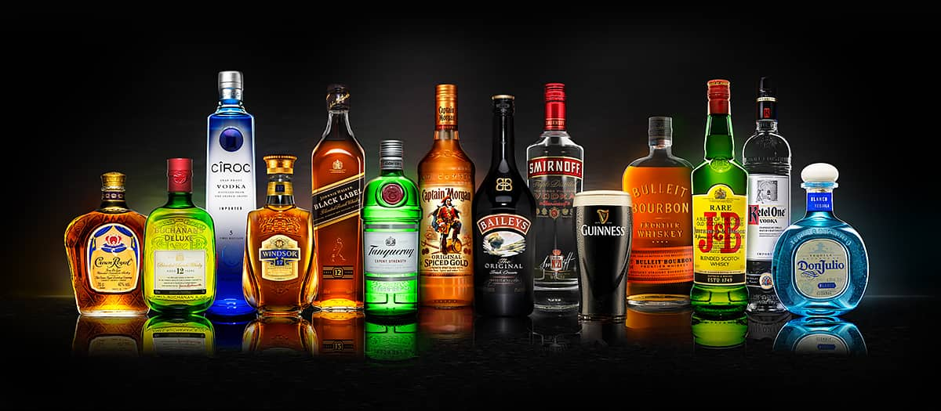
DIAGEO

Slide 2
The History of Diageo
Diageo,a multinational beverage alcohol company, formed in 1997 with a merger between Guinness plc and Grand Metropolitan.
They did not begin wholly alcohol based, before 2002 Diageo also owned Burger King which was sold to the American based company Texas Pacific.
Also they sold Pillsbury, a baking company, to General Mills in 2000.
Diageo began trading its shares on the london stock exchange on December 17, 1997.

Slide 3
Diageo at a glance
Diageo is the world's leading premium drinks company with a large range of beverage alcohol across the collection of spirits, wine and beer.
You'll probably have heard of some of their most famous products:
  Smirnoff
  Baileys
  Johnnie Walker
  Captain Morgan
  J&B
  And possibly the most well known of all Guinness.

Slide 4
Diageo have 27,775 employees around the world both in the manufacturing side and business side.
They operate in over 180 countries across five regions: North America, Europe, Asia Pacific, Africa, and Latin America.
They produce their brand at over 138 sites around the world.
Their goal is to be one of the best performing, most trusted and respected consumer products companies in the world.

Slide 5
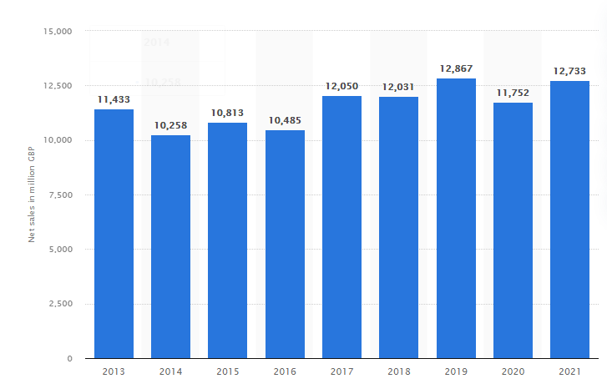
Net sales of Diageo worldwide from 2013 to 2021 (in million GBP)*

Slide 6
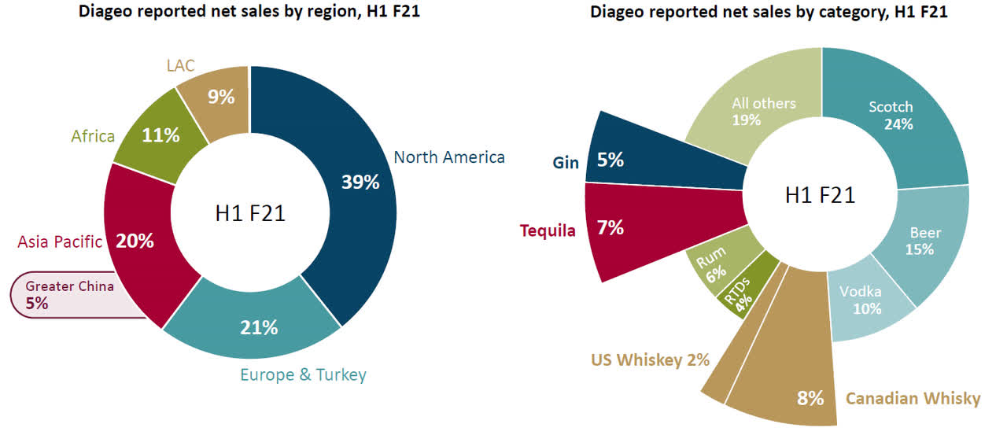

Slide 7
THANK YOU

