Slide 2
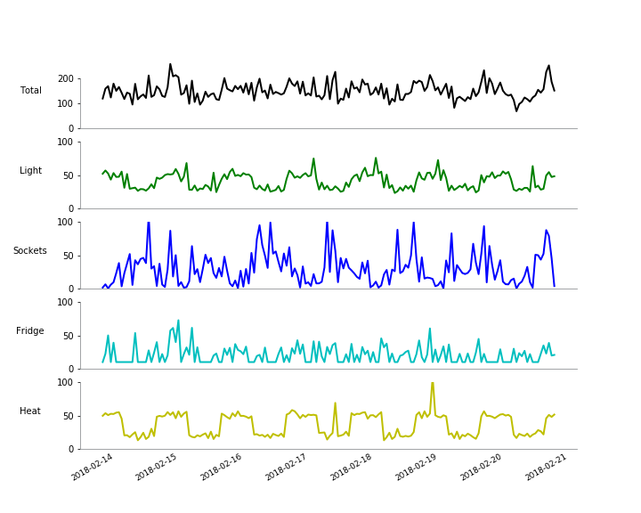

Slide 3
Lag(X)
RF
X
weather
yi

Slide 5
