Slide 1
Test Automation
Presented by Samir Shaik

Slide 2
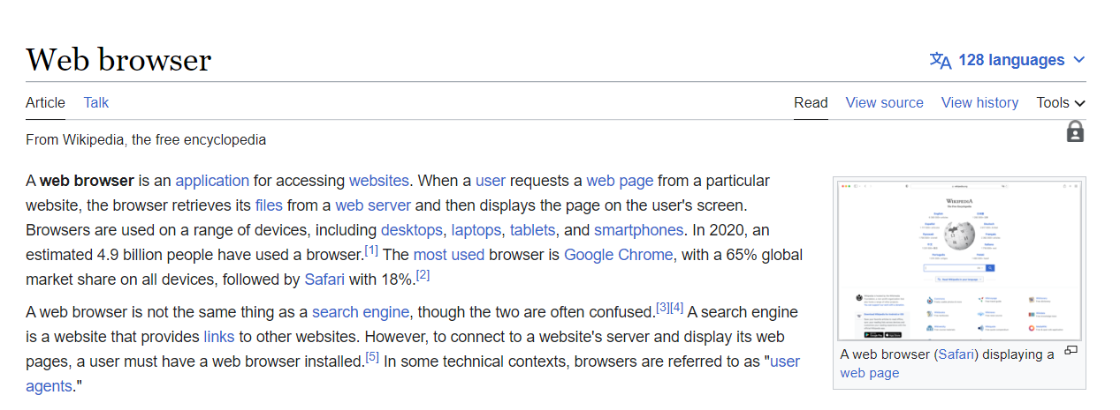
Browser Basics

Slide 3
Key Words
Request
Response
Web page
Web server
Search Engine

Slide 4
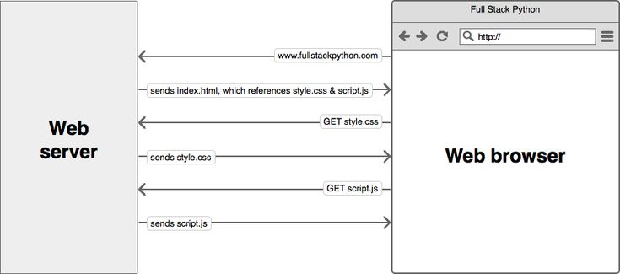
Request & Response

Slide 5
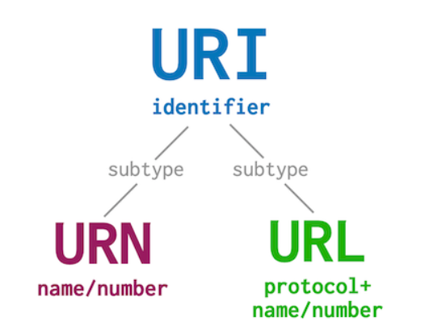
URI, URL & URN
Reference: https://danielmiessler.com/study/difference-between-uri-url/

Slide 6
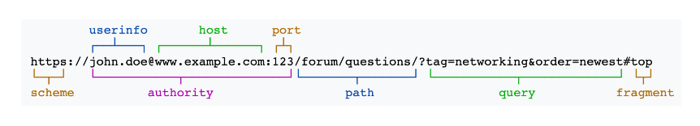
URL Structure

Slide 7
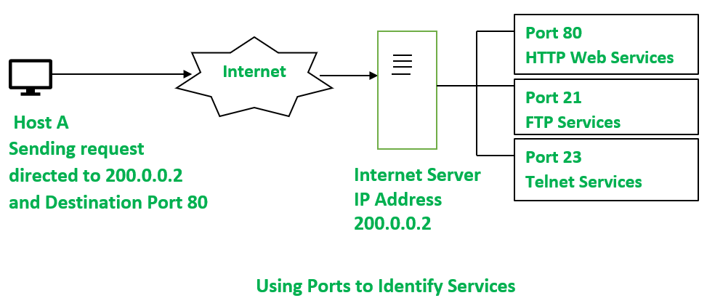
Host & Port

Slide 8
Web Page
The page served when you visit a particular URL is called web page

Slide 9
Web Server
The server that serves web page on a particular port is web server.

Slide 10
Search Engine
A web page that is used to search for information is a search engine. Google, Bing, are few examples of search engine.

Slide 11
Demo: Explore Browser

Slide 12
Installation
Java
Maven
Git

