Slide 1
Interprocess Communication
Session -2
Samir Paul

Slide 2
Interprocess Communication
Interprocess communication is a way to communicate between processes or testbench components.
SystemVerilog provides three mechanisms for communication.
- Events
- Semaphores
- Mailbox

Slide 3

Semaphore
Semaphore is a SystemVerilog built-in class, used for access control to shared resources, and for basic synchronization.
A semaphore is like a bucket with a number of keys. processes using semaphores must first procure a key from the bucket before they can continue to execute, All other processes must wait until a sufficient number of keys are returned to the bucket.
Imagine a situation where two processes try to access a shared memory area. where one process tries to write and the other process is trying to read the same memory location. This leads to an unexpected result. A semaphore can be used to overcome this situation.
Semaphore syntax:

Slide 4
Semaphore
Semaphore methods
Semaphore is a built-in class that provides the following methods,
new(); Create a semaphore with a specified number of keys
get(); Obtain one or more keys from the bucket
put(); Return one or more keys into the bucket
try_get(); Try to obtain one or more keys without blocking

Slide 5
Semaphore
new( );
The new() method is used to create the Semaphore.
The new method will create the semaphore with number_of_keys keys in a bucket; where number_of_keys is integer variable.
The default number of keys is ‘0’
The new() method will return the semaphore handle or null if the semaphore cannot be created.
put( );
The semaphore put() method is used to return key/keys to a semaphore.
When the semaphore_name.put() method is called, the specified number of keys are returned to the semaphore. The default number of keys returned is 1.

Slide 6
Semaphore
get( );
The semaphore get() method is used to get key/keys from a semaphore.
If the specified number of keys are available, then the method returns and execution continues
If the specified number of keys are not available, then the process blocks until the keys become available
The default number of keys requested is 1.
try_get();
The semaphore try_get() method is used to procure a specified number of keys from a semaphore, but without blocking.
If the specified number of keys are available, the method returns 1 and execution continues
If the specified number of keys is not available, the method returns 0 and execution continues
The default number of keys requested is 1

Slide 7
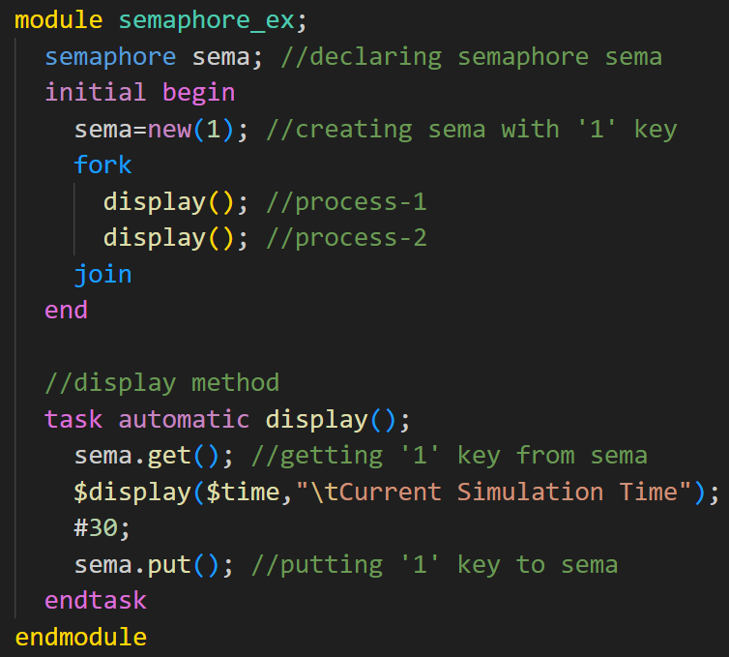

Semaphore
semaphore sema is created with the 1 key, two processes are accessing the display method at the same time, but only one process will get the semaphore key and the other process will wait till it gets the key.

Slide 8
Mailbox
A mailbox is a communication mechanism that allows messages to be exchanged between processes. The process which wants to talk to another process posts the message to a mailbox, which stores the messages temporarily in a system-defined memory object, to pass it to the desired process.
Based on the sizes mailboxes are categorized as,
Bounded Mailbox:
A bounded mailbox is with the size defined. mailbox becomes full when storing a bounded number of messages. A process that attempts to place a message into a full mailbox shall be suspended until enough space becomes available in the mailbox queue.
Unbounded Mailbox:
Unbounded mailboxes are of unlimited size.

Slide 9

Mailbox
Mailbox types:
There are two types of mailboxes,
Generic Mailbox (type-less mailbox):
The default mailbox is typeless. That is, a single mailbox can send and receive data of any type.
Parameterized mailbox (with a particular type):
Parameterized mailbox is used to transfer a data of particular type.

Slide 10
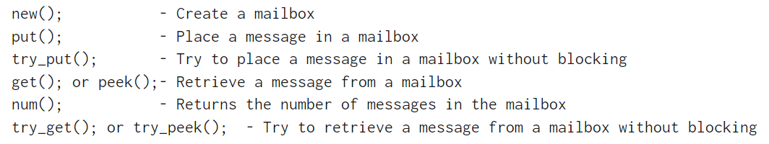
Mailbox
Mailbox Methods
SystemVerilog Mailbox is a built-in class that provides the following methods. these are applicable for both Generic and Parameterized mailboxes

Slide 11
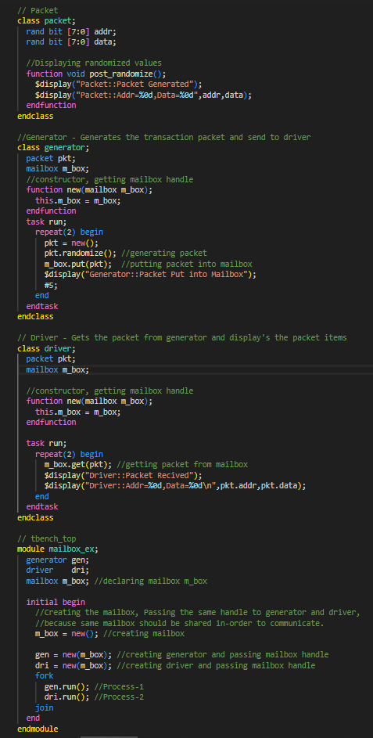
Mailbox
Mailbox Example
Mailbox is used for communication between generator and driver.
Process-1(Generator class) will generate (create and randomize) the packet and put it into the mailbox mb_box
Process-2(Driver class) gets the generated packet from the mailbox and displays the fields

Slide 12
Events
Events are static objects useful for synchronization between the process. Events operations are of two staged processes in which one process will trigger the event, and the other processes will wait for an event to be triggered.
Events are triggered using -> operator or ->> operator
wait for an event to be triggered using @ operator or wait() construct
Event triggering:
-> operator: Named events are triggered via the -> operator. Triggering an event unblocks all processes currently waiting on that event.
->> operator: Non-blocking events are triggered using the ->> operator.

Slide 13

Events
Waiting for event trigger:
@ operator:
wait for an event to be triggered via the event control operator, @.
The @ operator blocks the calling process until the given event is triggered.
Wait() operator:
If the event triggering and waiting for the event trigger with @ operator happens at the same time, @ operator may miss detecting the event trigger.
Whereas wait(); construct will detect the event triggering.

Slide 14

Events
wait_order();
The wait_order construct is blocking the process until all of the specified events are triggered in the given order (left to right). event trigger with out of order will not unblock the process.

Slide 15
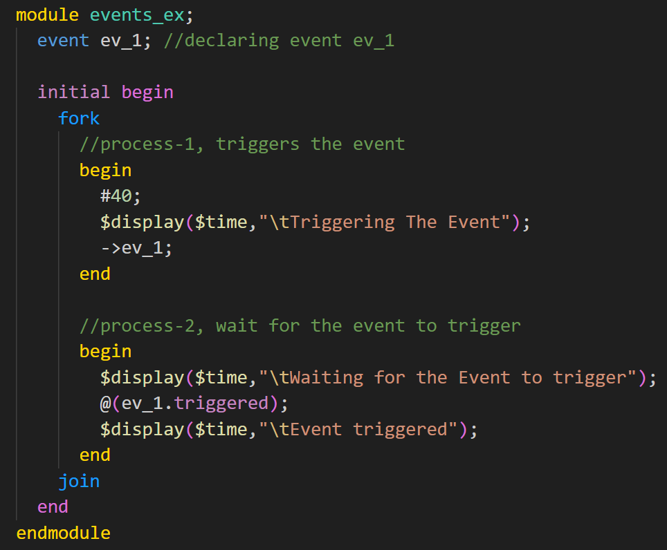
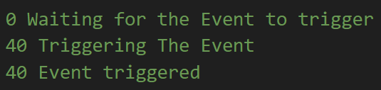
Events
Event waiting with @ operator:
example shows the event triggering and waiting for the event trigger

Slide 16
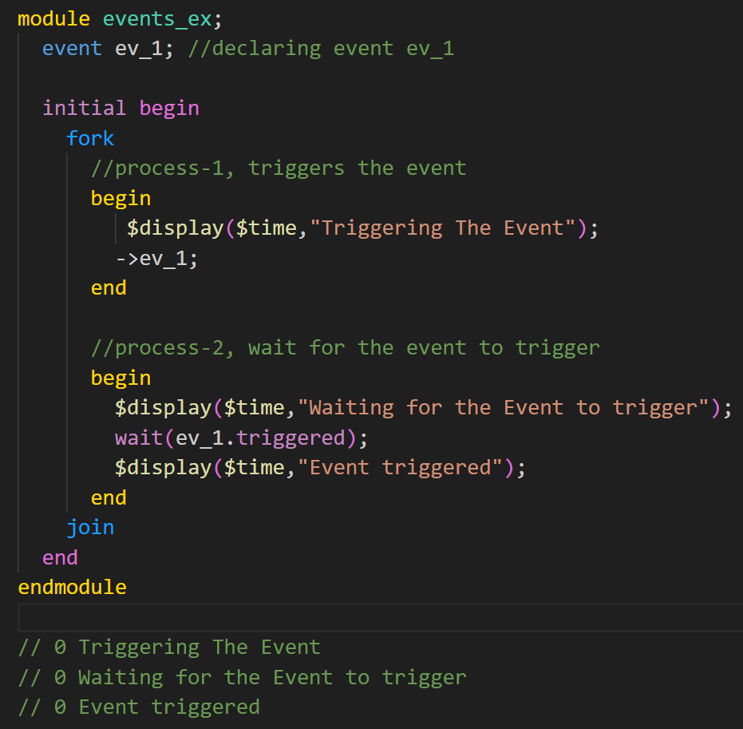
Events
trigger and wait for an event at the same time
event triggering and waiting for the event trigger will happen at the same time. wait(); the operator is used to detect the event triggering.

Slide 17
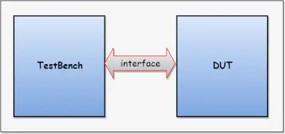
Interface
In Verilog, the communication between blocks is specified using module ports. SystemVerilog adds the interface construct which encapsulates the communication between blocks. An interface is a bundle of signals or nets through which a testbench communicates with a design. A virtual interface is a variable that represents an interface instance. this section describes the interface, interface over the traditional method, and virtual interface.
Interface Construct:
The interface construct is used to connect the design and testbench.
Below diagram shows connecting the design and testbench with the interface.

Slide 18
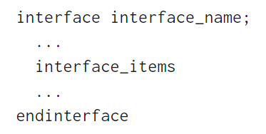
Interface
Interface is a bundle of wires, the interface’s aim is to encapsulate communication.
An interface can have parameters, constants, variables, functions, and tasks.
Simple interface declaration:
Advantages of the interface over the traditional connection:
Allows the number of signals to be grouped together and represented as a single port, the single port handle is passed instead of multiple signals/ports.
Interface declaration is made once and the handle is passed across the modules/components.
Addition and deletion of signals are easy.
Changes made to the interface will reflect everywhere.

Slide 19
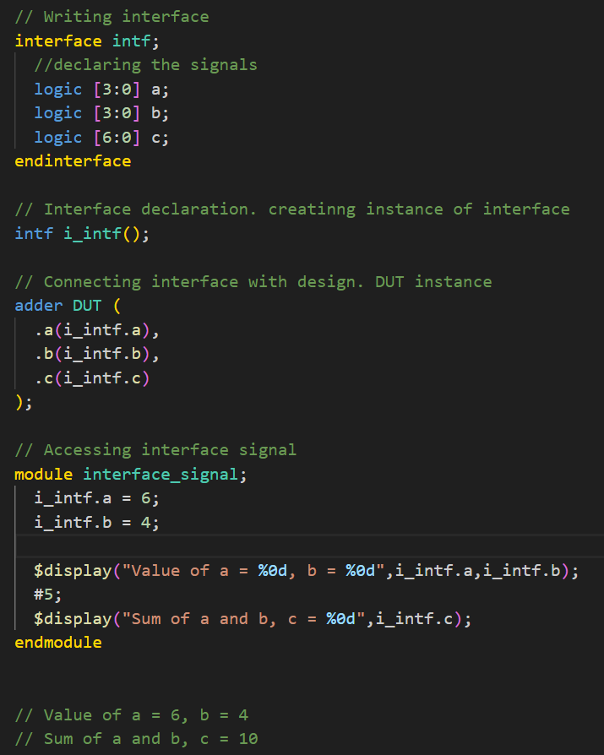
Interface
This example shows the writing interface, declaration of an interface, connecting the interface with design, and accessing interface signals.

Slide 20
Virtual Interface
A virtual interface is a variable that represents an interface instance.
The virtual interface must be initialized before using it. i.e., Virtual interface must be connected/pointed to the actual interface.
Virtual interface variables can be passed as arguments to the tasks, functions, or methods.
All the interface variables/Methods can be accessed via a virtual interface handle. i.e virtual_interface.variable
accessing the uninitialized virtual interface result in a run-time fatal error.

