Slide 1
Session 1
SystemVerilog
Class, Functions & Task
Samir Paul
A0507124

Slide 2
Functions
A chunk of code that you can use over and over again, rather than writing it out multiple times.
Functions splits the code into small parts so that it would be easier to manage and debug code. we use Function to implement small sections of code which we can reuse throughout our design.
A Function can contain declarations of range, return type, parameters, input arguments, registers, and events.
Any expression can be used as a function call argument
Functions can return only one value
Static: Static functions share the same storage space for all function calls. Memory allocation will be done only once. Use keyword static.
(Ex: using the same static variables for multiple functions)
Automatic: Automatic functions allocate unique, stacked storage for each function call. This will allow SystemVerilog to dynamically allocate variables and array memories. Use the keyword automatic.
(Ex: Recursion uses auxiliary stack space for dynamically called functions)

Slide 3
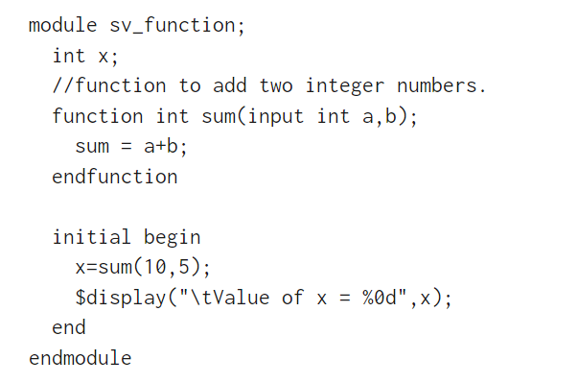
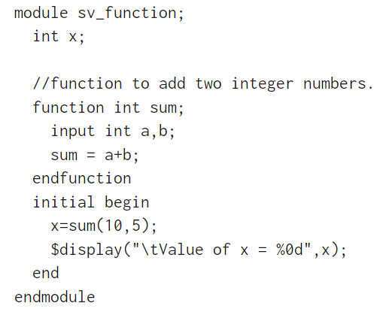

Function

Slide 4
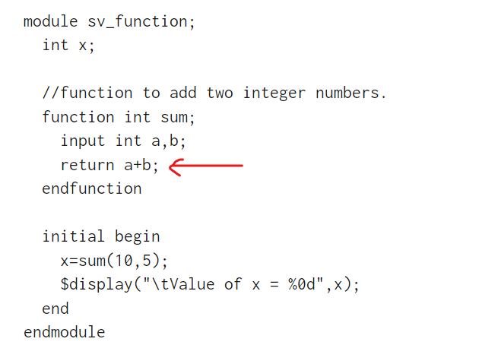
Function
return value is specified using the return statement

Slide 5
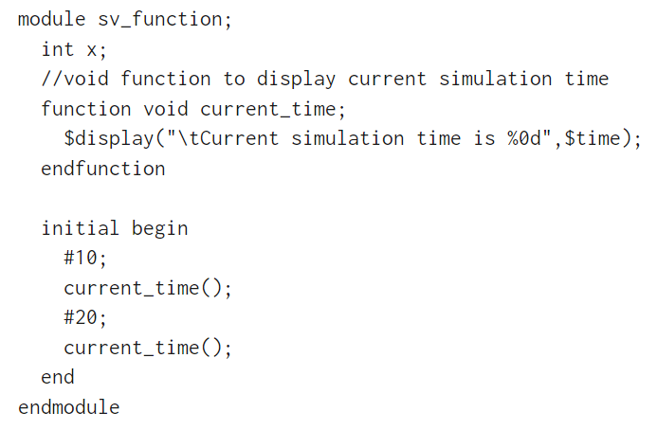

Void Function

Slide 6
Tasks
Tasks and Functions provide a means of splitting code into small parts. Just like functions, we use tasks to implement small sections of code which we can reuse throughout our design.
Task contains a declaration of parameters, input arguments, output arguments, registers, events, and zero or more behavioral statements.
Static: Static tasks share the same storage space for all task calls. Memory allocation will be done only once. Use keyword static.
(Ex: using the same static variables for multiple tasks)
Automatic: Automatic tasks allocate unique, stacked storage for each function call. This will allow SystemVerilog to dynamically allocate variables and array memories. Use the keyword automatic.
(Ex: Recursion uses auxiliary stack space for dynamically called tasks)

Slide 7
Difference between task and function
SystemVerilog functions execute immediately and can't contain time-consuming constructs such as delays, posedge macros, or wait statements but tasks can contain them.
The performance of both task and function approaches are the same.
Function can return only a single value but task can calculate multiple values and return them using output and input type arguments.

Slide 8
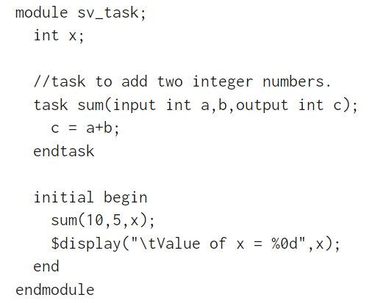
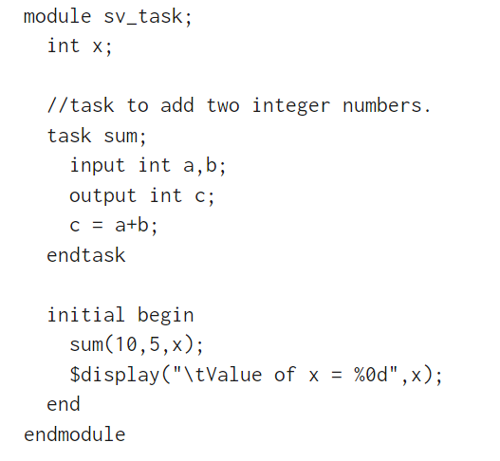

Tasks

Slide 9
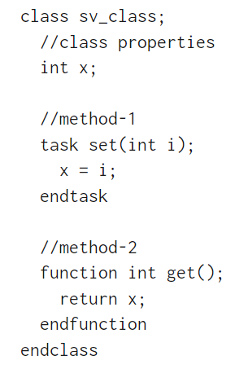
Class
A class is a blueprint that defines the variables and the methods common to all objects of a certain kind.
For example, your BMW car is just one of many cars in the world. Using object-oriented terminology, we say that your car object is an instance of the class of objects known as cars.
object is a specific instance of a class; it contains real values instead of variables.
A specific car of any model is an object.
Note: classes are translated during compile time, and objects are created from classes at runtime

Slide 10
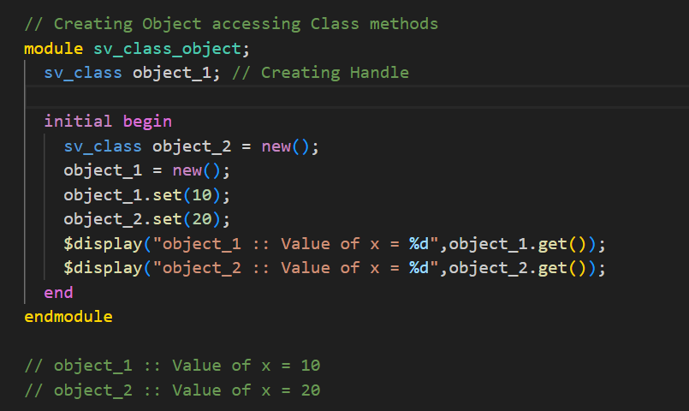

Class properties and methods can be accessed only after creating the object.
Creating an object/instance of the class and calling the constructor
Accessing the methods of the class for this particular object.

Slide 11
Class Constructors:
The constructor can be used for initializing the class properties. In case of any initialization is required, those can be placed in the constructor.
If we need any global variable then we can declare that in the constructor.
On calling the new() method it allocates the memory and returns the address to the class. It does not have any return type.
It is possible to pass arguments to the constructor, which allows run-time customization of an object (“this” keyword is used).

Slide 12
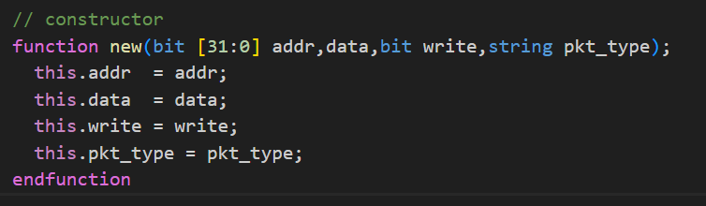
this keyword
this keyword is used to refer to class properties or methods of the current instance/object.
Example of class constructor and this keyword

Slide 13
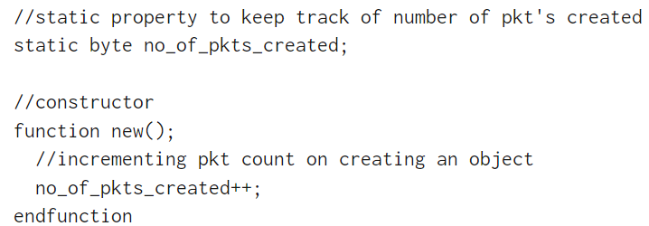
Static Properties
The class can have multiple instances, each instance of the class will be having its own copy of variables.
Sometimes only one version of a variable is required to be shared by all instances. These class properties are created using the keyword static.
class members with the keyword static are called as static class members
Static methods are the same as static properties.

Slide 14
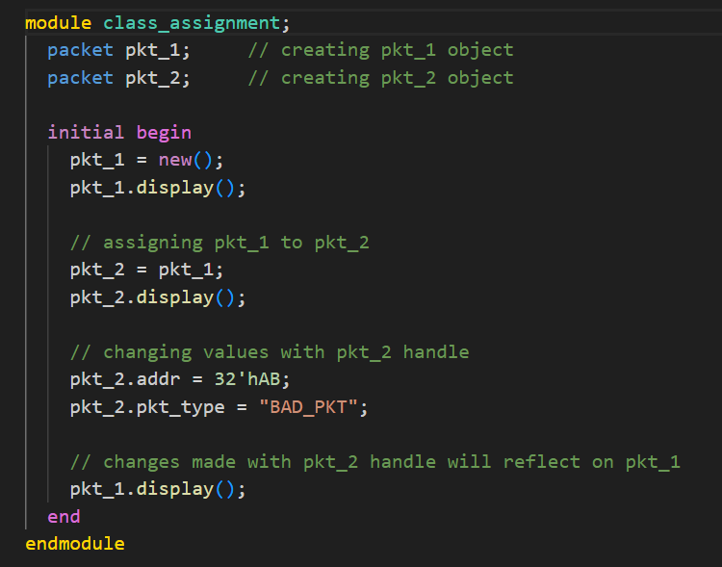
Class Assignment
Create two objects (pkt_1, pkt_2) of a class. Assign one object to another(pkt_2 = pkt_1). That means making the memory pointers of the two objects equal. So if we make changes with pkt_2 that change will be reflected on pkt_1.
Only the handle of the object gets copied. This is called Shallow Copy.

Slide 15
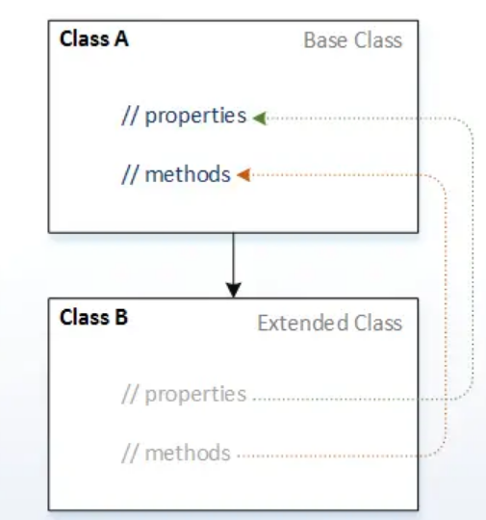
Inheritance
> Inheritance is an OOP concept that allows the user to create classes that are built upon existing classes.
> A derived class may add new
properties and methods, or modify
the inherited properties and
Methods.

Slide 16
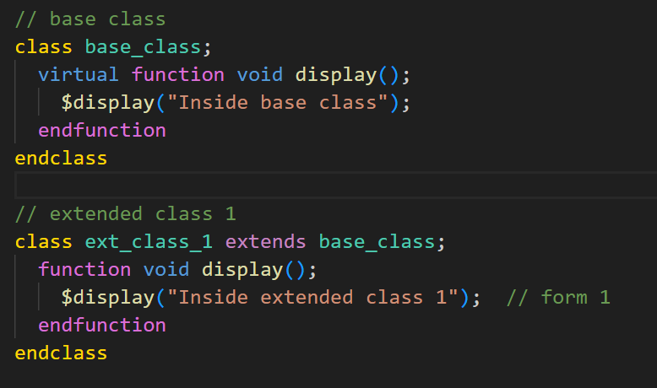
Virtual functions and tasks
A virtual method is a virtual function or task from the base class which can be overridden by a method of its child class having the same signature (same method name and arguments).
It is mainly used in polymorphism.

Slide 17
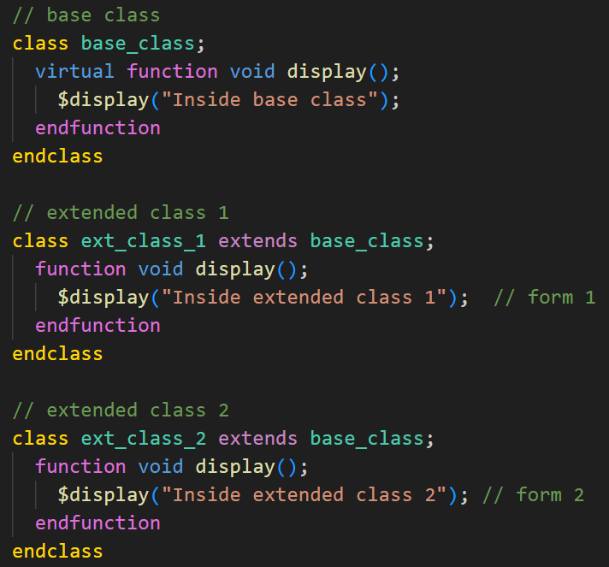
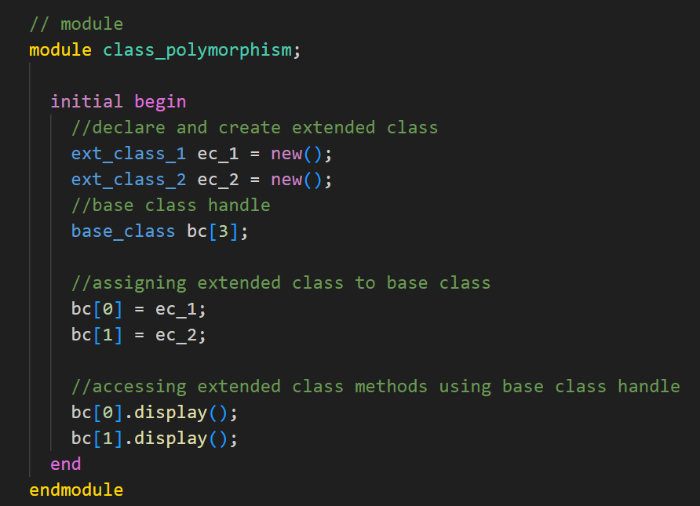
Polymorphism
Polymorphism means many forms. Polymorphism in SystemVerilog provides the ability for an object to take on many forms.

Slide 18
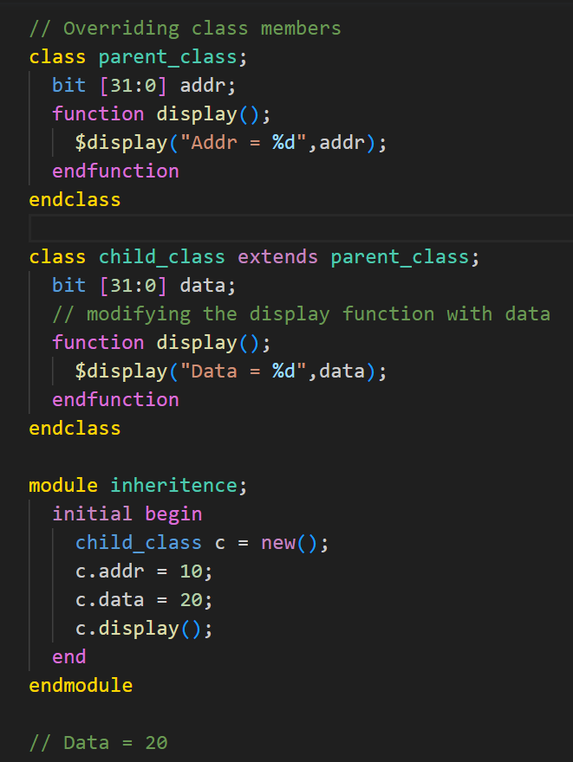
Overriding class members
Base class properties and methods can be
overridden in the child class or extended class.

Slide 19
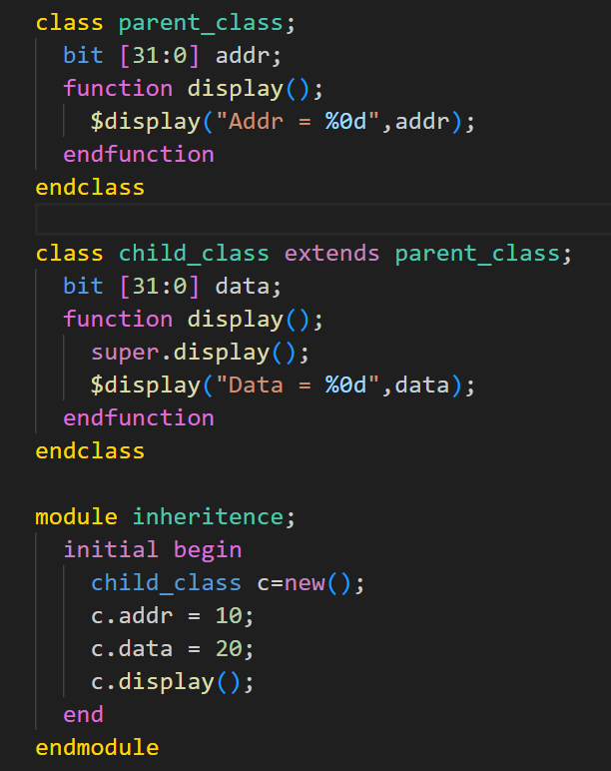
Super keyword
The super keyword is used in a derived class to refer to the members of the parent class.
When class members are overridden in the derived class, It is necessary to use the super keyword to access members of a parent class.

Slide 20
Data hiding and Encapsulation
The technique of hiding the data within the class and making it available only through the methods is known as encapsulation.
By default all the members and methods of a class are accessible from anywhere using the object handle, sometimes this could corrupt the class members’ values, which should not be touched at all.
Keywords:
1. local
2. protected

Slide 21
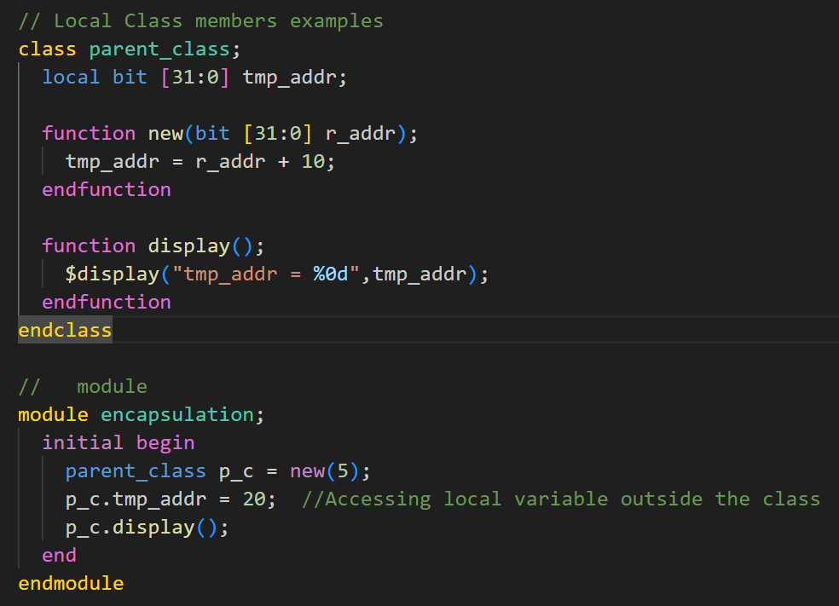
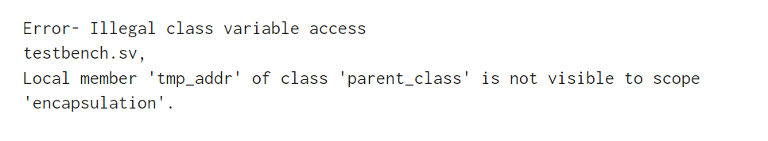
Local Class members
Accessing local variables outside the class is NOT Allowed.
Accessing local variables inside the class is Allowed.

Slide 22
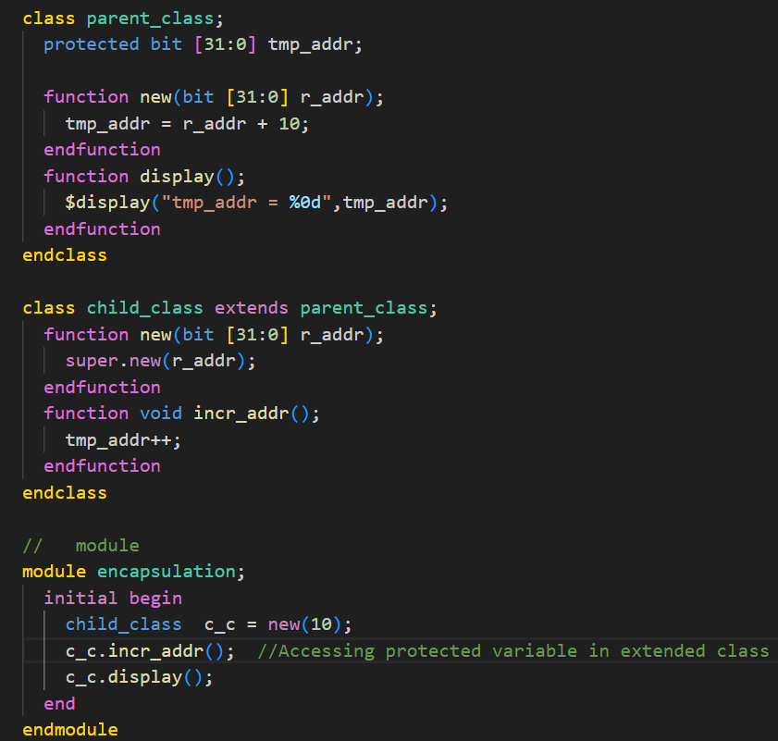
Protected class members
Accessing Protected variables outside the class is NOT Allowed.
Accessing Protected variables in extended class is Allowed.
Output: tmp_addr = 21

Slide 23
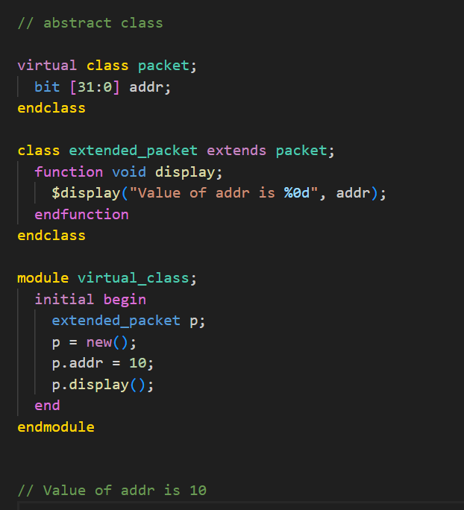
Abstract Class
Abstract class cannot be instantiated, it can only be derived.
Virtual class is generally used when we want to abstract from the parent class.

Slide 24
Difference between abstraction and inheritance
Abstract Class:
Abstraction hides the implementation details and shows only the functionality to the user.
Abstraction helps to reduce the complexity of the code.
We can't create objects of an abstract class.
Inheritance:
Inheritance is the methodology of creating a new class using the properties and methods of an existing class.
Inheritance helps to improve code reusability.
We can create the object of the parent class.

Slide 25
Source Code
github.com/samirti/sv

Slide 26
Thank You

