Slide 1
Interprocess Communication
Session -2
Samir Paul

Slide 2
Interprocess Communication
Interprocess communication is a way to communicate between processes or testbench components.
SystemVerilog provides three mechanisms for communication.
- Semaphores
- Mailbox
- Events

Slide 3

Semaphore
Semaphore is a SystemVerilog built-in class, used for access control to shared resources, and for basic synchronization.
A semaphore is like a bucket with a number of keys. processes using semaphores must first procure a key from the bucket before they can continue to execute, All other processes must wait until a sufficient number of keys are returned to the bucket.
Imagine a situation where two processes try to access a shared memory area. where one process tries to write and the other process is trying to read the same memory location. This leads to an unexpected result. A semaphore can be used to overcome this situation.
Semaphore syntax:

Slide 4
Semaphore
Semaphore methods
Semaphore is a built-in class that provides the following methods,
new(); Create a semaphore with a specified number of keys
get(); Obtain one or more keys from the bucket
put(); Return one or more keys into the bucket
try_get(); Try to obtain one or more keys without blocking

Slide 5
Semaphore
new( );
The new() method is used to create the Semaphore.
The new method will create the semaphore with number_of_keys keys in a bucket; where number_of_keys is integer variable.
The default number of keys is ‘0’
The new() method will return the semaphore handle or null if the semaphore cannot be created.
put( );
The semaphore put() method is used to return key/keys to a semaphore.
When the semaphore_name.put() method is called, the specified number of keys are returned to the semaphore. The default number of keys returned is 1.

Slide 6
Semaphore
get();
The semaphore get() method is used to get key/keys from a semaphore.
If the specified number of keys are available, then the method returns and execution continues
If the specified number of keys are not available, then the process blocks until the keys become available
The default number of keys requested is 1.
try_get();
The semaphore try_get() method is used to procure a specified number of keys from a semaphore, but without blocking.
If the specified number of keys are available, the method returns 1 and execution continues
If the specified number of keys is not available, the method returns 0 and execution continues
The default number of keys requested is 1

Slide 7
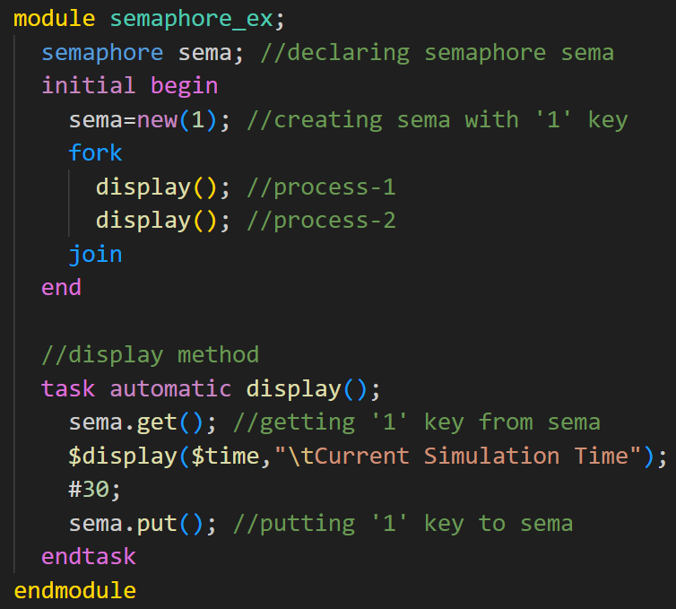

Semaphore
semaphore sema is created with the 1 key, two processes are accessing the display method at the same time, but only one process will get the semaphore key and the other process will wait till it gets the key.

Slide 8
Mailbox
A mailbox is a communication mechanism that allows messages to be exchanged between processes. The process which wants to talk to another process posts the message to a mailbox, which stores the messages temporarily in a system-defined memory object, to pass it to the desired process.
Based on the sizes mailboxes are categorized as,
Bounded Mailbox:
A bounded mailbox is with the size defined. mailbox becomes full when storing a bounded number of messages. A process that attempts to place a message into a full mailbox shall be suspended until enough space becomes available in the mailbox queue.
Unbounded Mailbox:
Unbounded mailboxes are of unlimited size.

Slide 9

Mailbox
Mailbox types:
There are two types of mailboxes,
Generic Mailbox (type-less mailbox):
The default mailbox is typeless. That is, a single mailbox can send and receive data of any type.
Parameterized mailbox (with a particular type):
Parameterized mailbox is used to transfer a data of particular type.

Slide 10
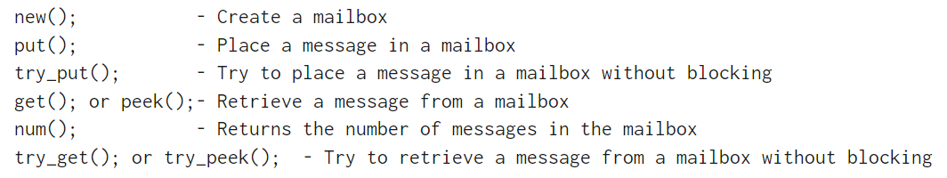
Mailbox
Mailbox Methods
SystemVerilog Mailbox is a built-in class that provides the following methods. these are applicable for both Generic and Parameterized mailboxes

Slide 11
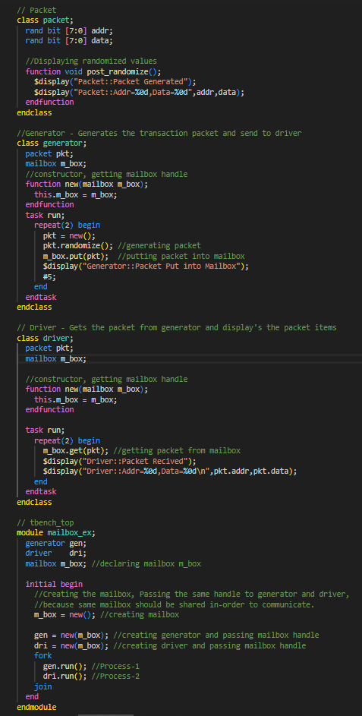
Mailbox
Mailbox Example
Mailbox is used for communication between generator and driver.
Process-1(Generator class) will generate (create and randomize) the packet and put it into the mailbox mb_box
Process-2(Driver class) gets the generated packet from the mailbox and displays the fields

Slide 12
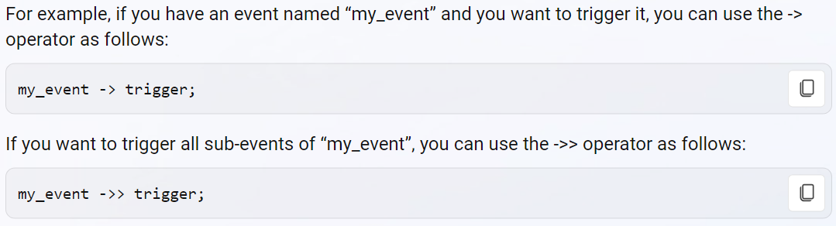
Events
Events are static objects useful for synchronization between the process. Events operations are of two staged processes in which one process will trigger the event, and the other processes will wait for an event to be triggered.
Events are triggered using -> operator or ->> operator.
wait for an event to be triggered using @ operator or wait() construct.
Event triggering:
-> operator: Used to trigger a named event
->> operator: Used to trigger a named event and all its sub-events.

Slide 13
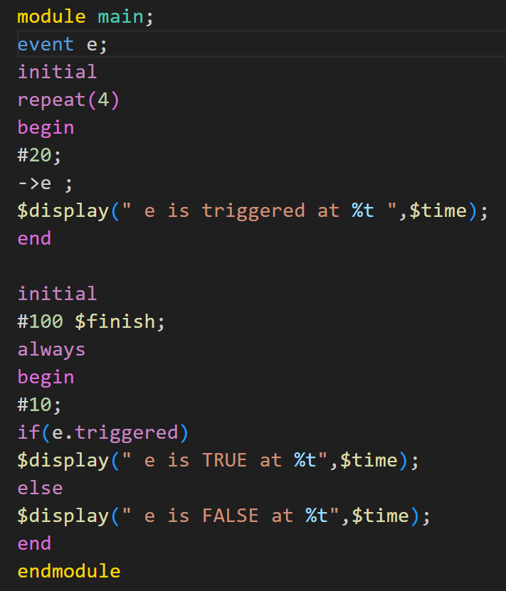
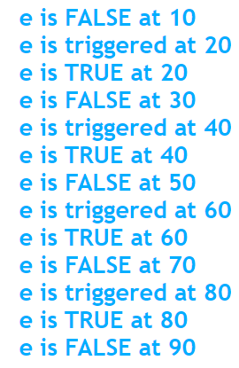
Events
Triggered property:
The "triggered" event property evaluates to true if the given event has been triggered in the current time-step and false otherwise.
Using this mechanism, an event trigger shall unblock the waiting process whether the wait executes before or at the same simulation time as the trigger operation.
In this example, event "e" is triggered at times 20,40,60,80. So the Value of "e.triggered" should be TRUE at times 20,40,60,80 and FALSE at rest of the time.

Slide 14
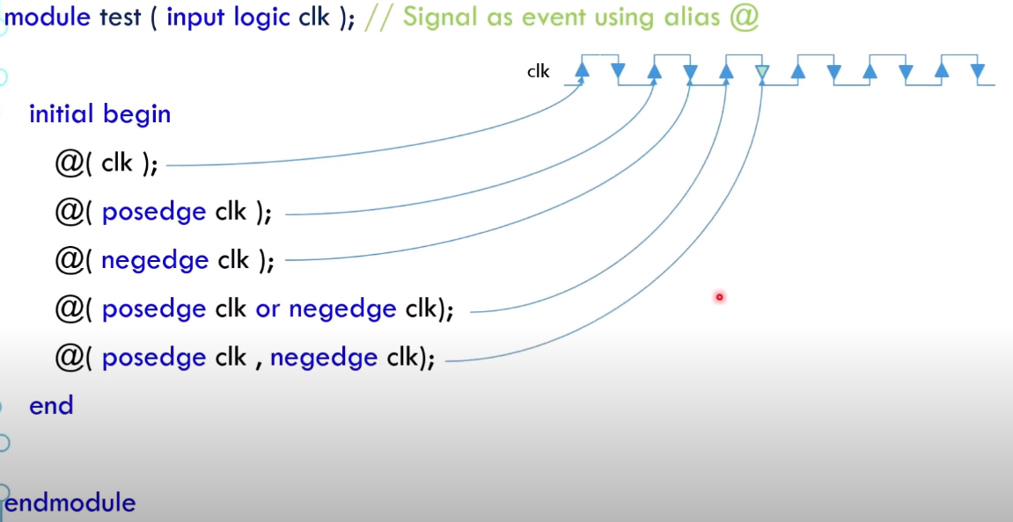

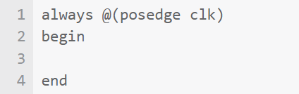
Events
@ operator:
wait for an event to be triggered via the event control operator, @.
The @ operator blocks the calling process until the given event is triggered.
’@’ => used in procedural statements acts as an edge-triggered circuit.

Slide 15
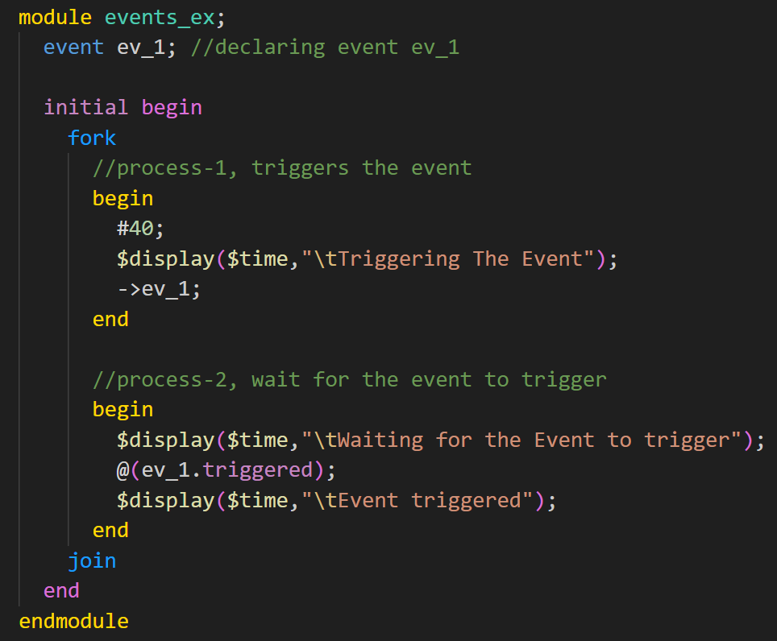
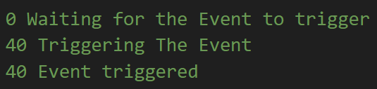
Events
Event waiting with @ operator:
example shows the event triggering and waiting for the event trigger.

Slide 16
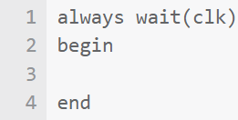
Events
Wait() operator:
If the event triggering and waiting for the event trigger with @ operator happens at the same time, @ operator may miss detecting the event trigger.
If the condition is true, the subsequent statements will be executed, or else will be blocked!
Wait() statement gets blocked until it evaluates to TRUE. "event_name.triggered" returns the trigging status of the event in the current time step.
‘wait’ => used in procedural statements acts as a level-triggered circuit (prefer to use as a common clock)

Slide 17
Events
Race Condition:
For a trigger to unblock a process waiting on an event, the waiting process must execute the @ statement before the triggering process executes the trigger operator, ->. If the trigger executes first, then the waiting process remains blocked.
The wait(e.triggered) statement says wait for the condition that event e has been triggered in the current time slot means it evaluates as true (1’b1) if event e has been triggered in the current time slot else false (1’b0).
A process that waits on the triggered state always unblocks, regardless of the order of execution of the wait and trigger operations.

Slide 18
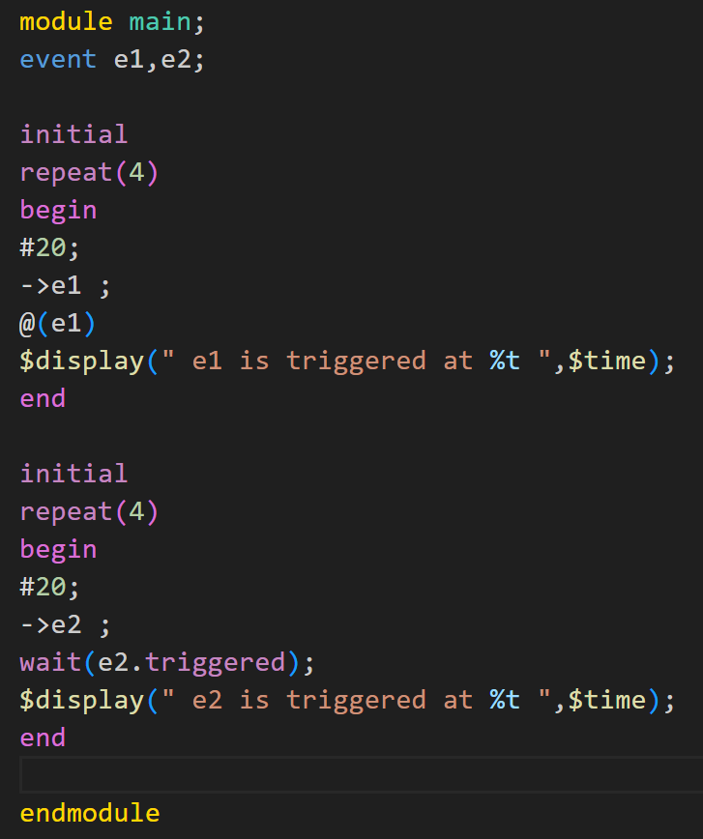
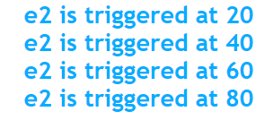
Events
In this example, event "e1" is triggered and a process is waiting on "e1" in the same time step. The process can never catch the triggering of "e1" as it occurs after the event "e1" triggering. Event "e2" triggering occurrence can be recognized by wait (e2.triggered) in spite of the above condition.

Slide 19
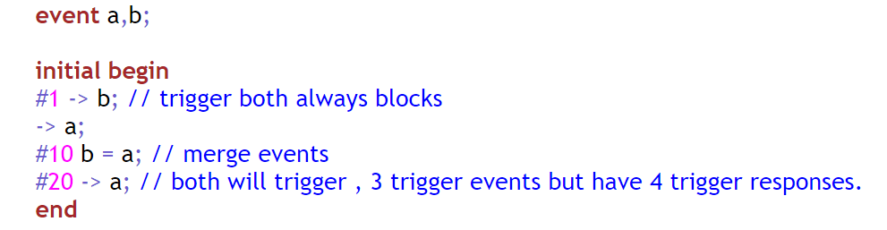
Events
Merging Events:
When an event variable is assigned to another, both events point to the same synchronization object. In the following example, Event "a" is assigned to event "b" and when event "a" is triggered, event occurrence can be seen on event "b" also.

Slide 20
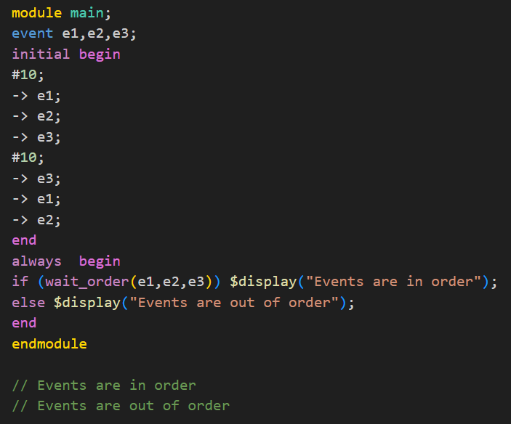
Events
wait_order() operator:
The wait_order construct suspends the calling process until all of the specified events are triggered in the given order (left to right).
Wait_order() does not consider time, only ordering is considered.

Slide 21
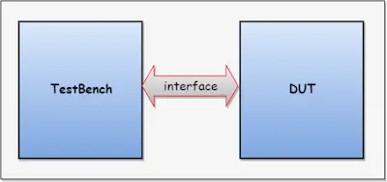
Interface
Communication between blocks is specified using module ports. SystemVerilog adds the interface construct which encapsulates the communication between blocks. An interface is a bundle of signals or nets through which a testbench communicates with a design.
Interface Construct:
The interface construct is used to connect the design and testbench.
Below diagram shows connecting the design and testbench with the interface.

Slide 22
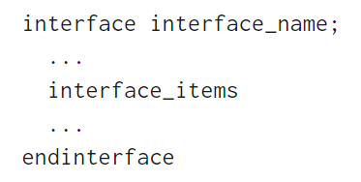
Interface
Interface is a bundle of wires, the interface’s aim is to encapsulate communication.
An interface can have parameters, constants, variables, functions, and tasks.
Simple interface declaration:
Advantages of the interface over the traditional connection:
Allows the number of signals to be grouped together and represented as a single port, the single port handle is passed instead of multiple signals/ports.
Interface declaration is made once and the handle is passed across the modules/components.
Addition and deletion of signals are easy.
Changes made to the interface will reflect everywhere.

Slide 23
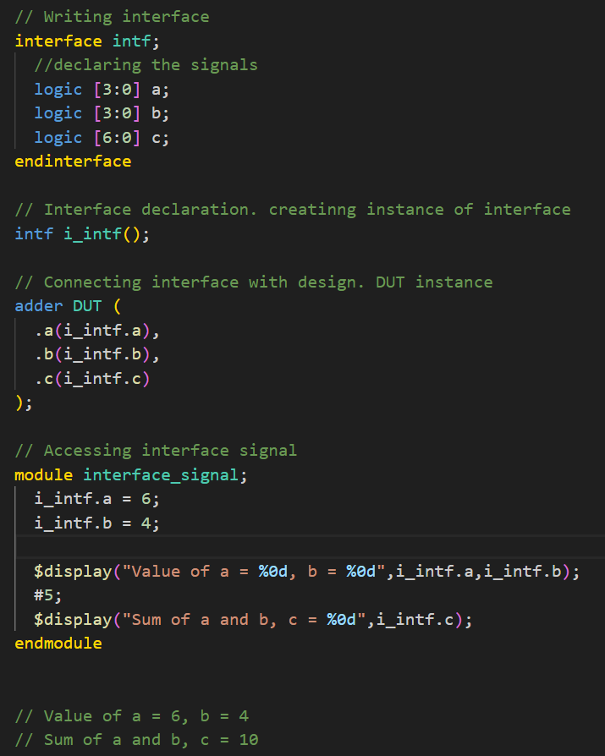
Interface
This example shows the writing interface, declaration of an interface, connecting the interface with design, and accessing interface signals.

Slide 24
Virtual Interface
A virtual interface is a variable that represents an interface instance.
The virtual interface must be initialized before using it. i.e., the Virtual interface must be connected/pointed to the actual interface.
Virtual interface variables can be passed as arguments to the tasks, functions, or methods.
All the interface variables/Methods can be accessed via a virtual interface handle. i.e virtual_interface.variable
accessing the uninitialized virtual interface result in a run-time fatal error.

Slide 25
Scheduling Semantics
To describe the element’s behavior and their interaction with each other, with respect to event execution and its scheduling.
SystemVerilog process concurrently schedules elements such as always, always_comb, always_ff, always_latch, and initial procedural blocks, continuous assignments, asynchronous tasks, and primitives.
Divide time slots into ordered regions to provide predictable interactions between the design and testbench code.

Slide 26
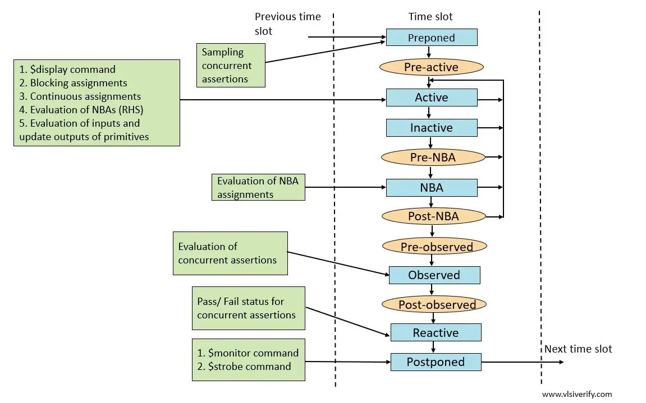
Scheduling Semantics

Slide 27
Scheduling Semantics
Preponed region
The values of variables that are used in concurrent assertions are sampled in the Preponed region. (Evaluation is done at the observed region). The preponed region is executed only once in each time slot, immediately after advancing simulation time.
Pre-active region
The Pre-active region is specifically for a PLI callback control point that allows for user code to read and write values and create events before events in the Active region are evaluated.
Active region
The Active region holds current events being evaluated and can be processed in any order.
Execute all module-blocking assignments.
Evaluate the Right-Hand-Side (RHS) of all nonblocking assignments and schedule updates into the NBA region.
Execute all module continuous assignments
Evaluate inputs and update outputs of Verilog primitives.
Execute the $display and $finish commands

Slide 28
Scheduling Semantics
Inactive region
The Inactive region holds the events to be evaluated after all the active events are processed. In this region, #0 blocking assignments are scheduled.
Pre-NBA region
The Pre-NBA region is specifically for a PLI callback control point that allows for user code to read and write values and create events before the events in the NBA region are evaluated
Non-blocking Assignment Events region (NBA)
The principal function of this region is to execute the updates to the Left-Hand-Side (LHS) variables that were scheduled in the Active region for all currently executing nonblocking assignments.
Post-NBA region
The Post-NBA region is specifically for a PLI callback control point that allows for user code to read and write values and create events after the events in the NBA region are evaluated.

Slide 29
Scheduling Semantics
Observed region
The principal function of this region is to evaluate the concurrent assertions using the values sampled in the Preponed region. The property evaluations must only occur once in any clock-triggering time slot. During the property evaluation, the pass/fail code shall be scheduled in the Reactive region of the current time slot.
Post-observed region
The Post-observed region is specifically for a PLI callback control point that allows for user code to read values after properties are evaluated in the Observed or earlier region.
Reactive region
The code specified in the program block, and pass/fail code from property expressions, are scheduled in the Reactive region. The principal function of this region is to evaluate and execute all current program activity in any order
Execute program-blocking assignments.
Execute pass/fail code from concurrent assertions.
Evaluate Right-Hand-Side (RHS) of all program nonblocking assignments and schedule
Execute all program continuous assignments
Execute $exit and implicit $exit commands

Slide 30
Scheduling Semantics
Re-Inactive Events region
In this region #0 blocking assignments in a program process are scheduled.
Postponed Region
The principal function of this region is to execute the $strobe and $monitor commands that will show the final updated values for the current time slot. This region is also used to collect functional coverage for items that use strobe sampling.

Slide 31
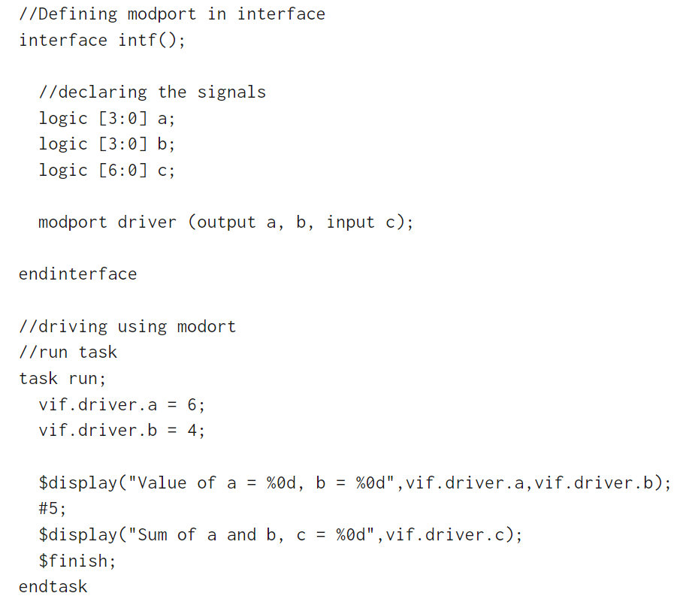
Modport
Modport groups and specifies the port directions to the wires/signals declared within the interface. modports are declared inside the interface with the keyword modport.
By specifying the port directions, modport provides access restrictions
Modpports can have input, output, and ref.

