Slide 1

Gender Responsive Budgeting in Practice: Focus on Nigeria and Selected Developing Countries. Bola Akanji and Funmi Soetan, (eds) https://share.google/jLL4oyvn13ZUMASpw
A Book Talk of the African Feminist Initiatives (AFI)
Penn State University, USA
Bola Akanji, Ph.D
Adjunct Faculty, Quinnipiac University, Hamden, Connecticut;
Consultant and Independent Scholar, Gender, Agriculture and International Development

Slide 2
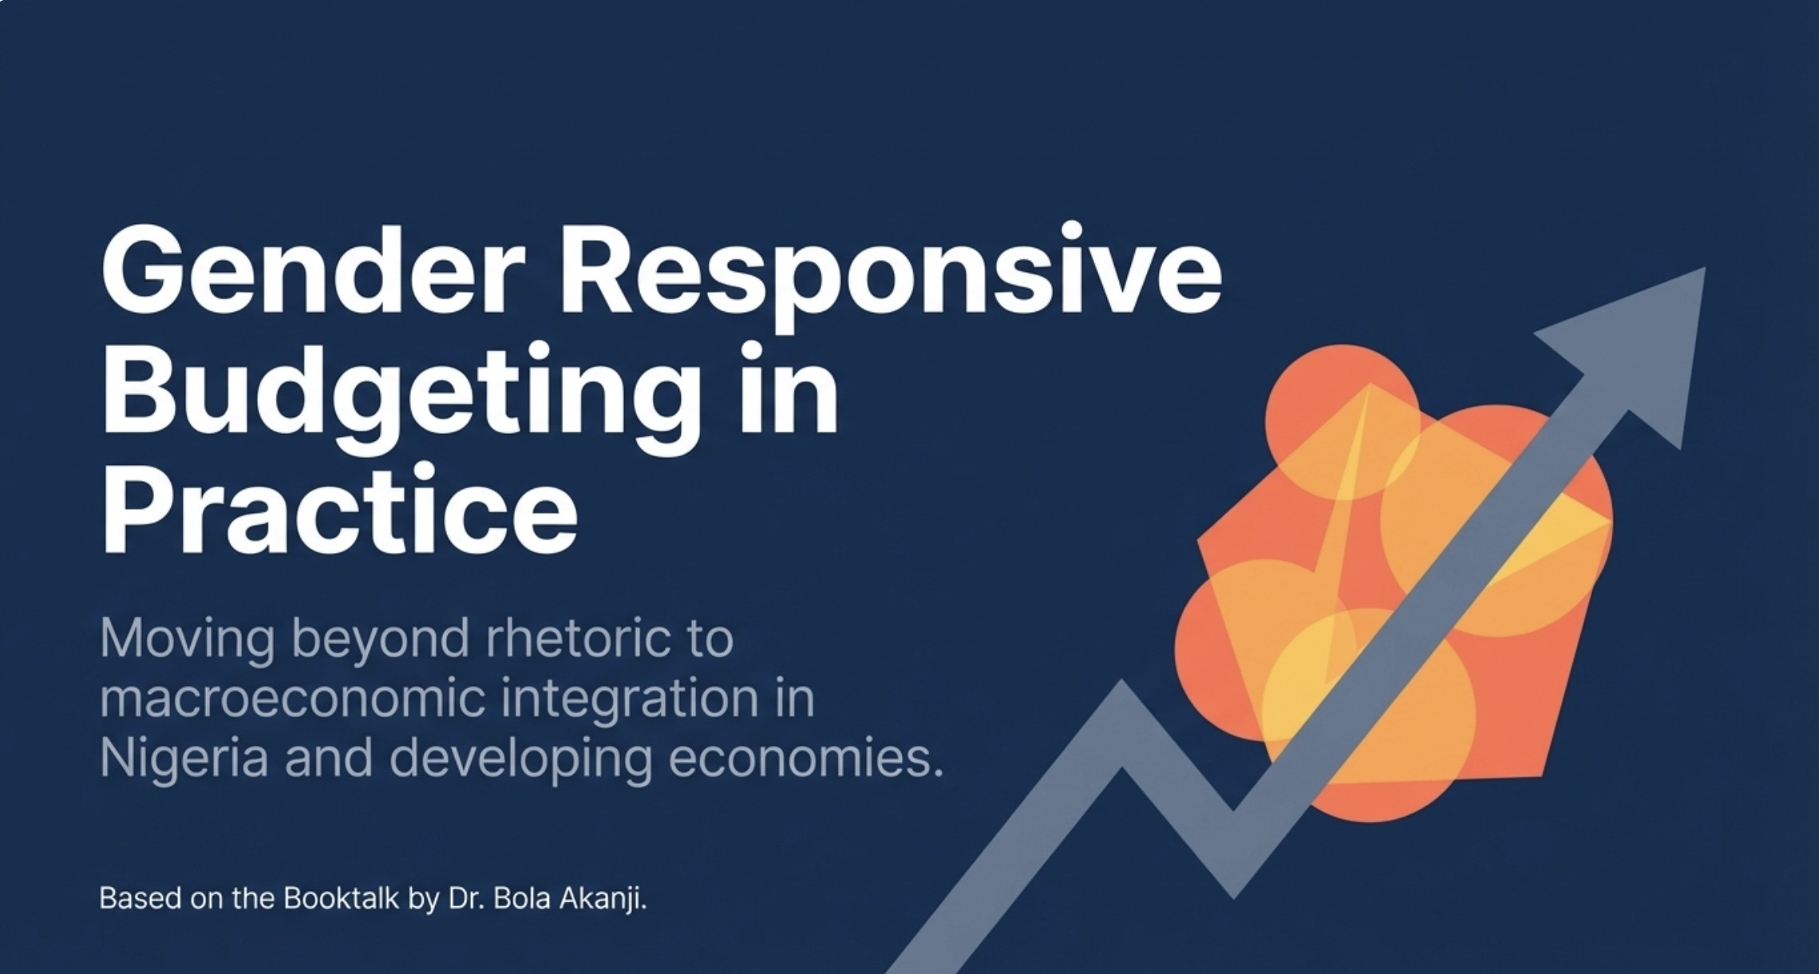

Slide 3
Part 1: Rationale and Justification for GRBs Part 2: Nigeria’s experiences of GRB between 2000 and 2020 Part 3: Cross country examples of GRB experience Epilogue Lessons Learnt and what needs to change

Slide 4
Part 1: Rationale for GRBs in Africa - Its importance to the achievement of Africa’s Development Agenda
Gender profiles the productive sectors show significant gender gaps - agriculture, trade (including cross border trade), employment, informal sector enterprises, finance, technology etc
Expenditure on closing gender gaps have been clearly linked to economy-wide benefits such as GDP growth - greater revenue flow from women’s paid work especially when productivity growth is enabled; and hidden economic and social benefits from women’s unpaid work to the formal sector.
Budgeting for gender equality is not just a women’s issue; it is smart economics. (IMF studies in the last 10 years have sought to prove this) – encouraging expenditures (budgetary allocation to women’s empowerment etc. GRB is smart economics, not largess to women
The “financing development” concept – evolved during MDGs. Not just about setting policy goals and programme development; rather a systematic way to ensure that proposed interventions to achieve each of the MDGs were implemented through funding mechanisms;
Achievement of many SDGs goals are linked with related gender gaps that need to reduce.

Slide 5
Part 1: Justification for GRBs in developing countries
Participatory Development: GRB is a form of participatory budgeting and promotes Good governance. The GRB template can be used by other marginalized groups to demand their right to development financing in the name of inclusive governance and inclusive development
Strong macroeconomic interlinkages between gender inequality and economic growth (tax policies, trade policies, fiscal policies, etc are strongly gendered)
Accountability to Global and African Charters and Declarations: The call for GRBs feeds into several Covenants: the African Charter on Human Rights; The Solemn Declaration on Gender Equality, the SDGs (especially Goal 5), the Africa Agenda 2063 as well as other global Covenants on Gender Equality.
Budgeting is political
Rationing occurs where resources are finite or scarce. In the African context, resources are highly subject to rationing. Voice and representation at the budget table is key.
Gender equity must be ensured within Public Financial Management systems (PFMs). Only fair representation of both men and women in the economic planning process can ensure the financing of gender equality programs; and inclusive development.

Slide 6
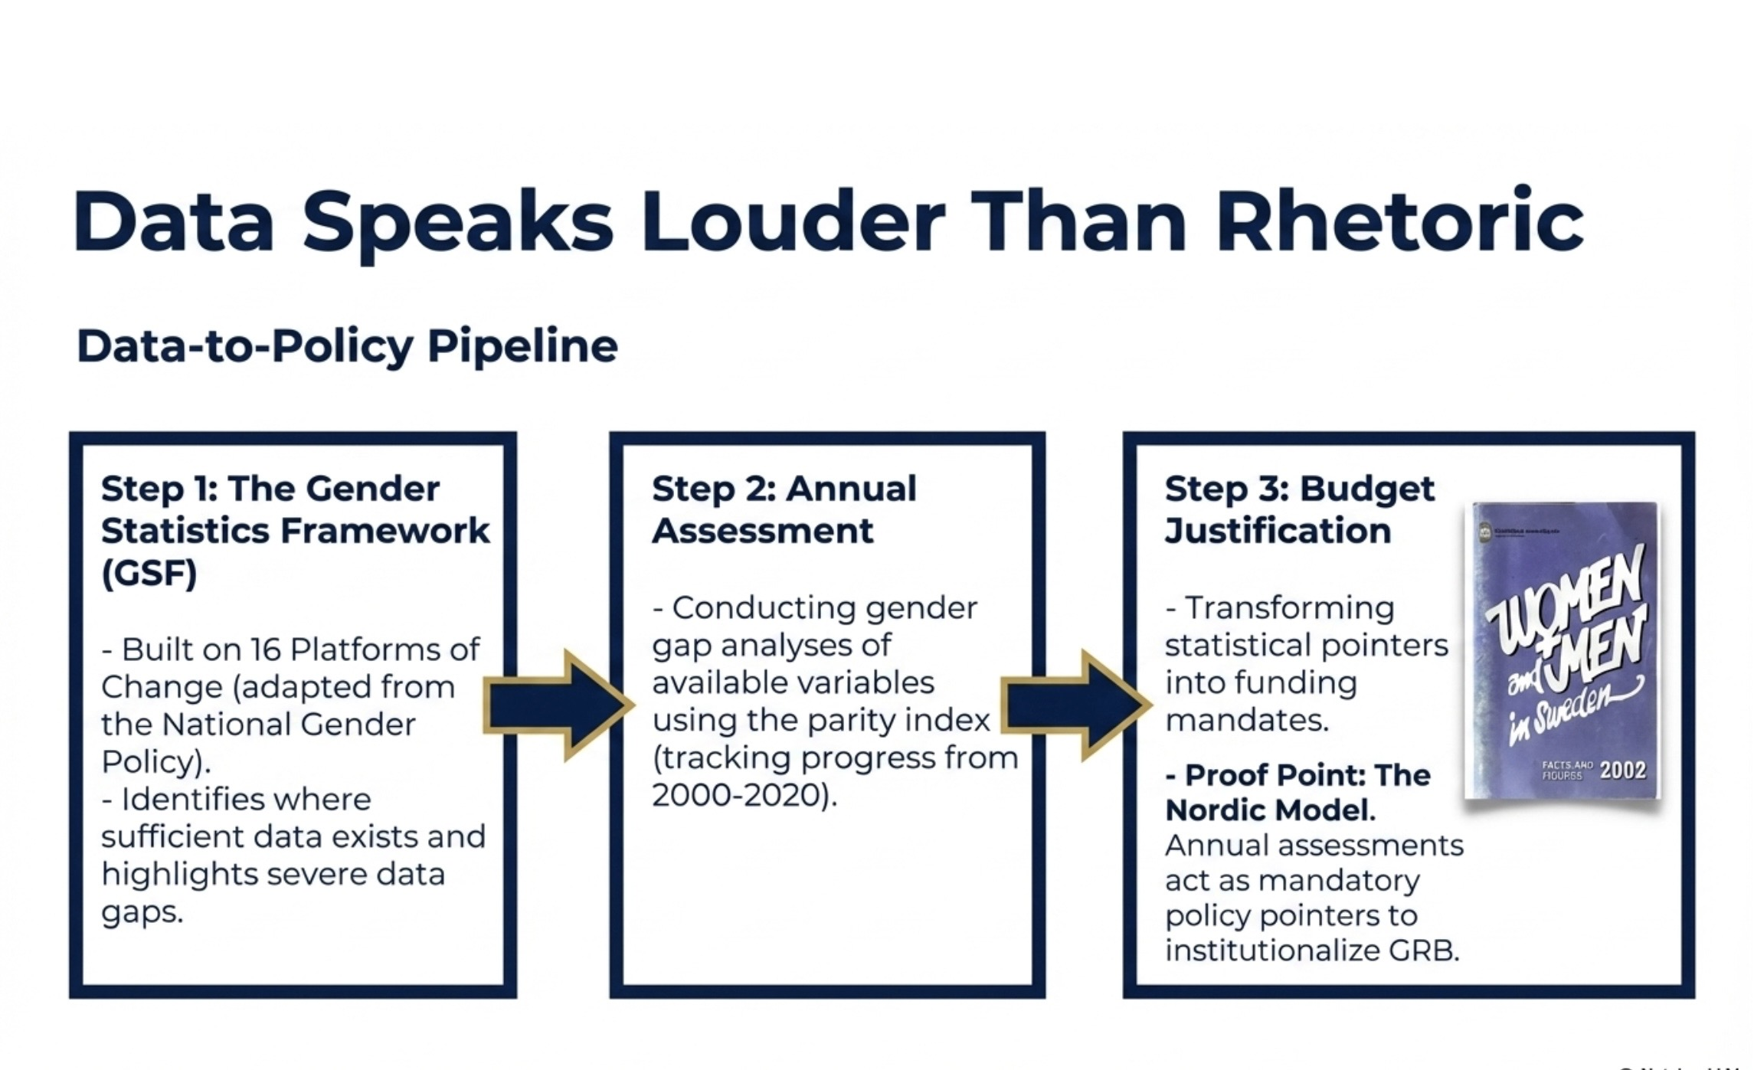

Slide 7
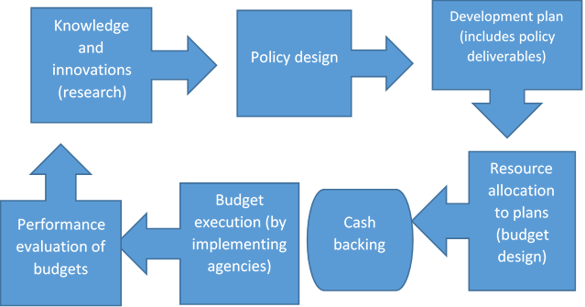
A GRB must be set within the Policy and Budget Cycles
The Policy Cycle
The Budget Cycle. GRB must follow the Budget Cycle

Slide 8
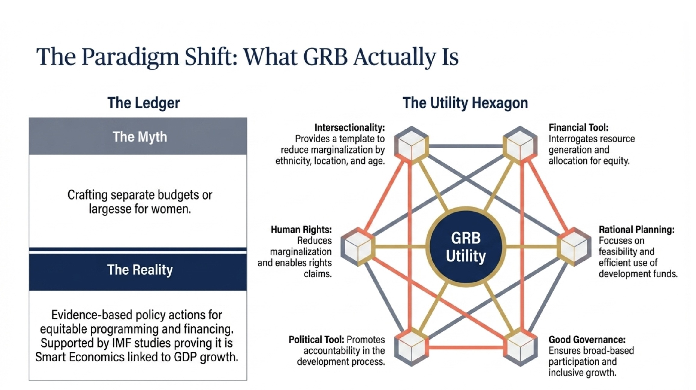

Slide 9
The main conclusions from the volume
Much action but no real traction for GRBs
Weak links between policies and budgets with regards to gender policies – implying low priority given to full integration of gender concerns in policies, beyond mere policy statements that are often not implemented
A misunderstanding of what GRB is and what it is NOT – often seen as crafting budgets for women – rather than promoting evidence-based policy actions for gender equitable policies, programming and financing
There is a difference between gender budget analysis (GBA) and Gender Responsive Budgeting (GRB)
A limitation of knowledge on implementation – concepts and findings as justification, methodologies and tools, data needs and holistic coverage etc
Lack of legislative imperatives for integration of structural issues within Public Financial management systems in most countries - Poor democratic values and failure to adopt participatory budgeting as a tool of good governance
GRB actions mostly initiated by CSOs, funded by development partners, not supported by governments; gender statistics production often relegated in statutory statistical surveys; not available on sectoral basis

Slide 10
Three Critical Success Factors promote traction for GRBs
Lessons from the cross-country studies
Is there a policy, institutional and legal framework for GRB in place?
Is GRB action changing the ways that government decisions are made in fund allocation?
Is GRB action leading to (defined) outcomes: positive changes in the situation of the affected?

Slide 11
