Slide 1
WEBSITE MAINTENANCE
Presented By:
Submitted To:

Slide 2
Contents:
http://dmt.customer.netspace.net.au/wot/
Introduction
What makes it bad?
Best about the Website
What's the user point of view
Conclusion

Slide 3
My Website:
“Wheel of Time Character Archive”

Slide 4
Beginning
Definition: A website can be defined as a collection of several WebPages that are all related to each other and can be accessed by visiting a homepage, by using a browser like Internet Explorer, Mozilla, Google Chrome, or Opera.
When you visit a website, the first page has the biggest impact because there you should find all the information that you need to know in order to make an idea.
Today here I am talking about the Website “Wheel of Time Character Archive “designed by Robert Jordan. It contains numerous characters and their number is near about 1761. It was last updated on 24th January 2003. It got copyright registration by expert @ copyright Robert Jorden. It has powered by counter block.com. Counter Block is a quality tool for reputable publishers.

Slide 5
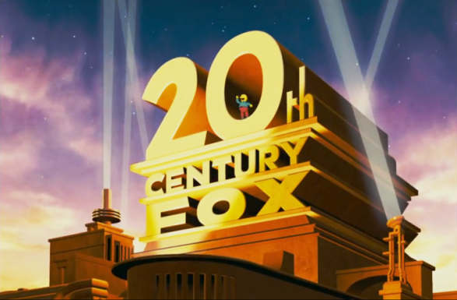
A copyright is a form of protection provided by the laws of the United states to authors of “Original works of authorship”
“Wheel of Time Character Archive” got Copyright from 20th Century Fox studios. The company partnered with 20th Century Fox to launch a new collection of fine art photography from the 20th Century Fox Photo Archive.

Slide 6
Different issues in web site
1. Designing Issues:
The site literally places the contents and links anywhere. All the elements together make the site an incomprehensible mess.
The biggest problem is that the site does not use a grid. A grid can make everything clean and organized on your website.
Typeset design:
The lack of design contrast a clear and powerful contrast between the elements can help users to know what is the core info of the page. It helps the user to better read & understand the information.
On this site , the background color and text color are pretty similar , leaving a very weak contrast
The poor contrast makes the text become blurry to the eyes.
At the bottom of the site small and Italic font size makes the readability of the test extremely poor

Slide 7
3. Bad Links:
The biggest drawback of the site is issue regarding hyperlinks. These are not working well.
A mess of links and dead links are both major errors in the site.
4. Issue Regarding HTTPS:
The Website does not support Hypertext Transfer Protocol Secure (HTTPS) is a combination of two different protocols.
It is more secure way to access the web. It is combination of Hypertext Transfer Protocol (HTTPS) and SSL/TLS protocol

Slide 8
5. Applets: An applet is a small application designed to run within another application. Portability is defined as the applet’s ability to run on different computers and operating systems. but Wheel of Time Character Archive website applets are outdated so it is not able to support new browser .
6. Content Issues: The another issue regarding website is its contents are written in the first person ,but these should be written in the third person.

Slide 9
8. Link hits since 20 April 2000:
It the bottom of the site the link is not working .It does not have any value associated .
9. BAD USER INTERFACE DESIGN :
The design lacks of contrast: When browsing a website, we’d like to see it with a clear and fresh contrast.

Slide 10
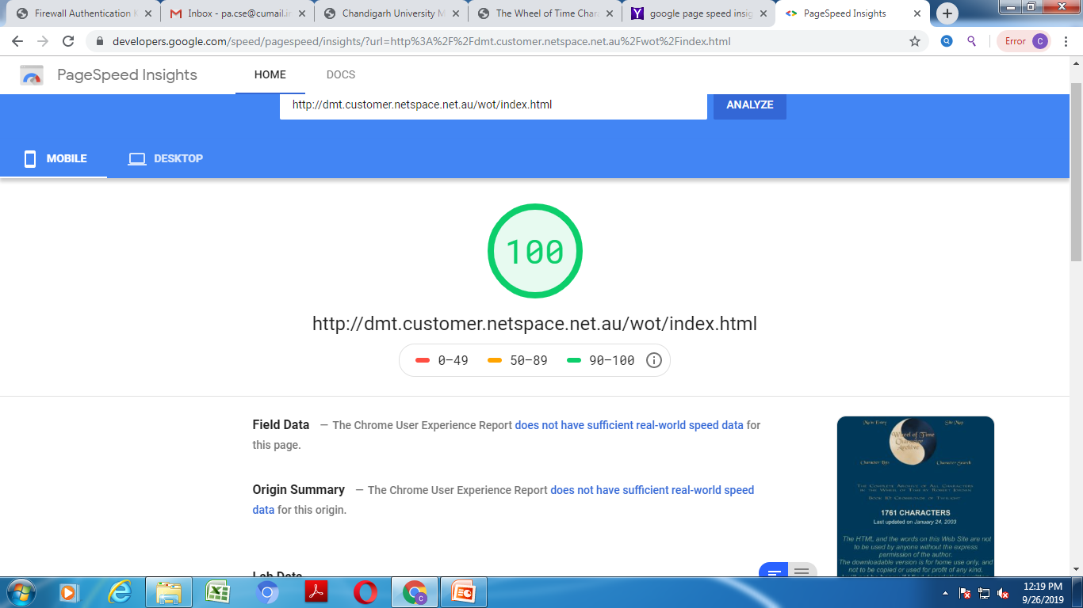
Good Things

Slide 11
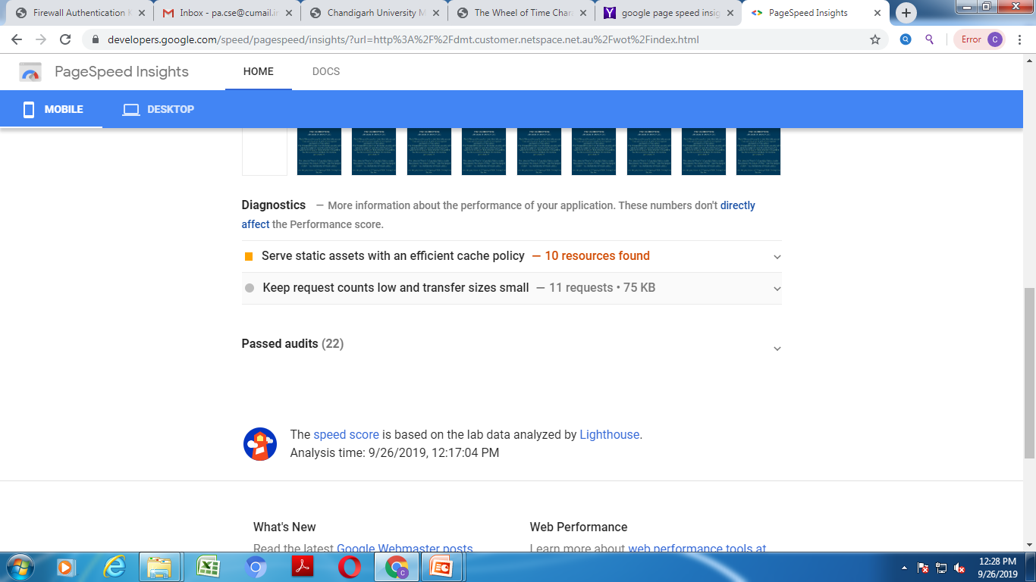
Server Static Assets , With an efficient Cache Policy

Slide 12
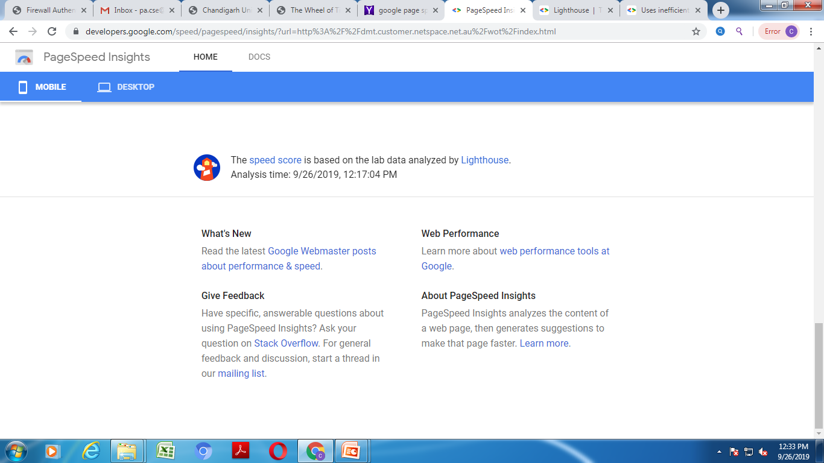
The speed score is based on the lab data analyzed by LIGHTHOUSE

Slide 13
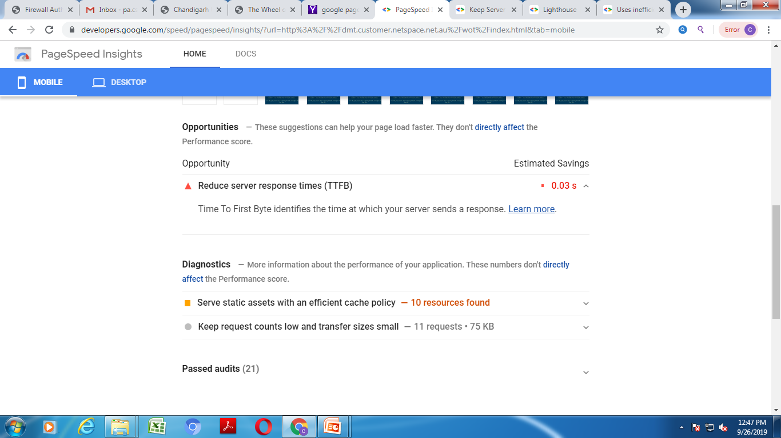
Keep Server Response Time Low

Slide 14
Suggestion Users Point of View
1. Simple is the best: Over-designed website may not work. Putting too many elements on the page may lead to distract visitors from the main purpose of your website.
2. Consistency: Consistency in website design matter a lot. Give your attention to match design elements throughout each of the pages.
3. Typography & Readability:
No matter how good your design is text still rules the website as it provides users the desired information.

Slide 15
4 .Easy loading
No one likes the website that takes too much time to load.
5. Easy Navigation
You should follow the “three-click-rule” so that visitors can get the required information within three clicks.
6. Communication
The ultimate purpose of the visitors is to get information, and if your website is able to communicate your visitors efficiently, most probably they would spend more time on your website.

Slide 16
7. Mobile compatibility
Keeping in mind the ever-growing usage of smart phones, tablets web design must be effective for various screens.
8. Color palette and imagery
A perfect color combination attracts users while a poor combination can lead to distraction. This necessitates you to pick a perfect color palette for your website which can create a pleasing atmosphere, thus leaving a good impact on visitors.

Slide 17
Conclusion:
Websites are playing important part in improvement of business. Although we don’t want the website to be confusing for the customer to navigate . However it is essential that these are constant links.
70% of the population is using dynamic & interactive websites because of their eye capturing visual effects.

Slide 18


