Slide 1


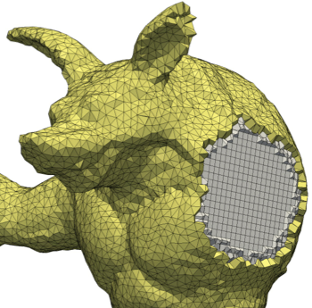
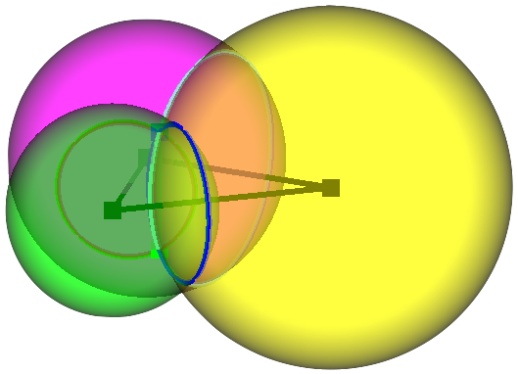
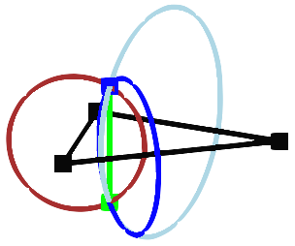
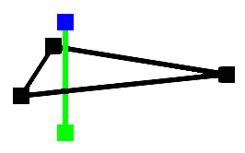
Unstructured Primal-Dual Mesh Improvement and Generation
Scott A. Mitchell¹
Patrick M. Knupp²
¹Sandia National Laboratories
²Dihedral
Goal: good primal (triangle) properties and dual (Voronoi) properties simultaneously
Discrete Exterior Calculus (DEC) PDE simulations
Do you have a DEC simulation?
We want to partner, discover what makes a difference in practice!
Mathematical advances
  Analyzed metric bounding Hodge-star discretization error
      Designed new metric with good optimization behavior
Mesh-improvement software framework
resampling, constrained to improve quality
traditional smoothing, insertion/deletion
Goal: dual Voronoi polyhedral meshing, VoroCrust
Do you need polyhedral meshes? Tell us!
Math advantages of boundary-conforming Voronoi cells
flat facets, convex cells, aspect ratio bounds
Derived sufficient conditions for provably correct meshes
DEC
Discrete
Exterior
Calculus
matrix
Discretization error < HOT energy(primal-dual σ-*σ)
References
Meshes Optimized for Discrete Exterior Calculus, tech report
A Constrained Resampling Strategy for Mesh Improvement, CGF
Disk Density Tuning of a Maximal Random Packing, CGF
Spoke-Darts for High-Dimensional Blue Noise Sampling, accepted to TOG
A Seed Placement Strategy for Conforming Voronoi Meshing, CCCG
VoroCrust Surface Reconstruction Conditions, manuscript
VoroCrust: Clipping-Free Voronoi Meshing, manuscript
Team members: A. Abdelkader (UMD), M. A. Awad (UC Davis), C. L. Bajaj
(UT Austin), M. S. Ebeida (SNL), S. A. English (SNL), P. M. Knupp (Dihedral),
A. H. Mahmoud (UC Davis), D. Manocha (UNC), S. A. Mitchell (SNL),
S. C. Mousley (UIUC), C. Park (UNC), A. Patney (NVIDIA), J. D. Owens
(UC Davis), A. A. Rushdi (SNL), D. Yan (CAS), and L. Wei (HKU).
Sandia National Laboratories is a multimission laboratory managed and operated by National Technology and Engineering Solutions of Sandia, LLC, a wholly owned subsidiary of Honeywell International, Inc., for the U.S. Department of Energy’s National Nuclear Security Administration under contract DE-NA0003525.
SAND2017-9545 D

