Slide 1


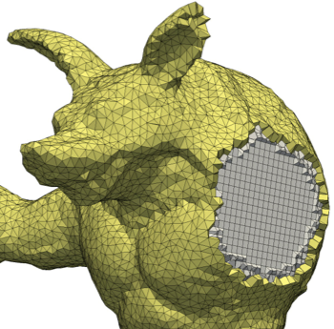
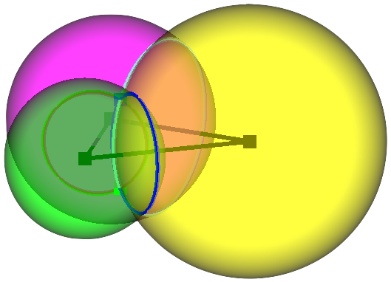
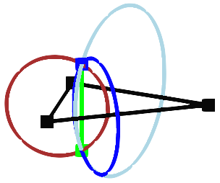
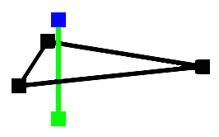
Unstructured Primal-Dual Mesh Improvement and Generation
Scott A. Mitchell¹
Patrick M. Knupp²
¹Sandia National Laboratories
²Dihedral
Abstract
Results
Conclusions and Future Work
We investigate the math and algorithms for primal-dual mesh quality improvement and generation. We advanced simultaneously-good primal-dual mesh quality, resampling nodes for mesh improvement, and dual Voronoi polyhedral mesh generation.
Primal-Dual Quality Metric Analysis, Design, and Optimization.
We discovered that while the HOT-energy metric may be a reasonable way to evaluate quality, the community practice of directly optimizing it leads to undesirable behavior.
In particular, HOT has no barrier to mesh inversion and bad local minima exist.
Because of these limitations, the community relies on preconditioning by Lloyd’s iterations, as in Centroidal Voronoi Tesselation (CVT).
We designed a metric HOT that overcomes these shortcomings, is unitless and scale invariant, and has better values over non-Delaunay meshes. Our new metric holds the promise of better behavior under optimization, while still reducing discretization error [1].
Primal-dual mesh quality analysis, and optimization to reduce discretization error
Sampling-based framework for improving multiple mesh qualities simultaneously
Dual Voronoi polyhedral mesh generation algorithms, and
derivation of mathematically-sufficient conditions for provably correct output
We reached a depth of mathematical understanding of primal-dual energy metrics that enabled the design of a new metric that should behave better under optimization. Near-future work is actually optimizing this new metric, tuning for efficiency, and achieving the properties that are the most beneficial in practice. While resampling can produce a well-centered primal-dual mesh, we seek to demonstrate it over energy metrics more closely tied to simulation error. Extending to weighted meshes is challenging: we understand the mathematics of the metric and its gradient with respect to node weights, but an algorithm to simultaneously modify both weights and positions is challenging due to their different units and scales.
Besides meshes, we demonstrated building an accurate model of a fiber material.
Motivation
Primal-dual meshes, otherwise known as well-centered meshes, find use in Discrete Exterior Calculous (DEC) formulations of PDE’s and play a role in compatible discretizations. Mirroring the geometric orthogonality of primal and dual elements, these are most well suited for simulations involving orthogonal phenomena, such as electro-magnetism, and other divergence-curl phenomena. Besides PDE’s, primal-dual meshes are ubiquitous in geometry processing, for applications including the design of self-supporting structures, and the design and modeling of tight packings.
Wasserstein distance
A Delaunay triangulation (black) and its dual Voronoi polygon mesh (gray). The primal edge
σ (red) is dual to the Voronoi edge *σ, which has green and blue half-edges contributed by the adjacent blue and green triangles.
Optimizing HOT collapses triangles!
(0,1)
Input
“Horseshoe” Mesh Patch
HOT behaves poorly
HOT behaves well
(8,0)
The HOT energy depends on |σ| and |*σ|.
HOT bounds the discretization error of the system of equations Ax=b given by the DEC formulation of the PDE. The error arises from the diagonalization of the dual Hodge-star operator.
The error roughly corresponds to how well-
(0,-1)
HOT:
Replace formula-based by
theory-based extrapolation over non-Delaunay meshes.
Energies stay positive, and partial barriers are created.
Scaling by 1/area²
a. removes point “holes”
in barriers.
b. improves landscape
Landscape after 1, before 2
Two local minima,
both collapse triangles!
Our “Tuned MPS” material model, with correct fiber-to-epoxy ratio and random locations of fiber strands, gives a more accurate simulation of fracture response [3].
centered the mesh is, how
close the dual vertices are to
the triangles’ barycenters.
Areas in which we can help
DEC
Discrete
Exterior
Calculus
Quality Improvement by Resampling.
We demonstrated eliminating obtuse angles so triangles are well-centered.
We produced a general framework for local resampling of mesh nodes[2,3,4]
Support multiple quality objectives, ensure none degrade.
Nodes move randomly within the local feasible space, are inserted and deleted.
Locally “satisfice” quality rather than optimize it. Constraints act like barriers.
Getting stuck in an undesirable local minimum is possible, but rare.
We seek to deliver a general-purpose primal-dual mesh improvement library,
useful across many types of next-generation simulations. While the literature has demonstrated some primal-dual mesh optimization, no open-source capabilities exist.
We derive math in support of general-purpose dual polyhedral mesh generation.
LANL’s Center for Nonlinear Studies has expressed interest in VoroCrust meshes.
Sandia’s Engineering Sciences Center has demonstrated fracture mechanics using prior versions of our Voronoi-based meshing.
matrix
Dual polyhedral meshes are interesting and useful in and of themselves, outside their role in primal-dual meshes. The cells of a Voronoi tessellation boast many properties that make them useful for polyhedral mesh generation, such as convexity and flat facets. Polyhedral mesh generation finds use in fracture mechanics within the Labs complex, and is now widespread in industry for fluid flow and similar phenomena, e.g. CD-adapco. Polyhedra’s efficiency in filling space (i.e. a low node-to-cell ratio), leads to calculation efficiency. Polyhedra provide flexible element formulations.
VoroCrust Dual-Polyhedral Meshing. We developed the “VoroCrust” theory and algorithms for polyhedral mesh generation and surface reconstruction [5,6,7].
It works by generating Voronoi cells whose boundaries match a prescribed domain.
We discovered sufficient conditions for provably correct meshing and reconstruction, for both smooth manifolds and piecewise linear complexes.
Areas in which we need help
We seek partnerships with simulation groups based on DEC or polyhedral meshes!
The major gap we seek to close is tying our results to simulation practice. In particular, while the theory connects mesh quality to simulation error, we wish to discover how tight this connection is, and whether coarser meshes and worse quality suffice in practice.
Sufficient Conditions for VoroCrust Polyhedral Meshing of Smooth Manifolds
References
Approach
Meshes Optimized for Discrete Exterior Calculus, tech report
A Constrained Resampling Strategy for Mesh Improvement, CGF
Disk Density Tuning of a Maximal Random Packing, CGF
Spoke-Darts for High-Dimensional Blue Noise Sampling, accepted to TOG
A Seed Placement Strategy for Conforming Voronoi Meshing, CCCG
VoroCrust Surface Reconstruction Conditions, manuscript
VoroCrust: Clipping-Free Voronoi Meshing, manuscript
Team members: A. Abdelkader (UMD), M. A. Awad (UC Davis), C. L. Bajaj
(UT Austin), M. S. Ebeida (SNL), S. A. English (SNL), P. M. Knupp (Dihedral),
A. H. Mahmoud (UC Davis), D. Manocha (UNC), S. A. Mitchell (SNL),
S. C. Mousley (UIUC), C. Park (UNC), A. Patney (NVIDIA), J. D. Owens
(UC Davis), A. A. Rushdi (SNL), D. Yan (CAS), and L. Wei (HKU).
The major strengths we build on are our mathematical depth in computational geometry, sampling, and mesh optimization.
For the design and analysis of mesh metrics for quality optimization, we exploit metric properties that make them well-behaved under iterative local mesh optimization.
For sampling-based mesh improvement, we exploit that sampling is insensitive to how well behaved a metric is, e.g. no gradients are required, and take advantage of how constraint satisfaction easily supports multiple objectives.
For the proof of VoroCrust correctness we exploit the mathematics of local-feature size (lfs) sampling to bound how close the mesh is to the domain boundary.
VoroCrust produces a polyhedral mesh matching a prescribed set of triangles:
The intersection of dual power spheres around three input samples (mesh nodes)
produces two primal seeds.
The seeds’ Voronoi cells have the input triangle as their common boundary.
Sandia National Laboratories is a multimission laboratory managed and operated by National Technology and Engineering Solutions of Sandia, LLC, a wholly owned subsidiary of Honeywell International, Inc., for the U.S. Department of Energy’s National Nuclear Security Administration under contract DE-NA0003525.
SAND2017-9545 D

