Slide 1
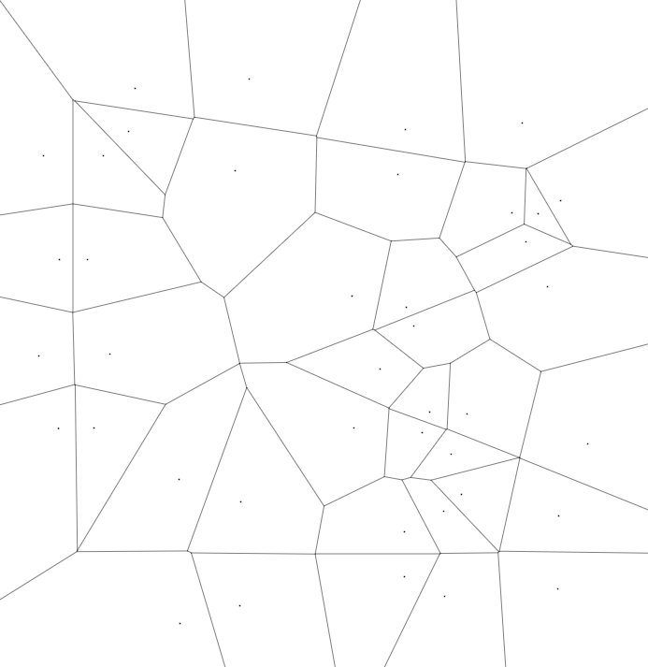
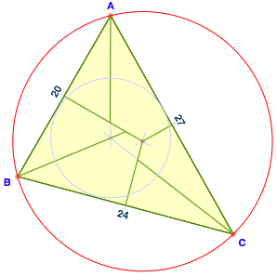


A Seed Placement Strategy for
Conforming Voronoi Meshing
Ahmed Abdelkader, Chandrajit Bajaj, Mohamed Ebeida and Scott Mitchell
University of Maryland, College Park University of Texas, Austin
Sandia National Labs, Center for Computing Research
CCCG 2017, Ottawa
Thursday 27 July 2017, 10:30-10:50, Session 3B in TB 340
20 minutes gross (17 incl. questions, + transition)
This material is based upon work supported by the U.S. Department of Energy, Office of Science,
Office of Advanced Scientific Computing Research (ASCR), Applied Mathematics Program.
Sandia National Laboratories is a multi-mission laboratory managed and operated by National Technology and
Engineering Solutions of Sandia, LLC., a wholly owned subsidiary of Honeywell International, Inc., for the
U.S. Department of Energy's National Nuclear Security Administration under contract DE-NA-0003525.
Notes:
Fraction of work…

Slide 2
Outline
Ahmed Abdelkader sends regrets
Problem definition
  conforming, not constrained or clipped
  analogous to conforming Delaunay, but not dual of it (no seeds on bdy)
  PLC
Motivation
  polyhedral meshing, interior seed freedom
  vs. Powercrust, weighted and non-local to bdy
Spherical constructions
  vertex, edge, triangle
  Sufficient conditions: refinement for empty ball-neighborhoods
Non-zero radius
Reducing the number of Steiner points
Forward peek to VoroCrust proper
  smooth manifolds
  sampling conditions

Slide 3
Problem Definition
Conforming Voronoi Complex
  Given PLC (Piecewise Linear Complex, 3D)
    place Voronoi seeds
      such that refinement of PLC appears as faces of Voronoi cells
      i.e. input face is a union of Voronoi faces
  Analogous to conforming Delaunay triangulation
  but dual of a conforming Delaunay is not a conforming Voronoi
  e.g. no seeds (Delaunay vertices) on boundary
x
x
x
x
x
x
x
x
x
x
x
Simple 2d example

Slide 4
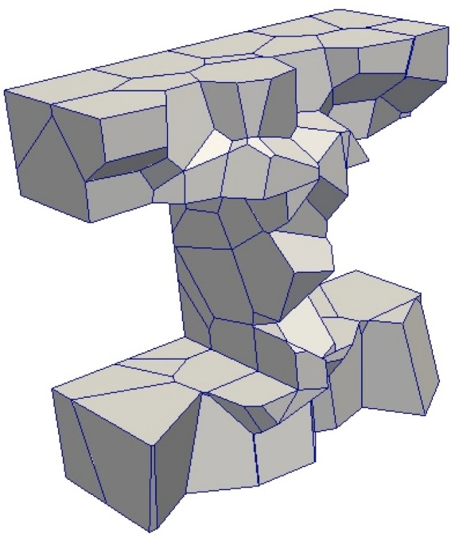
Problem Definition
  Voronoi seeds: refinement of PLC appears as faces of Voronoi cells
    conforming, not constrained, not clipped, not restricted
x
clipping = intersect Voronoi cell with domain bdy
may lose convexity, other Voronoi properties

Slide 5
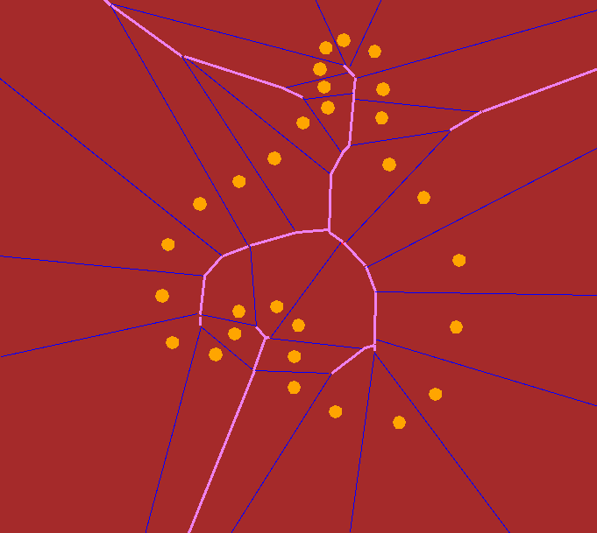
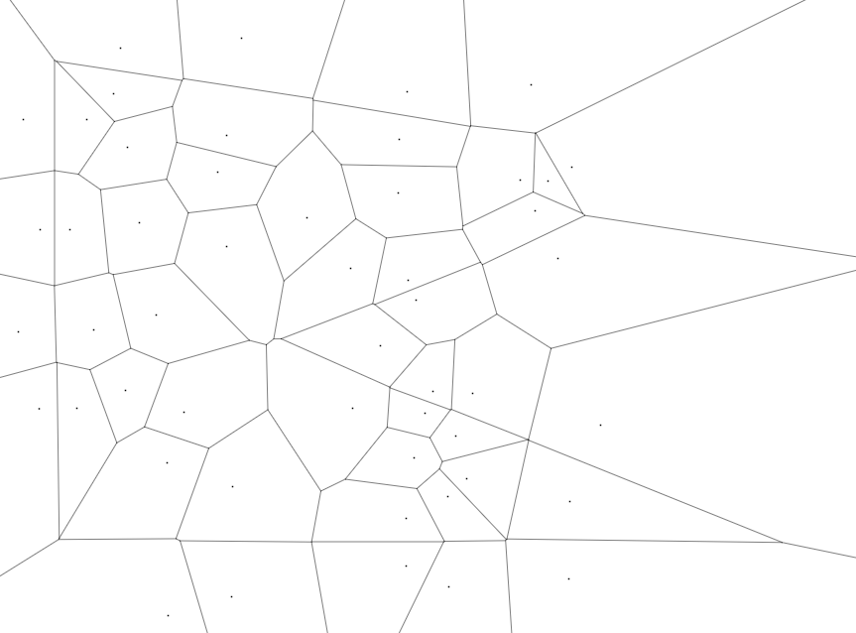
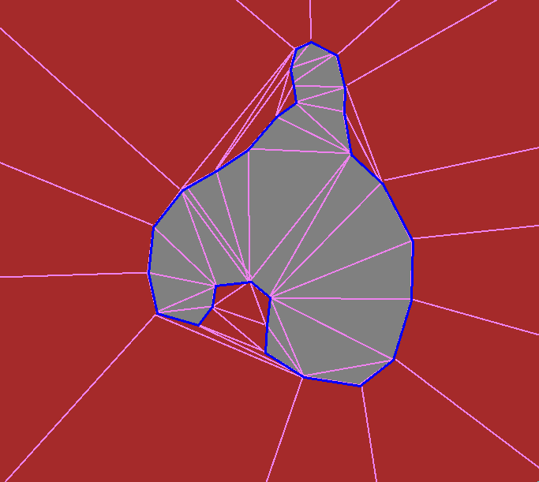
Why solve it?
  power crust images courtesy Nina Amenta,
  https://www.cs.utah.edu/~jeffp/8F-CG/namenta.ppt
Powercrust
weighted and non-local
Our approach
unweighted output,
polyhedral meshing
interior seed freedom

Slide 6
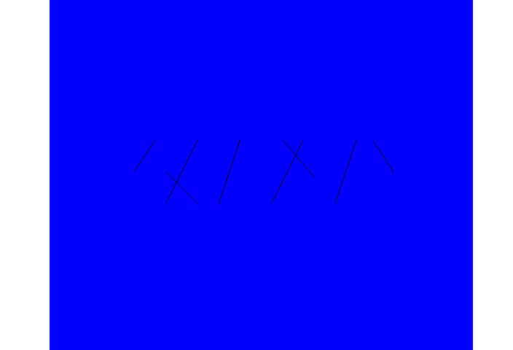
Why solve it?
Voronoi meshing -> polyhedral meshing
Fracture Simulations
Courtesy of
Joe Bishop
(Sandia Nat’l Labs)

Slide 7
Solution
Problem
  Given PLC, in 3D
    place Voronoi seeds
      such that refinement of PLC appears as faces of Voronoi cells
Solution
  Triangulate
  Place seeds
    co-spherical around input vertices
    co-circular around input edges
    pairs symmetric to either side of input triangles
Large number of output seeds
  mostly theoretical interest
  rules for fewer seeds
  sets stage for concurrent/future practical work

Slide 8
Construction Steps
Preprocess
  3D PLC -> triangulate every 2D facet
    possibly not simply-connected, not manifold,
    non-planar, not-connected

Slide 9
Reconstructing a Vertex
Input vertex appears as Voronoi Vertex
4+ seeds
cospherical around vertex

Slide 10
Reconstructing a Vertex
Input vertex appears as Voronoi Vertex
4+ seeds
cospherical around vertex

Slide 11
Reconstructing a Edge
Input edge appears as set of Voronoi edges
3+ seeds
cocircular around edge
(at each vertex)

Slide 12
Reconstructing a Triangle
Input Triangle appears as set of Voronoi faces
2 seeds
across triangle
(at every edge-vertex)
=
6 pairs/ triangle

Slide 13
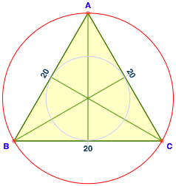
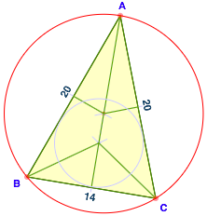
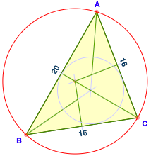
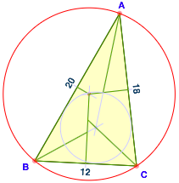
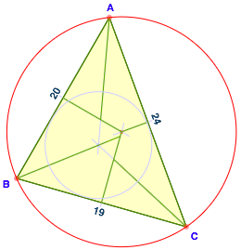
Triangle Cases
Ahmed Abdelkader online applet
Input triangle appears as 6 Voronoi faces, quads or triangles
3D cells per triangle: 12

Slide 14
What’s sufficient, using zero-radius?
Let radii of {vertex spheres, edge circles} -> 0
seeds -> vertices
  works iff every point of every input face has closest vertices ⊆ face’s vertices
  empty ball neighborhoods
    Union of spheres centered in triangle, excluding triangle vertex =
    union of smallest enclosing spheres for input {edge, triangle},
    is empty of input {vertices}

Slide 15
What’s sufficient, using zero radius?
  Empty ball neighborhoods
  For planar triangulations, refine into nonobtuse as preprocess
    Linear-size nonobtuse triangulation of (2D) polygons [Bern, Mitchell, & Ruppert 1994]
    Nonobtuse triangulations of (2D) PSLG [Bishop 2016]
  3D PLSG, nonobtuse + extra refinement + extra seeds,
    method in paper, #seeds depends on angles, dihedrals, & distances
    open: obtain polynomial-sized refinement giving empty ball neighborhoods
(1) obtuse edge-edge angle
-> propagation path
of inserted seed pairs
nonobtuse is sufficient if all dihedrals are flat,
and triangles subdivided enough
to avoid foreign triangles or edges or vertices
(i.e. only faces sharing original vertex in ball neighborhood)

Slide 16
What’s sufficient, using zero radius?
  3D PLSG, “refine” by extra seeds
    method in paper, #seeds depends on angles, dihedrals, & distances
    open: obtain polynomial-sized refinement giving empty ball neighborhoods
(3) additional refinements to make
all edge lengths small compared to
edge-circle radii may be needed…
Analogous to triangle subdivision last page…
Analogous to “Collars and intestines: Practical conforming
Delaunay refinement Rand & Walkington 2009
(2) if non-flat, then
sharp edge-triangle or
triangle-triangle dihedral angle
-> seed pair above/below triangle
on vertex sphere, below red seeds
(propagation possible)

Slide 17
Positive-radius vertex spheres & edge circles
Theorem: strictly positive radius always possible
  Refinement needed, depending on geometry
    Bad case: vertex just outside and above triangle’s purple enclosing sphere
      Extra refinement and propagation paths
    Details in paper. Open: can be avoided by modifying the construction?
Empty ball neighborhoods, changed
  Exclude seeds (only), not input vertices
  Larger vertex spheres -> smaller ball neighborhood
  Larger edge circles -> larger ball neighborhoods
Positive vertex spheres
& positive edge circles
(more purple balls, not shown)
zero-radius spheres
Positive vertex spheres
(more purple balls for non-equilateral)

Slide 18
Reducing the number of Steiner points
Recall 2 seed pairs per triangle vertex. (Zero radius case.)
3D view
Side view
Top view
Each dot is one pair

Slide 19
Reducing the number of Steiner points
Overlap edge-circles = 1 seed pairs per triangle vertex
Section 3.2
Equations for edge radii
Nonobtuse -> feasible
Side view
Top view
Each dot is one pair
Half as many seeds

Slide 20
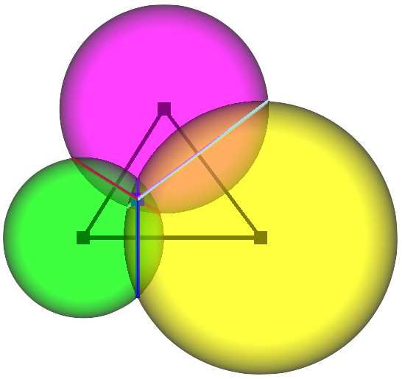
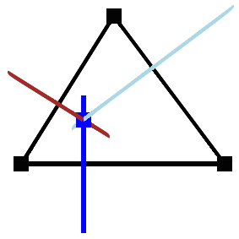
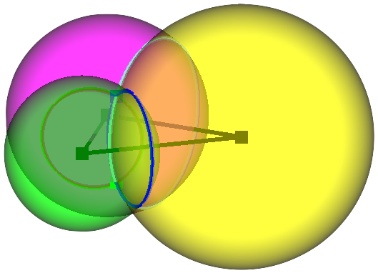
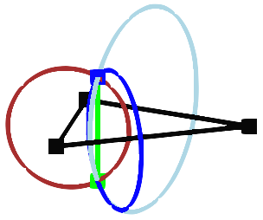
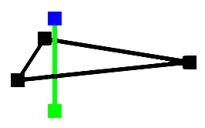
Reducing the number of Steiner points
Overlap vertex-spheres, shared pair for each vertex of an edge VoroCrust future/concurrent work
Top view
Overlap vertex spheres
for an edge
One third as many seeds
Triple overlap vertex spheres
for a triangle
= both reductions
= 1/2 x 1/3 = 1/6 as many seeds
One seed pair per triangle
G↑
G↓
Side view

Slide 21
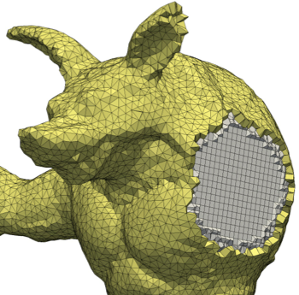

VoroCrust
VoroCrust concurrent and future work
[Ahmed A. Abdelkader, Chandrajit L. Bajaj, Mohamed S. Ebeida,
Ahmed H. Mahmoud, Scott A. Mitchell, Ahmad A. Rushdi, John D. Owens …]
  Triple-overlaps only (as this “reducing the number of Steiner points”)
  Smooth manifolds and sampling conditions (theory paper, vs. PLC)
  Sampling algorithms, useful software release (practical paper)

Slide 22
Conclusion
Any PLC can be represented as the union of true Voronoi faces
  Not power, not clipped, not restricted
Number of seeds and faces may be large
depending on geometry and desired vertex- and edge-sphere radii
  Open: want polynomial #faces
    As in literature for nonobtuse triangulation, conforming Delaunay
    O(n^{2.5}) as Bishop? Can Bishop for 2D PSLG be improved?
Concurrent
  VoroCrust polyhedral mesh generation from Voronoi cells
    ideas related to this paper
    Theory & practice

