Slide 1
Introduction to Wild Animals
Wild animals are an integral part of our ecosystem, playing a crucial role in maintaining the balance of nature. The preservation of wild animals is essential for the health of our planet, as they contribute to seed dispersal, pollination, and nutrient cycling...

Slide 2
Types of Wild Animals
• Mammals, such as lions, elephants, and bears, are a diverse group of wild animals that can be found in various habitats around the world.
• Birds, including eagles, parrots, and penguins, are another significant group of wild animals, with many species facing threats such as habitat destruction and hunting.
• Reptiles, like snakes, crocodiles, and turtles, are often misunderstood and play a vital role in maintaining the balance of their ecosystems.
• Fish and other aquatic animals, such as dolphins and whales, are also an essential part of the world's wild animal population, with many species facing threats from pollution and overfishing.
• The classification of wild animals into these categories helps us better understand their characteristics, habits, and conservation needs.

Slide 3
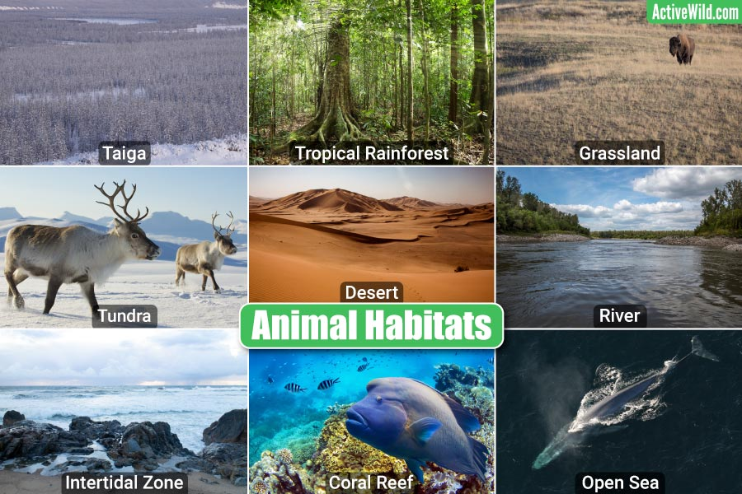
Habitats of Wild Animals
• Forests, including tropical rainforests and boreal forests, provide habitat for a vast array of wild animals, from insects to large mammals.
• Grasslands, such as savannas and prairies, are home to many iconic wild animals, including lions, zebras, and bison.
• Deserts, like the Sahara and Mojave, support a unique range of adapted wild animals, such as camels, snakes, and lizards.
• Oceans and other aquatic ecosystems, including coral reefs and estuaries, are home to a diverse range of wild animals, from tiny plankton to massive blue whales.
• Understanding the different habitats of wild animals is crucial for developing effective conservation strategies.

Slide 4
Threats to Wild Animals
• Habitat destruction and fragmentation, often caused by human activities such as deforestation and urbanization, pose a significant threat to the survival of many wild animal species.
• Climate change, which alters ecosystems and disrupts food chains, is another major threat to wild animals, with many species struggling to adapt to changing environmental conditions.
• Pollution, including plastic pollution, chemical runoff, and noise pollution, has a devastating impact on wild animals, from entanglement and ingestion to disruption of communication and behavior.
• Overhunting and poaching, driven by demand for wild animal products such as ivory, rhino horn, and fur, are major contributors to the decline of many wild animal populations.
• Addressing these threats is essential for the conservation of wild animals and the preservation of ecosystem health.

Slide 5
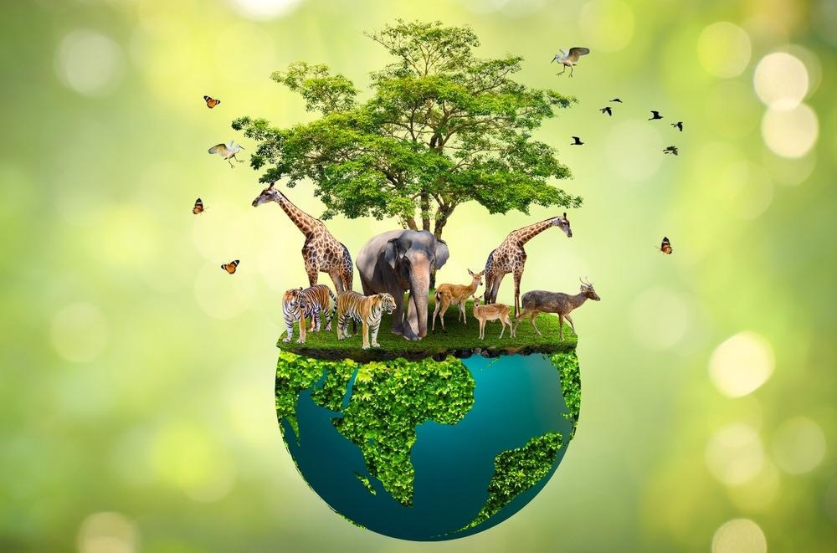
Conservation Efforts
• National parks and protected areas provide a safe haven for many wild animal species, allowing them to thrive in their natural habitats.
• Conservation organizations, such as the World Wildlife Fund and the International Union for Conservation of Nature, work tirelessly to protect wild animals and their habitats.
• Community-based conservation initiatives, which engage local people in the conservation process, have been shown to be effective in promoting the protection of wild animals and their habitats.
• Research and monitoring programs, which study wild animal populations and their habitats, are essential for developing effective conservation strategies and evaluating the impact of conservation efforts.
• By supporting conservation efforts, we can help ensure the long-term survival of wild animals and the ecosystems they inhabit.

Slide 6
Importance of Wild Animals
• Wild animals play a crucial role in maintaining ecosystem health, contributing to processes such as seed dispersal, pollination, and nutrient cycling.
• They also provide important ecosystem services, including pest control, climate regulation, and water filtration.
• Wild animals have significant cultural and spiritual value, featuring prominently in the mythology, art, and literature of many societies.
• Additionally, wild animals can provide valuable insights into the natural world, helping us to better understand the complex relationships between species and their environments.
• By appreciating the importance of wild animals, we can work to ensure their conservation and the preservation of the ecosystems they inhabit.

Slide 7
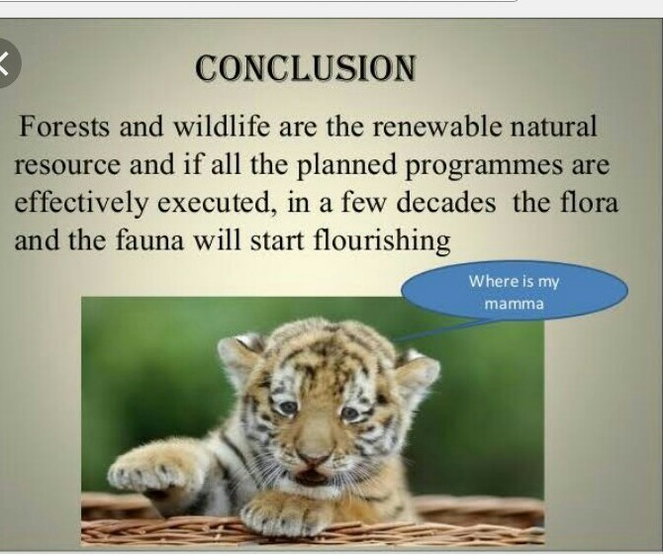
Conclusion
• In conclusion, wild animals are an integral part of our planet's ecosystem, playing a vital role in maintaining the balance of nature.
• The preservation of wild animals is essential for the health of our planet, and it is our responsibility to take action to protect them.
• By supporting conservation efforts, reducing our impact on the environment, and promoting sustainable practices, we can help ensure the long-term survival of wild animals and the ecosystems they inhabit.
• Ultimately, the conservation of wild animals requires a collective effort, and it is up to us to take action and make a positive impact on the world around us.
• By working together, we can create a future where wild animals continue to thrive and inspire future generations.

Slide 8
Thank You

