Slide 1
Introduction to Artificial Intelligence
Artificial intelligence (AI) refers to the development of computer systems that can perform tasks that typically require human intelligence, such as visual perception, speech recognition, and decision-making...

Slide 2
History and Evolution of AI
• The concept of AI dates back to the 1950s, when computer scientists like Alan Turing and Marvin Minsky began exploring the possibilities of creating intelligent machines.
• The 1980s saw a resurgence in AI research, with the development of expert systems and the introduction of machine learning algorithms, which enabled computers to learn from data and improve their performance over time.
• In recent years, the advancement of deep learning techniques and the availability of large datasets have led to significant breakthroughs in AI, including the development of chatbots, voice assistants, and image recognition systems.
• The evolution of AI has been marked by periods of rapid progress, followed by periods of stagnation, but the field continues to advance at an unprecedented rate, with new applications and innovations emerging regularly.

Slide 3
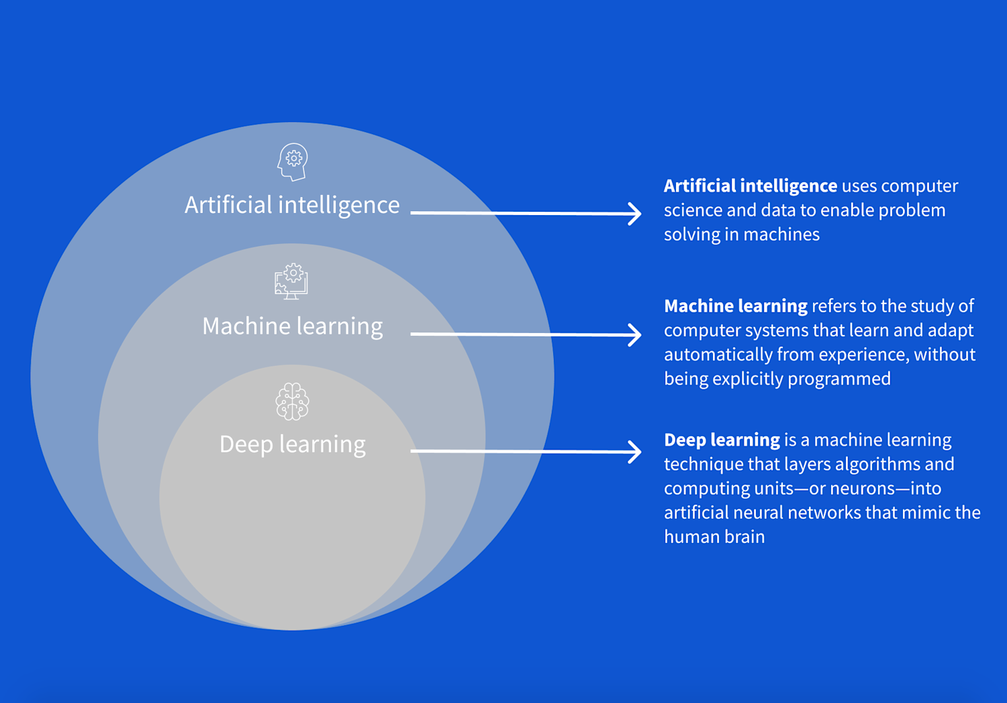
Machine Learning and Deep Learning
• Machine learning is a subset of AI that involves training algorithms to learn from data and make predictions or decisions without being explicitly programmed.
• Deep learning is a type of machine learning that uses neural networks to analyze complex patterns in data, such as images, speech, and text, and has achieved state-of-the-art results in various applications.
• The key difference between machine learning and deep learning lies in the complexity of the algorithms and the amount of data required, with deep learning typically requiring larger datasets and more computational resources.
• Machine learning and deep learning have become essential tools in many industries, including healthcare, finance, and transportation, where they are used to improve predictive accuracy, automate decision-making, and enhance customer experiences.

Slide 4
AI Applications in Business
• AI is being used in various business functions, including customer service, marketing, and operations, to improve efficiency, reduce costs, and enhance customer experiences.
• Chatbots and virtual assistants are being used to provide 24/7 customer support, while AI-powered marketing tools are helping businesses to personalize their marketing campaigns and improve their targeting accuracy.
• AI is also being used to automate repetitive tasks, such as data entry and bookkeeping, freeing up human resources for more strategic and creative work, and enabling businesses to respond more quickly to changing market conditions.
• The adoption of AI in business is expected to continue growing, as companies seek to leverage the technology to gain a competitive advantage and stay ahead in the market.

Slide 5
AI Ethics and Responsibility
• As AI becomes increasingly pervasive, there are growing concerns about the ethics and responsibility of AI development and deployment, including issues related to bias, transparency, and accountability.
• There is a need for AI systems to be designed and developed with fairness, transparency, and explainability in mind, to ensure that they do not perpetuate existing biases or discriminate against certain groups.
• The development of AI also raises questions about the future of work, as automation and AI-powered systems potentially displace human workers, and the need for businesses and governments to invest in education and retraining programs to prepare workers for an AI-driven economy.
• The responsible development and deployment of AI require a multidisciplinary approach, involving technologists, ethicists, policymakers, and other stakeholders, to ensure that the benefits of AI are realized while minimizing its risks and negative consequences.

Slide 6
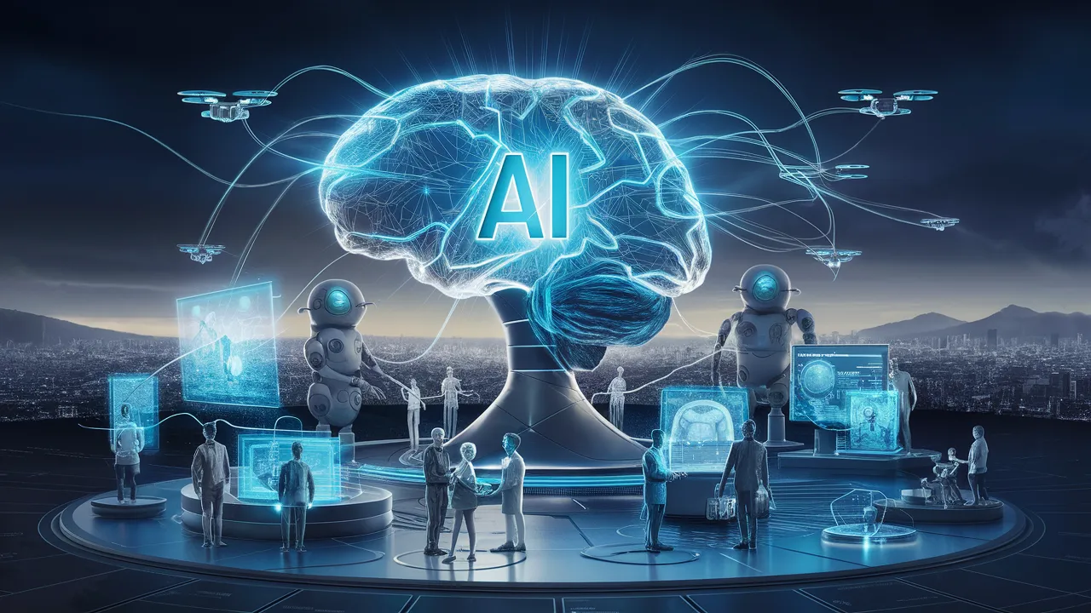
Future of Artificial Intelligence
• The future of AI holds much promise, with potential applications in areas such as healthcare, education, and environmental sustainability, where AI can help to improve outcomes, reduce costs, and enhance the quality of life.
• The development of more advanced AI systems, such as those using cognitive architectures and hybrid approaches, is expected to enable more sophisticated and human-like intelligence, with potential applications in areas such as robotics, autonomous vehicles, and smart cities.
• However, the future of AI also poses significant challenges, including the need to address issues related to job displacement, bias, and accountability, and to ensure that the benefits of AI are shared equitably among all members of society.
• The future of AI will depend on the ability of businesses, governments, and other stakeholders to work together to develop and deploy AI in a responsible and sustainable manner, and to ensure that the technology is used to benefit humanity as a whole.

Slide 7
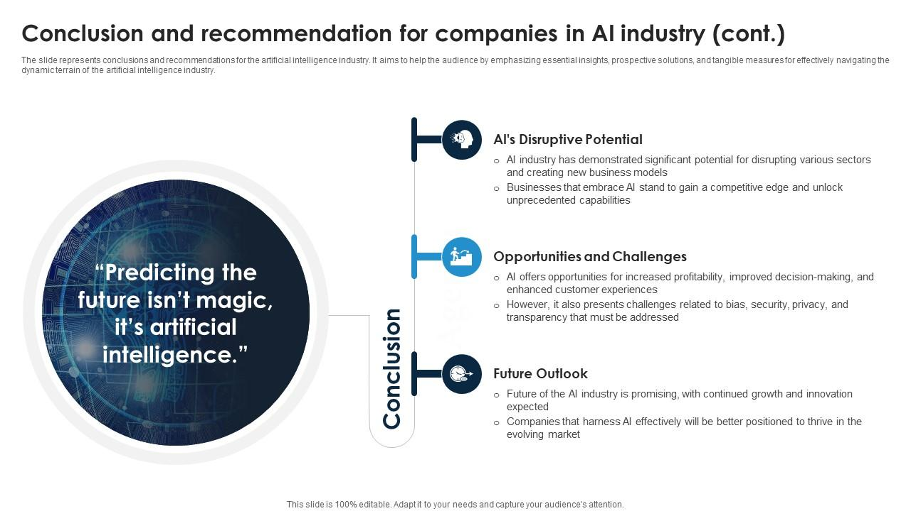
Conclusion and Recommendations
• In conclusion, AI has the potential to transform numerous industries and aspects of our lives, but its development and deployment must be done in a responsible and sustainable manner.
• To realize the benefits of AI, businesses and organizations must invest in AI research and development, and develop strategies for implementing AI in a way that complements human capabilities and enhances business outcomes.
• Recommendations for businesses and organizations include investing in AI education and training, developing AI ethics and governance frameworks, and collaborating with other stakeholders to address the challenges and risks associated with AI, and to ensure that the benefits of AI are shared equitably among all members of society.
• By working together and adopting a responsible and sustainable approach to AI development and deployment, we can unlock the full potential of AI and create a brighter future for all.

Slide 8
Thank You

