Slide 1
Introduction to Baseball
Baseball is a bat-and-ball game played between two teams of nine players, with the objective of scoring more runs than the opposing team by hitting a ball with a bat and running around the four bases on the field...

Slide 2
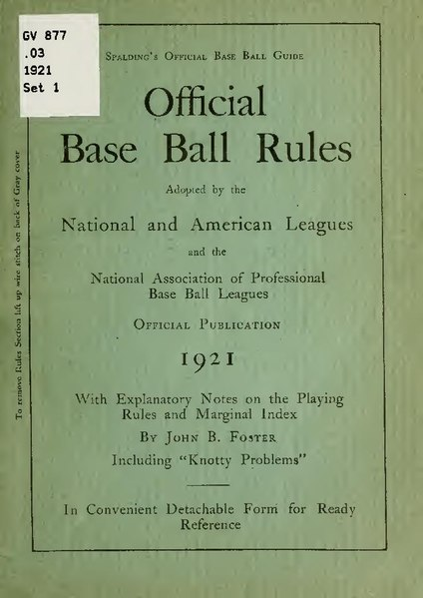
The Rules of Baseball
• A standard baseball game consists of nine innings, with each team getting a chance to bat and field, and the team with the most runs at the end of nine innings declared the winner.
• The game is overseen by an umpire, who enforces the rules and makes decisions on plays, such as whether a player is safe or out.
• The rules of baseball are complex and nuanced, with many subtleties and exceptions, requiring players, coaches, and umpires to have a deep understanding of the game.
• The rules of baseball are designed to ensure a fair and exciting game, with a balance between offense and defense.

Slide 3
The Equipment of Baseball
• The essential equipment in baseball includes a bat, ball, glove, and cleats, with each piece of equipment designed to provide a specific function and advantage to the player.
• The bat is used to hit the ball, and is typically made of wood, aluminum, or composite materials, with different types of bats suited to different types of players and playing styles.
• The ball is made of cork and rubber, wrapped in yarn and covered with leather, and is designed to be hit and thrown with precision and accuracy.
• The equipment used in baseball is carefully crafted to provide the best possible performance and safety for players.

Slide 4
The Positions in Baseball
• The nine positions in baseball include the pitcher, catcher, first baseman, second baseman, third baseman, shortstop, left fielder, center fielder, and right fielder, each with its own unique role and responsibilities.
• The pitcher is responsible for throwing the ball to the batter, with the goal of getting the batter out, while the catcher is responsible for catching the ball and throwing out runners.
• The infielders, including the first baseman, second baseman, third baseman, and shortstop, are responsible for fielding ground balls and throwing out runners, while the outfielders are responsible for catching fly balls and tracking down hits.
• The positions in baseball require a combination of physical skill, strategy, and teamwork to execute effectively.

Slide 5
The Strategy of Baseball
• Baseball is a game of strategy, with teams using a variety of tactics to outmaneuver their opponents, including the use of pitching styles, defensive alignments, and batting orders.
• The manager is responsible for making key decisions, such as when to substitute players, how to align the defense, and when to issue intentional walks.
• The game also involves a significant amount of mental preparation and focus, with players needing to stay concentrated and motivated over the course of a long season.
• The strategy of baseball is complex and multifaceted, requiring a deep understanding of the game and its many nuances.

Slide 6

The Culture of Baseball
• Baseball has a rich and vibrant culture, with a massive following and a significant impact on American society and history.
• The game has been the subject of numerous books, films, and songs, and has been immortalized in the National Baseball Hall of Fame and Museum in Cooperstown, New York.
• The culture of baseball is also marked by its many traditions and rituals, including the singing of the national anthem, the throwing out of the first pitch, and the eating of hot dogs and cracker jacks.
• The culture of baseball is a unique and fascinating aspect of the game, reflecting its history, values, and appeal.

Slide 7

Conclusion
• In conclusion, baseball is a complex and fascinating sport, with a rich history, nuanced rules, and a vibrant culture.
• The game requires a combination of physical skill, strategy, and teamwork, making it a challenging and exciting game to play and watch.
• Whether you are a seasoned fan or a newcomer to the game, baseball has something to offer, from its thrilling gameplay to its nostalgic charm and historic significance.
• Baseball is a sport that continues to captivate audiences around the world, with its unique blend of action, strategy, and tradition.

Slide 8
Thank You

