Slide 1
Introduction to MS Dhoni
MS Dhoni is a former Indian international cricketer who served as the captain of the Indian national team. He is widely regarded as one of the greatest wicket-keeper batsmen in the history of the game, known for his exceptional leadership and finishing skills...

Slide 2
Early Life and Career
• MS Dhoni was born on July 7, 1981, in Ranchi, Bihar (now Jharkhand), India, and developed a passion for cricket at a young age.
• He began his cricket career as a wicket-keeper batsman, playing for his school and local clubs, before being selected for the Bihar Under-19 team.
• Dhoni's breakthrough came in 2004, when he made his international debut for India, and quickly established himself as a key player in the team.
• His early career was marked by impressive performances, including a 148-run innings against Pakistan in 2005, which helped to cement his place in the Indian team.

Slide 3
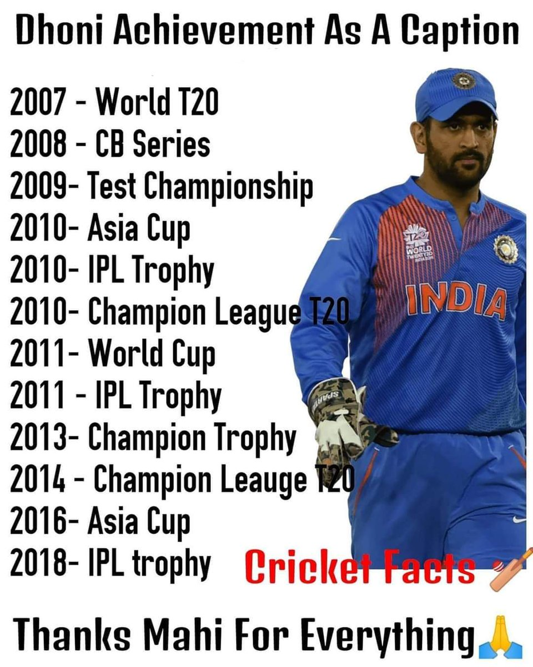
Captaincy and Achievements
• MS Dhoni took over as captain of the Indian team in 2007, and led the team to numerous victories, including the ICC World Twenty20 in 2007 and the ICC World Cup in 2011.
• Under his captaincy, India became the number one ranked team in the world, and Dhoni was praised for his innovative and aggressive leadership style.
• Dhoni's achievements as captain include winning the Champions Trophy in 2013, and leading the team to the finals of the ICC World Cup in 2015.
• He is also known for his ability to remain calm under pressure, and for making strategic decisions that have helped to turn the tide of matches in India's favor.

Slide 4
Awards and Recognition
• MS Dhoni has received numerous awards and accolades for his contributions to Indian cricket, including the Padma Bhushan, India's third-highest civilian honor.
• He has also been awarded the ICC ODI Player of the Year award, and has been named as one of the Wisden Cricketers of the Year.
• Dhoni has been recognized for his philanthropic work, particularly in the area of education, and has been involved in various charitable initiatives throughout his career.
• He has also been named as a brand ambassador for several major brands, and has been featured in various advertising campaigns.

Slide 5
Post-Cricket Career
• After retiring from international cricket in 2020, MS Dhoni has remained involved in the sport, serving as a mentor and coach for the Indian Premier League (IPL) team, the Chennai Super Kings.
• He has also been involved in various business ventures, including a chain of gyms and a production company, which has produced several films and television shows.
• Dhoni has been recognized for his entrepreneurial spirit, and has been named as one of the most successful cricketers-turned-entrepreneurs in the world.
• He continues to be involved in various charitable initiatives, and has been praised for his commitment to giving back to the community.

Slide 6
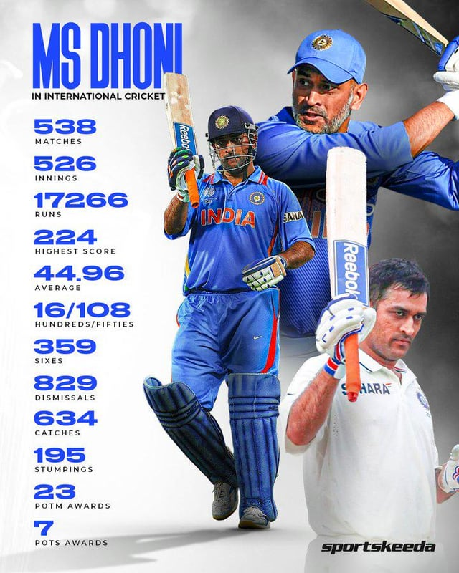
Legacy and Impact
• MS Dhoni's legacy extends far beyond his on-field accomplishments, as he has inspired a generation of young cricketers and helped to popularize the sport in India.
• He is widely regarded as one of the greatest leaders in the history of Indian cricket, and his innovative and aggressive captaincy style has been studied by teams around the world.
• Dhoni's impact on Indian cricket has been profound, and he has played a key role in shaping the team's culture and values.
• His commitment to giving back to the community has also made a significant impact, and he continues to be involved in various charitable initiatives.

Slide 7
Conclusion
• MS Dhoni is a true legend of Indian cricket, and his contributions to the sport will be remembered for generations to come.
• His on-field accomplishments, including his numerous awards and accolades, are a testament to his hard work and dedication.
• Dhoni's legacy extends far beyond his playing career, as he continues to inspire and influence the next generation of cricketers.
• His commitment to giving back to the community and his entrepreneurial spirit have made him a role model for young people around the world.

Slide 8
Thank You

