Slide 1
Introduction to Wild Animals
Wild animals are an integral part of our ecosystem, playing a crucial role in maintaining the balance of nature. These animals have adapted to survive in various environments, from the freezing tundra to the scorching deserts...

Slide 2
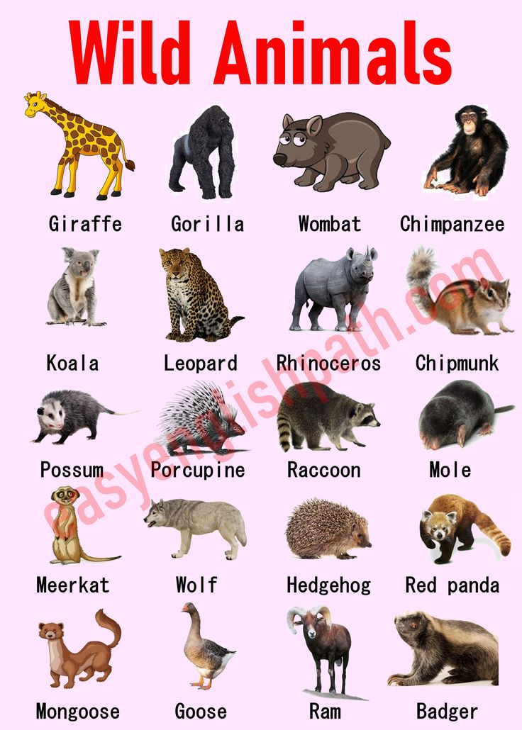
Types of Wild Animals
• Mammals, such as lions, elephants, and bears, are a diverse group of wild animals that can be found in different parts of the world.
• Birds, including eagles, parrots, and penguins, are another category of wild animals that are known for their unique characteristics and abilities.
• Reptiles, like snakes, crocodiles, and turtles, are often misunderstood but play a vital role in the ecosystem.
• The classification of wild animals is crucial for understanding their behavior, habitat, and conservation status.

Slide 3
Habitat and Distribution
• Wild animals can be found in various habitats, including forests, grasslands, deserts, and oceans.
• The geographic distribution of wild animals is influenced by factors such as climate, food availability, and predation.
• Human activities, like deforestation and pollution, have significantly impacted the habitats and distribution of wild animals.
• Understanding the habitat and distribution of wild animals is essential for developing effective conservation strategies.

Slide 4
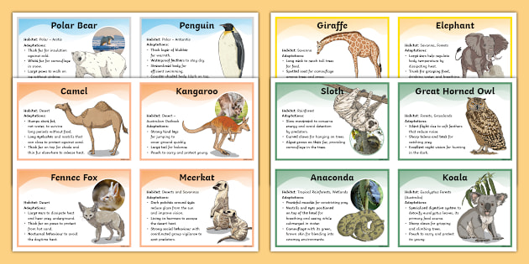
Adaptation and Survival
• Wild animals have evolved unique adaptations to survive in their environments, such as camouflage, migration, and hibernation.
• These adaptations enable them to find food, avoid predators, and regulate their body temperature.
• The ability of wild animals to adapt to changing environments is crucial for their survival and the maintenance of ecosystem balance.
• Studying the adaptations of wild animals can provide valuable insights into the natural world and inspire innovative solutions.

Slide 5
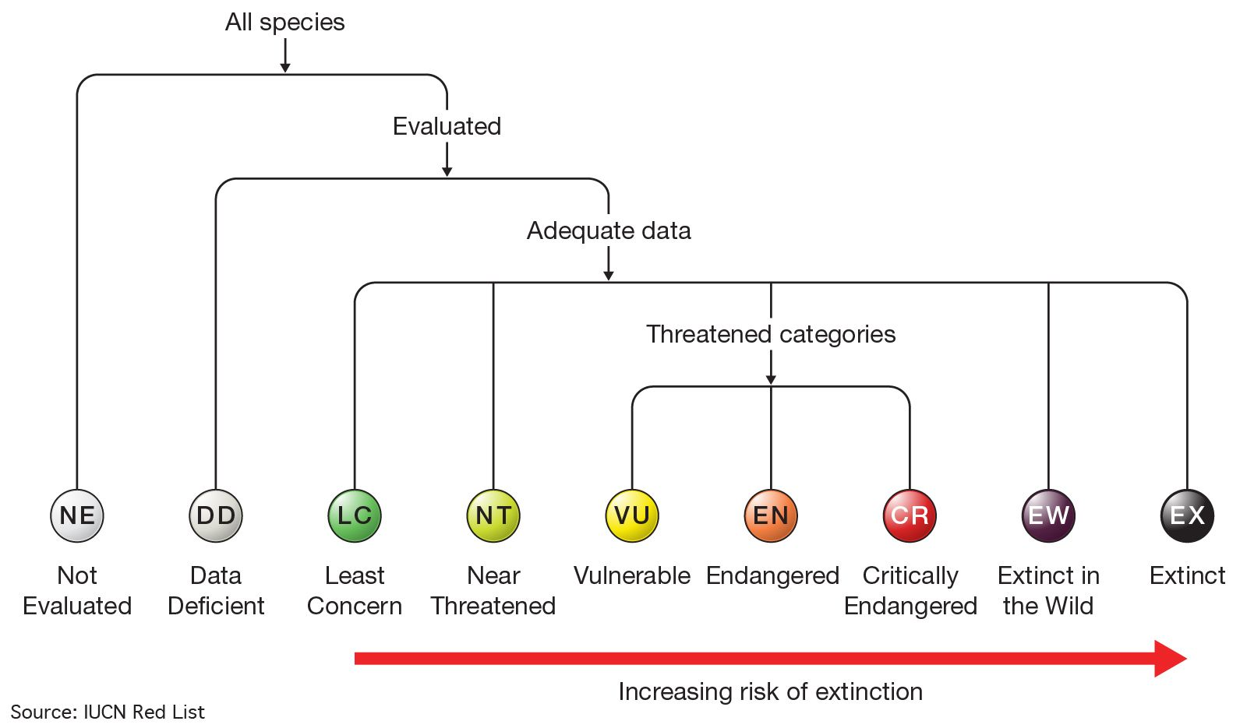
Conservation Status
• Many wild animals are facing threats to their survival, including habitat loss, poaching, and climate change.
• The conservation status of wild animals is often classified as endangered, vulnerable, or threatened, depending on the level of risk.
• Efforts to conserve wild animals, such as protected areas and anti-poaching laws, are essential for maintaining biodiversity.
• The conservation status of wild animals is a critical indicator of the health of our planet and requires immediate attention.

Slide 6
Endangered Species
• Endangered species, like the giant panda, mountain gorilla, and blue whale, are at high risk of extinction due to human activities.
• The loss of these species can have significant impacts on ecosystem function and human well-being.
• Conservation efforts, such as captive breeding programs and habitat restoration, are necessary to protect endangered species.
• The preservation of endangered species is a moral and ecological imperative that requires international cooperation.

Slide 7
Threats to Wild Animals
• Habitat destruction and fragmentation are major threats to wild animals, as they lead to population isolation and reduced resources.
• Pollution, including plastic pollution, climate change, and noise pollution, can have devastating effects on wild animals and their habitats.
• Human-wildlife conflict, such as poaching and crop damage, is a significant threat to wild animals and requires effective management strategies.
• Addressing these threats is essential for the long-term survival of wild animals and the maintenance of ecosystem services.

Slide 8
Human-Wildlife Conflict
• Human-wildlife conflict arises when the interests of humans and wild animals clash, resulting in negative impacts on both parties.
• Conflicts can occur due to competition for resources, such as food and water, or due to perceived threats, like attacks on livestock.
• Effective management of human-wildlife conflict requires a comprehensive approach that considers the needs of both humans and wild animals.
• Resolving human-wildlife conflict is crucial for promoting coexistence and reducing the risk of extinction.

Slide 9
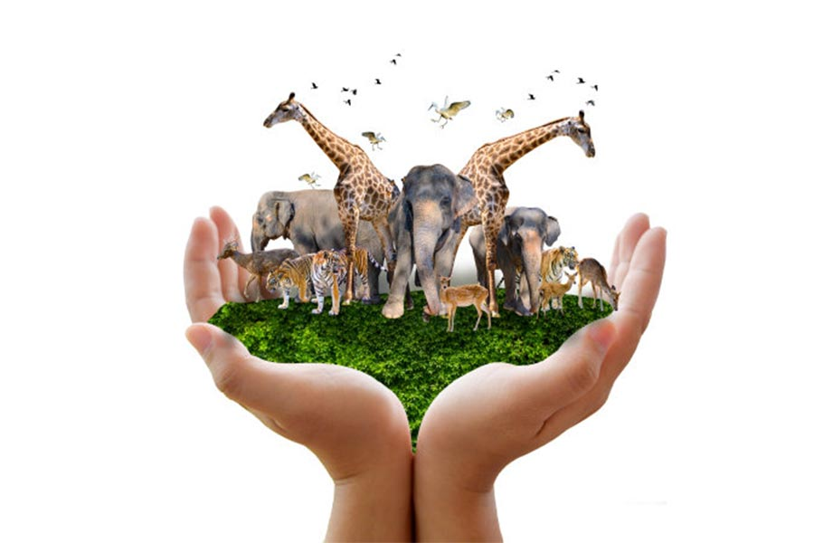
Wildlife Conservation Efforts
• Protected areas, such as national parks and wildlife reserves, provide a safe habitat for wild animals and help to maintain ecosystem balance.
• Conservation organizations, like the World Wildlife Fund, work to protect wild animals and their habitats through research, education, and advocacy.
• Community-based conservation initiatives, which involve local people in conservation efforts, can be effective in promoting the protection of wild animals.
• Collaborative conservation efforts are necessary to address the complex challenges facing wild animals and their habitats.

Slide 10
Research and Monitoring
• Scientific research and monitoring are essential for understanding the behavior, ecology, and conservation status of wild animals.
• Techniques such as camera trapping, satellite tracking, and genetic analysis provide valuable insights into the lives of wild animals.
• Long-term monitoring of wild animal populations helps to identify trends and patterns, informing effective conservation strategies.
• The application of research and monitoring results can significantly improve the management and conservation of wild animals.

Slide 11
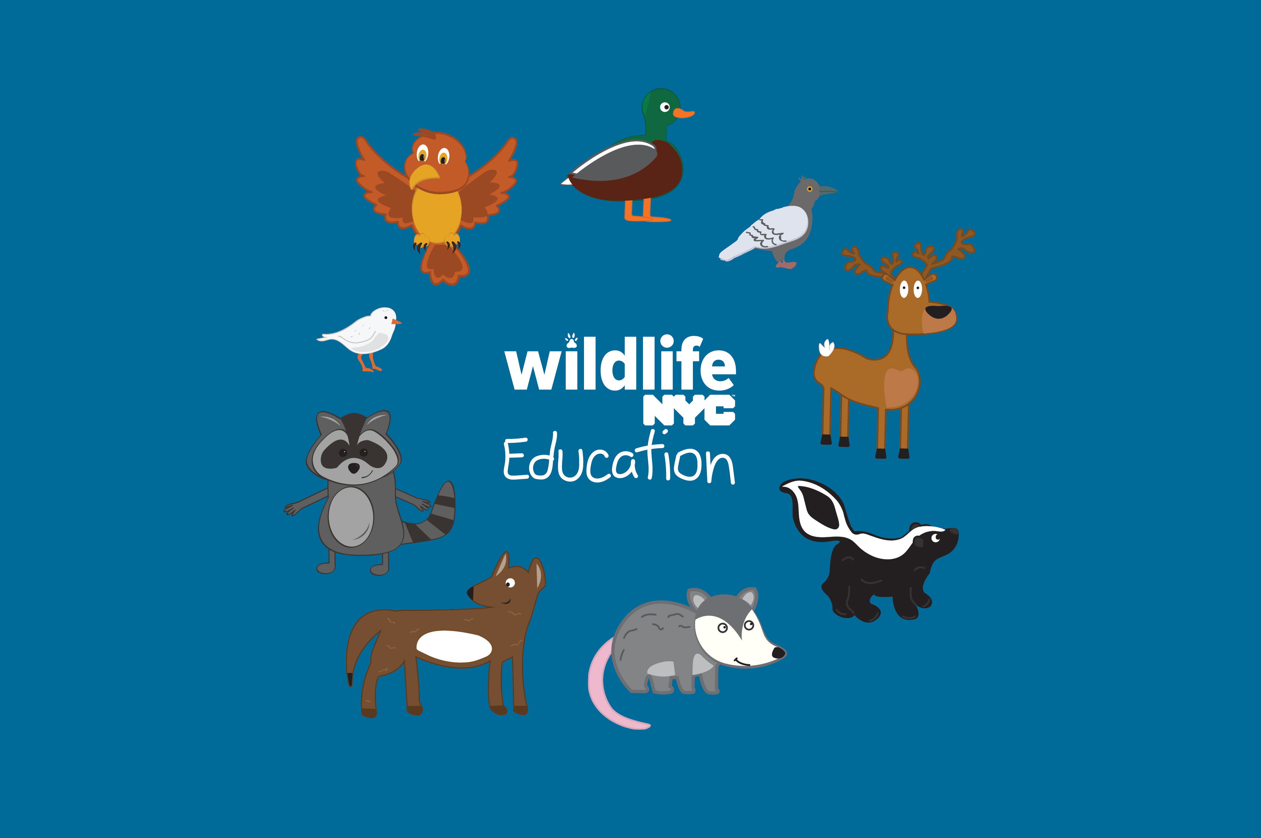
Education and Awareness
• Education and awareness are critical components of wild animal conservation, as they promote a culture of appreciation and respect.
• Educational programs, such as wildlife workshops and conservation camps, can inspire people to take action and make a positive impact.
• Raising awareness about the importance of wild animals and the threats they face can motivate individuals to support conservation efforts.
• Empowering people with knowledge and inspiring them to care about wild animals can lead to a significant increase in conservation efforts.

Slide 12
Community Engagement
• Community engagement is vital for the success of wild animal conservation efforts, as it fosters a sense of ownership and responsibility.
• Involving local communities in conservation initiatives can help to address human-wildlife conflict and promote coexistence.
• Supporting community-based conservation projects can provide economic benefits and improve livelihoods, while also protecting wild animals and their habitats.
• Community engagement is essential for building a strong foundation for long-term conservation success.

Slide 13
Policy and Legislation
• Effective policy and legislation are necessary for protecting wild animals and their habitats, as they provide a framework for conservation efforts.
• Laws and regulations, such as the Endangered Species Act, can help to prevent habitat destruction, reduce pollution, and combat wildlife trafficking.
• International cooperation and agreements, like the Convention on International Trade in Endangered Species of Wild Fauna and Flora, are crucial for addressing global conservation challenges.
• The development and implementation of conservation policies and laws require a collaborative effort from governments, organizations, and individuals.

Slide 14
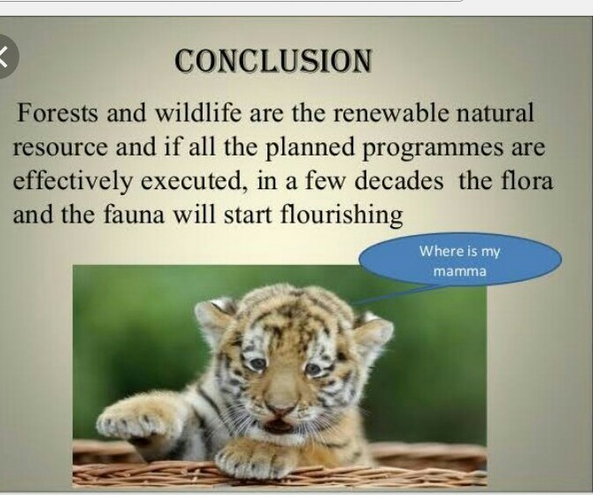
Conclusion
• Wild animals are a vital component of our planet's ecosystem, and their conservation is essential for maintaining biodiversity and ecosystem services.
• Addressing the challenges facing wild animals requires a comprehensive approach that involves research, conservation, education, and community engagement.
• By working together, we can protect wild animals, preserve their habitats, and ensure the long-term health of our planet.
• The future of wild animals depends on our ability to take action and make a positive impact on their lives and habitats.

Slide 15
Call to Action
• We must take immediate action to protect wild animals and their habitats, as the consequences of inaction will be severe and far-reaching.
• Individuals, organizations, and governments must work together to address the complex challenges facing wild animals.
• By supporting conservation efforts, reducing our environmental impact, and promoting coexistence with wild animals, we can make a significant difference.
• The time to act is now, and our collective efforts can help to ensure the survival of wild animals and the preservation of ecosystem balance.

Slide 16
Thank You

