Slide 1
Automatic Centre Stand For Motorcycles
Team: 17
Samithlal 230003013
Yogendhra Babu 230003056
Manthru Naik 230003055
Naveen 230003042
Praveen 230003063
Akshay 230003087

Slide 2
Problem Statement
Parking a motorcycle, especially heavier models, on a conventional center stand requires significant physical strength and technique. The rider must dismount and manually lift approximately 50% of the vehicle ' s weight, creating a significant barrier for a large portion of riders, including the elderly, women, and individuals with physical limitations.
As a result, most riders default to using the less stable side stand, which leads to several issues:
  Increased Parking Footprint: The motorcycle leans, consuming more space in crowded parking areas.
  Instability: The bike is less stable on uneven or soft ground, increasing the risk of it falling over.
  Uneven Load: It places prolonged, uneven stress on the tires and frame components

Slide 3
THE CHALLENGE OF MANUAL STANDS
The challenge is broken down into three main points:
Significant Physical Effort
Inconvenience & Instability
Accessibility Issues
Riders must lift over 50% of the bike's weight, a difficult task for many.
Most riders default to the side stand, which requires more space and is less stable..
A major barrier for elderly riders, women, and those with physical limitations.

Slide 4
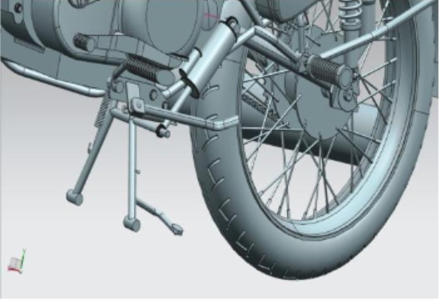
Our Solution: The Smart Stand
We have engineered a motorized mechanism that deploys and retracts the center stand with the flick of a switch with the help of a linear actuator. It does all the heavy lifting, making parking completely effortless.
Zero physical effort required
Increases safety and stability.
Designed for universal application

Slide 5
List of Items used
COMPONENTS
TT Gear Motor
nano board R3
M6 Threaded Bar & Nut
limit switches (2)
push buttons (2)
5V Relay Modules (2)
9v battery + snap clip connector

Slide 6
Working Principle
1. User Command
  The process begins when you give a single, quick press to one of the two limit Switches. One button is for "Extend" and the other is for "Retract".
2. The Arduino "Brain"
  The button press sends a simple electrical signal to the Arduino Nano. The Arduino, acting as the brain, instantly recognizes which button was pressed and knows which direction the motor needs to turn.
3. Controlling the Relays
  The Arduino then sends a low-power 5V signal to the 2-Channel 5V Relay Module.
    If you press "Extend" it activates Relay 1.
    If you press "Retract" it activates Relay 2.
  The relays act as heavy-duty, remote-controlled switches.
  They use the small 5V signal from the Arduino to switch the 9V circuit for the motor. The two relays are wired in an "H-Bridge " configuration, which allows them to reverse the motor ' s polarity.

Slide 7
4. Powering the Motor
  Once a relay is activated, it allows high-current 9V power to flow from the battery to the TT Gear Motor, causing it to spin. The 1N4007 Diodes(not attached) are connected across the motor to absorb any harmful voltage spikes, protecting the relays.
5. Creating Linear Motion
  The spinning TT Gear Motor turns the M6 Threaded Bar. As the bar spins, the M6 Nut (which is attached to the end of the 3D printed inner rod) is forced to travel along the threads. This is what converts the motor's rotation into a powerful linear push-or-pull motion. This whole assembly is housed inside the 3D printed cover pipe.
6. The Automatic Stop
  The actuator continues to move until the inner rod travels far enough to physically press one of the push buttons we installed at either end. When the "Extend" push button is pressed, it sends a signal back to the Arduino. The Arduino sees this signal and immediately tells the relay to cut power to the motor.

Slide 8


Ardino Code

Slide 9
NOVELTY
OUR AUTOMATED STAND PROVIDES A WIDE RANGE OF BENEFITS FOR THE RIDER AND THE VEHICLE.
Requires Zero Physical Effort: Makes the motorcycle accessible to a wider range of people.
Saves Parking Space: A vertically parked bike is more compact.
Easy to Handle: Perfect for heavy motorcycles (e.g., Royal Enfield), sports bikes, and scooters.
Improved Stability: Balances the motorcycle perfectly, even on slightly uneven surfaces.
Enhanced Safety: The actuator cannot be manually displaced, acting as an anti-theft feature.
Easy to Install: The system can be retrofitted onto existing motorcycles with minimal modification.

Slide 10
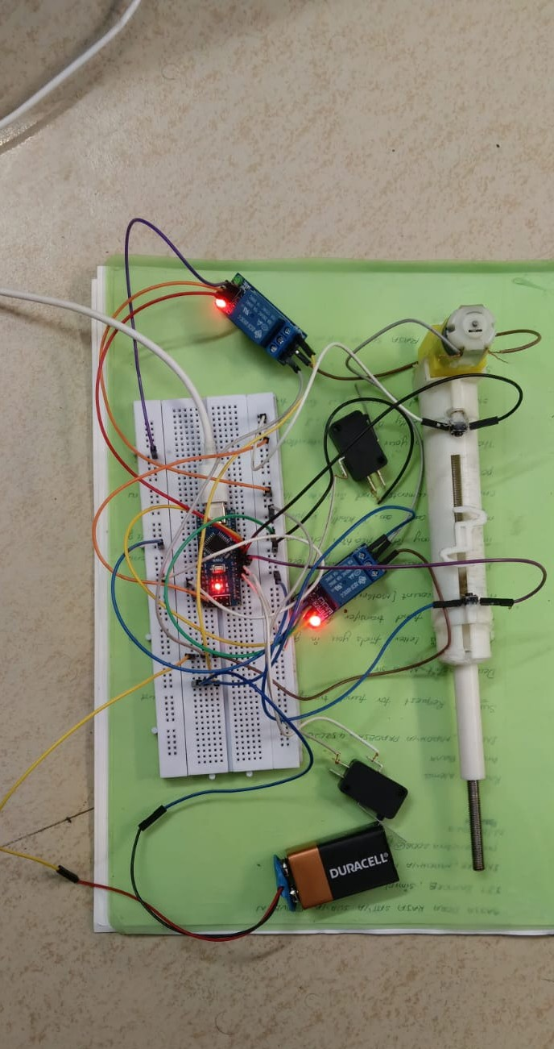
Our prototype

Slide 11
Limitations
Open-Loop Control: The system is "open-loop." It has no way of knowing its speed or its exact position at any given moment. It only knows its two endpoints when it physically strikes the limit switches (D4, D5).
No Positional Control: The actuator cannot be instructed to "move to the 50% position" or "extend 10 cm." Its only functions are "full forward" and "full reverse."
No Speed Control: The motor is either 100% ON or 100% OFF. This causes a high-inrush current, jerky motion, and significant mechanical stress (jolt) when starting, stopping, or reversing.
No Jam/Obstacle Detection: If the mechanism gets jammed by an external object, the motor will continue to try to run. This will cause the motor to stall, drawing a massive amount of current, which will likely burn out the motor or damage the power supply. It is a major reliability and safety failure point.

Slide 12
Future Scope
Variable Speed Control (Soft Start/Stop):
Action: Replace the two relays (D6, D7) with a solid-state L298N H-Bridge Motor Driver.
  Benefit: This allows the Arduino to use analogWrite() (PWM) signals to control the motor's speed. This would enable a "soft start" and "soft stop" feature, where the motor gently ramps up to speed and slows down, drastically reducing mechanical shock and wear.
Closed-Loop Positional Control (Servo-Actuator):
  Action: Add a rotary encoder to the motor's shaft or a potentiometer geared to the lead screw.
  Benefit: This gives the Arduino "eyes" to see its exact position, speed, and direction at all times. The system could then be programmed with precise commands like "extend 75mm" or "move to 30% of total length."
Overcurrent Protection (Jam Sensing):
  Action: Integrate an ACS712 Current Sensor on the motor's 12V power line.
  Benefit: The Arduino can constantly monitor the motor's current draw. If the current spikes above a pre-set limit (a sign of a jam), the program can immediately enter the stopMotor() state, protecting the hardware from damage and alerting a user to a fault.

