Slide 1
Challenges of Intercultural Project Management
General, Virtual, and onsite
Samiul Jahan, Imam Bux Mullah , Farzaneh Sabzi

Slide 2
Agenda
Challenges in general
Challenges in virtual PM
Challenges in on site PM
QA

Slide 3
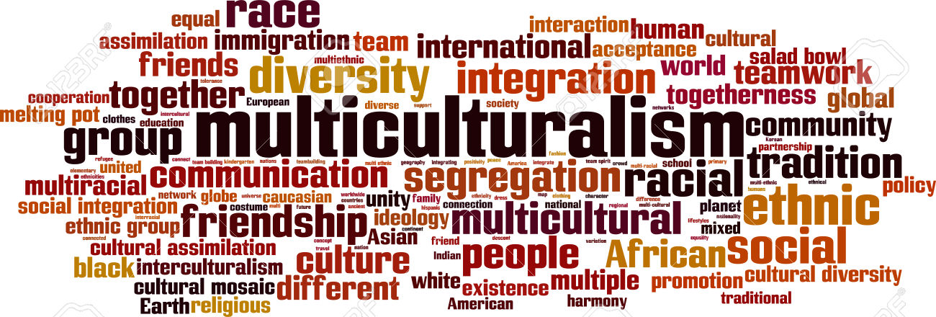
Introduction

Slide 4
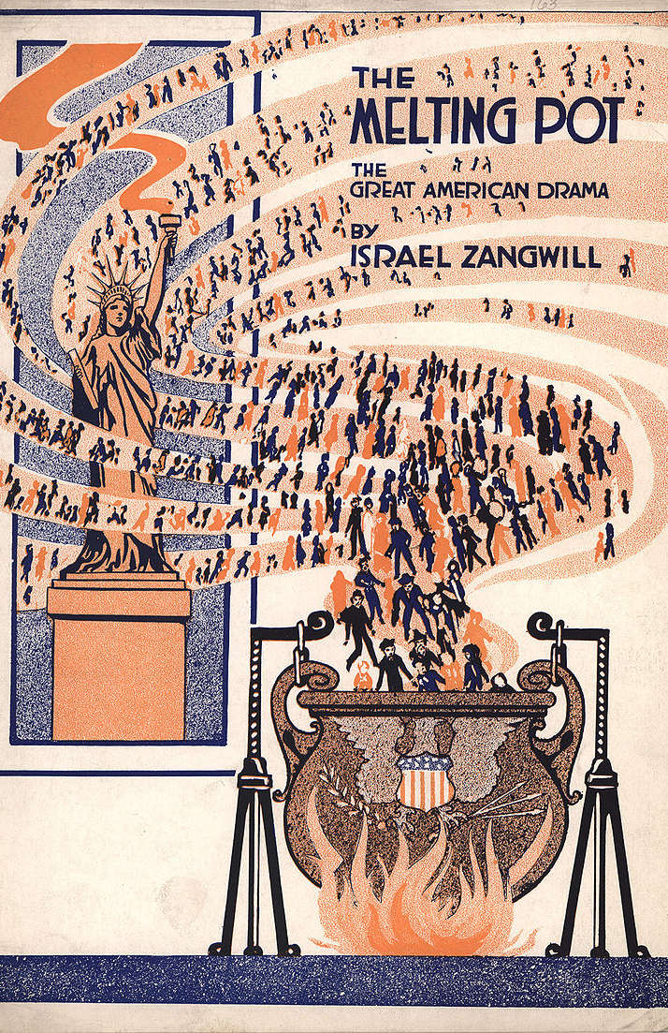
…whence came all these people? They are a mixture of English, Scotch, Irish, French, Dutch, Germans, and Swedes... What, then, is the American, this new man? He is either an European or the descendant of an European; hence that strange mixture of blood, which you will find in no other country. I could point out to you a family whose grandfather was an Englishman, whose wife was Dutch, whose son married a French woman, and whose present four sons have now four wives of different nations. He is an American, who, leaving behind him all his ancient prejudices and manners, receives new ones from the new mode of life he has embraced, the new government he obeys, and the new rank he holds. . . . The Americans were once scattered all over Europe; here they are incorporated into one of the finest systems of population which has ever appeared. — J. Hector St. John de Crevecoeur, Letters from an American Farmer

Slide 5
Culture is the integrated pattern of knowledge, belief, and behavior that depends upon the capacity for learning and transmitting knowledge to succeeding generations. Culture is the learned values and behaviors shared by a group of people and play a vital role in how a person performs his or her work based on individual patterns of thinking, feeling, and acting. Culture has visible attributes like dining, clothing, religious rituals, architectures, or sports while invisible attributes comprise of orientations to environment, time, communication, space, power, individualism, competitiveness, structure, and thinking.

Slide 6
General Challenges – key factors
According to experts in the field some factors include:
– The Cultural Identity Factor
– The Racial Identity Factor
– The Ethnic Identity Factor
– The Gender Role Identity Factor
– The Individual Identity Factor
– The Social Class Identity Factor
– The Age Identity Factor
– The Roles Identity Factor

Slide 7

General Challenges
Every country or even the states within the country have some different national culture and ways of business thinking.
Not understanding them might create issues during the projects. PMs should be encouraged to realize and respect these issues.

Slide 8
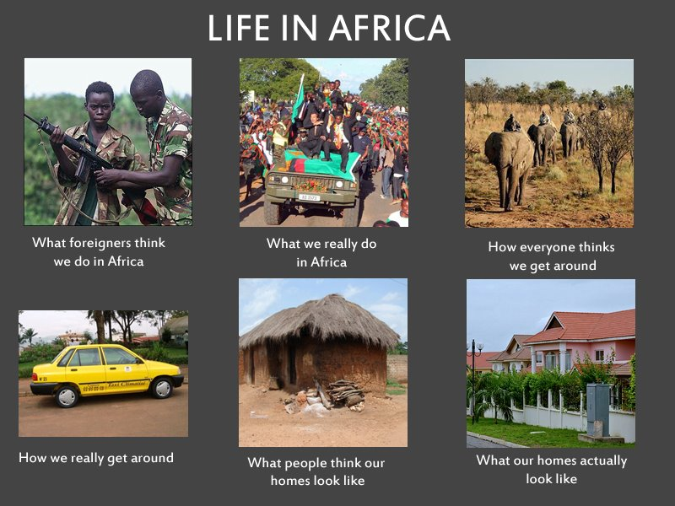
General Challenges
Not being careful with stereotypes, and peoples perspective.
Every individuals have different ideas and ways of looking at life.

Slide 9
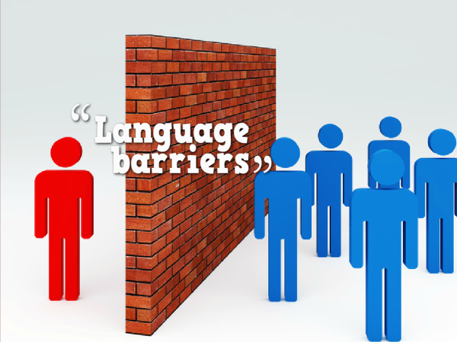
General Challenges
Language barrier. This is one of the primary reason behind miscommunication and misunderstanding in teams.
Some languages might sound rude, some might sound polite while speaking. By looking at others' voice and tone people might get offended while the person speaking is not actually meaning any offense.

Slide 10
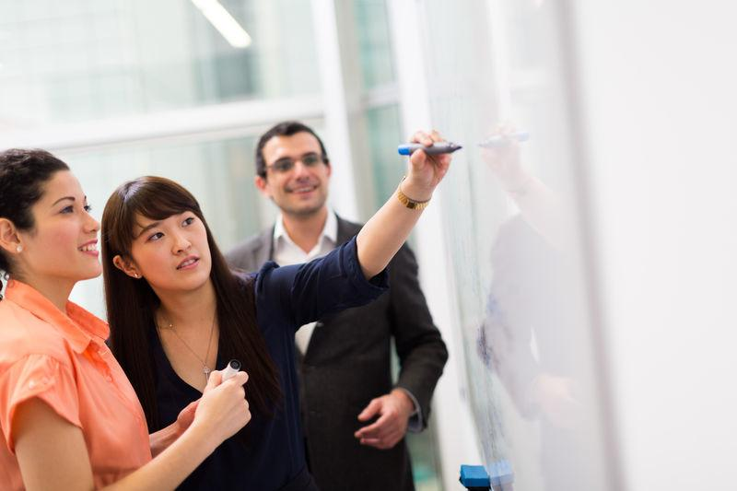
General Challenges
Understand and respect cultural differences
– Know your clients/team and be prepared; not knowing can affect relationship
– Judging people’s origin by looks Physical appearance or by their last names, for
example Pakistanis are not Indian, Taiwanese are not Chinese, Korean are not Japanese
– Accent can usually tell where people are from
– Respect culture by trying their food; can be a good conversation topic

Slide 11

General Challenges
Understand and respect cultural differences
– Religion/Culture vs. professionalism (get help from HR) Prayer before sunset
– People fasting (Ramadan). Not working on Sundays. Caste issue in India;
– taught to respect elders. Eye contact may be interpreted as rude.
– Siesta - a nap in the early afternoon (especially in hot countries)
– Different ways of greeting people. Namaste, Bowing, Hand shake, kissing on cheek, Rub noses, etc.

Slide 12
Virtual Challenges
What makes Team “Virtual”?
Group of geographically, organizationally dispersed knowledge workers who coordinate their work With electronic communication.
What makes Virtual Team “Intercultural”?
Cultural Diversity within team members.
Individuals from different communities having specific beliefs, ideas, myths when form a group in geographically dispersed team.
What is Virtual Project Management?
Virtual teams collaborate for a finite period of time toward a specific goal.

Slide 13
Virtual Challenges
Challenges in Virtual Project Management
1- Virtual Environments
Language Barriers
Physical Interaction
Scheduling everybody is difficult
Hard to keep up with the progress
Different Time Zone
2- Virtual Teams (Analysis based on Bruce Tuckman’s Model)
Forming: Project Team Members vary from Project to Project
Storming: Team dynamics are difficult to going, Positive Peer pressure is infectious
Norming: Communication is difficult although having daily Skype sessions.
Performing: Not open environment, barriers, limitations.

Slide 14
Virtual Challenges
Challenges in Virtual Project Management
3- Intercultural Virtual Project
With similar culture it’s easy to see its motivation.
Cultural Barriers
Difficult to build relationship in the beginning.
4- Self-Demotivaters in Virtual Intercultural Project Environment
Projects deadline and diversity of culture in that too in virtual environment.
Understanding other cultures takes time
Salary

Slide 15
Virtual Challenges
How to overcome the challenges?
Consider the following 25 rules
BE YOURSELF
1- Goal oriented
2- Open to the intercultural differences

Slide 16

Onsite

Slide 17
Drawbacks

