Slide 1
Team TECH ENABLERS
ENABLING PRODUCTIVITY FROM
DAY 1

Slide 2


What issues employees face during onboarding
What Tools do
I need to start development?
What Accesses do I need to get start delivering?

Slide 3
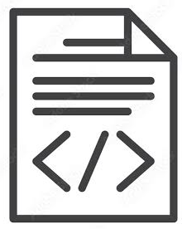

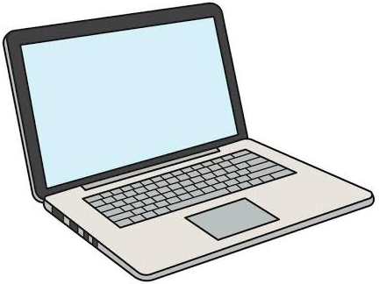




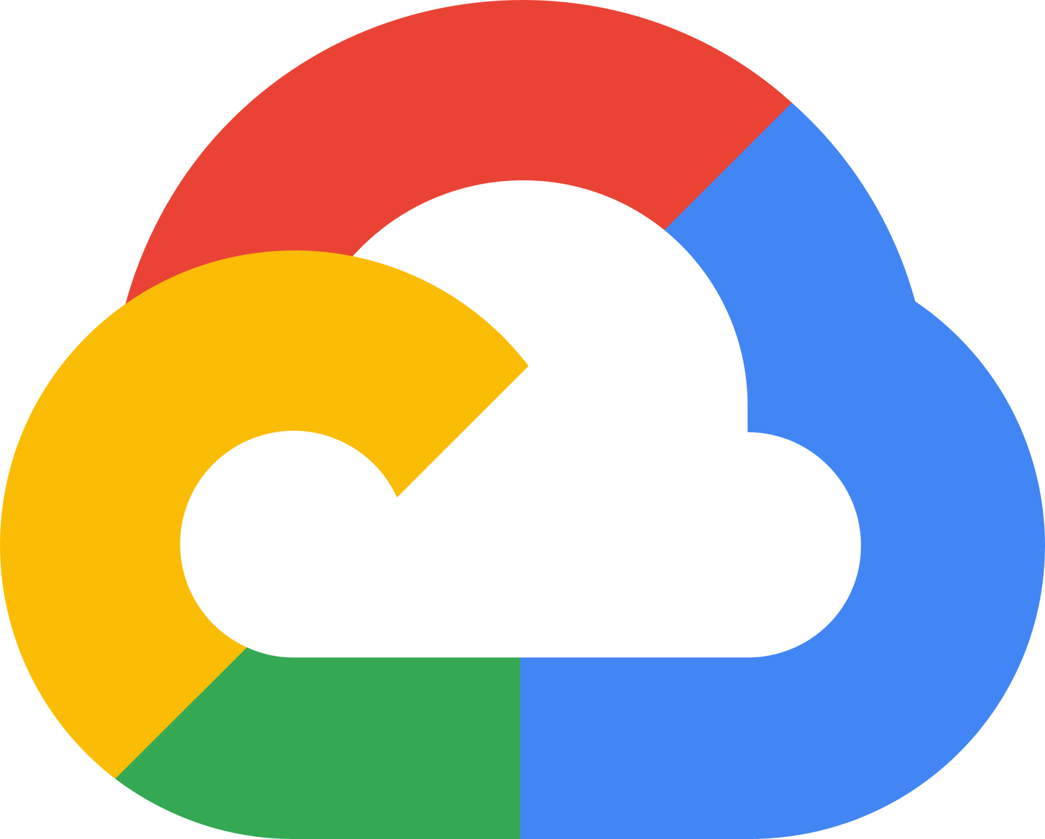

What is our solution (Prototype)
Java, Python, etc Ms VsCode IDE
LBG
Machine
Google SDKs, Git, Docker, etc IntelliJ IDE
GCP Win365

Slide 4
What are we achieving
Without our Solution
2 Week
30 Employees
10 Business Days
2400 Business hours
8 Days
2390 Hrs
SAVED
SAVED
With our Solution
2 Week
30 Employees
2 Business Days
10 Business hours

Slide 5





Prototype architecture
Laptop Issued
One Page
App Installation
Mobile
Number
One Click
(Raise Access Tickets)
Windows Cloud Machine Configured
Device Serial
Number
Raise Jira tickets for project
Application Installation
Employee productivity begins

Slide 6
Our future vision
Tools: Git, Java, IntelliJ, Notepad++,etc
PLATFORM
(DCI&D)
Java Developers
Tickets: Win365, GCP Dev access, etc
Tools: Git, Python, Pycharm, MySQL, etc
PERSONAS
PLATFORM
(DATA & ML)
Data Engineers
Tickets: Win365, GCP DE Personas, etc
Tools: Git, Docker, Terraform, Vs Code, etc
PLATFORM
(CHANNEL ENABLING)
DevOps Engineers
Tickets: Win365. GCP PE Personas, etc

Slide 7
Tech used
Tools download:
Front-End: React JS
Back-End: Java, Springboot and PowerShell
Automation of Jira:
Selenium and Java
Remote Machine Simulation:
GCP Compute Engine: Windows Server 2022, E2 standard, Balanced SSD
GCP VPC Networks: Ingress Port 3389
GCP IAM: Compute Engine API and service account

Slide 8
THANK YOU
Github Link: https://github.com/samiya-tamboli/Tech-Enablers-LTC
https://github.com/samiya-tamboli/Tech-Enablers-LTC/tree/JIRA_Automation

