Slide 1
Cutting Edge? Not so much. How STEM academia has condoned and perpetuated outdated treatment of women
Mio Akasako
MS1
04.23.19

Slide 2
Why is STEM academia a particularly harsh environment for women?
Intro graph placeholder
*

Slide 3
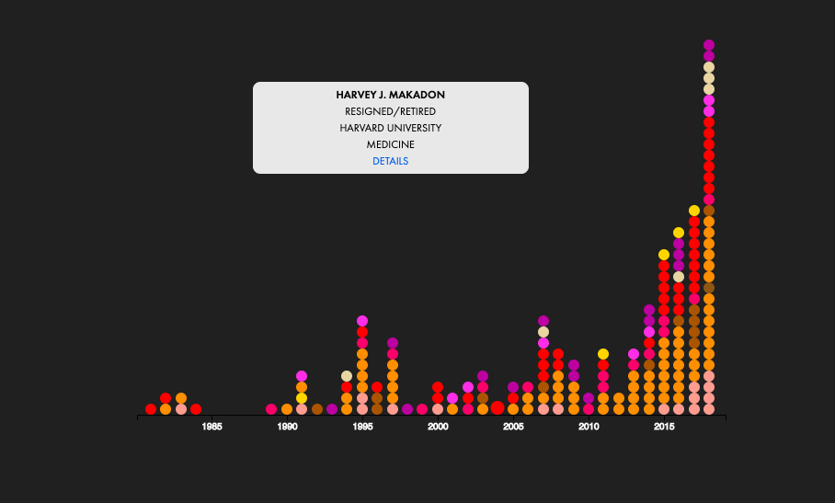
Sexual misconduct is often overlooked in academic institutions. Even when institutions do take proper action, many perpetrators still enjoy membership to powerful national organizations that can influence the careers of rising scientists.
The Academic Sexual Misconduct and Violation of Relationship Policies Database, Geocognition Research Lab

Slide 4
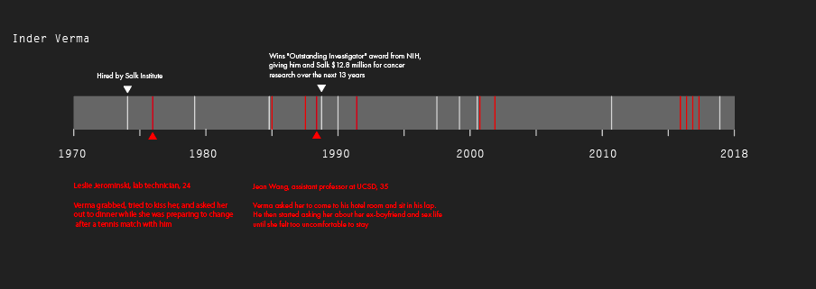

It takes many years and multiple allegations for any action to be taken against the perpetrators.
A Hidden History, Science. Findings of the Office of Equal Opportunity and Diversity.

Slide 5
Graph1 Placeholder: Comparison of Science vs Humanities/Social Science
NYU & Columbia University
In addition, there exists a retention problem in the STEM academic ladder. Though more than half of the undergraduates majoring in the sciences are women, the numbers drop down sharply at the faculty level. The pipeline is leaky, and it is due to the undesirable and often sexist environment created and sustained within STEM academia.
Graph2 Placeholder: Comparison of % women in academic ladder--
Undergrad, grad, tenure-eligible, tenured at Columbia
Columbia University Equity Report, 2018. NYU Faculty Equity Report, 2018. Advancement of Women Through the Academic Ranks
of the Columbia University Graduate School of Arts and Sciences: Where are the Leaks in the Pipeline? 2015

Slide 6
*Placeholder, timeline similar to misconduct case studies
Even now, prominent women-in-science advocate, BethAnn Franklin, neuroscience professor at Vanderbilt University, is being denied tenure for unjustified reasons.

Slide 7
What are female scientists advocating for?

