Slide 1

Book Library App
Created By Sam Joseph
Date: 02-20-26

Slide 2
Goal
Allow users to browse books.
Enable borrowing and returning
Reduce manual library work
Provide a clean, simple interface

Slide 3
Business Value
Saves time for librarians
Reduces errors in book tracking
Improves user experience
Make Library operations efficient
Provides real-time book status

Slide 4

Problems the App Solves
Manual tracking is slow
Hard to know which books are free
Borrow/return records get lost
No centralized system

Slide 5
UI Screens
Login (Unprotected)
Register (Unprotected)
Dashboard (Protected)
Book List (Protected)
Book Details (Protected)
Add/ delete or edit Book (Protected)
Borrow/Return (Protected)
About the App (Unprotected)

Slide 6
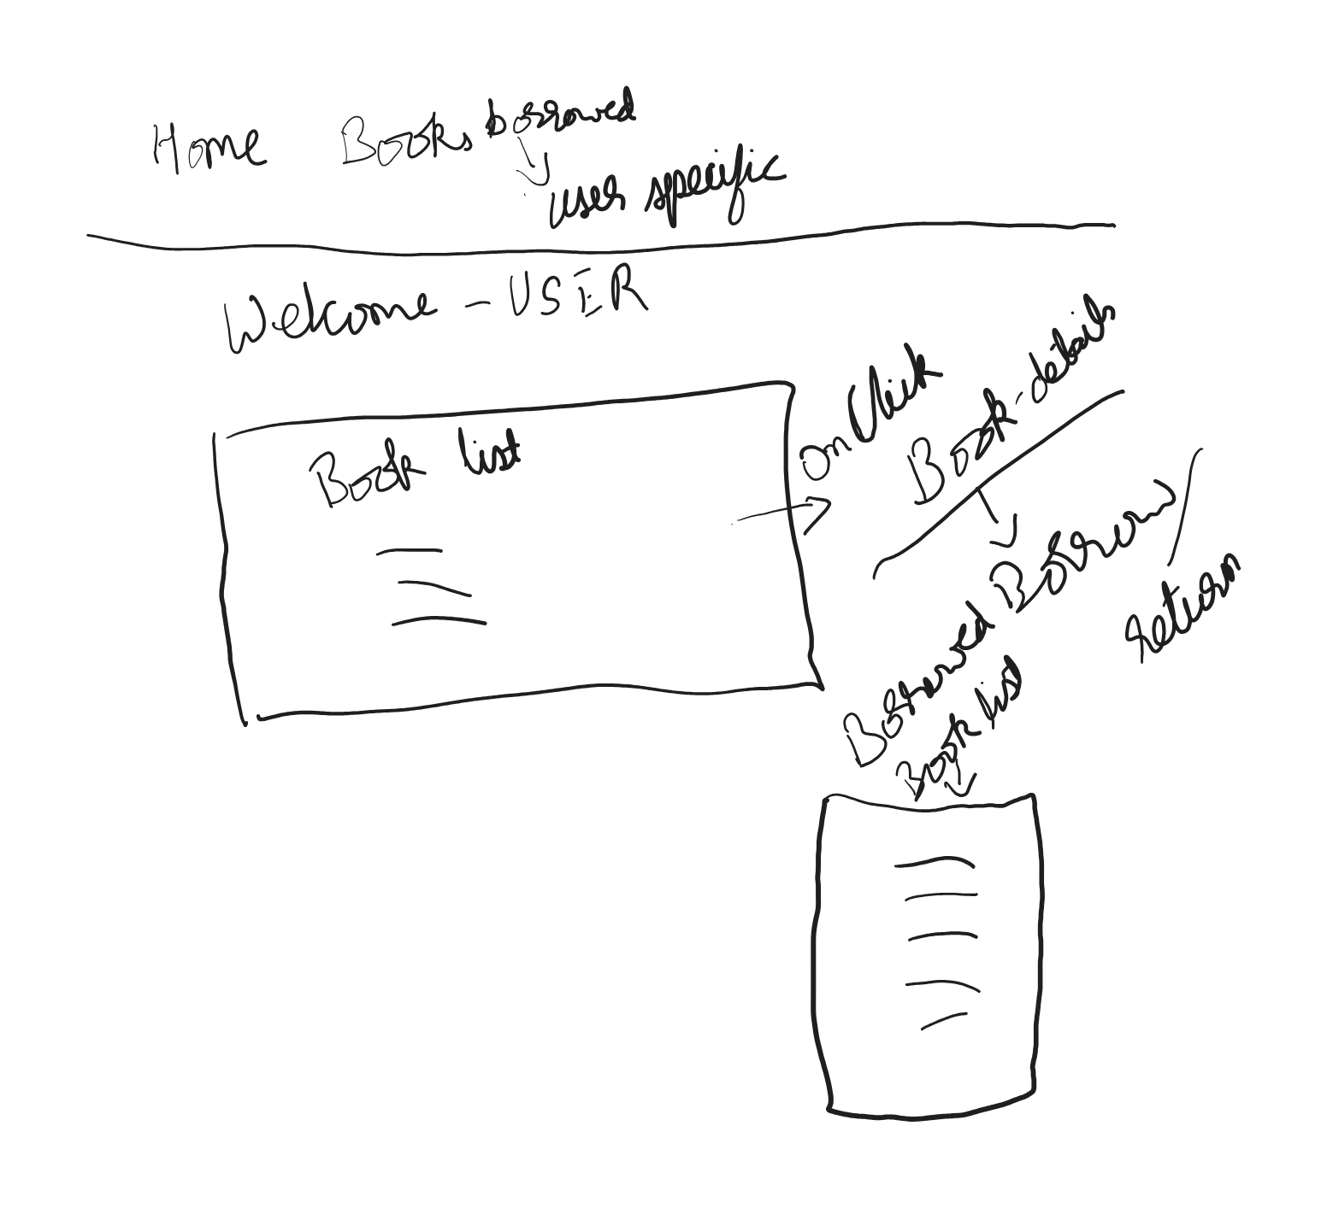
User Dashboard

Slide 7
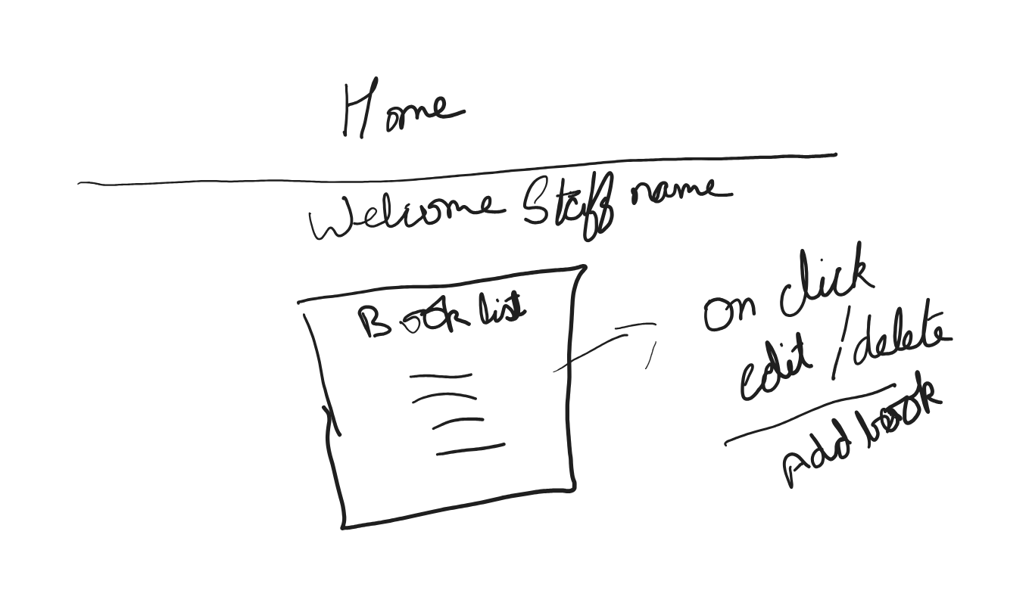
Staff Dashboard

Slide 8
Login Screen Email: [_______] Password: [_______] [Login Button]
Don’t have an account? Register

Slide 9
App Flow by Role
Users -
[Login] → [Dashboard] → [Book List] → [Book Details] → [Borrow]
Staff-
[login → [Dashboard] → [Book List] → [Add/Delete Books]/ [Edit Book details]

Slide 10
Database Design
Database Schema
Users
Id
Name
Email
passwordHash
Books
Id
Title
Author
genre
status
BorrowRecords
id
userId
bookId
borrowedAt
returnedAt

