Slide 1

MindFit
Ariel Jacobs, Megan Chan, Sam Jett
Goal: Develop a technology to identify when mental health patients are in distress and inform their support network
Technologies used
Purpose: | Obtaining Data | Frontend Dev. | Messaging | Anomaly Analysis
Tool used | Fitbit API | React/JS | Twilio | JS

Slide 2
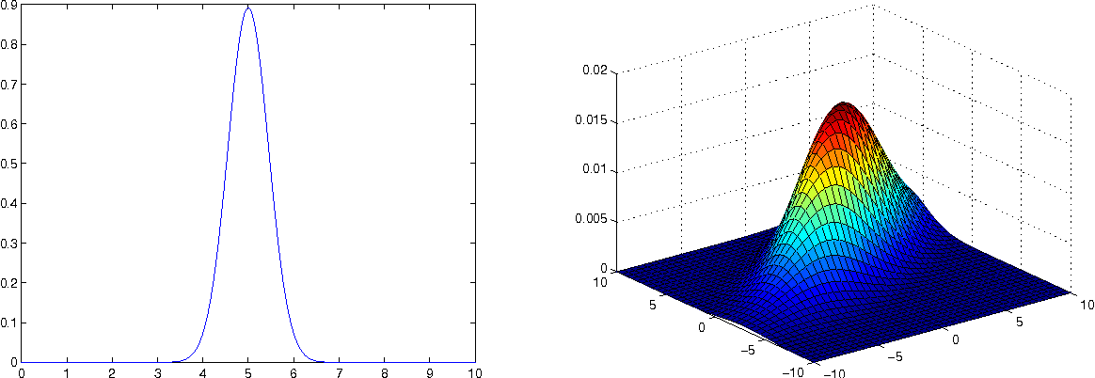
Anomaly Detection
Algorithm
Smooth input data via convolution with 1D, 4-element uniform kernel
Assume multivariate distribution to compute μ, Σ for healthy pop.
Compute p(x; μ, Σ)
If p(x) < ε = 1%, then datapoint is anomaly, else normal.
If anomaly, trigger prompt for permission to inform support network.
Assuming Multivariable Gaussian Distribution
Anomalies are found via time-series analysis compared most recent data point (after smoothing) to a personalized training data set

