Slide 1
Exploring Coffee Quality Data
Title: Coffee Quality Analysis Project
Subtitle: Comprehensive Data Exploration and Insights
Presented by: Sam Joel D
Date: 10-06-2024

Slide 2


Introduction
The purpose of this report is to present the findings from the exploratory data analysis (EDA) conducted on the Coffee Quality Dataset. The dataset contains information about various aspects of coffee production and quality evaluation, including quality measures, bean metadata, and farm metadata.

Slide 3
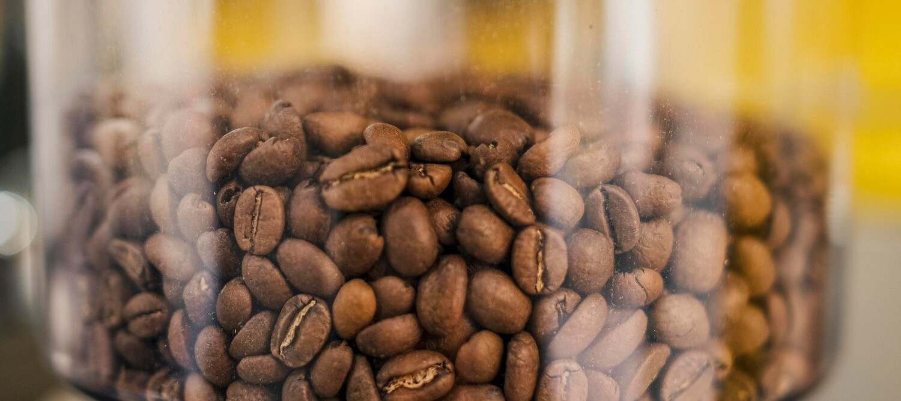

Aim
Objective: To identify key factors affecting coffee quality and understand the relationships between different variables in the dataset.
Goal: Provide actionable recommendations to enhance coffee quality and production practices.

Slide 4

Business Problem / Problem Statement
Problem Statement: The project aims to address the need for identifying critical factors influencing coffee quality and improving production methods based on data-driven insights.
Key Questions:
What are the key factors affecting coffee quality?
How do different variables interact and influence the overall quality?

Slide 5

Data Collection and Understanding Data Cleaning and Preprocessing Exploratory Data Analysis (EDA) Visualization and Interpretation Reporting and Recommendations
Project Workflow

Slide 6
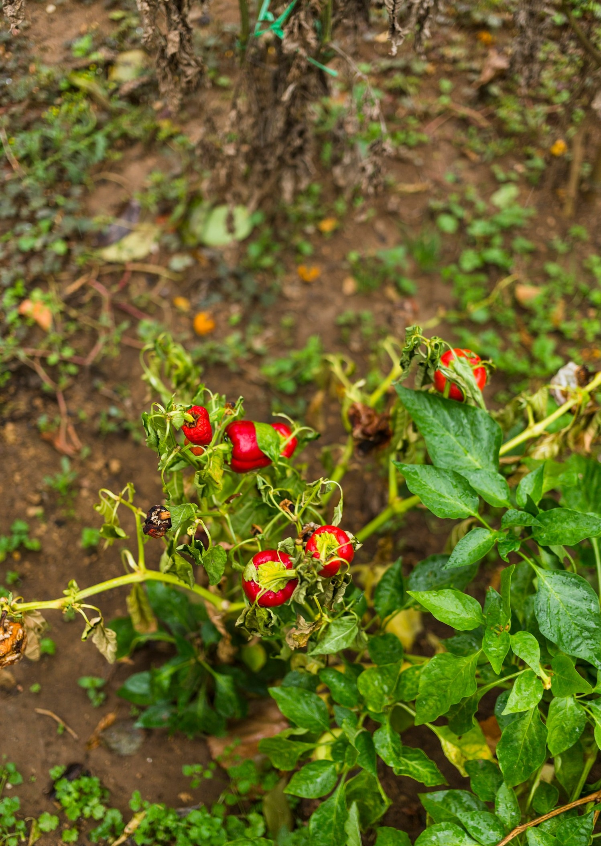
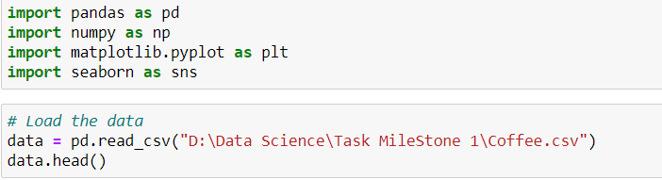

Data Collection and Understanding
Dataset Structure: The dataset consists of various columns including quality measures (aroma, flavor, aftertaste, etc.), bean metadata, and farm metadata.
Initial Exploration: Summary statistics and data distribution were analyzed to gain initial insights.
pandas as pd:
Purpose: pandas is a powerful library for data manipulation and analysis.
Purpose: numpy is a library for numerical computing.
Purpose: matplotlib is a plotting library for creating static, animated, and interactive visualizations in Python.
Purpose: seaborn is a statistical data visualization library based on matplotlib.

Slide 7
Handling Missing Values: Imputation and removal techniques were applied based on the nature of the missing data. Outliers: Identified and addressed outliers to ensure data integrity. Inconsistent Values : Rectified typos and irregular formatting for consistency.
Data Cleaning

Slide 8

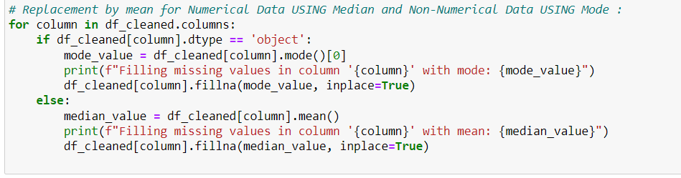
Handling Missing Values

Slide 9
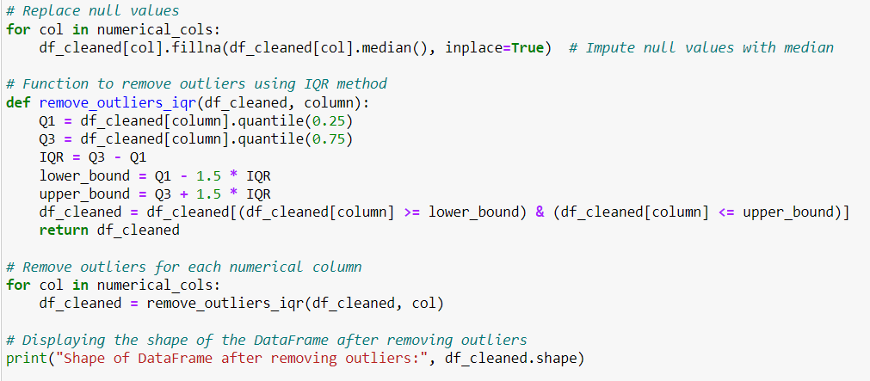
Outliers
Purpose: This loop iterates through each column in numerical_cols (a list of numerical columns in the DataFrame df_cleaned).
Action: For each column, it replaces any null (missing) values with the median value of that column.
Reason: Imputing with the median is a common strategy because the median is less sensitive to outliers compared to the mean, providing a robust central tendency measure.

Slide 10
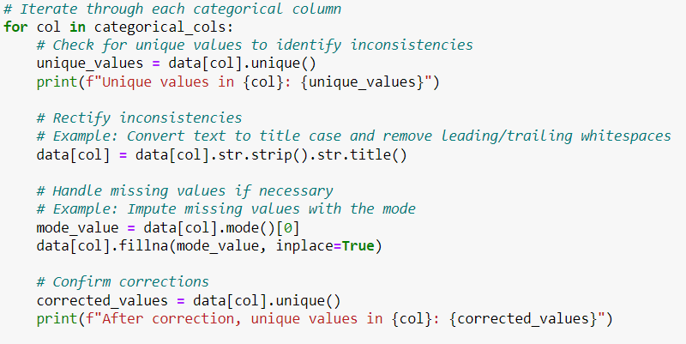
Inconsistent Values
Examples of Inconsistent Values:
Different Units of Measurement:
Height recorded as both centimeters and inches within the same column.
Dates recorded in different formats (e.g., DD/MM/YYYY and MM/DD/YYYY).
Variations in Naming Conventions:
Category names with different spellings or cases, such as "Male", "male", and "M".
City names with different abbreviations or spelling variations, like "NYC", "New York", "N.Y."
Unexpected or Out-of-Range Values:
Age values that are negative or unreasonably high, like -5 or 200.
Scores or ratings that exceed the possible range, such as a score of 110 in a scale of 0-100.
Mixed Data Types:
A column intended for numeric data containing text strings, such as 23, 45, and forty.
Misclassified Categories:
Gender recorded as "Unknown", "Other", "U", when the expected categories are only "Male" and "Female".
Sample Output
Unique values in Color: ['Green' nan 'Bluish-Green' 'Blue-Green']
After correction, unique values in Color: ['Green' 'Bluish-Green' 'Blue-Green']
Unique values in unit_of_measurement: ['m' 'ft']
After correction, unique values in unit_of_measurement: ['M' 'Ft']

Slide 11
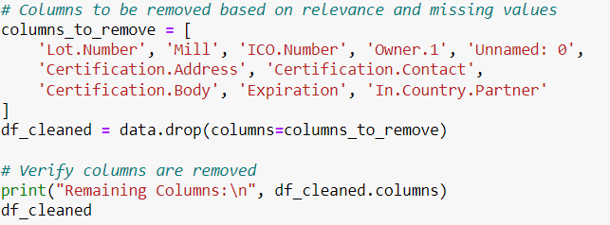


Filtering Data for Analysis
Filtering Criteria: Applied filters to focus on relevant data for the analysis.
Rationale: Ensured that the data used for analysis is clean, consistent, and relevant to the research questions.

Slide 12


Data Visualization
Utilizing interactive charts, heat maps, and scatter plots to visually represent complex coffee quality data. Visualization aids in identifying patterns and trends for better decision-making.

Slide 13
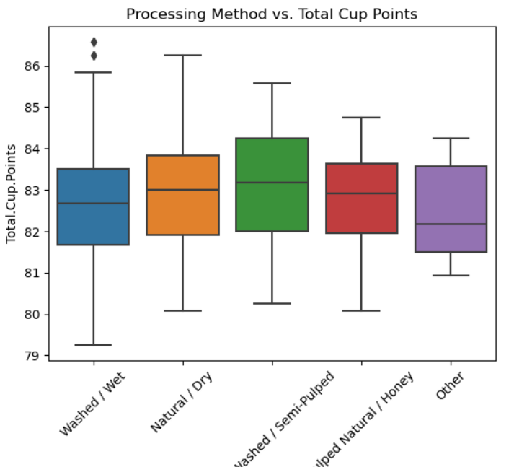

Slide 14
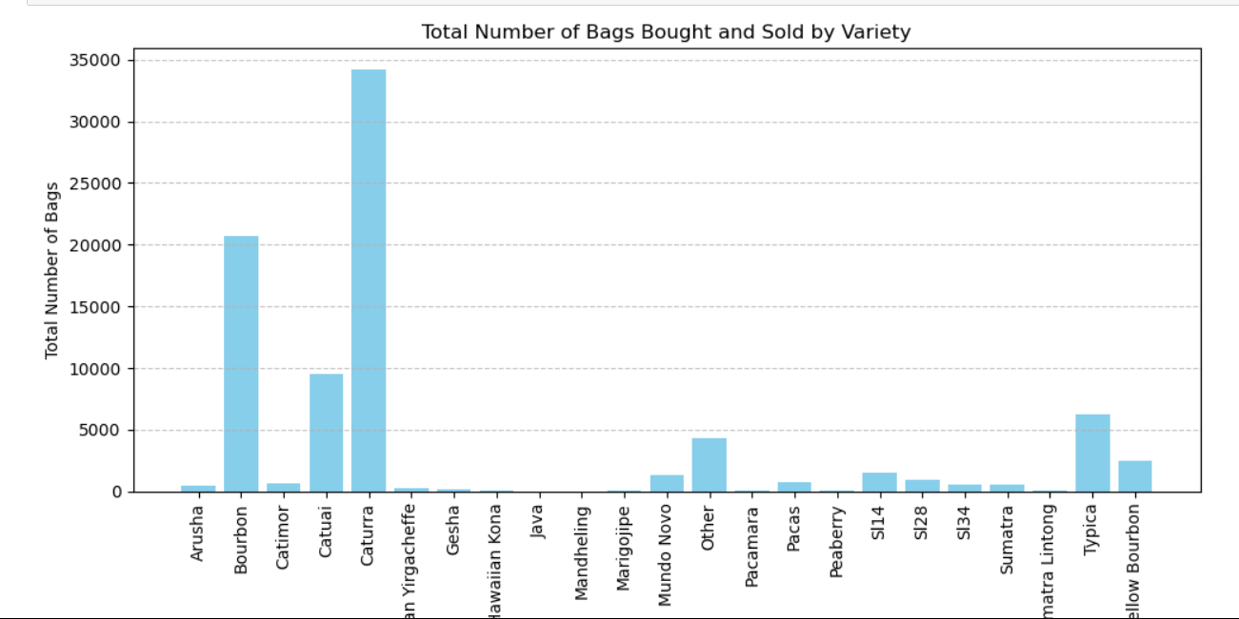

Slide 15
The image you provided is a 3D scatter plot. Here's a breakdown of the components and what the plot represents:
Axes:
X-axis (Aftertaste): This axis represents the aftertaste score of the data points.
Y-axis (Body): This axis represents the body score of the data points.
Z-axis (Acidity): This axis represents the acidity score of the data points.
Color Mapping:
Color Bar (Total Cup Points): The color of each point represents the total cup points. The color scale ranges from purple (lower scores) to yellow (higher scores).
Data Points:
Each point on the plot represents a sample with specific aftertaste, body, and acidity scores.
The color of the points provides additional information about the total cup points for each sample.
Title:
"3D Scatter Plot": Indicates that the plot is a three-dimensional scatter plot.
Interpretation:
The plot allows you to see how the aftertaste, body, and acidity scores are related to each other and how they influence the total cup points.
Generally, lighter colors (yellow) represent higher total cup points, while darker colors (purple) represent lower total cup points.
This visualization helps in identifying patterns or clusters among the samples, showing how combinations of aftertaste, body, and acidity correlate with the overall quality (total cup points).

Slide 16

Overall Insights
Key Factors: Identified key factors affecting coffee quality, such as aftertaste, body, and acidity.
Trends and Patterns: Noted trends in coffee quality based on various attributes and interactions.
Recommendations: Provided suggestions for improving coffee quality and production practices.

Slide 17

Final Report: Exploratory Data Analysis of Coffee Quality Dataset Introduction: The purpose of this report is to present the findings from the exploratory data analysis (EDA) conducted on the Coffee Quality Dataset. The dataset contains information about various aspects of coffee production and quality evaluation, including quality measures, bean metadata, and farm metadata. Key Findings: Identification of Key Factors Affecting Coffee Quality: Through univariate analysis, we identified aroma, flavor, aftertaste, acidity, and body as the key factors affecting coffee quality. Bivariate analysis revealed strong correlations between aroma and flavor, as well as between processing method and flavor.

Slide 18
Understanding the Relationship Between Different Variables: The correlation matrix highlighted significant relationships between variables such as acidity and flavor, altitude and cupping score, and processing method and aftertaste. Segmented univariate analysis showed variations in quality measures across different coffee varieties and processing methods. Recommendations for Improving Coffee Quality and Production Practices: Optimizing processing methods to enhance flavor profiles and aftertaste. Selecting suitable coffee varieties based on desired quality attributes. Implementing farming practices tailored to specific altitudes and regions to improve overall coffee quality. Monitoring and controlling factors such as moisture levels and defects to ensure consistent quality. Important Variables: Aroma, flavor, aftertaste, acidity, body Processing method, coffee variety, altitude, region Dependencies: Aroma and flavor are strongly correlated, indicating that improvements in aroma may lead to enhancements in flavor. Processing method has a significant impact on aftertaste, with certain methods yielding better results. Altitude and region influence coffee quality, with specific regions known for producing beans with distinct flavor profiles.

Slide 19
CONCLUSION
The EDA of the Coffee Quality Dataset provided valuable insights into factors influencing coffee quality and production practices. By understanding the relationships between different variables, stakeholders can make informed decisions to optimize coffee quality and enhance overall production processes.

Slide 20

Thanks!

