Slide 1
Employee Tracker

Slide 2
Problem Statement
Marketing team management tools (mobile app or cross platform web application)
Requirement:
1. Tracking any marketing executive location and providing leads to meet customer nearby.(via push notification)
2. Tracking the task status. (Dashboard view of assigned task and marketing executives availability)
3. Managing client appointments. (Managing google calendar)

Slide 3
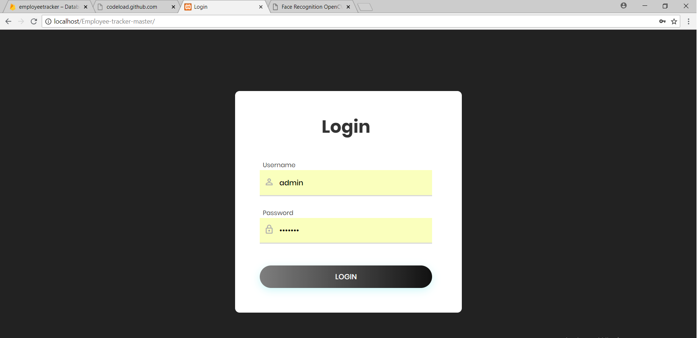
Log-in Page

Slide 4
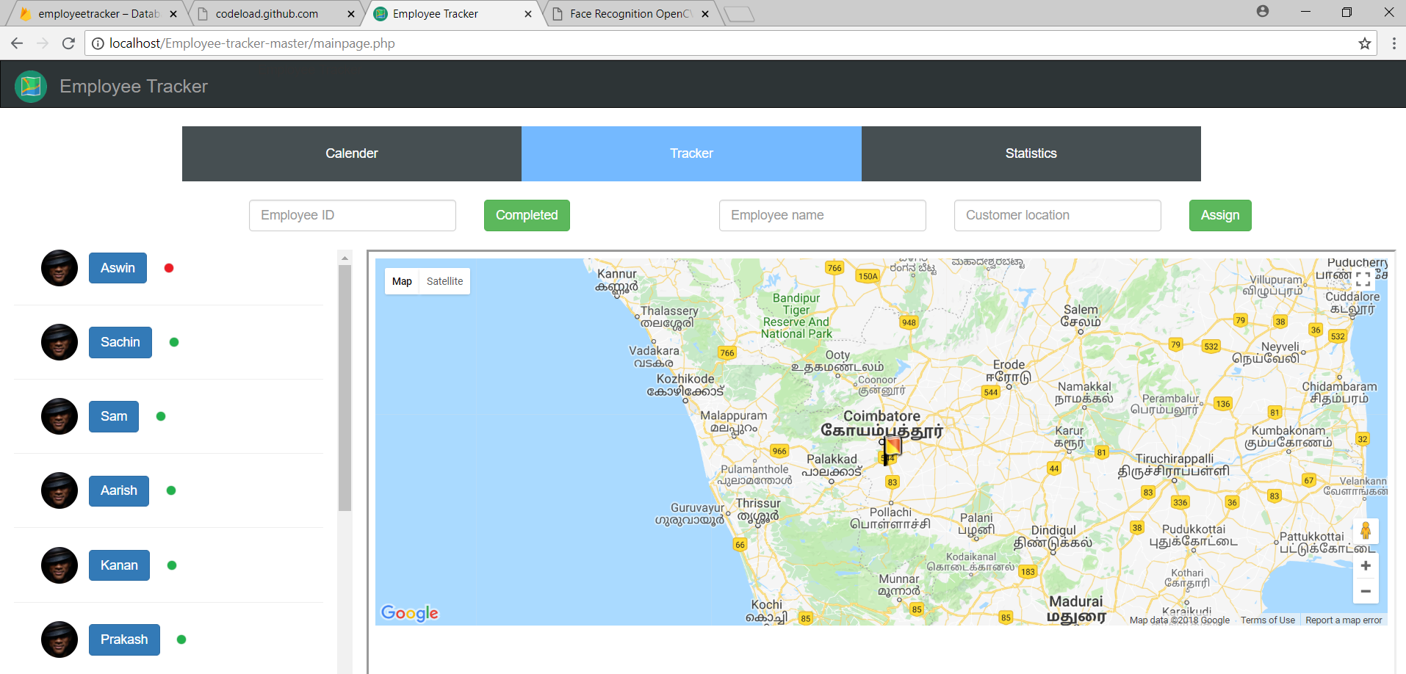
Home View

Slide 5
Tracking the task status
Engaged
Available

Slide 6
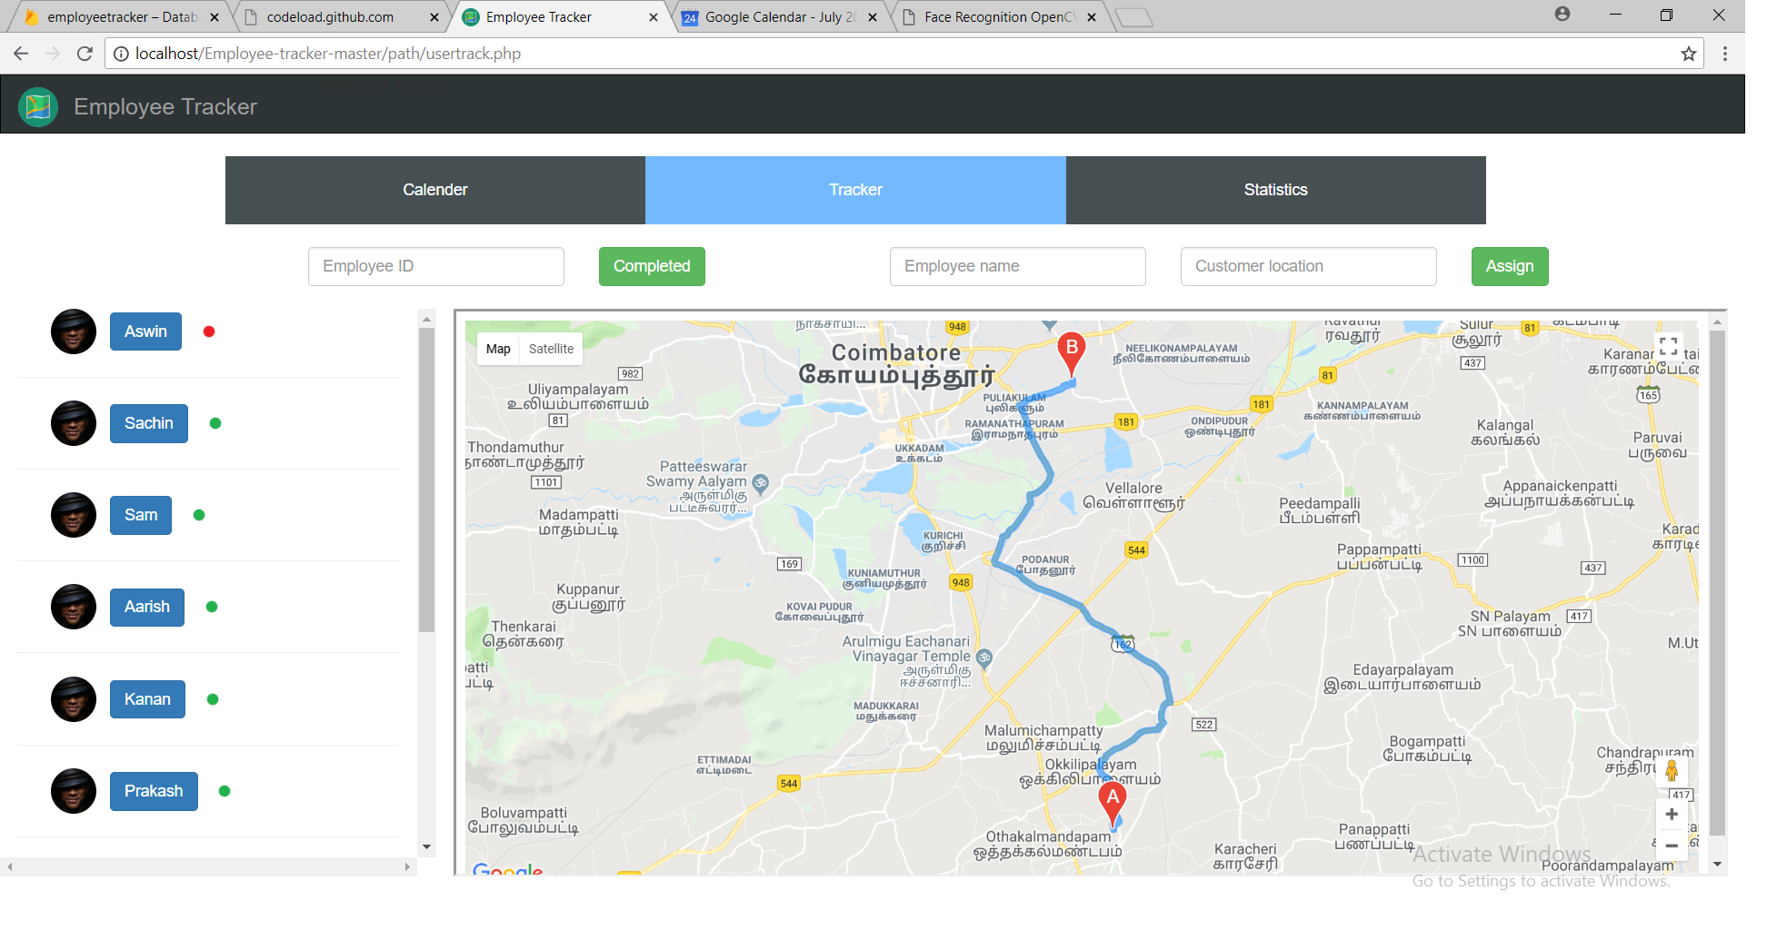
Live Tracking of an employee

Slide 7
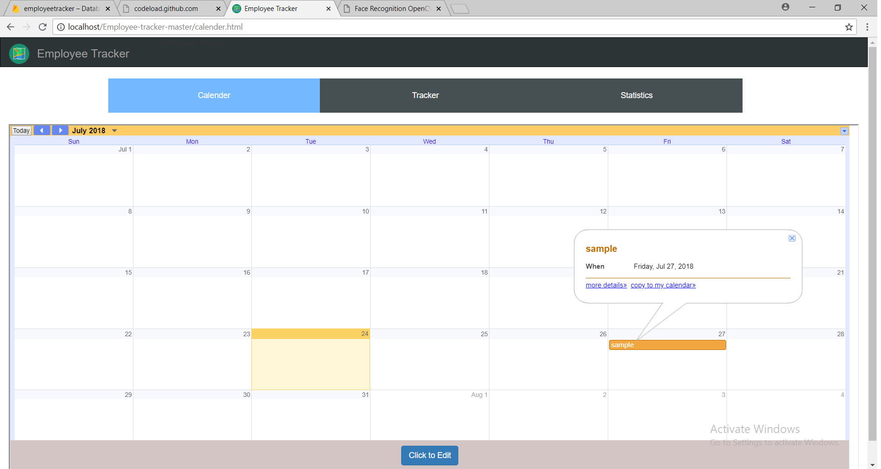
Calendar View

Slide 8
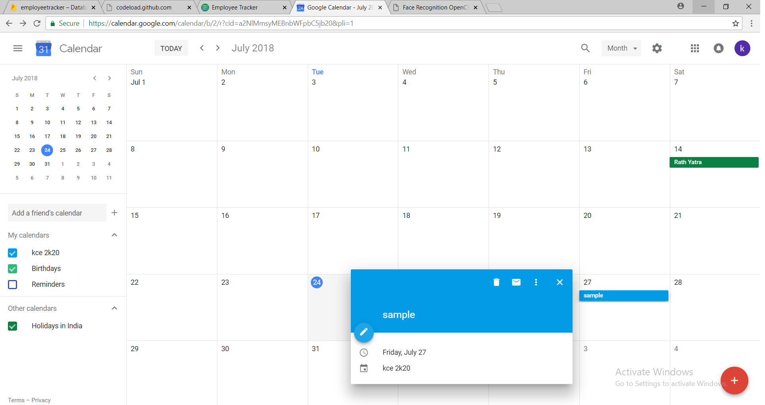
Adding Event

Slide 9
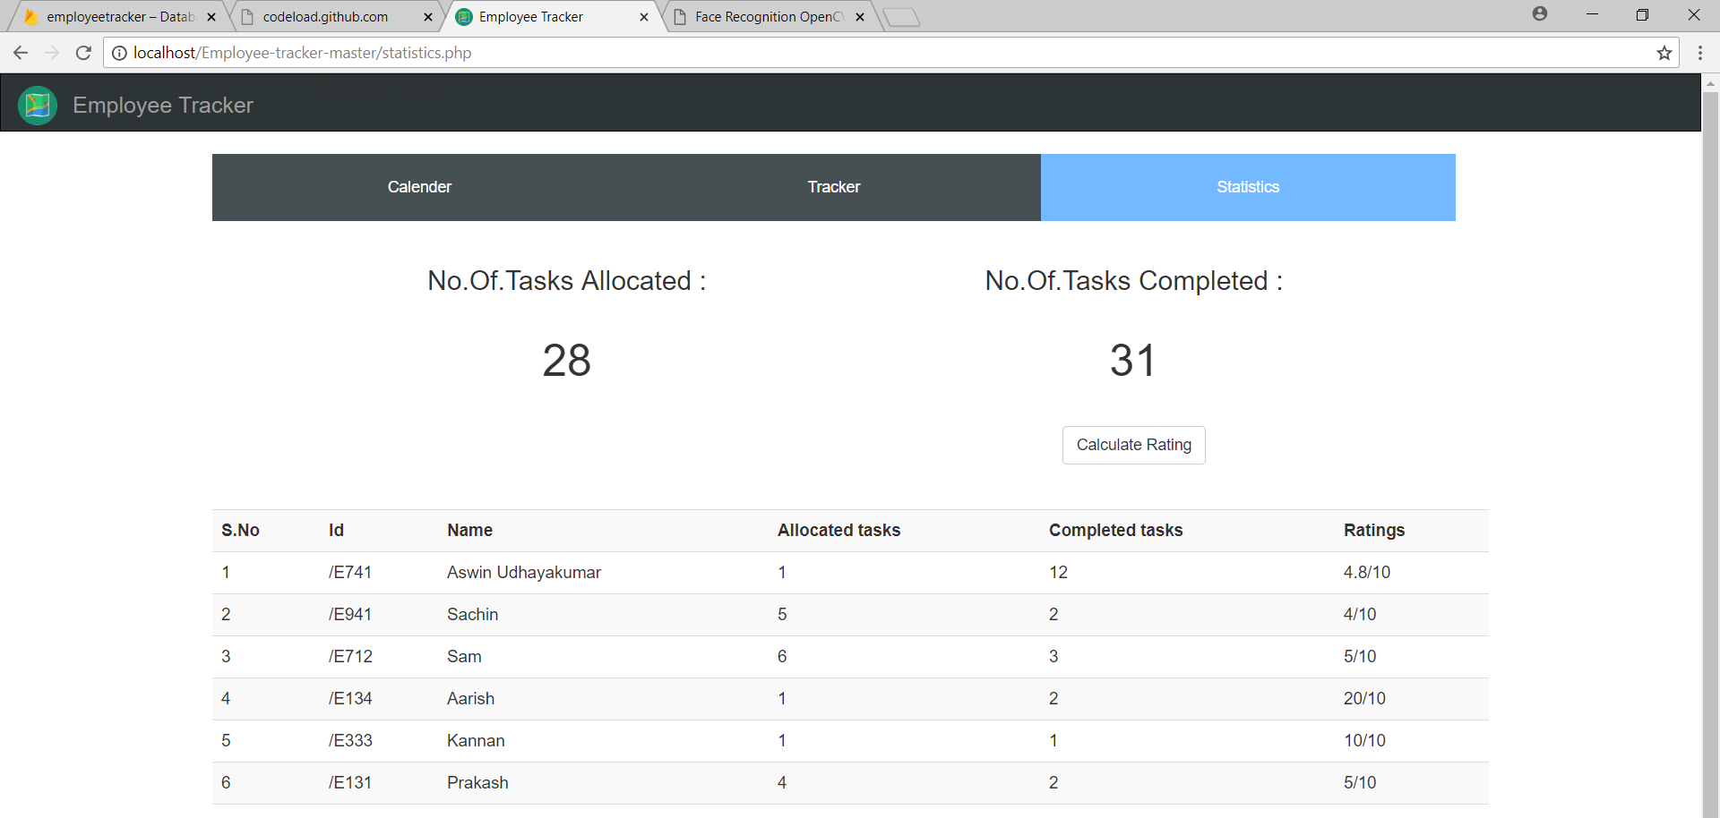
Statistics added

Slide 10
Data Base: Firebase
One platform, with products that work better together
Firebase products work great individually but share data and insights, so they work even better together.

Slide 11
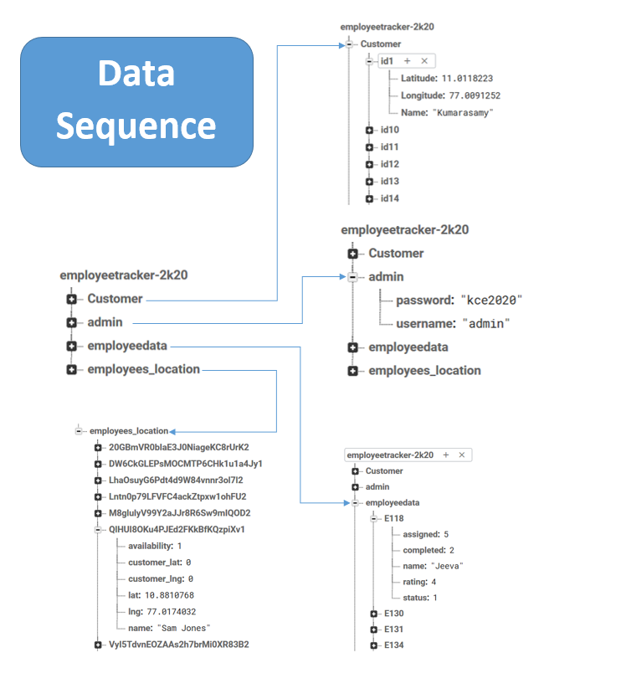

Slide 12
Thank you

