Slide 1
TEAM - III
AWARENESS-
CANCER

Slide 2
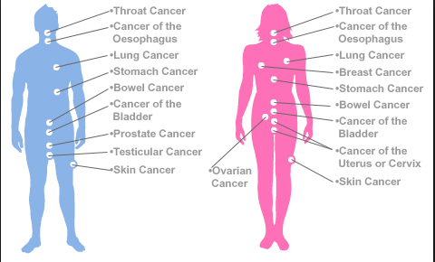
INTRODUCTION
Cancer is not just one disease but many diseases. Cancer is practically as old as life. Dinosaurs had cancer. Trees get cancer. Right now, all of us have some cells with the potential to cause cancer, though they usually get destroyed before becoming a problem. There are many ways to think about the end of cancer: The end of fear of cancer; the end of pain, suffering, and death from cancer; the end of cancer as an inevitable disease. One way is prevention.

Slide 3
OBESITY AND CANCER
Overweight and obesity are associated with cancer
Overweight and obesity are associated with at least 13 different types of cancer.
These cancers make up 40% of all cancers diagnosed. About 2 in 3 occur in adults 50-74 years old.
Overweight and obesity can cause changes in the body that lead to cancer, such as increases in levels of certain hormones and inflammation.
More than half of Americans don’t know that overweight and obesity can increase their risk for cancer.
Many things are associated with cancer, but avoiding tobacco use and keeping a healthy weight are among the most important things people can do to lower their risk of getting cancer.

Slide 4
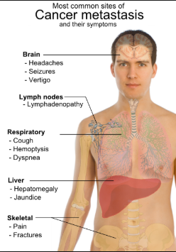
CANCER SYMPTOMS
Cancer gives most people no symptoms or signs that exclusively indicate the disease. Unfortunately, every complaint or symptom of cancer can be explained by a harmless condition as well.
Some common symptoms that may occur with cancer are as follows:
Persistent cough or blood-tinged saliva
A change in bowel habits
Blood in the stool
Unexplained anemia (low blood count)
Lumps in the testicles
Indigestion or difficulty swallowing
Unusual vaginal bleeding or discharge
Unexpected weight loss, night sweats, or fever

Slide 5
CANCER SYMPTOMS
Signs that your pain may be due to cancer:
It can't be attributed to something specific, like an injury or overexertion
It persists and does not improve
It is severe
It interferes with sleep
It is coupled with other minor symptoms
Fatigue and Weight Loss
Feeling unusually tired without being able to pinpoint a cause — you're getting enough sleep, sleeping well, and are not sick — is another warning sign that cancer may be invading your body. It feels somewhat like the fatigue associated with the flu, notes Fisch, but without other flu symptoms.
As for weight loss, if you’re dieting and losing weight relatively slowly, like a pound or two a week, this is probably cause for celebration. But if weight loss happens very quickly or without much effort, it could be a warning sign. Weight loss that is just a little too easy or too quick can be a sign of cancer, says Fisch

Slide 6
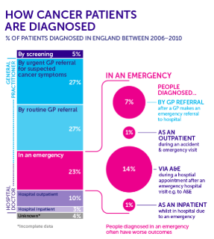
DIAGNOSIS
LAB TEST:
Lab test of the blood, urine or other body fluids that measure these substances can help doctors make a diagnosis.
Lab test are an important tool, but doctors cannot rely on them alone to diagnose cancer.
IMAGING PROCEDURES:
Imaging procedures create pictures of areas inside a body that help the doctor see whether a tumor is present.
These pictures can be made in several ways:
CT scan
Nuclear scan
MRI
Ultrasonic

Slide 7
AWARENESS
According to the World Health Organization, at least one-third of all cancer cases are preventable.
Take a free Cancer Risk Test to identify behaviors that may lead to cancer and ways to reduce your risk.
Avoid all tobacco products.
Avoid heavy alcohol use. (The combination of tobacco use and heavy alcohol use is estimated to cause the majority of oral cancers diagnosed in the United States.) Avoid exposure to the sun which can increase the risk of lip cancer.
If any problems , Visit your doctor for regular cancer screenings that may save your life.
Fifty percent of all cancers in males are tobacco related and a large proportion of them can be prevented by anti-tobacco programs

Slide 8
AWARENESS
More than 30% of cancer cases could be prevented by modifying lifestyle or avoiding key risk factors.
It accounts for 7.4 million deaths (around 13% of all deaths) in 2004
Since 1987, the Indian Cancer Society has conducted more than 5000 Cancer Awareness Programs , which have benefited more than 6,35,000 participants.
ICS has also conducted more than 300 Cancer related Exhibitions benefiting more than 1,90,000 participants.
The program encourages the participants to seek prompt medical attention for symptoms ,which may include lumps, sores, bleeding, hoarseness, weight loss etc.,
A multidisciplinary approach to cancer treatment is essential and this has to be made available at all Regional Cancer Centres.
Radiotherapy services chemotherapy services for common cancers have to be made available in all centres.

Slide 9





CANCER SURVIVORS

Slide 10
TEAM MEMBERS
Team Members:
R. Swathi
K. S. Ranjith
S. Gokul
K. Saran
G. Yugeshwari
I. Mohammed Sikkander
Thank you

