Slide 1
Team 7.
CHILD ABUSE
By

Slide 2
Introduction :
Child abuse is a life-scarring experience for a child, not to mention the emotional trauma for the family. Feelings of shame, guilt or even confusion prevent young children from informing their parents about the event.
The physical, psychological or sexual maltreatment or neglect of a child is termed as child abuse. This can happen at the hands of a parent, a close relative or a caregiver or any other stranger and has a significant detrimental effect on the child’s psyche.

Slide 3
Types of Child Abuse :
There are many ways in which a child may be maltreated or abused, and these include sexual abuse, physical abuse, emotional abuse and neglect.
Physical abuse occurs when a parent or a caregiver causes deliberate physical injury to a child.
When a child is exploited for a sexual purpose or is involved in a sexual act, sexual abuse occurs.
If a child’s social and mental development is compromised by a parent, it is called emotional abuse.
Neglect of a child occurs when the parent or caregiver does not carry out necessary care and support activities necessary for a child.

Slide 4
Causes of Child Abuse :
Children who are part of households where there is frequent domestic violence are prone to becoming victims of abuse themselves.
Many children face psychological mistreatment when their caregivers or parents are under stress. Parents find it difficult to deal with the emotional needs of a child especially when they face stressful situations. Divorces, relationship issues, financial worries and job-related problems can lead to parents meting out abuse to their children.

Slide 5
Effects of Child Abuse :
Child abuse and neglect often leave long-term scars on the child, ones that are difficult to erase from the mind and the body too. It can have a massive impact on the way the child will manage relationships during adulthood and can dent their self-confidence. Children are unable to function normally at school, college or work when they grow up .
It is very difficult for children to trust other people, especially when their parents have been responsible for abuse. An abused child may not be able to form strong relationships nor maintain a healthy relationship.

Slide 6
Abused children are unable to vent their feelings and emotions positively. This results in bottling up of emotions and may give way to different psychological problems. Abused children often resort to alcohol or drugs during adulthood to assuage the pain as they can suffer from anxiety and depression.
It is extremely difficult to overcome negative feelings if one is constantly being berated or even beaten up. Abused children harbour feelings of inferiority and being worthless and thus settle for lesser education and low-paying jobs when they grow up. Similarly, sexually-abused children cannot ignore the shamefulness of the act and the stigma attached to it.

Slide 7
Helping abused child :
On hearing or knowing about abuse of a child, make sure you respond with urgency and care.
Believe what the child has told you and do not repeat it to others without reason.
Never stop them from talking about it or make them feel guilty about it.Tell the child that he or she is now safe and you will take care of the situation.

Slide 8
Signs to watch out for :
Children are not always able to talk about the abuse they may be facing, either because they are too young to vocalise or recognise it, or because they don’t feel comfortable sharing it.
A child who’s being physically abused will be reluctant to go to daycare or spend time with a particular babysitter. Check if her body is covered with bruises or injury marks which cannot be explained rationally.

Slide 9
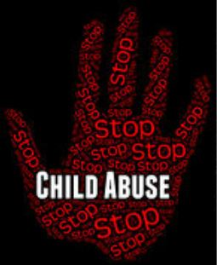
An emotionally abused child may display various behavioural changes that are extreme. She could rebuff a parent’s show of affection or can become extremely attached and cling to them. When an excessively talkative child turns quiet or vice versa, it indicates that she is disturbed emotionally and needs emotional support from parents. A parent should watch out for unexplained stomach aches or headaches or loss of appetite.

Slide 10
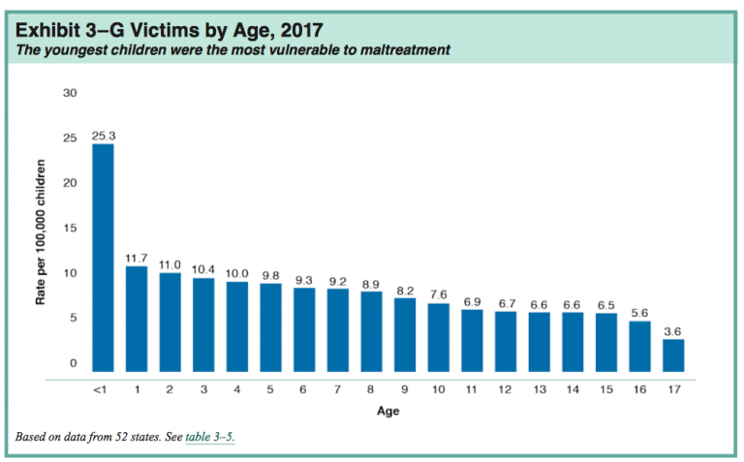
Statistics :

Slide 11
Facts :
A report of child abuse is made every ten seconds.
In 2014, state agencies found an estimated 7,02,000 victims of child maltreatment ,but that only tells part of the story.
(And this would Pack 10 modern football stadiums.)
In one study, 80% of 21-year-olds who reported childhood abuse met the criteria for at least one psychological disorder.
Approximately 5 children die everyday because of child abuse.

Slide 12
Conclusion :
We can stop child abuse by Spreading knowledge about child abuse in the neighbourhood or your town. When people become aware of the harsh realities of abuse and neglect, they will spread the word about it and this can stop a potentially abusive situation.
“Educate children about the good touch and the bad touch”.

Slide 13
Team Members :
Akalya P
Painguzhali G
Sankar Balaji M
Manikandan G
Rokesh Raghul S

