Slide 1
DEALING WITH EMOTIONS
TEAM NO:5

Slide 2
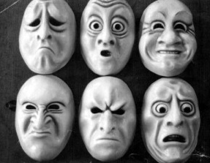
INTRODUCTION
Emotion is a mental state
variously associated with thoughts, feelings, behavioural responses, and a degree of pleasure or displeasure. There is currently no scientific consensus on a definition. Emotion is often of intertwined with mood, temperament, personality, disposition, and motivation.
"Emotions can be defined as a positive or negative experience that is associated with a particular pattern of physiological activity." Emotions produce different physiological, behavioral and cognitive changes. The original role of emotions was to motivate adaptive behaviors that in the past would have contributed to the passing on of genes through survival, reproduction, and kin selection
"A strong feeling deriving from one's circumstances, mood, or relationships with others."

Slide 3

FORGIVING & FORGETTING
Forgiveness is an conscious deliberate decision of release feelings of resentment towards the person regardless of whether they actually deserve your forgiveness.
Forgetting is the apparent loss of information already encoded and started in an individual’s long-term memory.
WHY TO FORGIVE…
Forgiveness is not something
that we do for other’s.It is something
that we do for ourselves.
Through forgiving we literally take away the power of the opponent.
WHY TO FORGET…
. By forgetting things we tend to remember only the good rather then the bad and understand it in a better way.

Slide 4
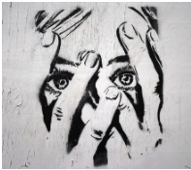
FEAR
Fear is a feeling induced by perceived danger or threat that occurs in certain types of organisms, which causes a change in metabolic and organ functions and ultimately a change in behavior, such as fleeing, hiding, or freezing from perceived traumatic events. Fear in human beings may occur in response to a certain stimulus occurring in the present, or in anticipation or expectation of a future threat perceived as a risk to body or life.
SYMPTOMS
Many physiological changes in the body are associated with fear are heart rate , sweating, increasing muscle tension including the muscles attached to each hair follicle to contract and causing "goose bumps", (piloerection ),alertness leading to sleep disturbance and "butterflies in the stomach" (dyspepsia).

Slide 5

ANGER
Anger is a basic human emotion that is experienced by all the people
Typically triggered by emotional hurt ,anger is usually experienced as an unpleasant feeling that occurs when we think we have been injuried,mistreated,when we are faced with obstacles that keep us from attaining personal goals.
When you are angry your body releases stress hormones.
The heart rate ,blood pressure and body temperature get increases.
To overcome:
Once you're calm, express your anger
As soon as you're thinking clearly, express your frustration in an assertive but nonconfrontational way. State your concerns and needs clearly and directly, without hurting others or trying to control them.
Stick with 'I' statements
To avoid criticizing or placing blame — which
might only increase tension — use "I" statements to describe the problem. Be respectful and specific.

Slide 6

SADNESS
SADNESS
Sadness is a type of emotion often defined as
a transient emotional state characterized by feelings
of disappointment, grief, hopelessness, disinterest, and dampened mood.
Sadness is something that all people experience from time to time. In some cases, people can experience prolonged and severe periods of sadness that can turn into depression.
IT SHOULD BE EXPRESSED THROUGH…..
Dampened mood,Quietness,Lethargy,Withdrawal from others,Crying.
IT LEADS TO….. lead people to engage in coping mechanisms such as avoiding other people, self-medicating, and ruminating on negative thoughts. Such behaviors can actually exacerbate feelings of sadness and prolong the duration of the emotion.

Slide 7
Managing Denfence Mechanism
Repression: Involuntary pushing of unpleasant feelings out of conscious thought.
Supression: Conscious,Intentional pushing of unpleasantness from one’s mind.
Dealing with Intense Emotions:
Take slow,deep breaths and relax when you feel your emotions.
Control your feelings by analyzing the situations that cause them.
Control your feelings by analyzing the situations to compose yourself.
Write a private journal or play music.

Slide 8

HAPPINESS
HAPPINESS
Happiness is often defined as a pleasant emotional state that is characterized by feelings of contentment, joy, gratification, satisfaction, and well-being. Research on happiness has increased significantly since the 1960s within a number of disciplines, including the branch of psychology known as positive psychology.
IT CAN BE EXPRESSED THROUGH…
* Facial expressions such as smiling,
* Body language such as a relaxed stance
* An upbeat, pleasant tone of voice.
UNHAPPINESS LEADS TO….
Unhappiness has been linked to a variety of poor health outcomes. Stress, anxiety, depression, and loneliness, for example, have been linked to things such as lowered immunity, increased inflammation, and decreased life expectancy.

Slide 9

SURPRISE
Surprise is a type of emotion that can trigger the fight or flight response. This type of emotion can be positive, negative, or neutral. An unpleasant surprise, for example, might involve someone jumping out from behind a tree and scaring you as you walk to your car at night. An example of a pleasant surprise would be arriving home to find that your closest friends have gathered to celebrate your birthday.
IT IS CHARACTERISED BY…
* Facial expressions such as raising the brows,
widening the eyes, and opening the mouth
*Physical responses such as jumping back,
*Verbal reactions such as yelling, screaming,
or gasping
EFFECTS OF SURPRISE…
Surprise can have important effects on human behavior Research has also found that people tend to be more swayed by surprising arguments and learn more from surprising information.

Slide 10
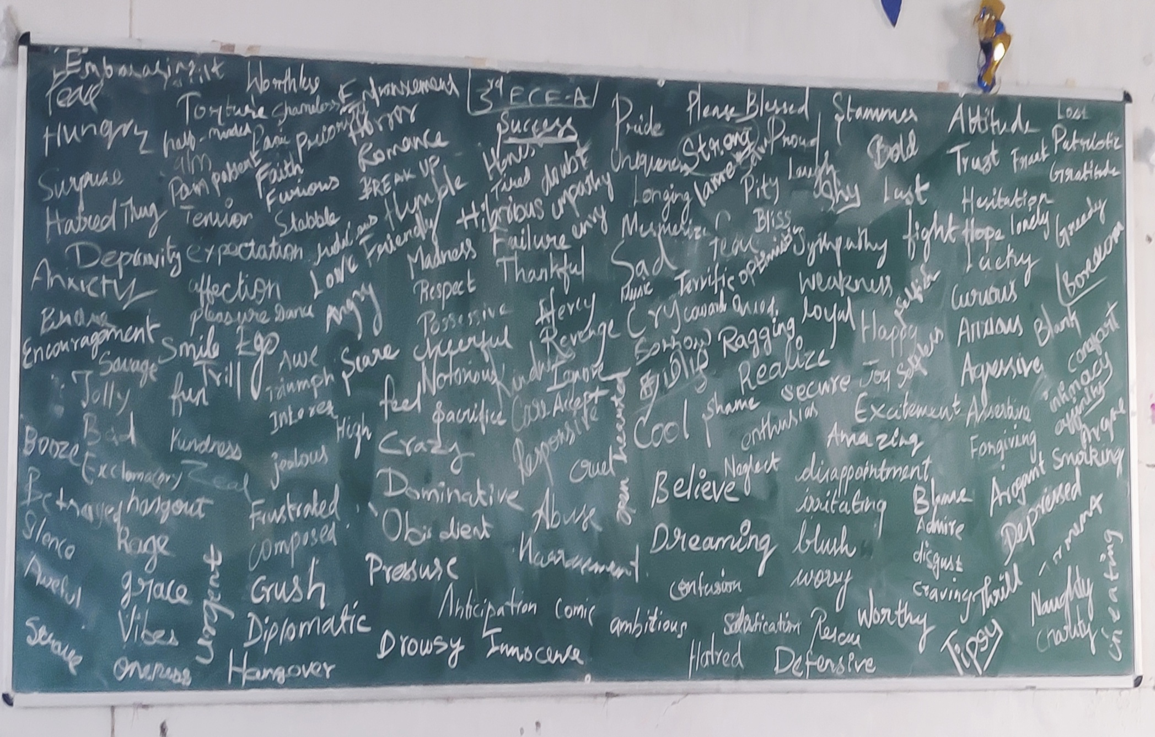

Slide 11
TEAM MEMBERS NAME
SRI SUSHMA.J.S
VIDYA.K(AL)
ABIRAMI.S
THOMAS NIRMAL S( L)
SRIRAM
AJITH KUMAR.M
ASWIN

Slide 12
THANK YOU

