Slide 1

ECE-A
Notes:
Have students complete daily hassles scale and major life events scale. Also have them complete mood scale
Once data have been collected, correlated the hassles and life events with mood
Video on stress, coping and health

Slide 2
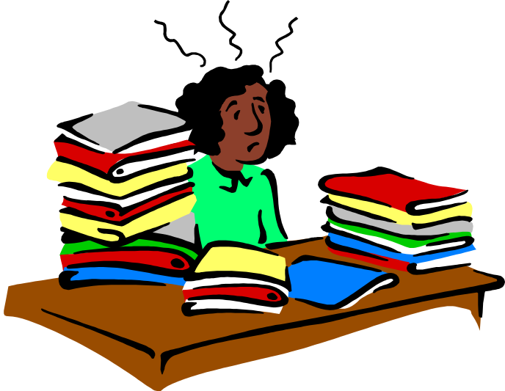
Definition of stress
Stress can be defined as our mental, physical, emotional, and behavioral reactions to any perceived demands or threats.

Slide 3
What is Stress?
Pressure perceived to be from the outside that can make you feel tense inside.
The rate of wear & tear on the body.
The nonspecific response of the body to any demand made upon it.
It’s the way your mind and body react to any new, threatening or exciting situation.
“It’s what you feel when there’s just too darned much going on!”

Slide 4
Stress Can Be Helpful or Harmful
Helpful (eustress): extra energy to meet physical challenges, solve problems and reach goals
Harmful (distress): can cause headaches, backaches, loss of appetite, fatigue, digestive problems, depression, difficulty focusing thoughts and impaired memory

Slide 5
Behavioral Symptoms of Stress
Neglecting appearance
Increasing use of alcohol or other drugs
Crying easily
Watching more TV
Withdrawing from family and friends
Arguing
Avoiding tasks and responsibilities
Difficulty concentrating
Being late to work.

Slide 6
Emotional Symptoms of Stress
Anger
Feeling powerless
Feeling unhappy for no reason
Being easily upset
Worrying frequently
Feeling trapped
Anxiety
Loneliness
Nervousness

Slide 7
Physical Symptoms of Stress
Allergies
Change in appetite
Back pain
Chest pain
Breathlessness
Clammy hands
Dizziness
Fatigue

Slide 8
Physical Symptoms of Stress
Racing heartbeat
Muscle tension
Restlessness
Rashes
Sleeping problems
Stomach aches
High blood pressure
Nightmares

Slide 9
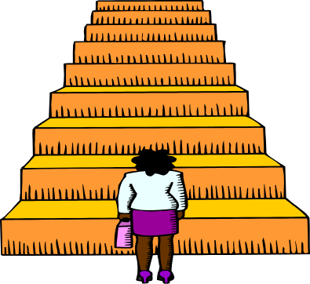
Suggestions for Reducing Stress
Change your attitude. Find other ways to think about stressful situations.
  "Life is 10% what happens to us, and 90% how we react to it."
Be realistic. Set practical goals for dealing with situations and solving problems.
  Develop realistic expectations of yourself and others.
  Get regular exercise. Exercising regularly can help relieve some symptoms of depression and stress, and help us to maintain our health.

Slide 10

Suggestions for Reducing Stress
Get regular exercise. Exercising regularly can help relieve some symptoms of depression and stress, and help us to maintain our health.
Get organized and take charge. Being unorganized or engaging in poor planning often leads to frustration or crisis situations, which most always leads to feeling stressed.
  Plan your time, make a schedule, establish your priorities.

Slide 11

Suggestions for Reducing Stress
Slow down. Know your limits and cut down on the number of things you try to do each day, particularly if you do not have enough time for them or for yourself.
Be realistic about what you can accomplish effectively each day.
  Monitor your pace. Rushing through things can lead to mistakes or poor performance. Take the time you need to do a good job.
    Poorly done tasks can lead to added stress.

Slide 12
Good personal habits are essential for stress management
Eat right – balanced, nutritious diet, with something from all 5 food groups. Minimize sugar, fats, caffeine and alcohol.
Exercise regularly – 30 minutes or more of moderate physical activity 3-5 days a week. An active mind benefits from an active body.
Get enough sleep – 6-9 hours per night.
Take time to relax.

Slide 13

Team Members
R.Yazhini
P.Sharmila Bavani
H.Divyaa lakshmi
J.Kodeeswaran
J.Pradeep
V.Sudharson

