Slide 1
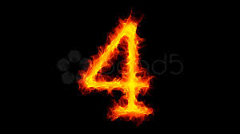
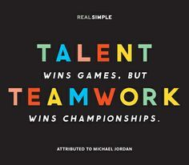
Team Work

Slide 2
What is it?
A process by which a group of people work collaboratively to achieve a set or given goal/ task.
They apply their individual talents with a positive spirit to achieve results.
Togeather Everyone Acheives More..
Charactersitics?
Credibility - All of team is responsible for the credit.
Sense of Purpose - All should have a single mission.
Accountability - Stand as team in faliures and success.
Cooperative Spirit - Work collectively to achieve the goal.
Appreciation - Appreciate and motivate each other .

Slide 3
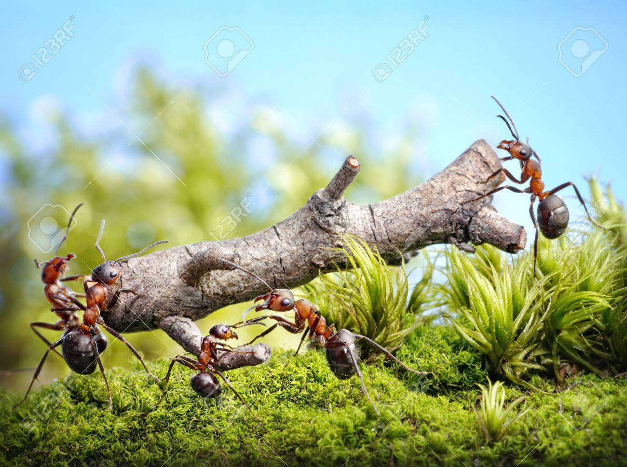
How the team should be?
Communication
Problem solving
Negotiation
Trust
Creates synergy - the sum is greater than the parts.
Supports a more empowered way of working.
Encourages multi-disciplinary work where teams cut across organizational divides.
Fosters flexibility and responsiveness.
Promotes the sense of achievement, equity and friendship, essential for a motivated workplace.
When managed properly, teamwork is a better way to work!.

Slide 4
Leadership Attributes
Focus on the goal.
Plan well .
Run effective meetings.
Promote team harmony.
Communicate.
Team Stages
Forming – “What’s going on?”
Norming – “I have to work with them?”
Storming – “How do we work this out?”
Performing – “How can we keep this up?”
Adjourning – “We did it – now what?”

Slide 5
Benefits
Employee
Tasks are completed more quickly.
Greater job satisfaction.
Work is often more enjoyable – happier workplace.
Ability to draw on other peoples’ experiences and ideas – getting support in the workplace.
Problem Solving and sharing of works.
Enterprenuer
Improved production and higher staff morale.
Reduced staff turnover.
Increased profits and product quality.
Customers
Innovative products reach the market.
More reliability .

Slide 6
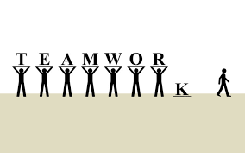
Why it Fails
Lack of vision.
Failure to be personally responsible.
Conflict between personality.
Personal work of individuals.
No clear identity.
Dominance in making decisions.
Time management.

Slide 7


C.Sam Jones
R.Logananth
P.Karthik
M.Shree Hari
R.Anusha
S.Vaishnavi

