Slide 1

Basic Concepts
Onboarding assignments

Slide 2
Compliation Proccess
Constructing an executable image for an application.
Four stages
Compiler tool
gcc <options> <source_file.c>
-Compiler Tool
-gcc

Slide 3
Four stages of compilation process
Pre-processing
Compilation
Assembling
Linking

Slide 4
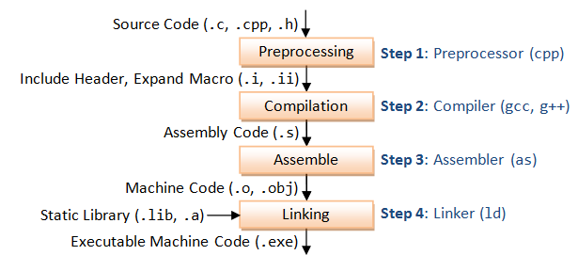
Compilation and Execution Stages

Slide 5
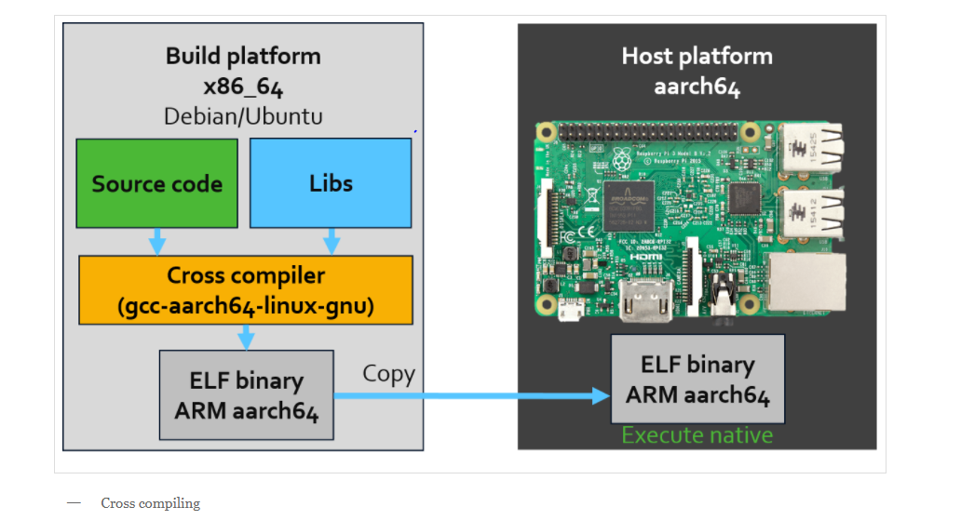
Cross Compilation

Slide 6
Build system
Build system
Make
Bazel build
Bazel test

Slide 7
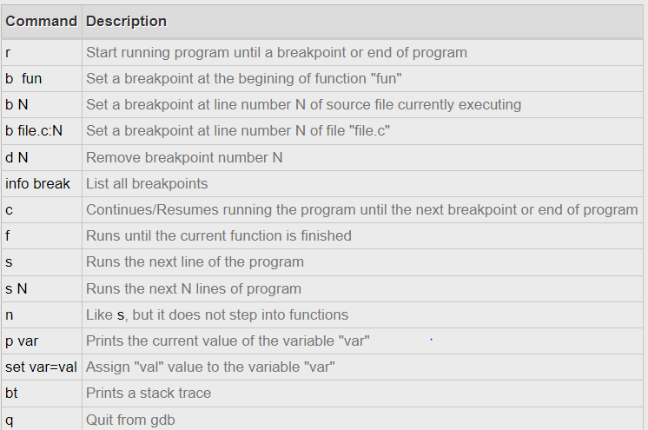
Debug
GDB or GNU Debugger is GNU project which helps to debug software applications and analyze what is happening during program execution.
Here are the some commands that are commonly used when debugging.

Slide 8
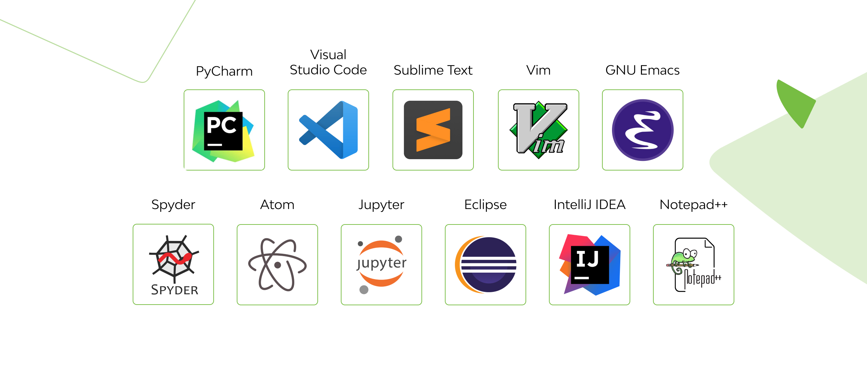
IDE (integrate development environment)
It is a software application that combines all of the features and tools needed by a software developer.

Slide 9
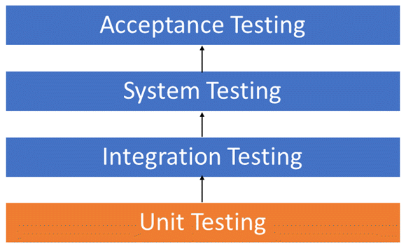
Testing

Slide 10
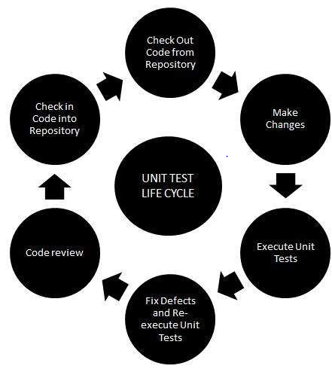
Unit Testing
Unit testing is a type of testing in which individual units or functions of software testing.
analyze and fix the defects, low level
close to the source of application
can be run very quickly

Slide 11
Integration Testing
-Different modules or services used by your application work well together.
-Require multiple parts of the application to be up and running
-Some types of integration testing
-Top down and bottom up

Slide 12
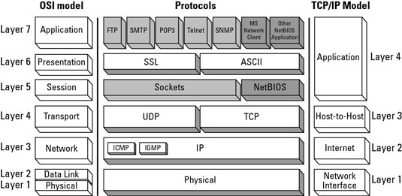
TCP/IP

Slide 13
Socket
A socket is one endpoint of a two-way communication link between two programs running on the network. A socket is bound to a port number so that the TCP layer can identify the application that data is destined to be sent to. An endpoint is a combination of an IP address and a port number.

Slide 14
Thank you

