Slide 1
Learning Process Onboarding Assignements
Sai
Ericsson

Slide 2
Static code analysis
Method of debugging
Analyze the code
No Compilation
Much faster then Uts/tests
Follow the set of rules or coding standards.
Notes:
2021 targets supporting distributing QoS within cell
Future Multilayer traffic management need to take “slice” info in consideration when distributing traffic between cells to further optimize
Relations:
NSA traffic will be identified per SPID and per UE, SA traffic via S-NSSAI. RRP will handle this (tied via ResourcePartitionMember) but how to handle observability?
RCS will somehow monitor that not too many resources are spend on UEs in poor coverage, similarly, the rate will somehow be measured by RCS. This could be useful to refine as observability?
RAN rate recommendation/Admission control will measure the load per partition, this may be used for orchestration?
Cell load conditions similar as for traffic management, needed for orchestration
Dynamic shares may utilize information from RCS?
Information on MSR utilization per share may be used for detection overload in partition and trigger rate recommendation to reduce partition load?
Dependencies:
Traffic and radio conditions needed to report SLA fulfilment
More advanced load condition may need to be available to answer question like if an SLKA with a certain QoS can be established

Slide 3
Tools for static Analysis
Mostly used by developers
Provides details about coding standards like nesting depth, cyclomatic complexity, check against coding standard etc.
Helps in finding the defects which are diffcult to find durning dynamic analysis.
Search for bugs can be automated at early stages.
Executes quickly compared with dynamic analysis
Get code insights before execution
Ability to identify weaknesses in the code and to adhere to strict development standards help reduce potential production issues.

Slide 4
Some of the Defects found by static Analysis tools are
Unused Variables
Unreachable code
Coding standard violations
Syntax issues
Add try-catch –finally blocks
Method returns
If-else statements merging

Slide 5
Static analysis tools
Coverity
Resharper
SonarQube
Codechecker
Babel.
Jprofiler.

Slide 6
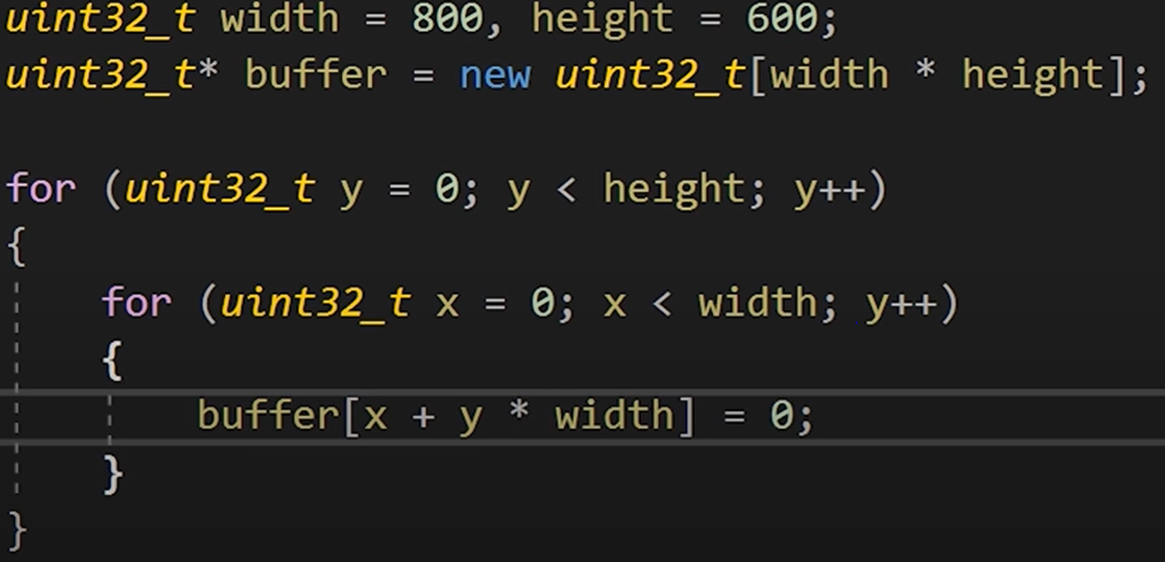
Here are the some examples that static analysis detects the errors

Slide 7
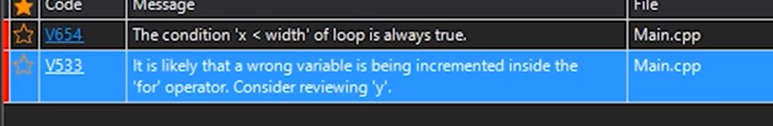

Slide 8
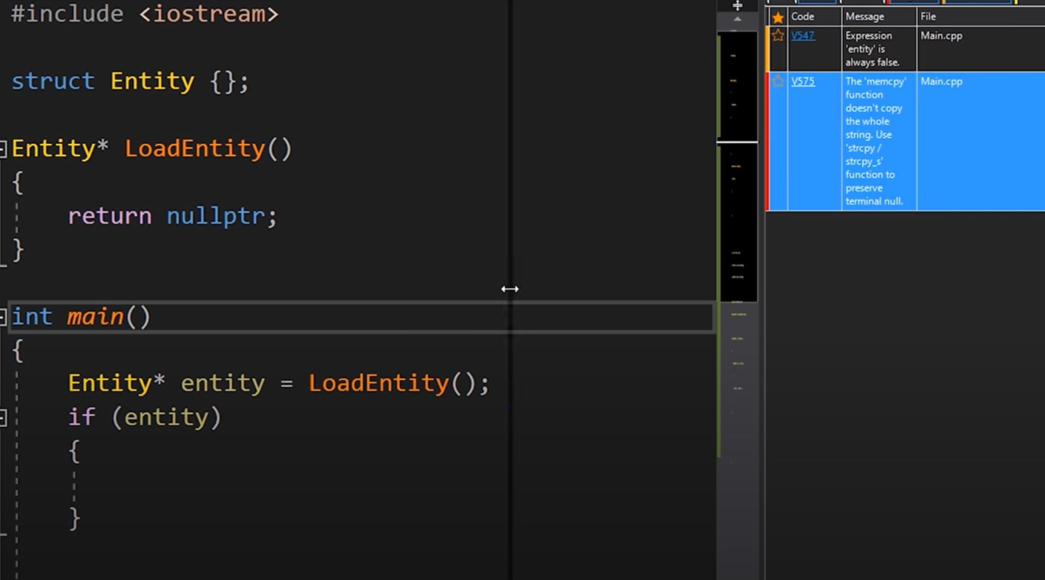

Slide 9
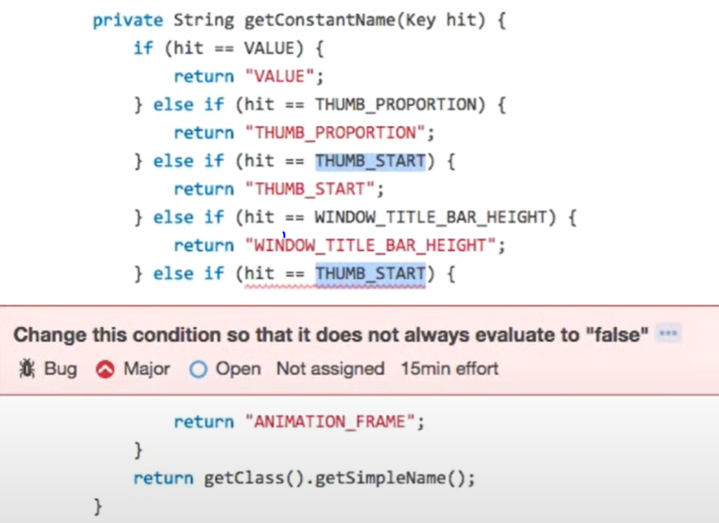

Slide 10
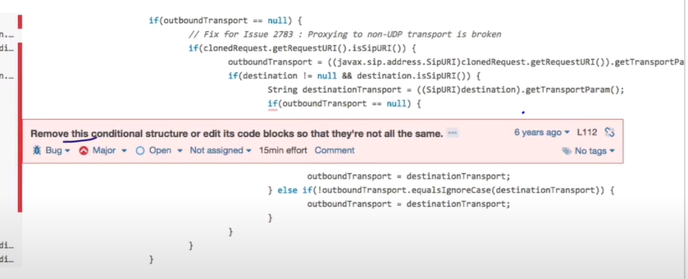

Slide 11
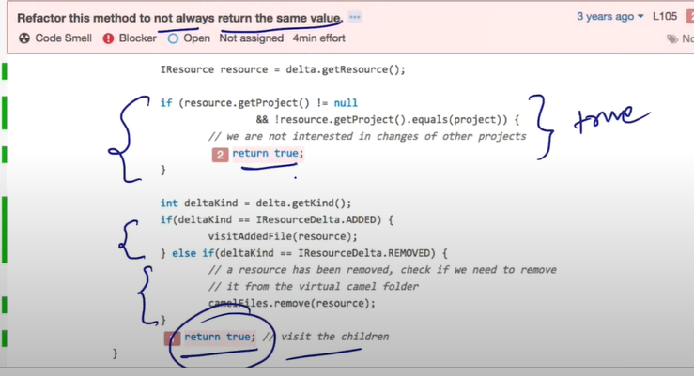

Slide 12
Advantages of static analysis code
Product quality has improved.
Dynamic Analysis will become more efficient after static analysis.
Using static analysis improves maintainability of code.
Checks addresses problems early on.

Slide 13
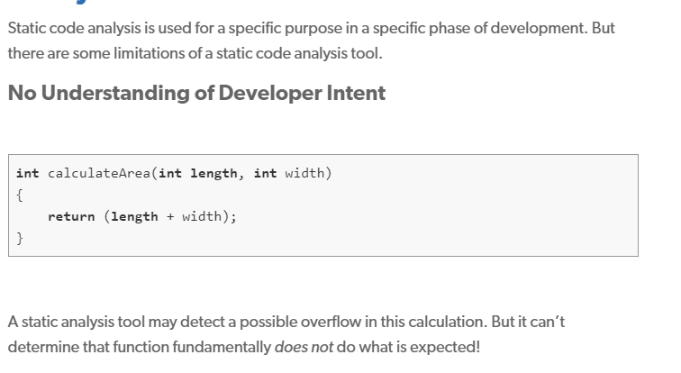
Limitations of a static Code Analysis tool

Slide 14
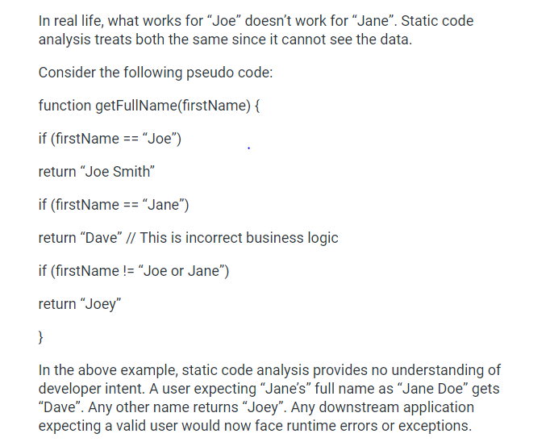

Slide 15
Dynamic analysis tool
It is a tool we can use to understand how the software works duríng execution
This involves testing the code while it runs.
To detect
- Memory Leaks
- Areas for performance improvement
- Ensure an application performs the same on different targets

Slide 16
Limitations
If the code doesn’t run, it doesn’t get analyzed. In addition, dynamic code analysis cannot perform the function of static code analysis tools, so it’s best used in conjunction with them.

Slide 17
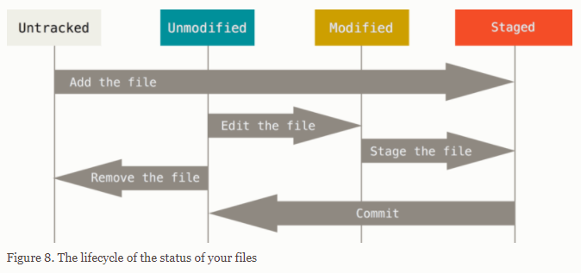
Git work flow

