Slide 1
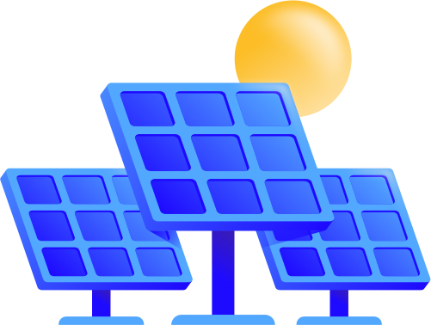
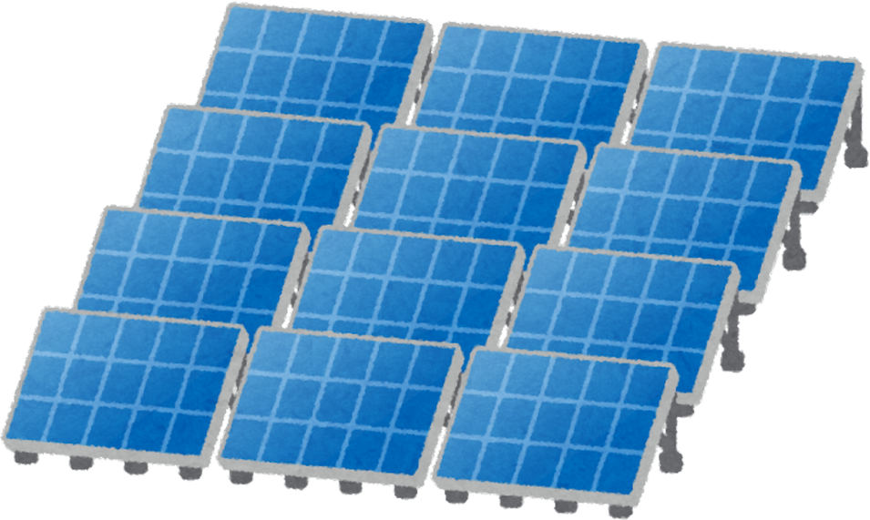





Predictive Solar Panel Maintenance System
By Team ya Julia
Julia Wangechi, Mugi Mugendi, Samuel Waweru

Slide 2
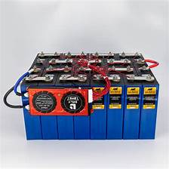
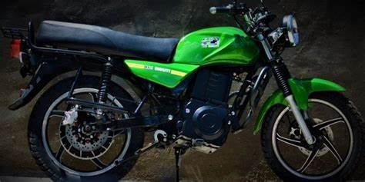
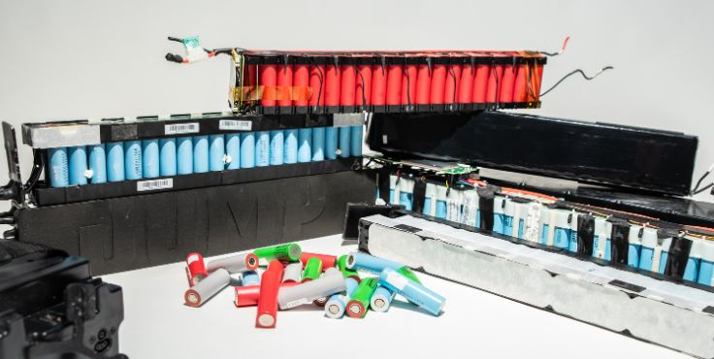

E-Boda
BMS
Need : Increase battery longevity, safety, and optimal performance thereby reducing disposal rate
E-Motorbike Battery
Problem : Smart BMS offers proactive maintenance, and efficient thermal management using Artificial Intelligence.

Slide 3
Sensors
Microcontroller e.g. Arduino/ Raspberry Pi
Power Electronics e.g. Transistors and Converters

Slide 4
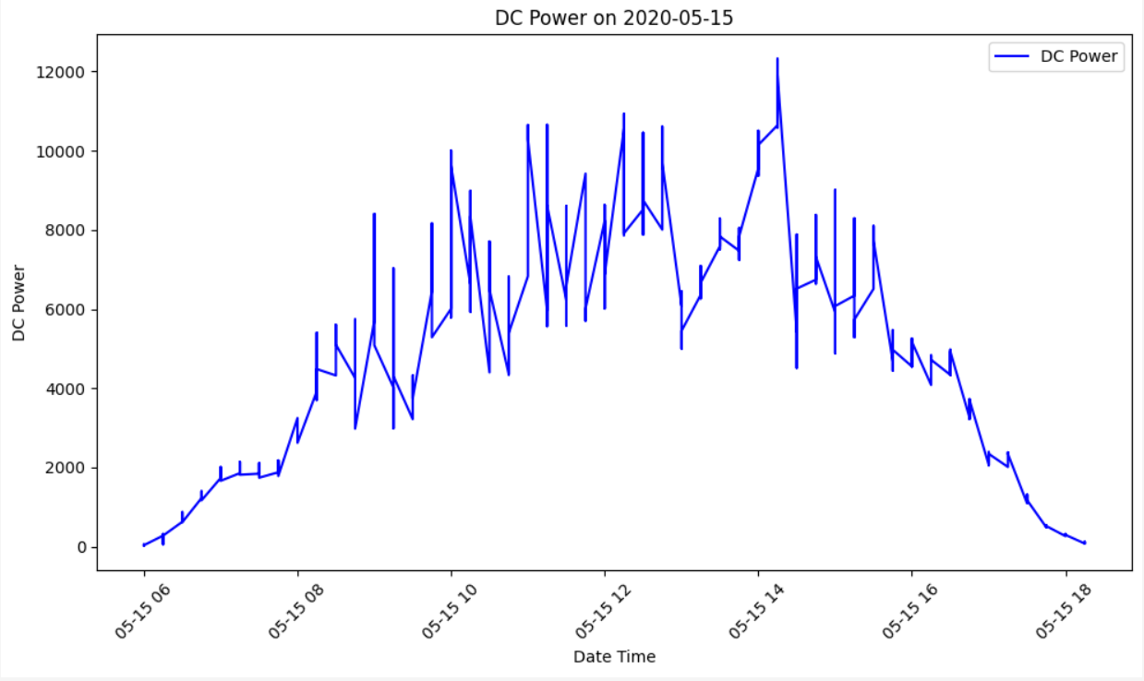

Slide 5

Goal : Reduce the number of batteries being disposed by Boda-boda Riders due to poor bms on the batteries
Environmental Impact : Reduce Heavy metal deposition due to high rate of disposal

