Slide 1
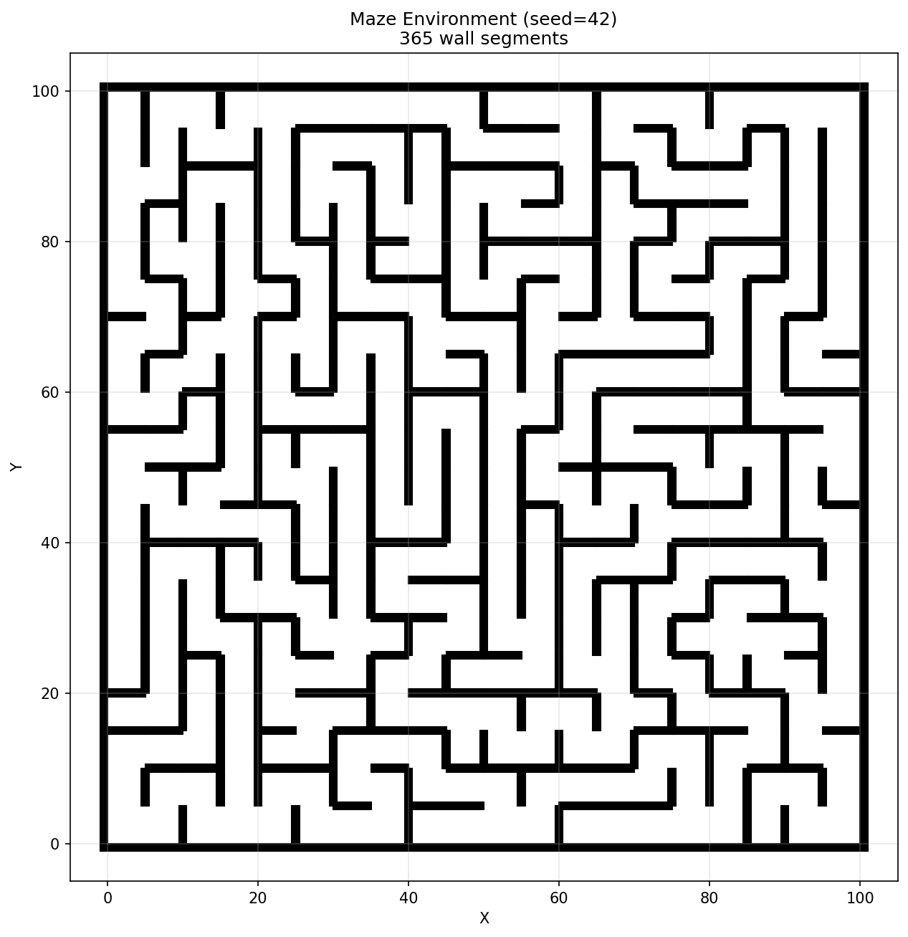
Planning Under
Goal Uncertainty
An MCMC-Guided RRT System
What happens when the planner doesn't know where the goal is?
Sam Kelly · UCLA SRP 199 · 2026
Notes:
Open: imagine a search-and-rescue robot dropped into a partially mapped building. A radio signal localizes the goal within a few meters, not exactly. Most planners assume the goal is a known point. What happens when the goal itself is a probability distribution? That's the question this system tries to address.

Slide 2

Why sampling-based motion planning?
2 / 12
▸ Path planning in C-space X ⊆ R²: find a collision-free path from q_start to q_goal
▸ Grid methods fail: O(nᵉ) storage, don't generalize to non-uniform obstacles
▸ Optimization methods trap in local minima on non-convex obstacle geometries
▸ RRT builds a tree T = (V, E) incrementally: sample → nearest-neighbor (KD-tree) → steer (η=2.0) → collision check → add
▸ Probabilistically complete and resolution-complete in the continuous limit
▸ Bottleneck: vanilla RRT samples uniformly from X_free, ignoring where the goal is
20×20 grid maze, 365 wall segments (seed=42)
0:30 – 1:15
Notes:
The setting is standard robot motion planning: given a continuous configuration space — in our case the 2D plane — find a collision-free path from a start to a goal. Grid-based methods are the obvious first attempt, but they scale exponentially with dimension and break down when obstacle geometry is irregular. Trajectory optimization is faster but gets trapped in local minima whenever the obstacle set is non-convex, which is essentially always in real environments.
Sampling-based planners sidestep both problems. The Rapidly-exploring Random Tree — RRT — grows a tree from the start by repeatedly sampling a random configuration, finding its nearest neighbor in the tree with a KD-tree lookup, and steering toward it by a fixed step size. The result is a space-filling tree that's fast to build and, in the limit, probabilistically complete.
The catch — and this is the starting point for everything that follows — is that vanilla RRT samples uniformly from free space. It has no model of where the goal is, and no way to exploit prior information. That's fine if the goal is a known point. It becomes a problem when the goal is uncertain.

Slide 3
Prior work biases toward a known goal
3 / 12
Prior work
Our angle
▸ Goal-biased RRT: sample toward fixed q_goal with probability p (typically 5–10%)
▸ RRT-Connect: simultaneously grow trees from q_start and q_goal, meet in middle
▸ Informed RRT*: restrict sampling to a prolate hyperspheroid defined by current best path cost
▸ All assume q_goal ∈ X_free is a known, fixed point
▸ Goal as a Gaussian belief: b(q_goal) = N(μ, Σ), initialized with wide covariance
▸ Belief updated sequentially via noisy range sensor: z_t = d(q_t, q_goal) + ε, ε ~ N(0, σ²(d))
▸ Sampler biases toward high-probability goal regions while also favoring informative viewpoints
▸ Plan, sense, update N(μ, Σ), replan — interleaved throughout execution
1:15 – 1:55
Notes:
Once you accept that uniform sampling is inefficient, the natural fix is to bias toward the goal. Goal-biased RRT does this literally — with some probability p, usually five to ten percent, you sample the goal location directly instead of a random point. RRT-Connect goes further and grows two trees simultaneously, one from the start and one from the goal, connecting them in the middle. Informed RRT-star is more principled: once you have any path, you restrict future samples to the ellipsoidal region that could possibly improve it.
All three of these are better than uniform RRT — but they all share a hidden assumption: that the goal is a known, fixed point in free space. In practice, that assumption breaks in exactly the situations where you most want a planner. Search and rescue: you know roughly where a person is from a radio signal, but not exactly. Autonomous exploration: your sensor flagged a region of interest, but the estimate has noise. In every case, what you actually have is a distribution over the goal location — and none of the standard methods know what to do with that.
Our angle: represent the goal as a Gaussian belief, update it from noisy range observations as the robot moves, and build a sampler that acts on the belief rather than a fixed point. The right panel shows the structure — we'll get into the mechanics next.

Slide 4
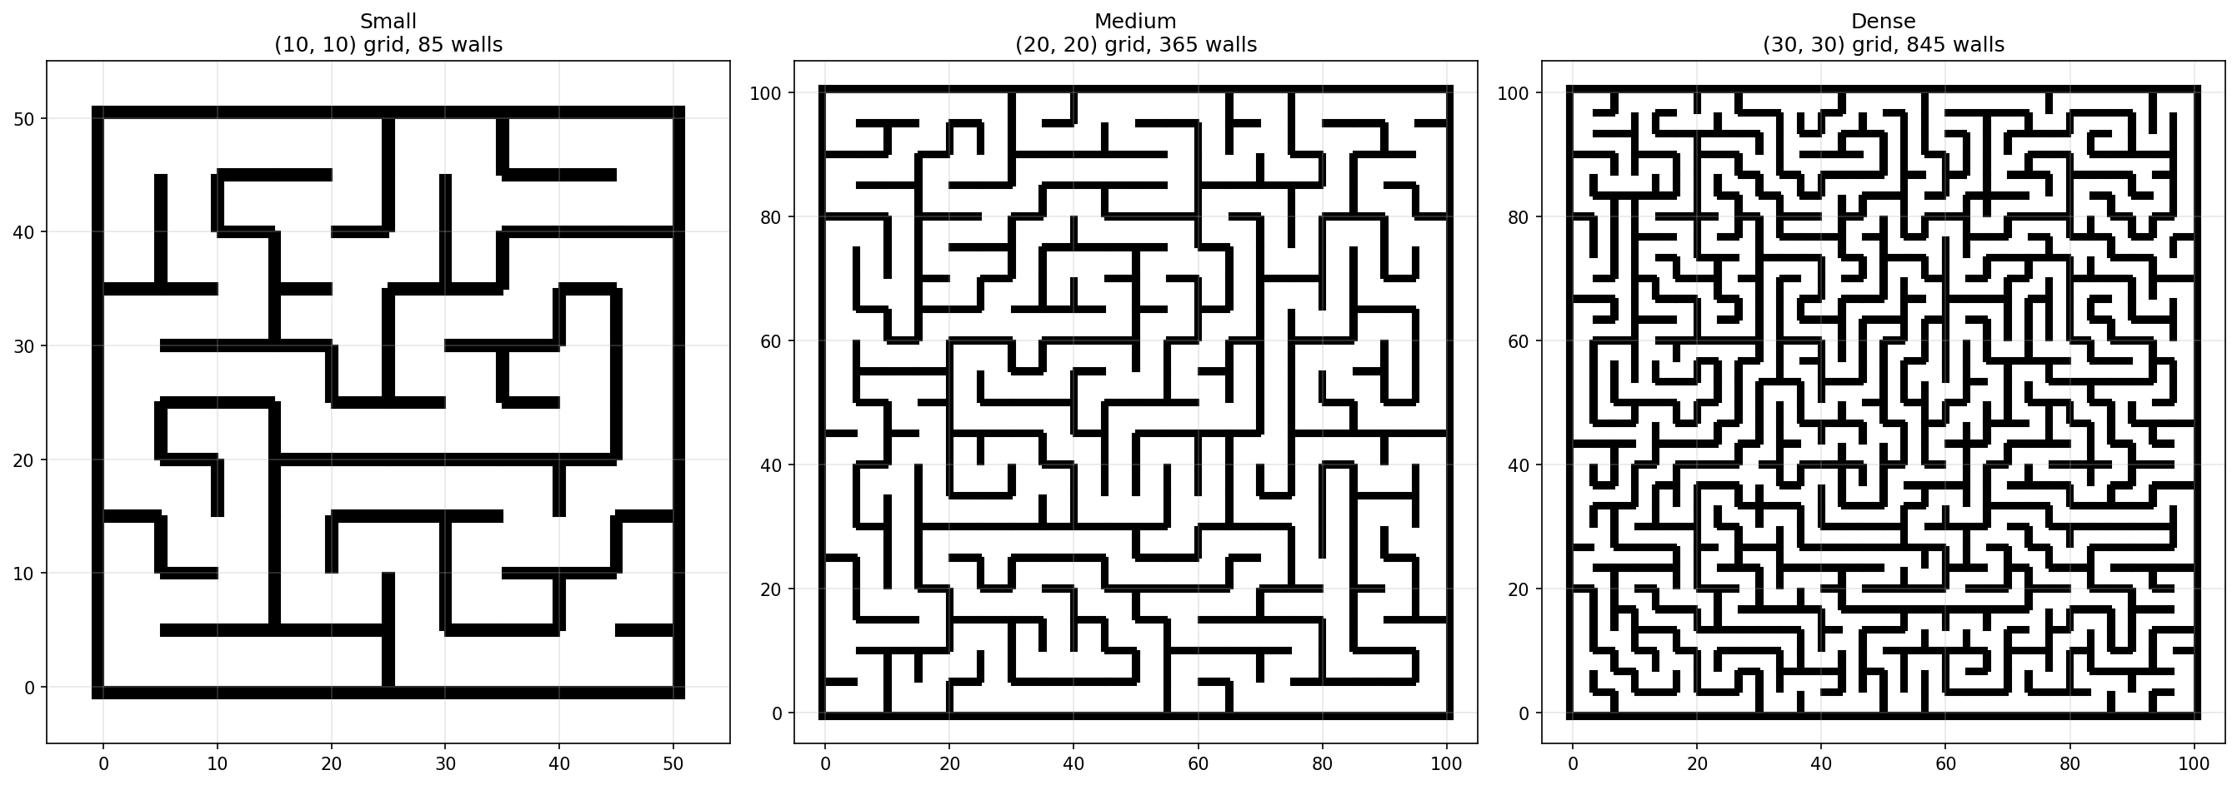
Environments: Procedurally Generated Mazes
4 / 12
2D continuous C-space X = [0, 100]² ⊂ R². Obstacles are Shapely polygons — RRT samples from continuous space, not discrete grid cells.
Easy
Medium
Hard
10×10 grid · ~85 walls
20×20 grid · ~365 walls
30×30 grid · ~845 walls
Grid-based random walk generates topology · Guaranteed-connected C_free · Start q_s = [15, 15], Goal q_g = [85, 85] (with Gaussian belief over q_g)
1:55 – 2:30
Notes:
For evaluation we needed environments with controllable difficulty and varied topology, so we built a procedural maze generator. The algorithm runs a random walk over a discrete grid — ten-by-ten cells for easy, twenty-by-twenty for medium, thirty-by-thirty for hard — carving passages as it goes. That gives you the connectivity structure.
The key implementation point is that those grid cells never appear in the actual planner. The maze walls get converted to rectangular Shapely polygons in a continuous hundred-by-hundred unit coordinate space, and the RRT samples from that continuous space using exact geometric collision checks — not lookups into a grid.
You can see the three difficulty levels here: easy has open corridors and few decision points, medium starts creating bottlenecks, and hard has dense walls with many narrow passages that are easy to miss. Start is always bottom-left, goal is always top-right, and crucially — the planner only ever receives a noisy distance estimate to the goal, not its location.

Slide 5
The system, end-to-end
5 / 12
A continuous loop: sense, update belief, sample, plan, execute, repeat.
Sense
Update belief
Sample
Plan
Execute
z_t = d(q_t, q_goal) + ε
Kalman update N(μ, Σ)
MCMC + λ-mix biased by b(q_goal)
RRT extends step η toward q_samp
follow path trigger replan
↺ replan triggered when H(b) = −Σ p_i log p_i drops past threshold
▸ Collision checking: Shapely polygon intersection, ~0.33 ms/query
▸ Nearest-neighbor: scipy KD-tree, O(log n) per lookup
▸ MCMC chain: Metropolis-Hastings with Boltzmann π(q) ∝ exp(−J(q)/T), T=10
▸ Step size η=2.0 units; max 15,000 RRT iterations per planning episode
2:30 – 3:10
Notes:
So now that we know what environment we're operating in, let's look at how the full system fits together before we go into any individual component.
The planner runs as a continuous loop across five stages. The robot takes a noisy distance observation to the goal — that's the sense step. That observation feeds a Kalman filter update, which refines the Gaussian belief over goal location. The updated belief then feeds the sampler, which is where the core contribution lives — we'll get to that next. The sampler produces candidate configurations, the RRT extends the tree toward them, and the robot executes a partial path before the loop repeats.
A few implementation details worth flagging: collision checking is done via Shapely polygon intersection at about 0.33 milliseconds per query, nearest-neighbor search uses a scipy KD-tree at O(log n), and each planning episode runs up to fifteen thousand RRT iterations. The MCMC chain runs Metropolis-Hastings targeting a Boltzmann distribution at temperature ten — that distribution is defined by the cost function we'll see on slide seven.
The loop doesn't replan on every step. It replans only when the entropy of the belief distribution drops past a threshold — meaning the robot learned something meaningful about where the goal is. That's the trigger condition shown at the bottom.

Slide 6
The sampler: lambda biasing
6 / 12
q_samp ~ (1 − λ) · MCMC( π ) + λ · Uniform( X_free )
exploit goal belief (λ = 0.30 in all experiments)
guarantee coverage + completeness
Why the mix?
MCMC target: π(q)
Engineering payoff
Pure MCMC concentrates mass near the current belief mean μ. If μ is wrong (early in the mission), the chain gets trapped and the tree stops growing toward the true goal — probabilistic completeness is lost.
Boltzmann: π(q) ∝ exp(−J(q)/T) Temperature T=10 controls sharpness. Metropolis-Hastings: proposal std=5.0, accept/reject preserves π.
Chain state persists across iterations; uniform draws don't reset it. 30% uniform restores completeness. Tunable: λ ↑ for wider exploration, λ ↓ once belief tightens.
3:10 – 3:55
Notes:
The sampler is the central engineering contribution, so let's be precise about what it does.
At each iteration we need a candidate configuration to grow the RRT toward. The formula at the top is how we get it: with probability one-minus-lambda we draw from an MCMC chain, and with probability lambda we draw uniformly at random from free space. In our experiments lambda is fixed at 0.30.
The reason you need the mix comes down to probabilistic completeness. Pure MCMC concentrates its mass around the current belief mean — wherever we think the goal is. If that estimate is wrong early in the mission, the chain gets stuck, the tree stops exploring, and the planner can fail even when a valid path exists. The thirty percent uniform component is what prevents that. It guarantees the tree will eventually reach any reachable configuration regardless of where the belief is pointing.
On the MCMC side: the chain runs Metropolis-Hastings with a Gaussian proposal at standard deviation five, and the target distribution is Boltzmann — pi of q proportional to exp of negative J of q over T, with temperature ten. The chain state is preserved between planning rounds so it doesn't restart cold. The practical payoff is that once the belief converges and the chain is mixing well near the true goal region, you can tune lambda down and get more focused sampling — it's a knob that tracks uncertainty.

Slide 7
Information-aware cost function
7 / 12
J(q) = λ_g · ∥q − μ∥ + λ_c · J_clear(q) − λ_i · I(q, Σ)
λ_g = 1.0 λ_c = 0.5 λ_i = 2.0 T = 10.0 (Boltzmann temperature)
λ_g · ∥q − μ∥
Euclidean distance to belief mean μ — convex, no gradient reversals. Pulls samples toward the most likely goal location. Weight λ_g=1.0.
J_clear(q) = λ_c / (d_obs(q) + ε)
Repulsive potential from nearest obstacle. d_obs = min distance to obstacle boundary, ε=0.1 prevents instability. Assigns J=+∞ for q ∈ X_obs. Weight λ_c=0.5.
I(q, Σ) = det(Σ) − det(Σ_new(q))
Expected reduction in total variance from a hypothetical observation at q. Simulated Kalman update: R_hyp(d) = σ²(d)·I (distance-dependent noise). Subtracted — high info gain lowers cost. Weight λ_i=2.0.
3:55 – 4:40
Notes:
That Boltzmann distribution the MCMC chain targets is defined by this cost function — so let's unpack it.
J of q has three terms. The first is just Euclidean distance to the belief mean mu. This is convex with a global minimum at mu, which is exactly what you want for MCMC — no gradient reversals, no saddle points, the chain mixes cleanly. Weight lambda-g is one.
The second term is a clearance penalty: lambda-c over d-obs of q plus epsilon, where d-obs is the minimum distance to any obstacle boundary. This creates a repulsive potential that grows as the robot approaches walls. Anything in collision or out of bounds gets assigned infinite cost — a hard constraint. Weight lambda-c is zero point five.
The third term is where the active perception idea lives. For any candidate configuration q, we simulate what would happen if the robot took a sensor reading from there — we run a hypothetical Kalman update and compute how much the total variance of the belief would shrink. That expected reduction in det-Sigma is the information gain. We subtract it from the cost, so high-information positions are cheaper to visit. Weight lambda-i is two.
The net effect is that the sampler naturally trades off three things at once: get closer to the likely goal, stay away from walls, and prefer positions where looking would actually tell you something. As the belief converges and Sigma shrinks, the third term vanishes on its own — no manual schedule needed.

Slide 8
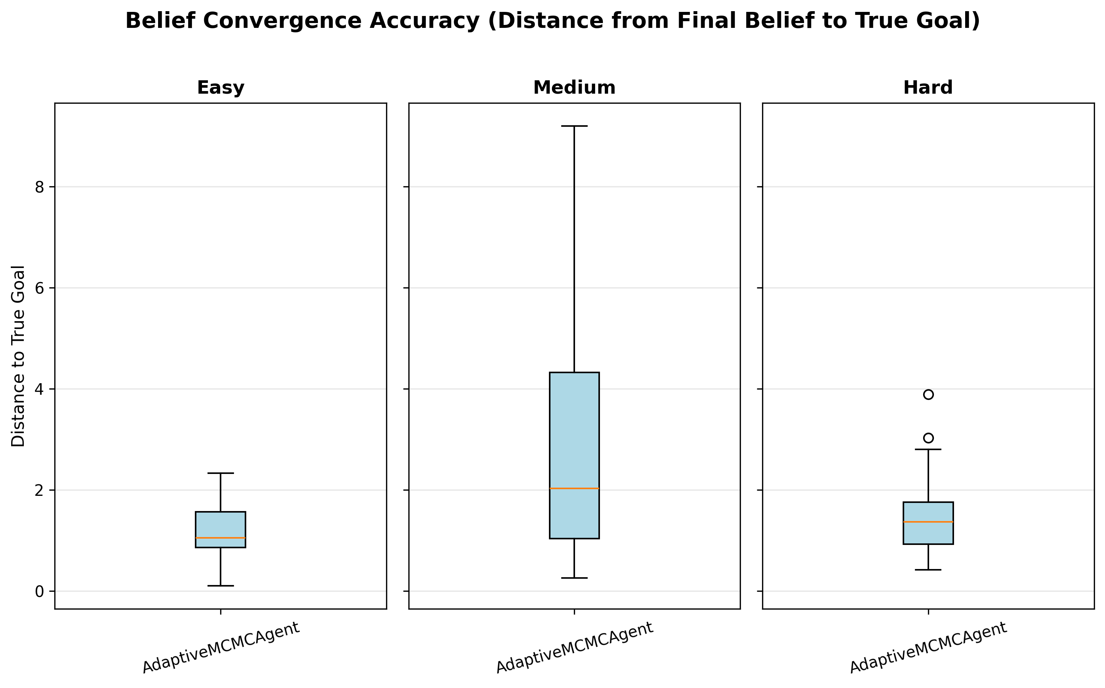
Goal belief: Kalman-style updates
8 / 12
State: b(q_goal) = N(μ, Σ)
▸ Sensor model: z = d(q_t, q_goal) + ε, ε ~ N(0, σ²(d))
▸ Noise scales with distance: σ²(d) = α·d + β — closer observations are more accurate
▸ Kalman update: μ ← μ + K(z − Hμ), Σ ← (I − KH)Σ
▸ Gain K = ΣHᵀ(HΣHᵀ + R)⁻¹ where R = σ²(d)·I
▸ Monotonic covariance reduction: det(Σ) strictly decreasing with each observation
▸ Module is fully decoupled — drops into any planner that needs localization-while-planning
Posterior covariance converging across all 90 MCMC-agent trials
4:40 – 5:15
Notes:
Standard Kalman filter update. The sensor reports noisy distance to the true goal. Noise variance grows with distance so early observations (far from the goal) are less informative. The covariance matrix shrinks monotonically with each update, so the belief can only sharpen. The right panel shows this convergence across all trials.

Slide 9
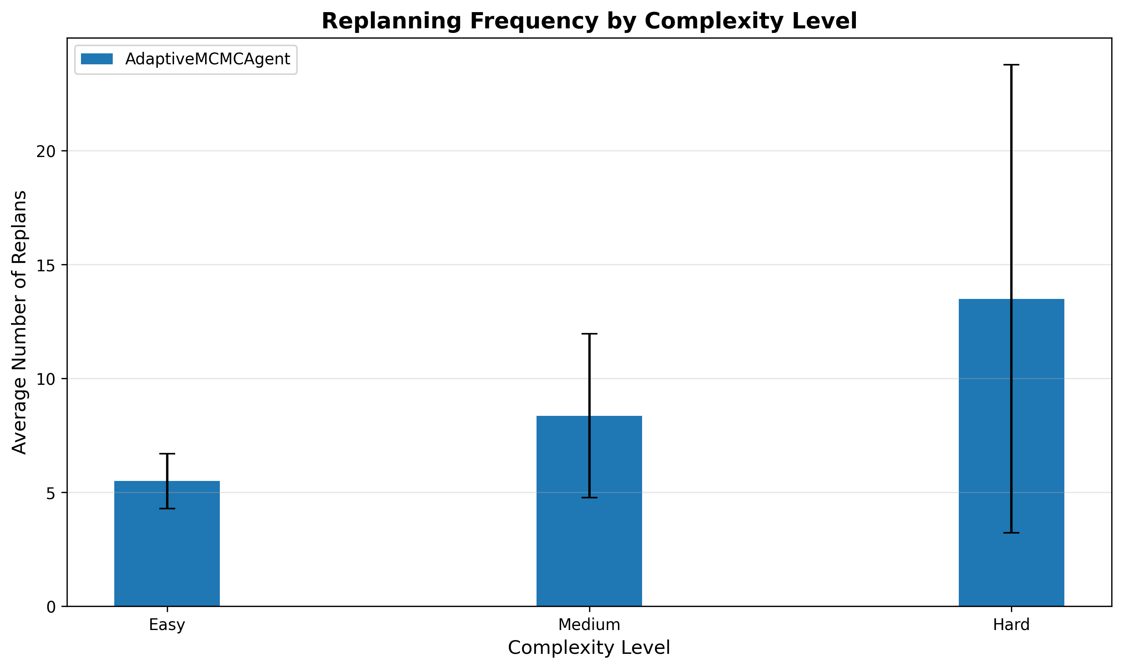
Receding horizon execution
9 / 12
▸ Plan under current belief N(μ, Σ) to produce a waypoint sequence
▸ Execute the first k waypoints while accumulating new sensor observations
▸ Replan trigger: when H(b) = −Σ p_i log p_i drops by more than ΔH_thresh
▸ Not every step — avoids redundant re-computation when belief is stable
▸ More replans at higher difficulty: ~5.6 (easy) → 8.4 (medium) → 13.6 (hard)
Average replanning events per trial (MCMC agent only)
5:15 – 5:50
Notes:
The receding horizon scheme bounds compute by only replanning when the belief actually changed significantly. The entropy drop threshold means the agent replans when a new observation meaningfully updates its estimate of where the goal is. On hard mazes, the belief takes longer to converge, so the agent replans more often — about 13.6 times on average.

Slide 10
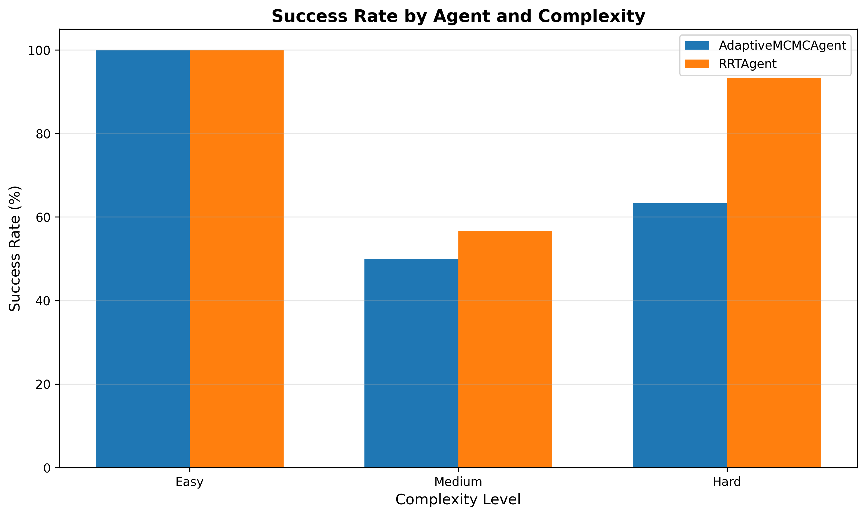
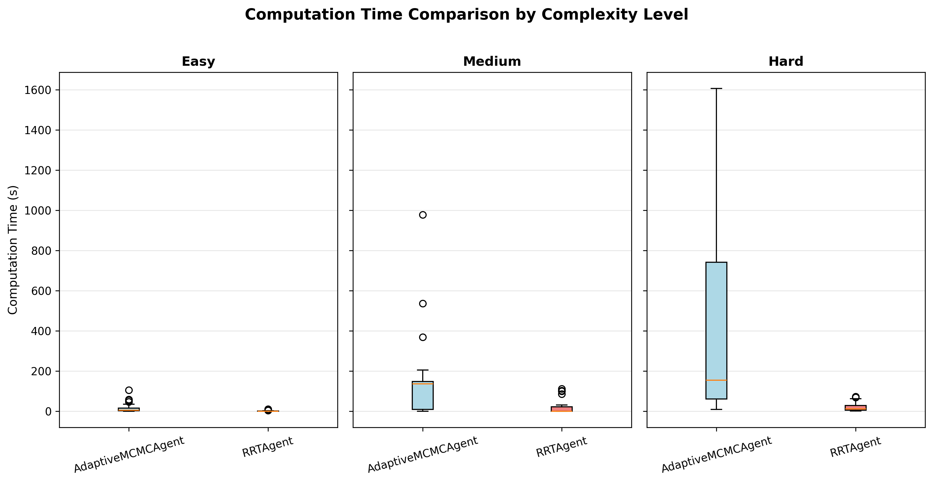
Empirical evaluation: 180 trials
10 / 12
180
trials total (30 per cell)
3
difficulty levels (easy / medium / hard)
2
agents compared (MCMC vs uniform RRT)
4
metrics per trial (success, time, path ℓ, replans)
Hard mazes: MCMC 63% success vs baseline 93% · 8–22× slower across all difficulties · shorter paths when MCMC succeeds (Mann-Whitney p<0.05)
5:50 – 6:30
Notes:
180 trials total. Honest result: on hard mazes, baseline RRT dominates on success rate and compute time. The MCMC agent finds shorter paths when it succeeds — statistically significant on easy and medium via Mann-Whitney. On hard mazes the high replan count and collision-checking cost overwhelm the path-quality benefit.

Slide 11
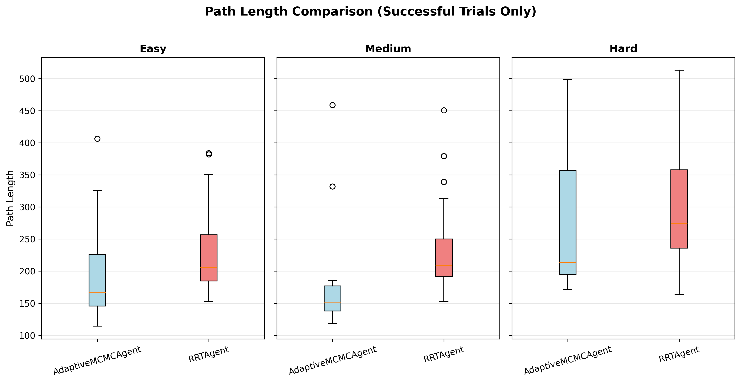
What we learned
11 / 12
What worked
▸ MCMC agent finds shorter paths when it succeeds (significant at easy/medium; Cohen’s d ≈ 0.4–0.6)
▸ Goal-belief integration converges reliably — det(Σ) monotonically decreasing across all 90 MCMC trials
▸ Lambda biasing prevents the worst local-minimum failures seen in pure MCMC runs
▸ Information-aware sampling guides the tree toward regions that also reduce goal uncertainty
What likely went wrong
▸ Entropy trigger too aggressive on hard mazes — 13+ replans each paying full 15k-iter RRT cost
▸ Lambda=0.30 and T=10 not re-tuned per difficulty; hard mazes may need lower T (sharper MCMC)
▸ Info-gain weight λ_i=2.0 may over-explore on dense mazes where sensing geometry changes slowly
Path length comparison — MCMC shorter when successful
6:30 – 7:10
Notes:
The honest read: there is genuine signal in goal-belief-guided sampling. Shorter paths, converging belief, lambda biasing helping. But the compute cost on hard mazes is catastrophic. The most tractable fix is adaptive lambda and temperature: tighten both as the belief converges so the chain sharpens and the uniform draw rate drops.

Slide 12
What’s reusable
Independent of whether goal-belief sampling wins on this benchmark, the components stand alone.
Modular MCMC sampler
Decoupled goal-belief module
src/samplers/adaptive_goal_mcmc.py Metropolis-Hastings + λ-mix, swappable cost function, persistent chain state across RRT iterations.
Kalman filter with distance-dependent noise. Monotonic covariance reduction guaranteed. Drops into any planner that needs localize-while-plan.
Evaluation harness
Benchmark dataset
180-trial batch runner with statistical tests: Mann-Whitney U, chi-square, Cohen’s d. Per-trial telemetry: belief trace, replans, path.
3 difficulty levels × 30 seeds × 2 agents. Full JSON telemetry for each trial. Reproducible via seed — same mazes every run.
And: the rejected MCMC samples turn out to be useful training data on their own — separate project on C-space topology learning.
7:10 – 7:45
Notes:
Closing. Four reusable pieces even if the aggregate result is mixed: the sampler, the belief module, the evaluation harness, and the dataset. One-line bridge to future work: the collision-rejected MCMC samples encode obstacle geometry and can train a learned C-space surrogate — that's a separate project. Thanks.

