Slide 1



Welcome Hackathon Beginners!
Notes:
EW: Hello everyone, I’m Emily, the Vice President Engagement of ECSS
EL: And I’m Ethan, the Vice President Operations of ECSS
EW: And we want to extend a warm welcome to the University of Southampton and in particular, to the school of electronics and computer science!
We’ve got a really fun induction week planned for you all
So make sure to participate, get to know people, find out more about what the society has to offer and make the most of your time at uni.

Slide 2

JUMPSTART
What is Microhack?
Sponsored by Critical Software and TPP
Run by the ECSS (aka Sam)
Notes:
EW: To help you settle into university life over the course of fresher’s week, ECS Jumpstart week will give you the opportunity to ask questions, meet people and to find your way around campus.
Jumpstart is sponsored by ECSS’s gold sponsor, IBM, who will be here throughout the week to show you what their company does and to give you a chance to interact with industry.
The week will be run by the ecs department and the ecss committee with student helpers from all years.
Hopefully you all will have received a jumpstart schedule in your email, (or else you probably wouldn’t be here) so you all roughly know what you’re going to be up to this week.

Slide 3
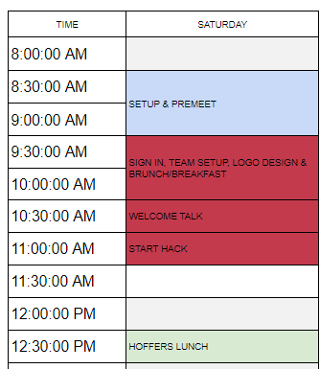
THE DAY
Notes:
Teams of 5
Eat food
Play games!
Win prizes (not about the prizes)
Have the fun
Don’t stress

Slide 4
FOOD
There’s plenty to go around!
BE CAREFUL WITH ALLERGIES
Notes:
Please ask about the allergens, don’t eat if you’re not sure
Help yourselves
We’ll bring out more at some point

Slide 5
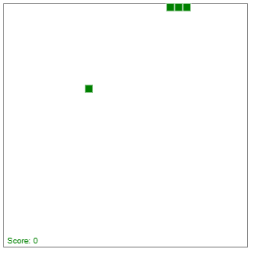
CHALLENGE 1: SnakeJS

Slide 6
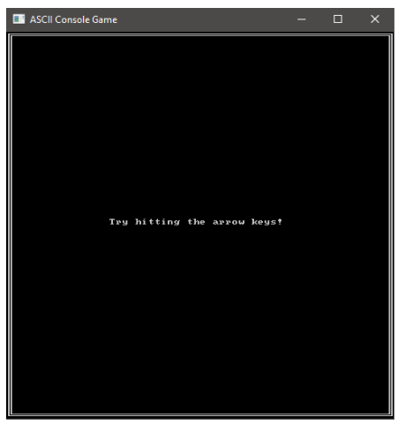
CHALLENGE 2: ASCII Console Game

Slide 7
CHALLENGE 3: Energy Simulator

Slide 8
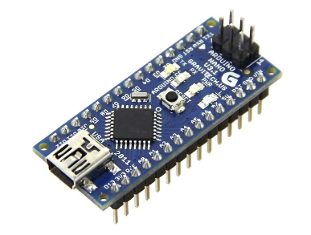
CHALLENGE 4: Key Pad Security System
Notes:
EL:
To find your team number and team leader go to the website on the slides and log in with your university of Southampton credentials:
You will be able to find your group number and your helper name and your jumpstart helper will be able to check you in
*wait for people to take a note of the url – maybe write up on board if needed*

Slide 9
CHALLENGE N: Free time
?
Notes:
Do whatever you want if you have the imagination and time!

Slide 10
JUDGING CRITERIA
POLISHED RESULT
FUNCTIONALITY
CREATIVITY
TEAMWORK
ENGAGEMENT
Notes:
POLISH: HARDWARE MIGHT LOOK AT USER INTERFACE LOOKS
FUNCTIONALITY: HOW WELL DOES IT WORK??
ORIGINALITY: HOW MUCH OF YOUR OWN STUFF YOU’VE ADDED (MAYBE CALL EXTENSION)

Slide 11
HACKATHON TIPS
Talk to people!
Try new things!!
Don’t be afraid to ask for help!!!
…Have fun and enjoy yourself!!!!

Slide 12
Get in yer teams
Freshers’ Facebook Group
https://www.facebook.com/events/399759247626838/
ECSS Page & Group
https://www.facebook.com/groups/ecss.soton/
https://www.facebook.com/ecss.soton/
Notes:
EW:
And most importantly, make sure you follow the ECSS facebook page and join the facebook group and groupchat. It’s the best way to keep up to date with all the great events we’ve got planned this year and to meet the other people on your course! Come and visit me and Ethan on the city challenge station for help joining these groups if you need it or to ask any other questions!
Thank you for listening and we hope you enjoy your time at the university.
Any questions about ECSS? ☺
*click to next slide if about to do the Q&A otherwise exit*
Please just talk amongst yourselves for a bit, while we wait for the Q&A panellists to come over.

Slide 13
Any Questions?

