Slide 1

Mesoscale Convective System (MCS) Detection and Tracking Methodology A case study of Texas extreme weather events and subsequent flooding in late May, 2015

Slide 2
Summary of MCS Classification Methodology
Requirement | Variable | Threshold | Physical Purpose
Cold cloud shield | Tb | Tb < 241 K | Identifies anvil-scale cloud organization
Convective core | Minimum Tb | Tb_min ≤ 225 K | Confirms ongoing strong convection
Horizontal scale | Area | ≥ 60,000 km² | Distinguishes mesoscale systems
Lifetime | Duration | ≥ 6 hours | Ensures sustained organization
Track continuity | Centroid distance | ≤ 250 km/frame | Follows lifecycle evolution

Slide 3

MCS Intensity Index
coldness of core (C)
mesoscale size (S)
Where:
T_CCS = 241 K (CCS threshold),
T_b,min⁡​ = minimum Tb within the object (K),
T_b,window = ~50 K below the 241 K threshold (i.e., down near ~191 K) corresponds to very cold overshooting tops.
A = CCS area (km²) for the object at that hour,
A_0 = 40,000 km² (a soft-saturation scale function from 0 - 1). It’s below the MCS area threshold (60,000 km²), so truly mesoscale anvils already yield high size scores while still leaving room for larger systems to stand out
Interpretation:
Larger systems → higher intensity
Colder cloud tops → stronger or more vigorous deep convection
This is not a rainfall measure; it is a structural + convective vigor indicator.

Slide 4
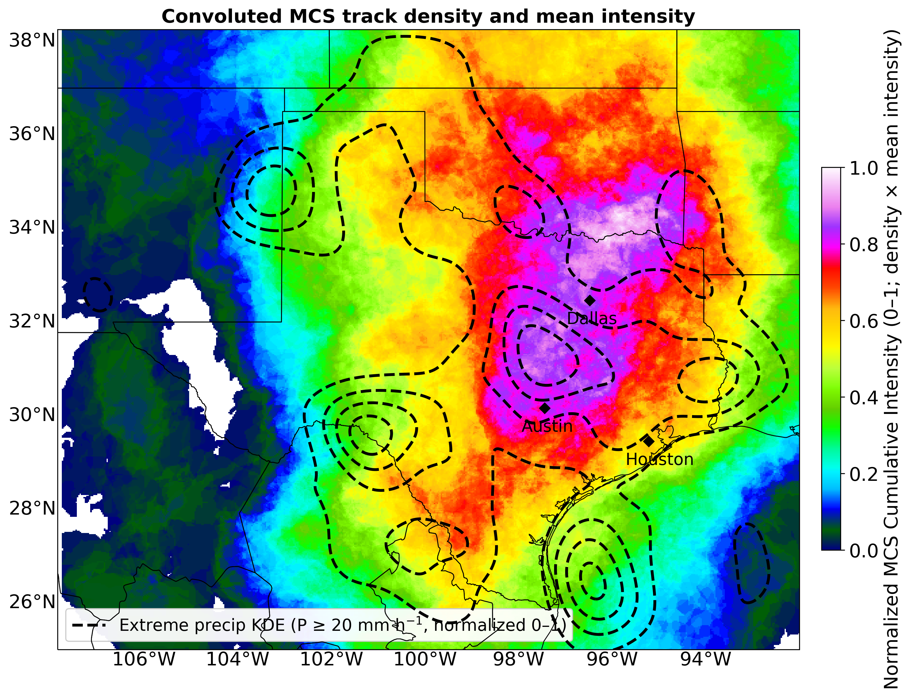
Strong spatial overlap between MCS cumulative intensity and extreme precipitation (≥ 20 mm h⁻¹) confirms MCSs as the primary driver of extreme rainfall in this region.
Globally available datasets are applied, Tb: MERGIR and Precipitation: GPM IMERG

Slide 5
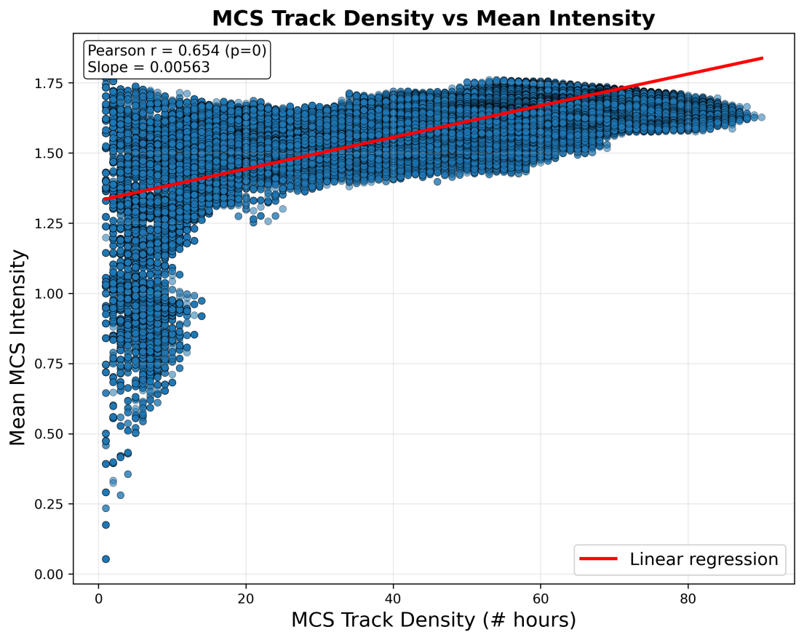
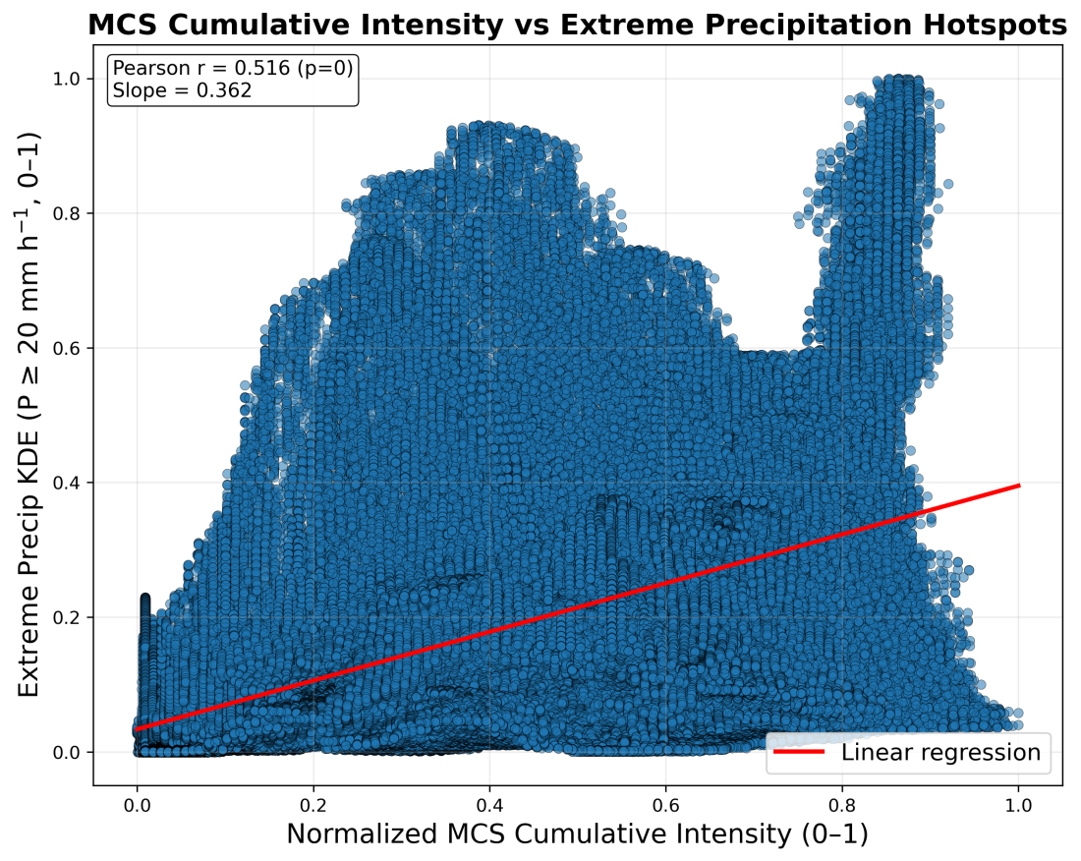
MCS frequency sets background risk: Higher MCS track density corresponds to higher mean and cumulative intensity, defining corridors of frequent, strong organized convection.
MCS activity governs heavy, not extreme, rainfall: Cumulative MCS intensity is strongly linked to heavy precipitation (≥ 20–30 mm h⁻¹) but shows a much weaker relationship with the most extreme rates (≥ 50 mm h⁻¹).

Slide 6
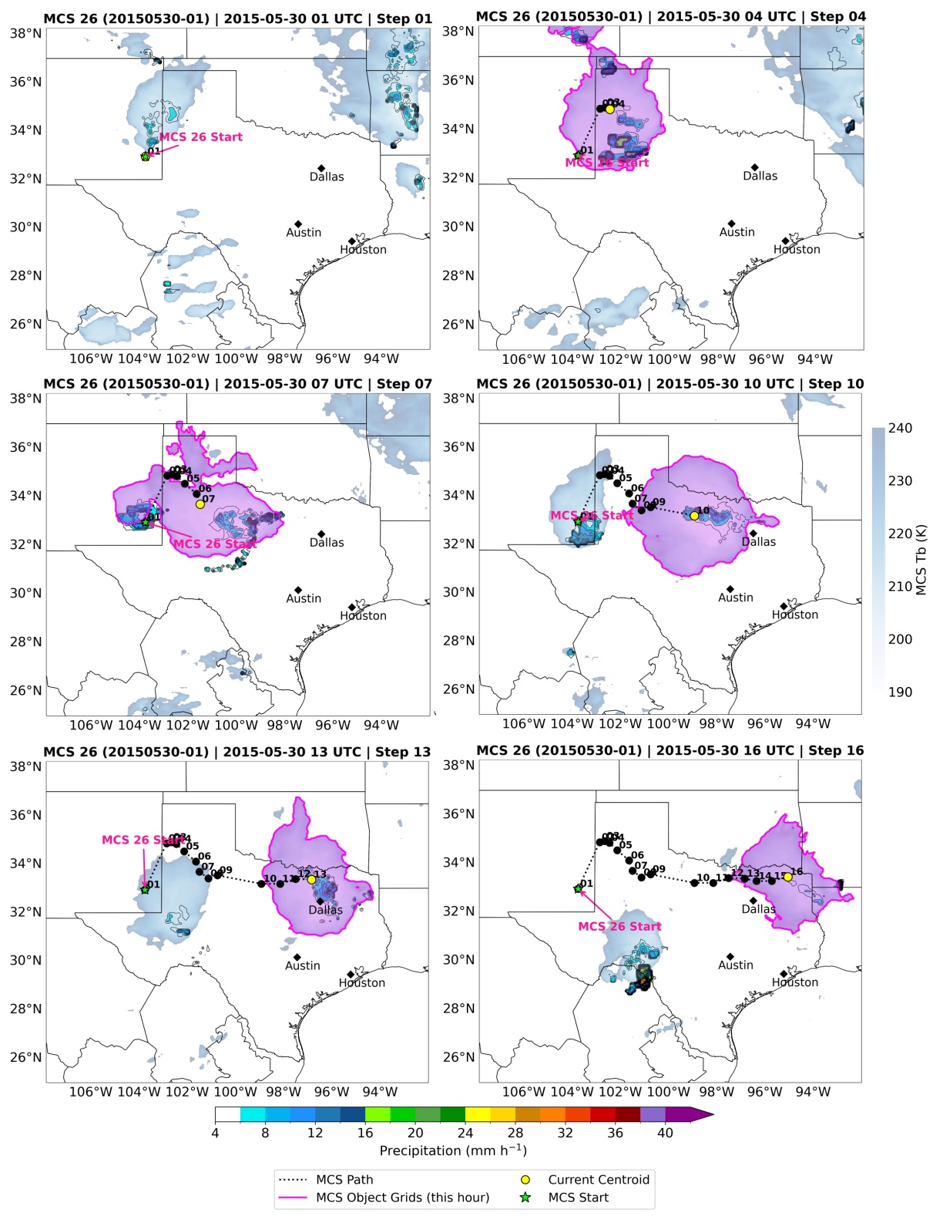
Robust MCS tracking performance:
The tracking algorithm successfully captures MCS initiation, coherent propagation, and structural evolution across multiple hours, demonstrating its ability to follow long-lived, organized convective systems.

