Slide 1
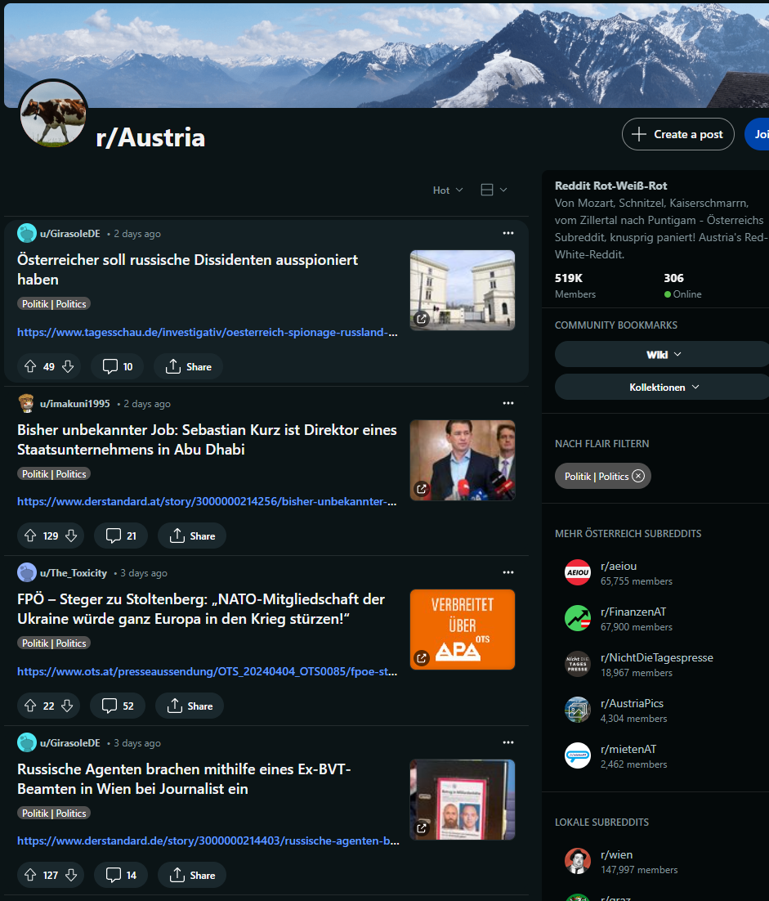
Austrian parties Sentiment Dashboard Visual Analytics
Group 09:
Samir Kumar
Stefan Romen
Vishal Singh
Niklas Tscheppe

Slide 2
Reddit Data
Reddit API
Python Reddit API Wrapper “PRAW” to collect posts and comments
used different subreddits like “r/Austria” , “r/wien” etc.
Alternatively searched in subreddits of larger cities like “r/graz”
didn‘t find any data for Burgenland, Carinthia and Vorarlberg
searched for posts about Austrian parties and use these comments for sentiment analysis

Slide 3
Sentiment Analysis
model: "ssary/XLM-RoBERTa-German-sentiment“ from transformers package
trained on over 200,000 German-language sentiment analysis samples
builds on Google‘s BERT
tried different models
Overall results:

Slide 4
Motivation
The aim is to gain insights into public opinion and discussions about the Austrian parties and election issues on Reddit
A new National Council will be elected in Austria by autumn at the latest. In order to show the political mood among Reddit users, we will analyze posts and comments from subreddits that deal with Austrian politics.

Slide 5
Who would be the customers
Journalists and Reporters
Political Analysts and Researchers
Government Officials and Policy Makers
Political Campaigns and Strategists
Academic Researchers
Market Researchers
Nonprofit Organizations
Social Media Managers
International Observers and Diplomats
Data Scientists and Analysts.

Slide 6
Use case
Get an overview over the political views of reddit.
Understand how often parties are referenced.
View connections between parties.

Slide 7
Solution Proposal

Slide 8
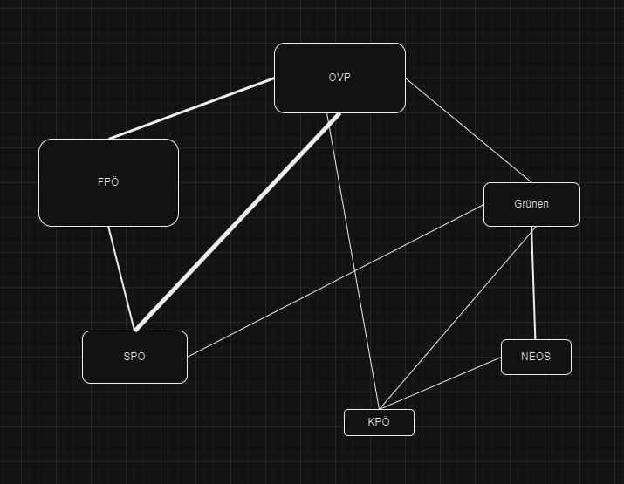
Solution description
- Cluster based on parties and how often parties are referenced.
- Sentiment about each party.
- Keywords mentioned with each party.

Slide 9
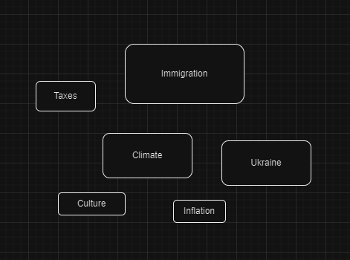
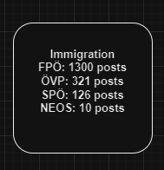

Slide 10
Development Environment
Backend
Python
FastApi
Uvicorn
Pandas
Praw
Transformers(BERT)
NLTK
Frontend
Javascript
vue.js
vis.js
Chart.js

Slide 11
Dataset
use the Python Reddit API Wrapper “PRAW” to collect the data
use of different subreddits like “r/Austria”
search for posts about politics and use these posts and comments

Slide 12
Timeline
Startdate: 15th of April
Deadline: 10th of June
1st-2nd week: Data preparation and cleaning
3rd-4th week: Data analysis
5th-7th week: Design and implementation of the interactive dashboard
8th week: Testing and troubleshooting

Slide 13
Questions?

