Slide 1
Cells clustered by endpoints/um^3 in each region
Correlation coefficient
cells
cells

Slide 2
Cells clustered by endpoints/um^3 in each region
mossys
Correlation coefficient
cells
cells

Slide 3
Cells clustered by endpoints/um^3 in each region
PeriV/V projections?
Correlation coefficient
cells
cells
Notes:
['N029-703070', 'N032-674185-IB', 'N010-703070', 'N023-703070',
'N004-703070', 'AA1460', 'AA1196', 'AA0947', 'N046-658735-AR', 'AA1521',
'N005-674185']

Slide 4
Cells clustered by length/mm^3 in each region
Mossy fibers clear
Strong trigeminal projections cluster
Little other structure
Correlation coefficient
cells
cells

Slide 5
This is that top left non mossy cluster, its all cells with lots of axon, projections to trigeminal motor areas, but seem to me to be two separate clusters in actuality

Slide 6
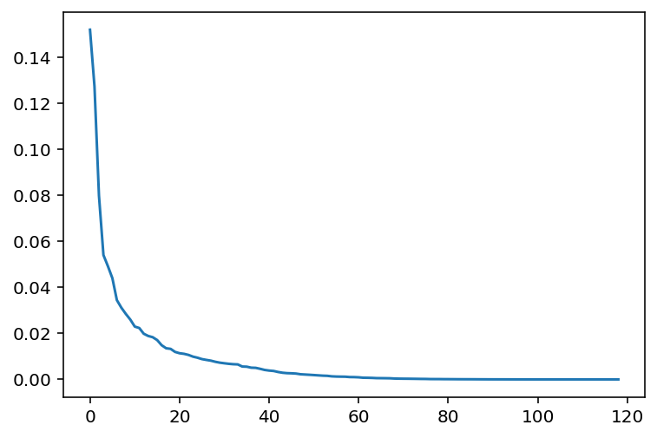
PCA on this same data, plotting explained variance by component
Top 20 components explain ~80% of variance
explained variance
n components

Slide 7
Cluster on top 20 components
1
2
3
4
5
6
Notes:
Yea this looks like trash
Loadings of regions onto these pcs don’t make a ton of sense either

Slide 8
1
2
3
4
5
6

Slide 9
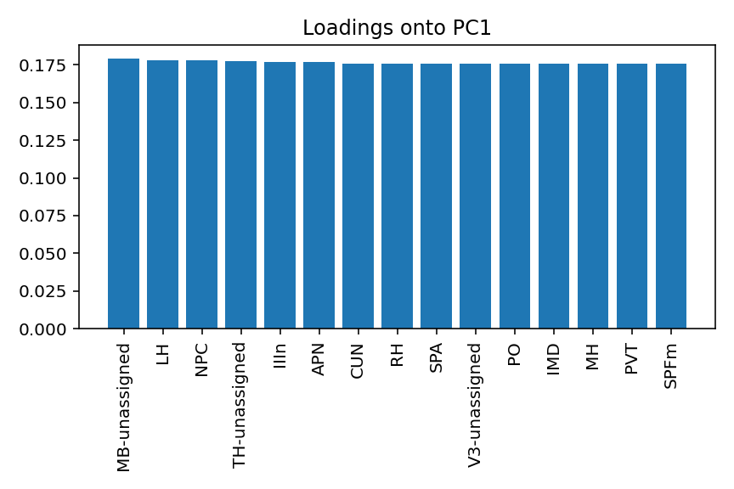
Loadings of regions onto top 6 PCs

Slide 10
sPCA cell by cell correlation coefficient, again top 20 PCs
1
2
3
4
5
Notes:
Unthresholded, this doesn’t look terrible at first glance
Maybe would be interested to sort the indices by my phenotypes and see if the structure is clearer?

Slide 11
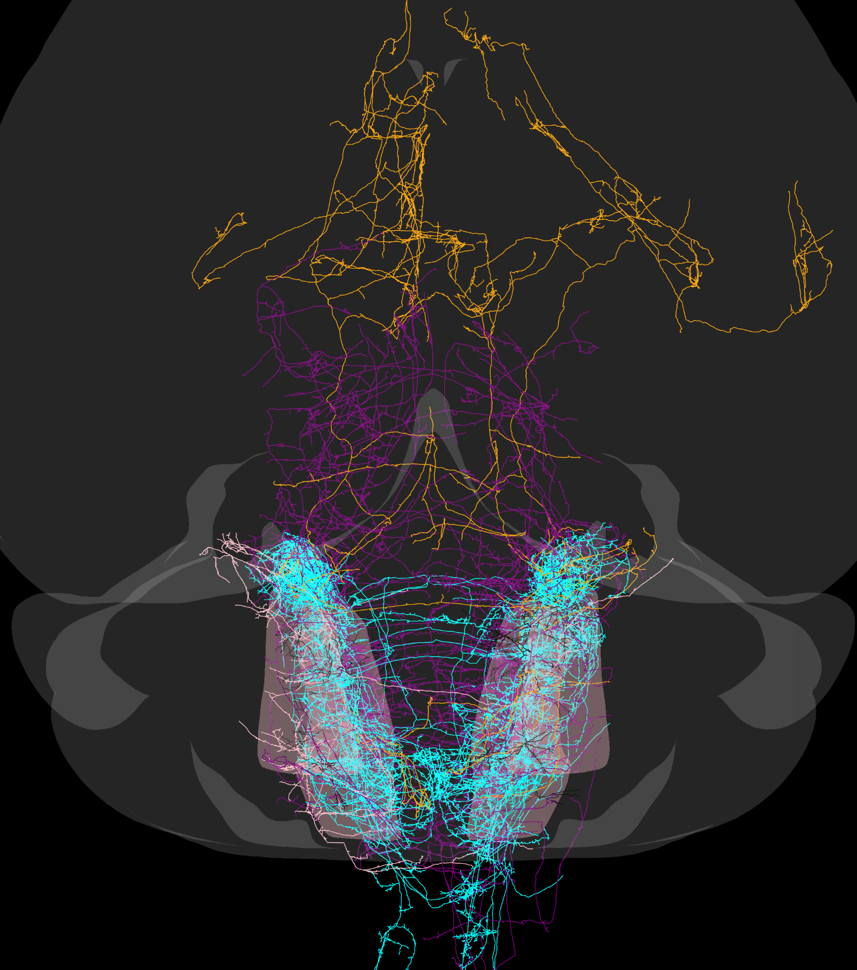
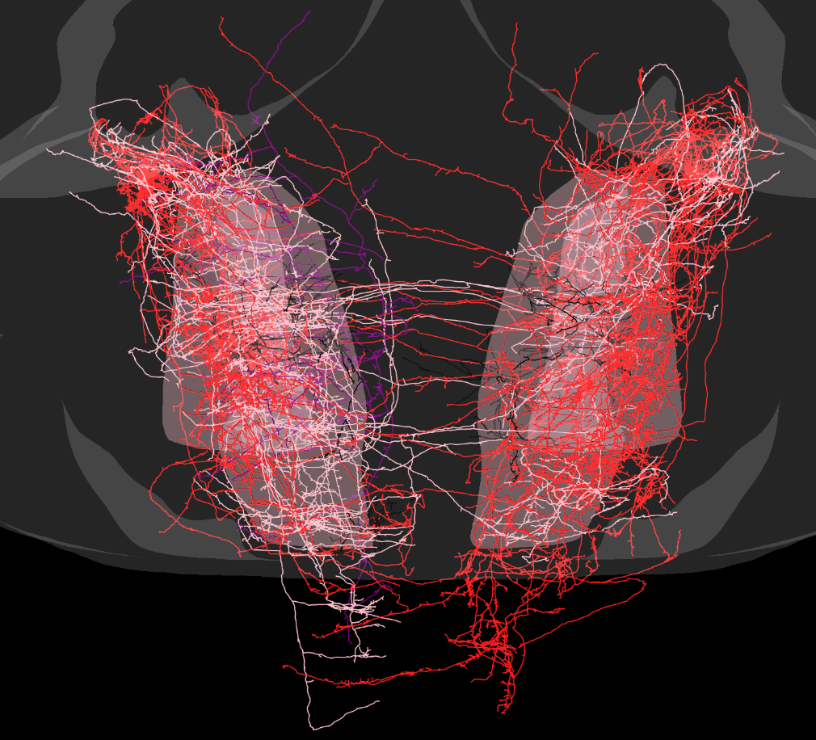
1
2
3
4
5

Slide 12
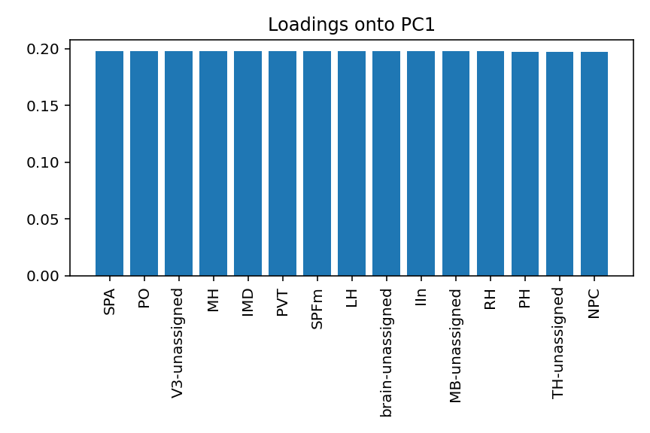
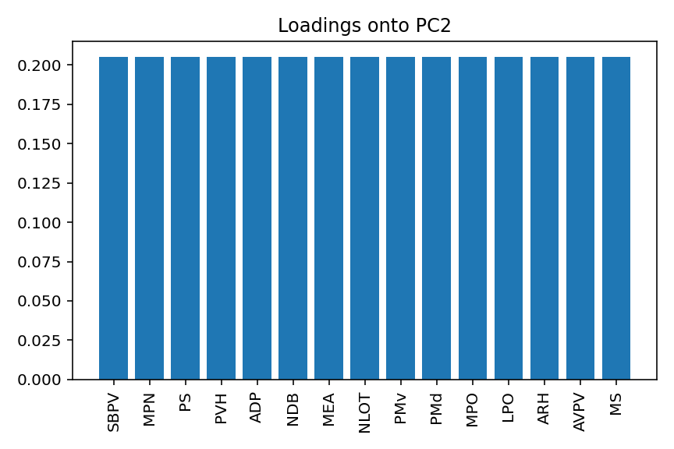
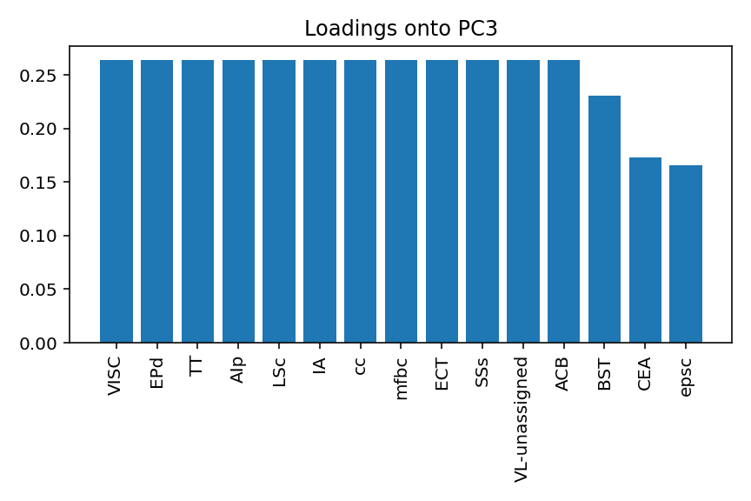
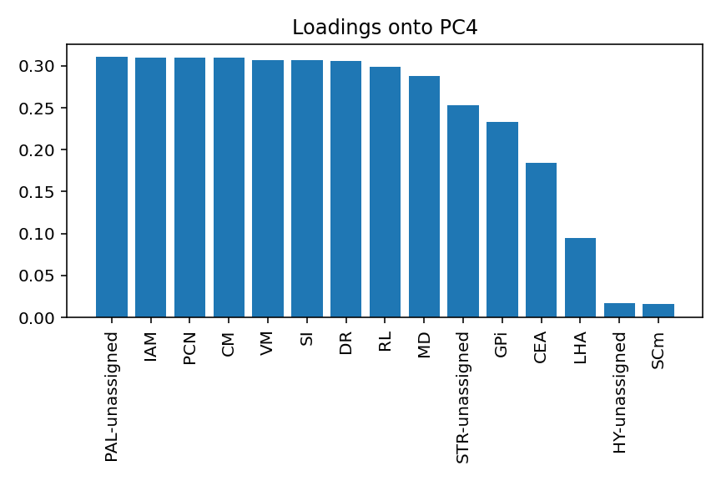
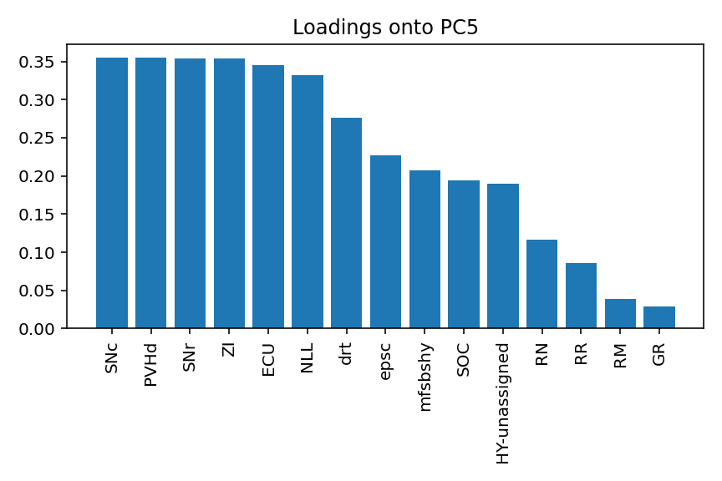
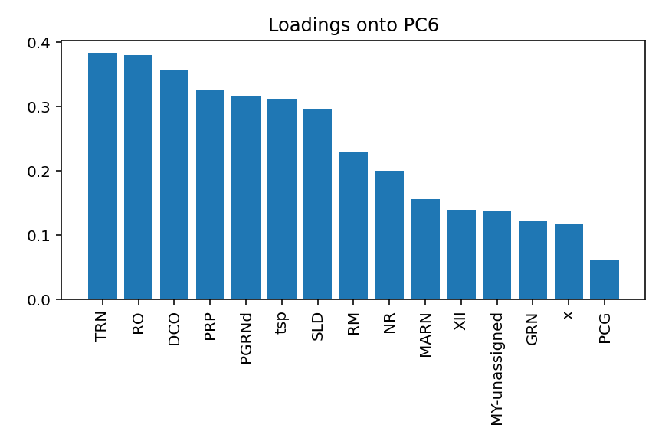
Loadings of regions onto top 6 PCs

Slide 13
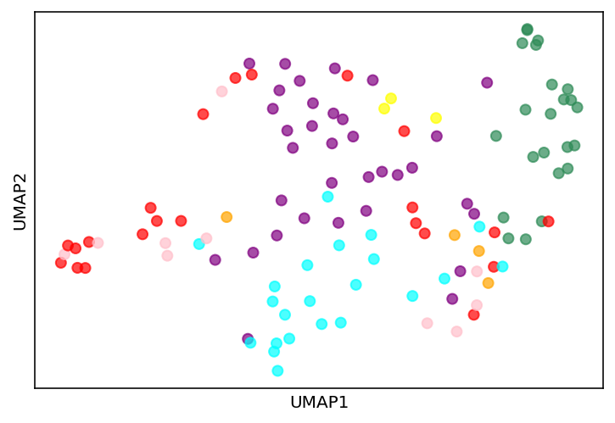
UMAP of sPCA’d data, clusters aren’t super distinct

Slide 14
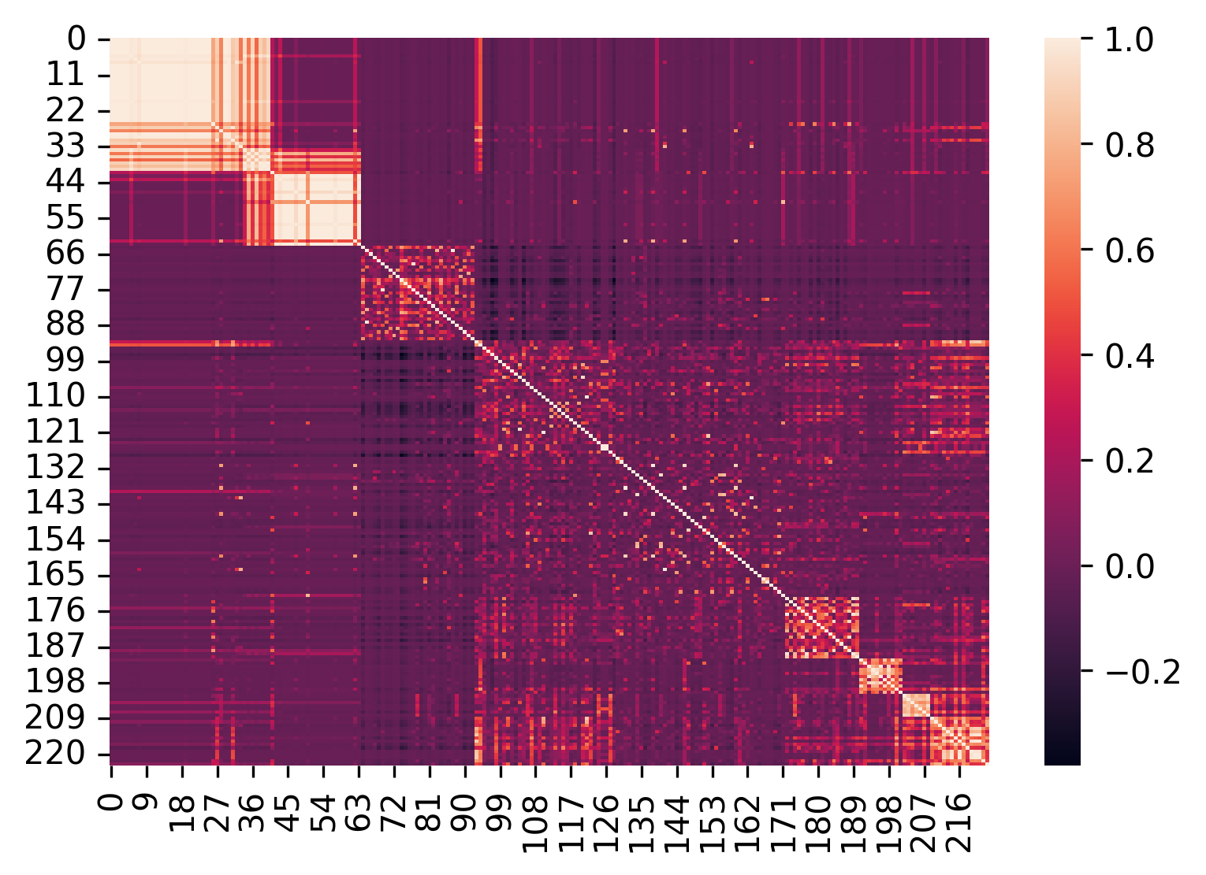
Grouping regions by clustered correlations
regions
regions
Notes:
Top to bottom, HY, CTXsp, CTX, CB, TH, MB

Slide 15
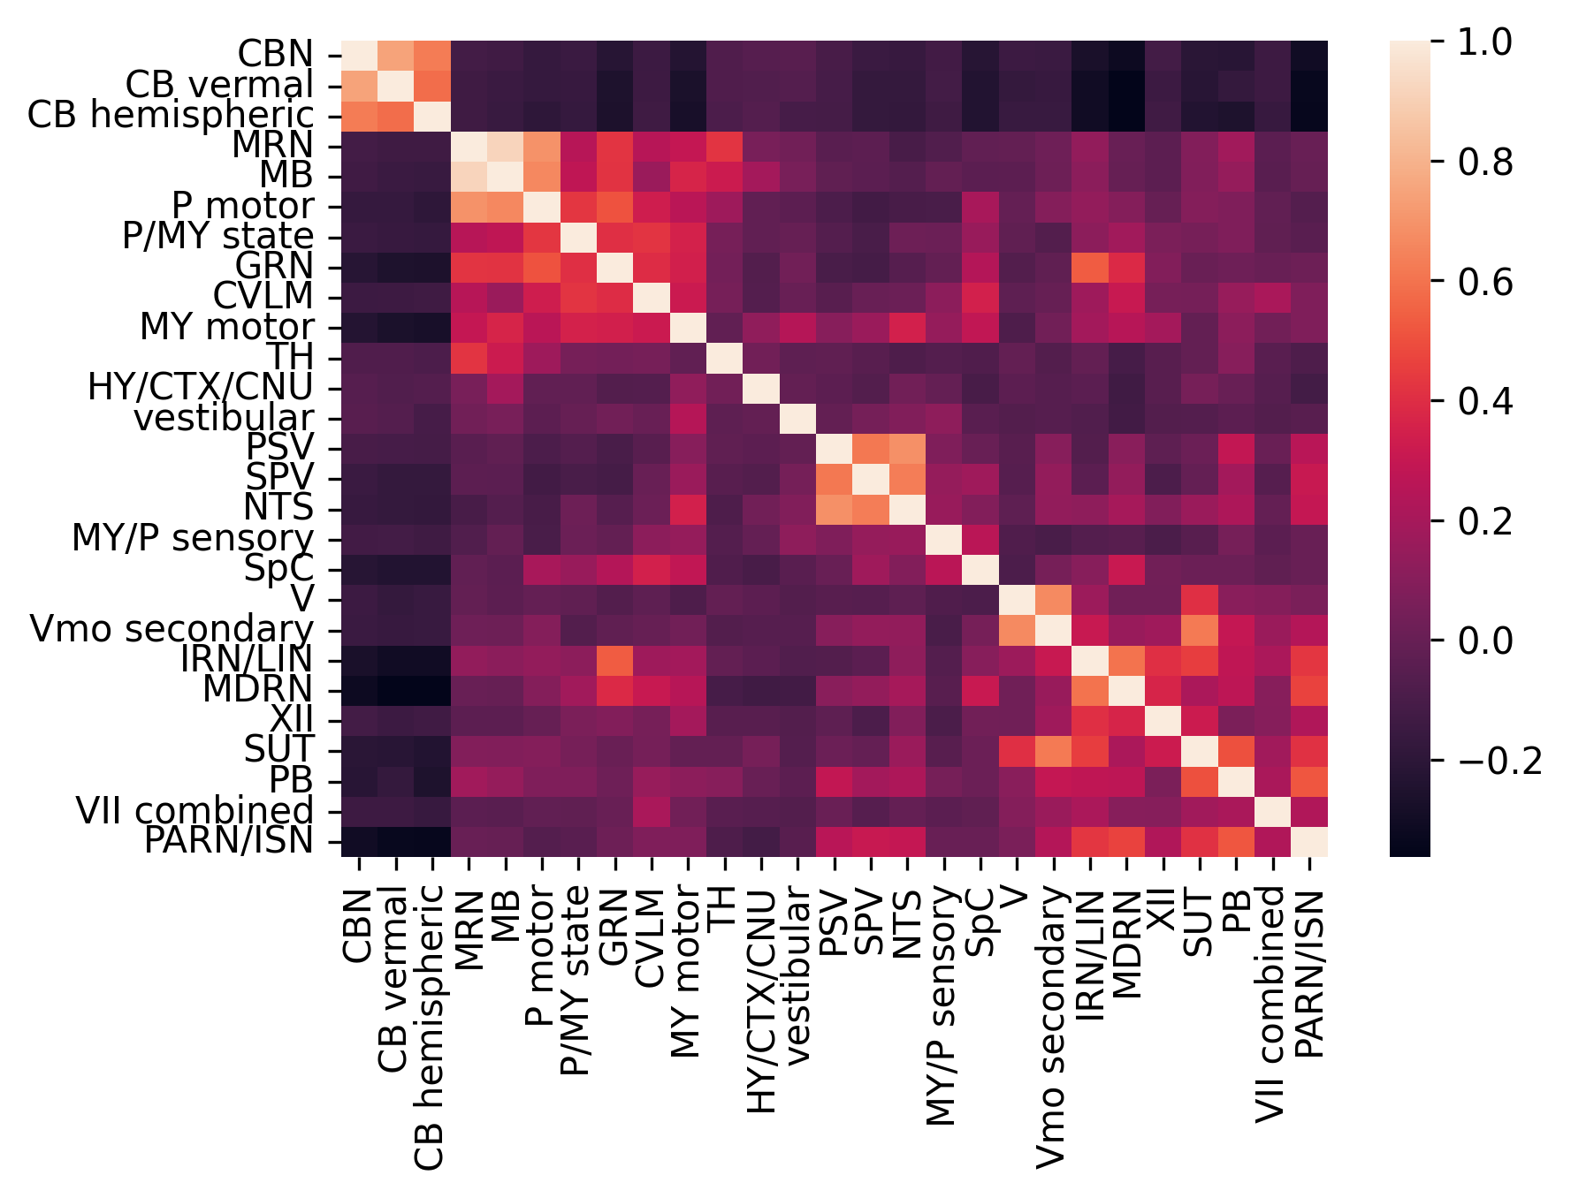
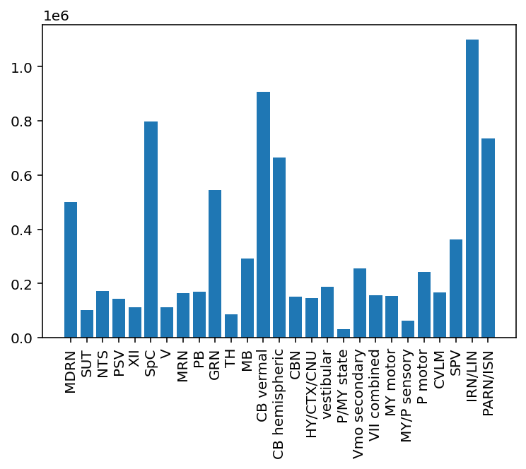
Lump a bunch of regions together, keep relevant ones separate
Total length (um) in region groups

Slide 16
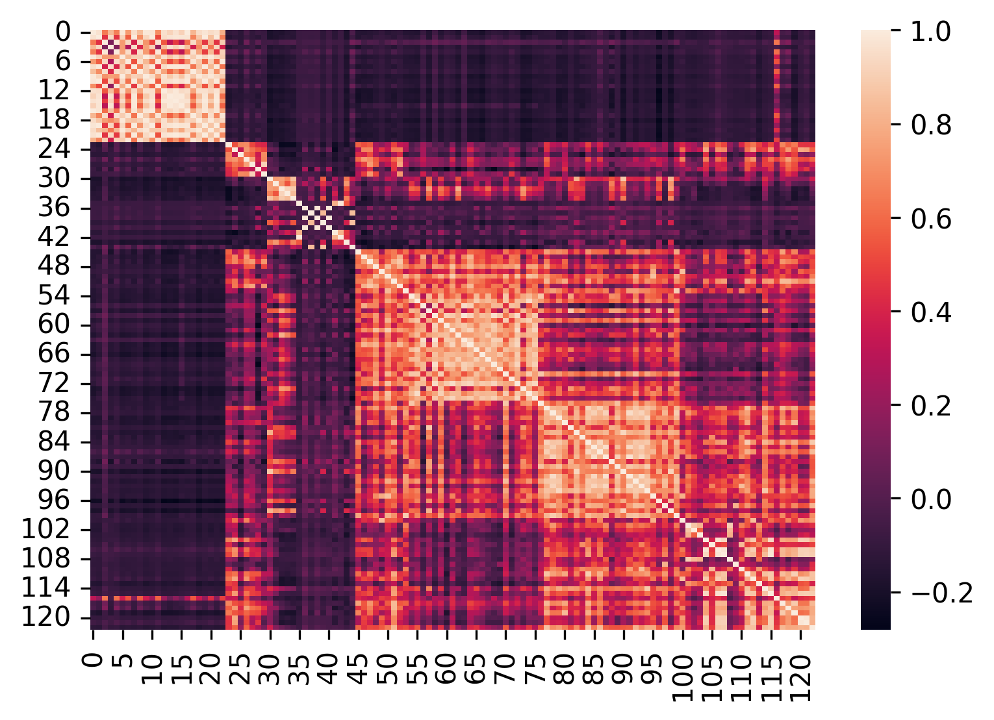
Cell by cell clustering on combined region lengths

Slide 17
Cell by cell clustering on combined region lengths
Cluster 1
Cluster 2
Cluster 3
Cluster 4
Cluster 5
Cluster 6
Cluster 7

Slide 18
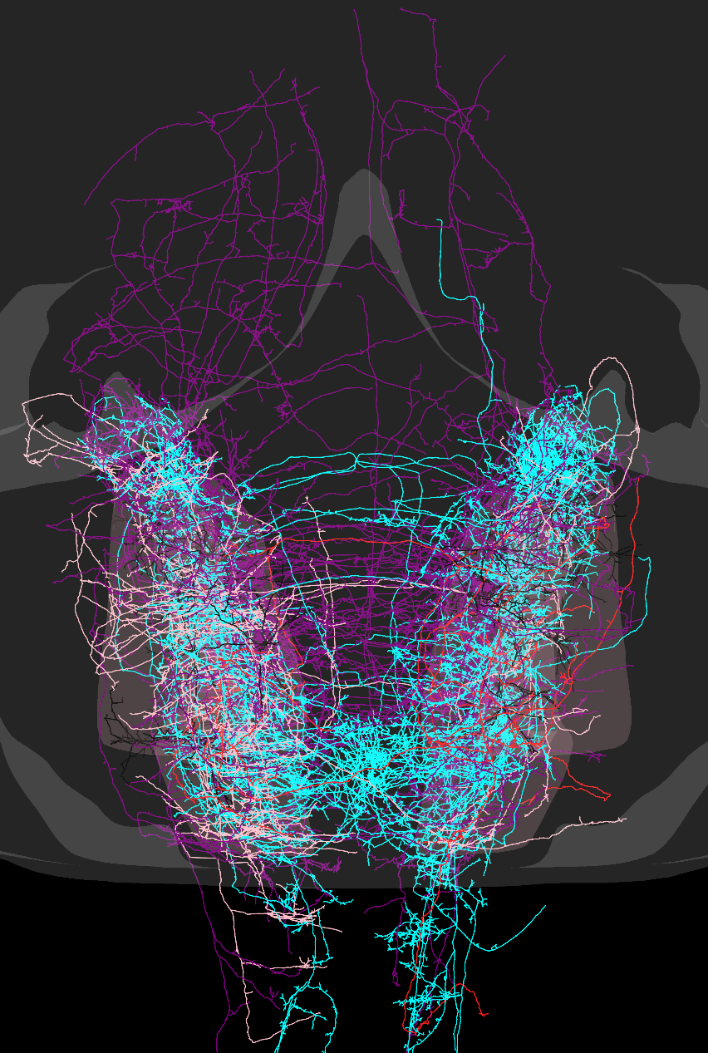
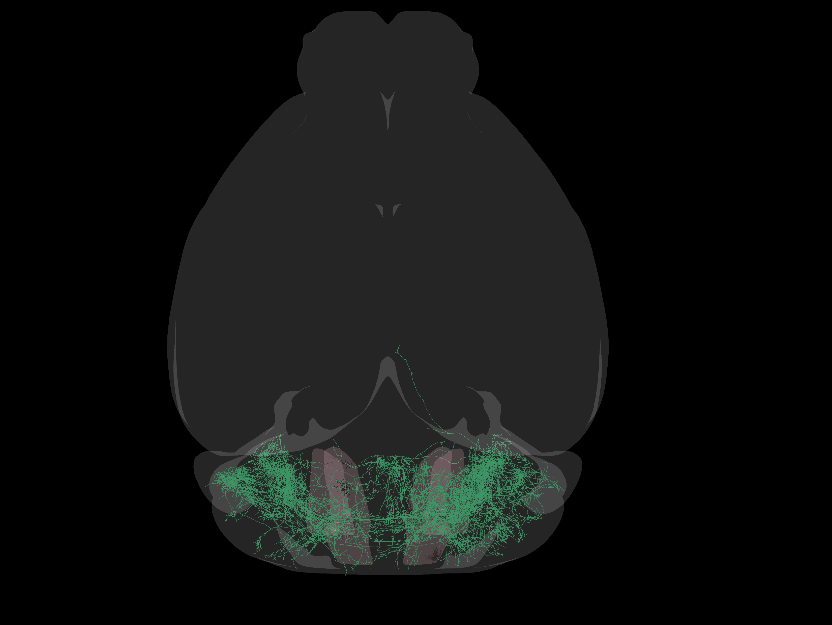
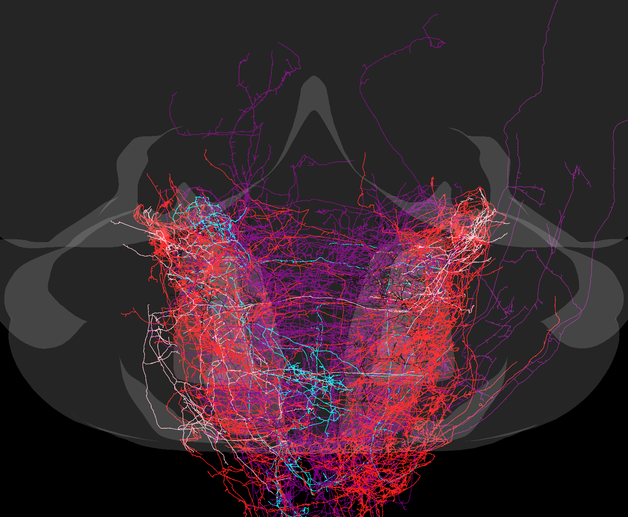
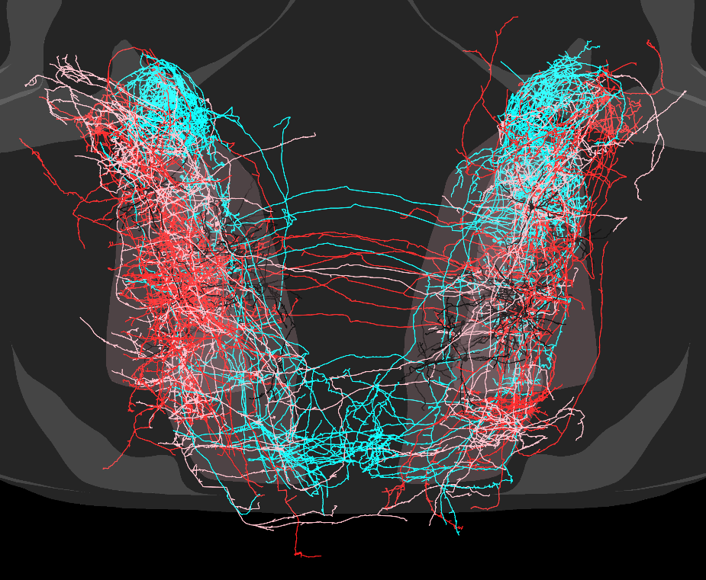
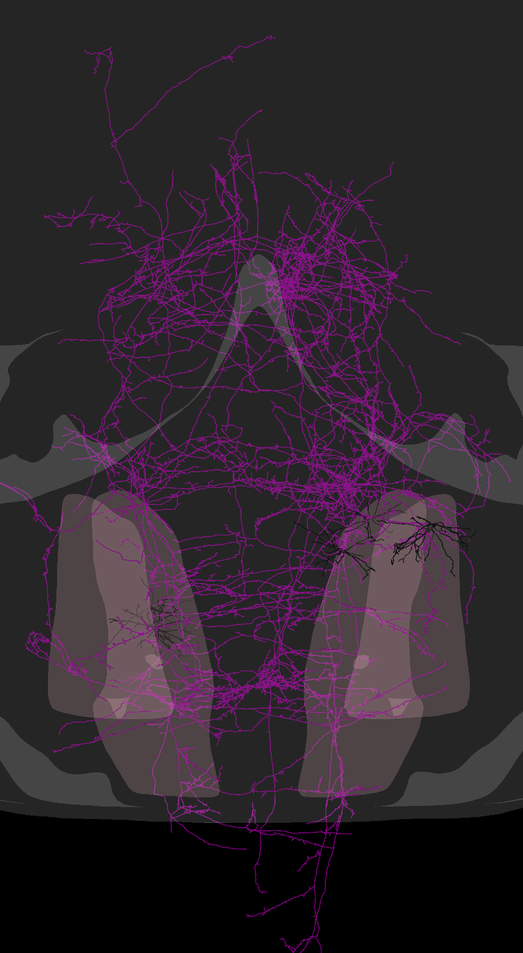
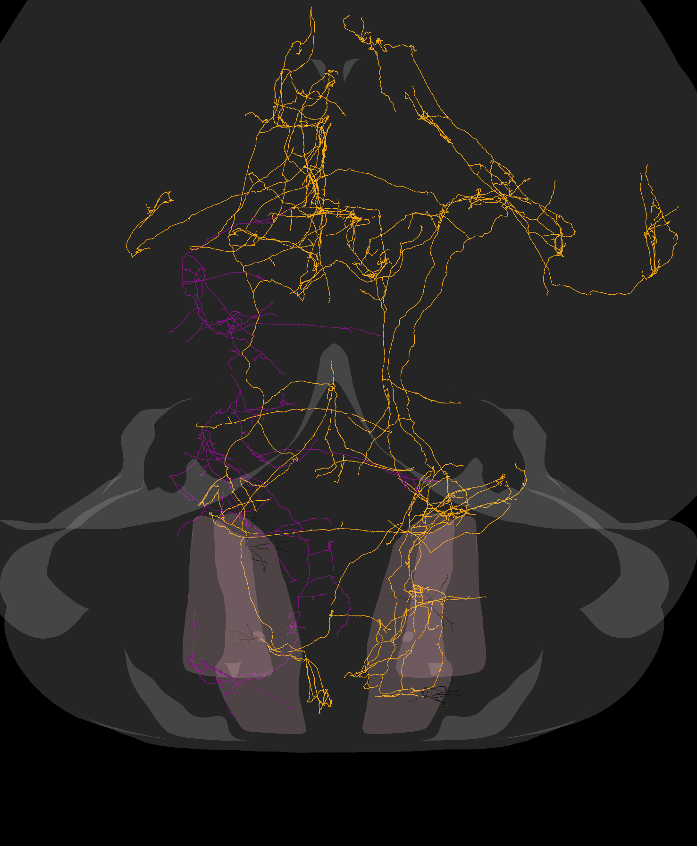
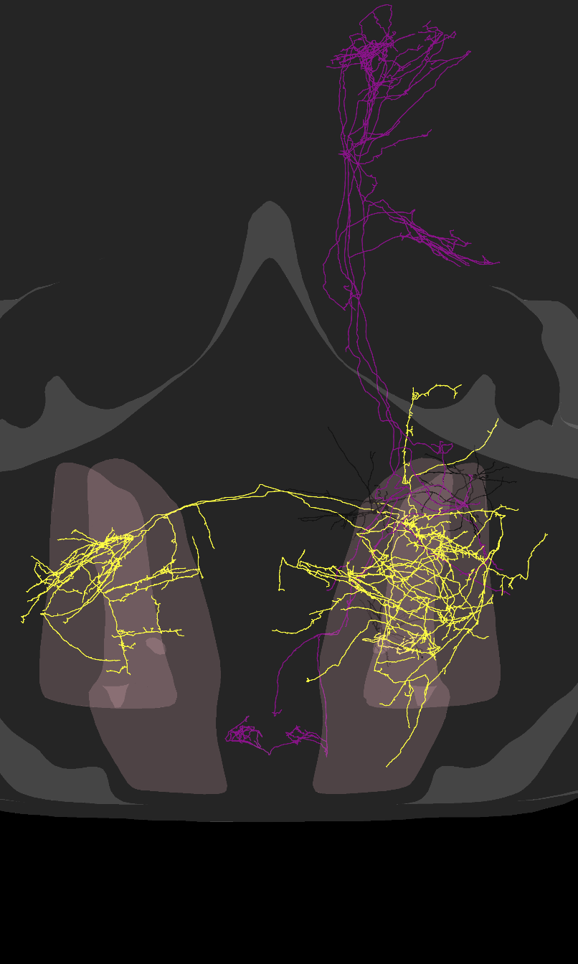
1
2
3
4
5
6
7

Slide 19
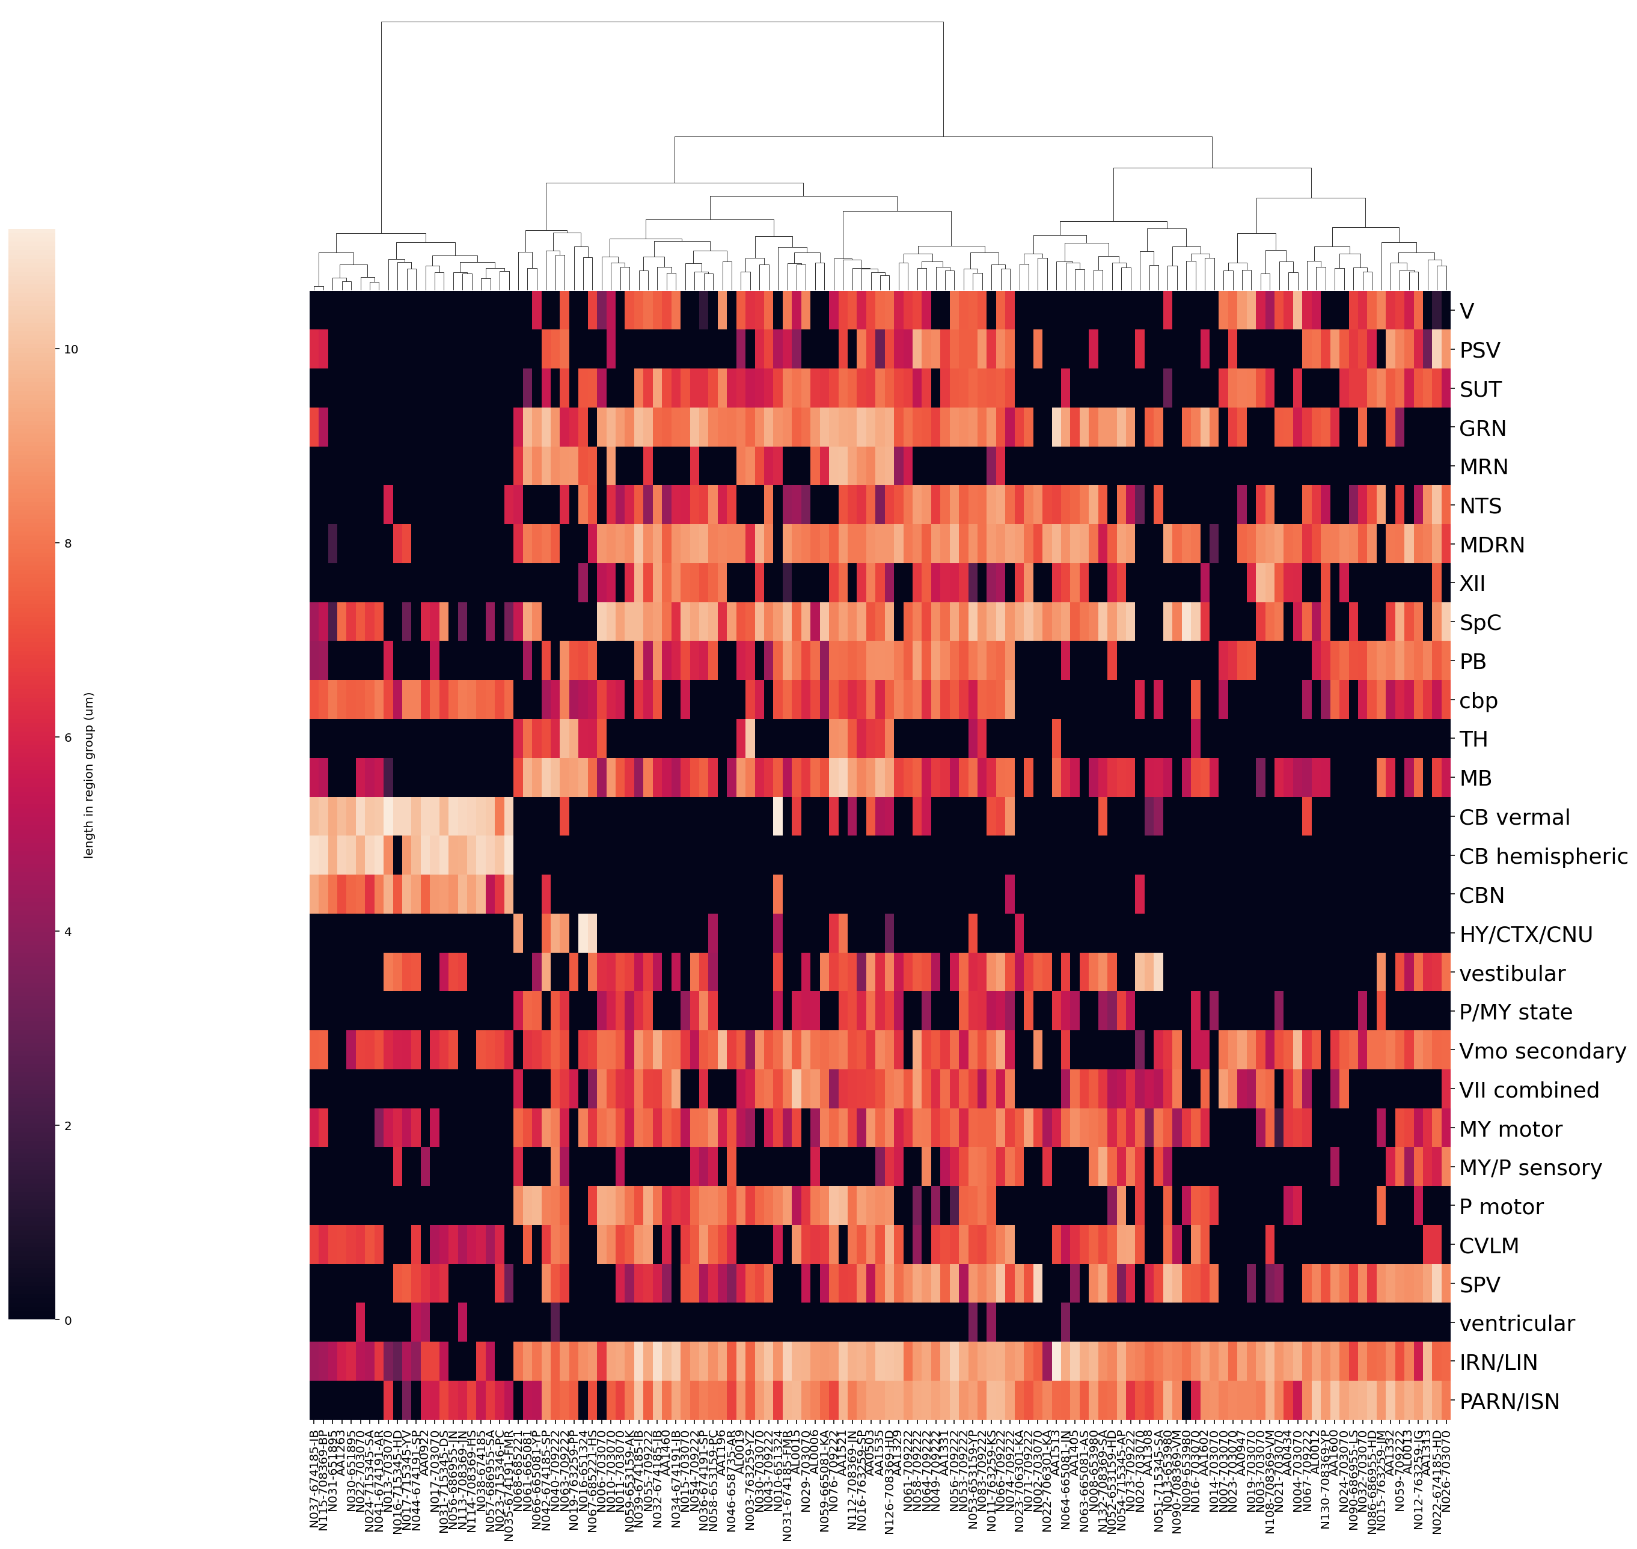
Hierarchical clustering, wards method w/Euclidean distance
Notes:
Log1p’d data, label on the color bar is wrong, should change that

Slide 20
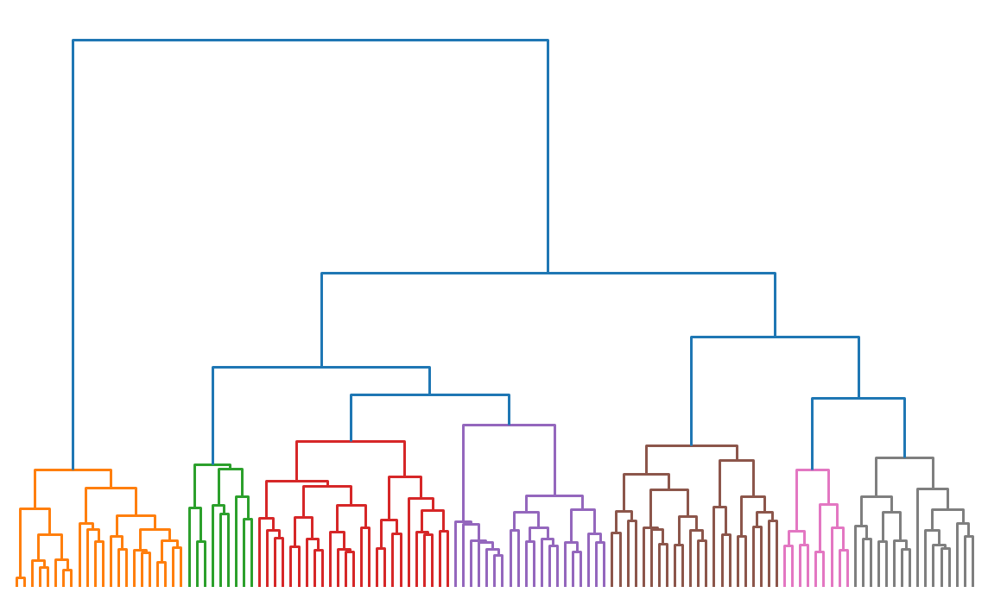
fcluster with 7 clusters max, to try to match my 7 phenotypes
1
2
3
4
5
6
7

Slide 21

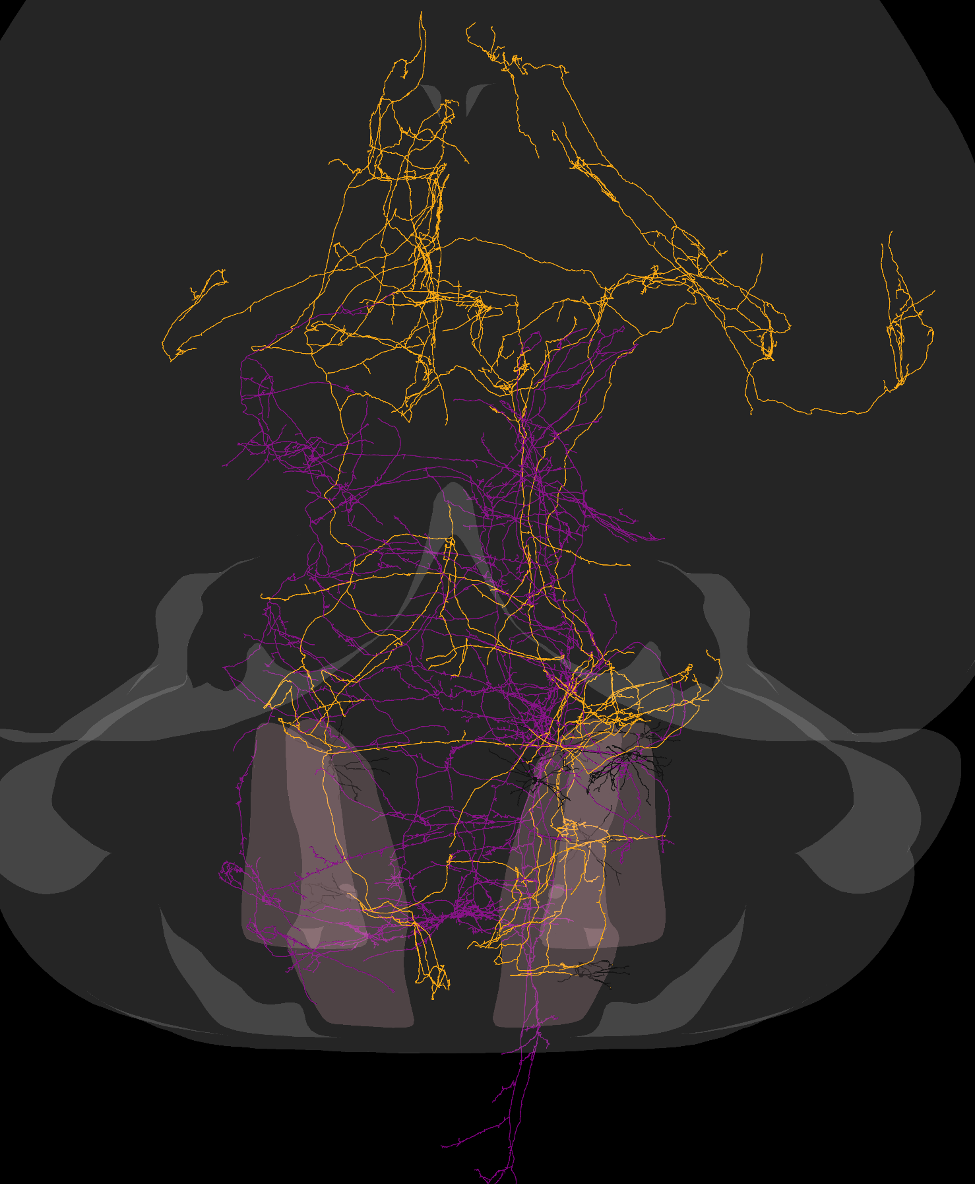
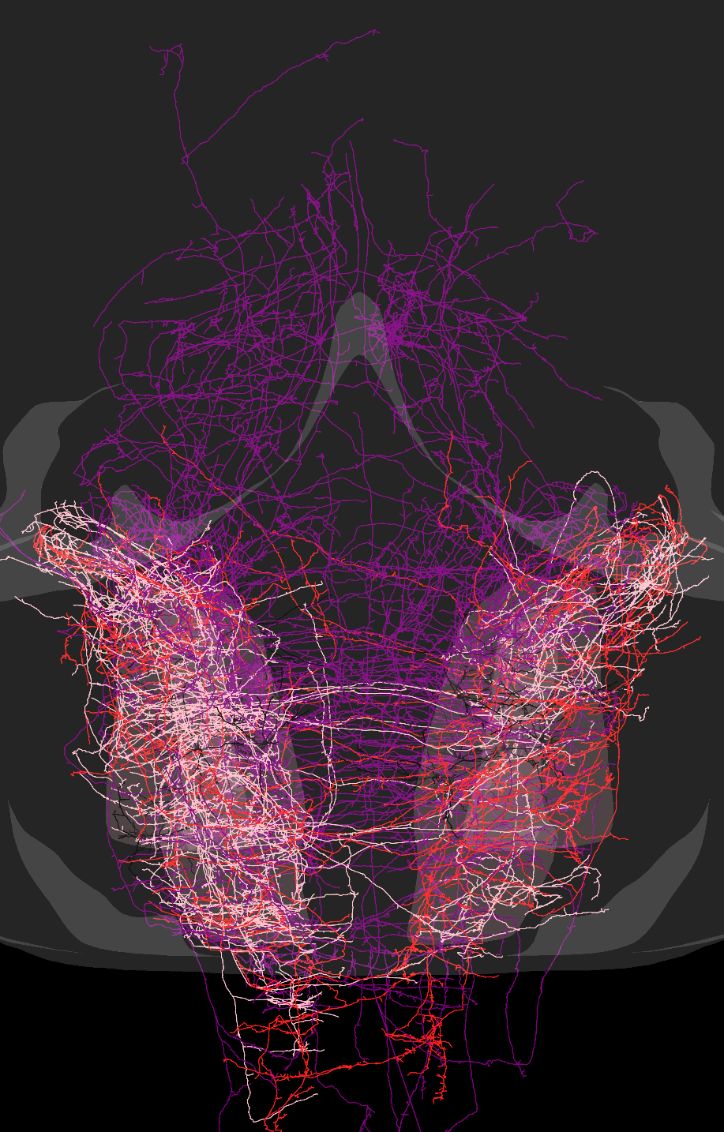
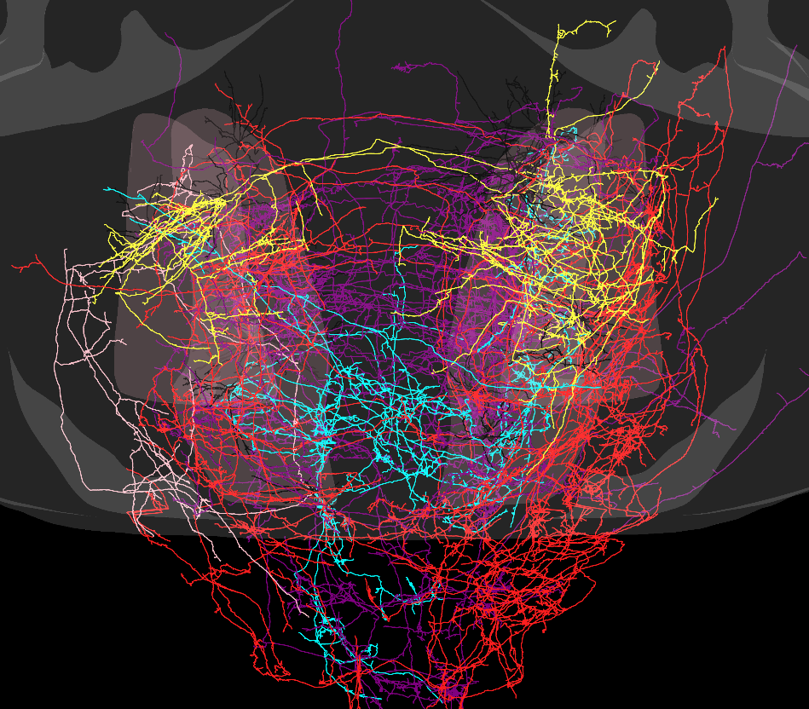
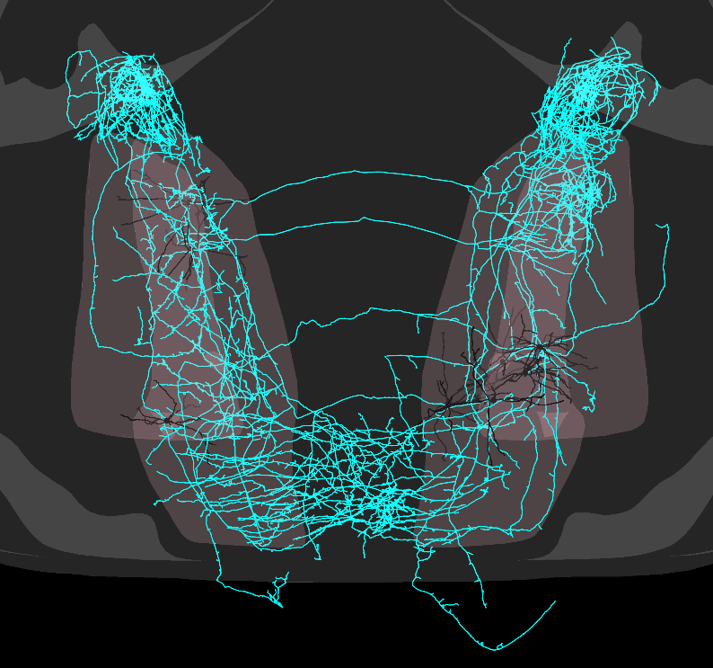
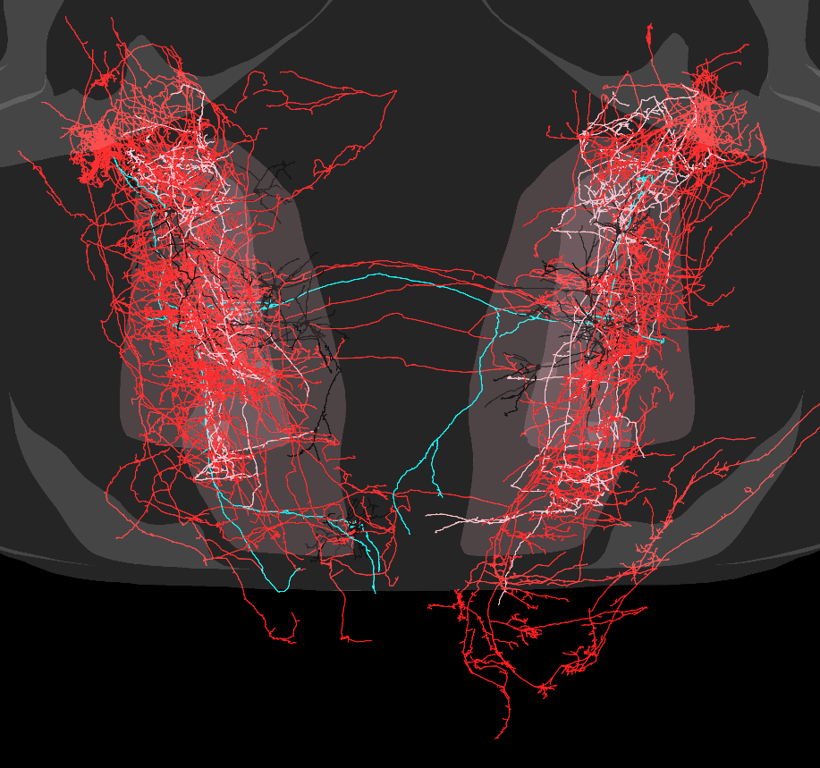
1
2
3
4
5
6
7
Notes:
Cluster images (colored by my phenotype assignments, not the colors I just showed

Slide 22
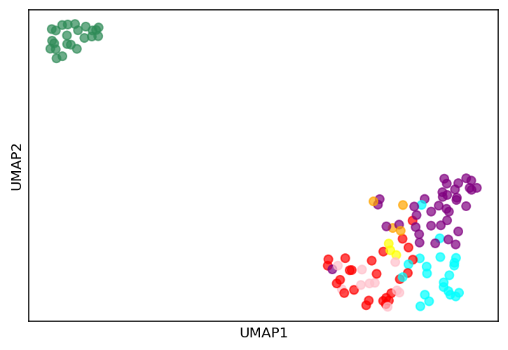
UMAP of combined region data
GRN
Sensory
Sensorimotor
Premotor
Forebrain
Mossy
Vestibular
Notes:
Umap done on just summed micron length in region groups

Slide 23
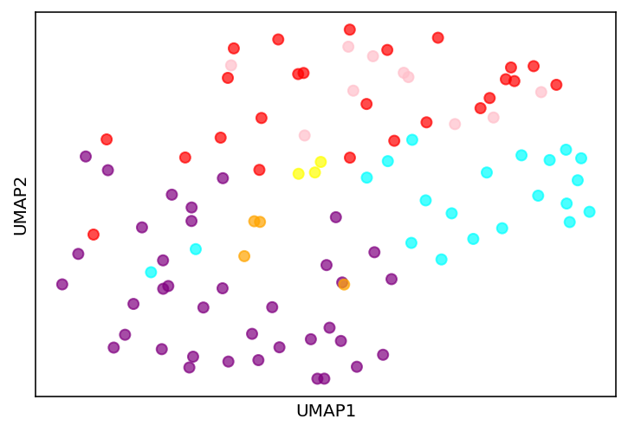
UMAP but drop the mossy fibers
GRN
Sensory
Sensorimotor
Premotor
Forebrain
Vestibular

Slide 24
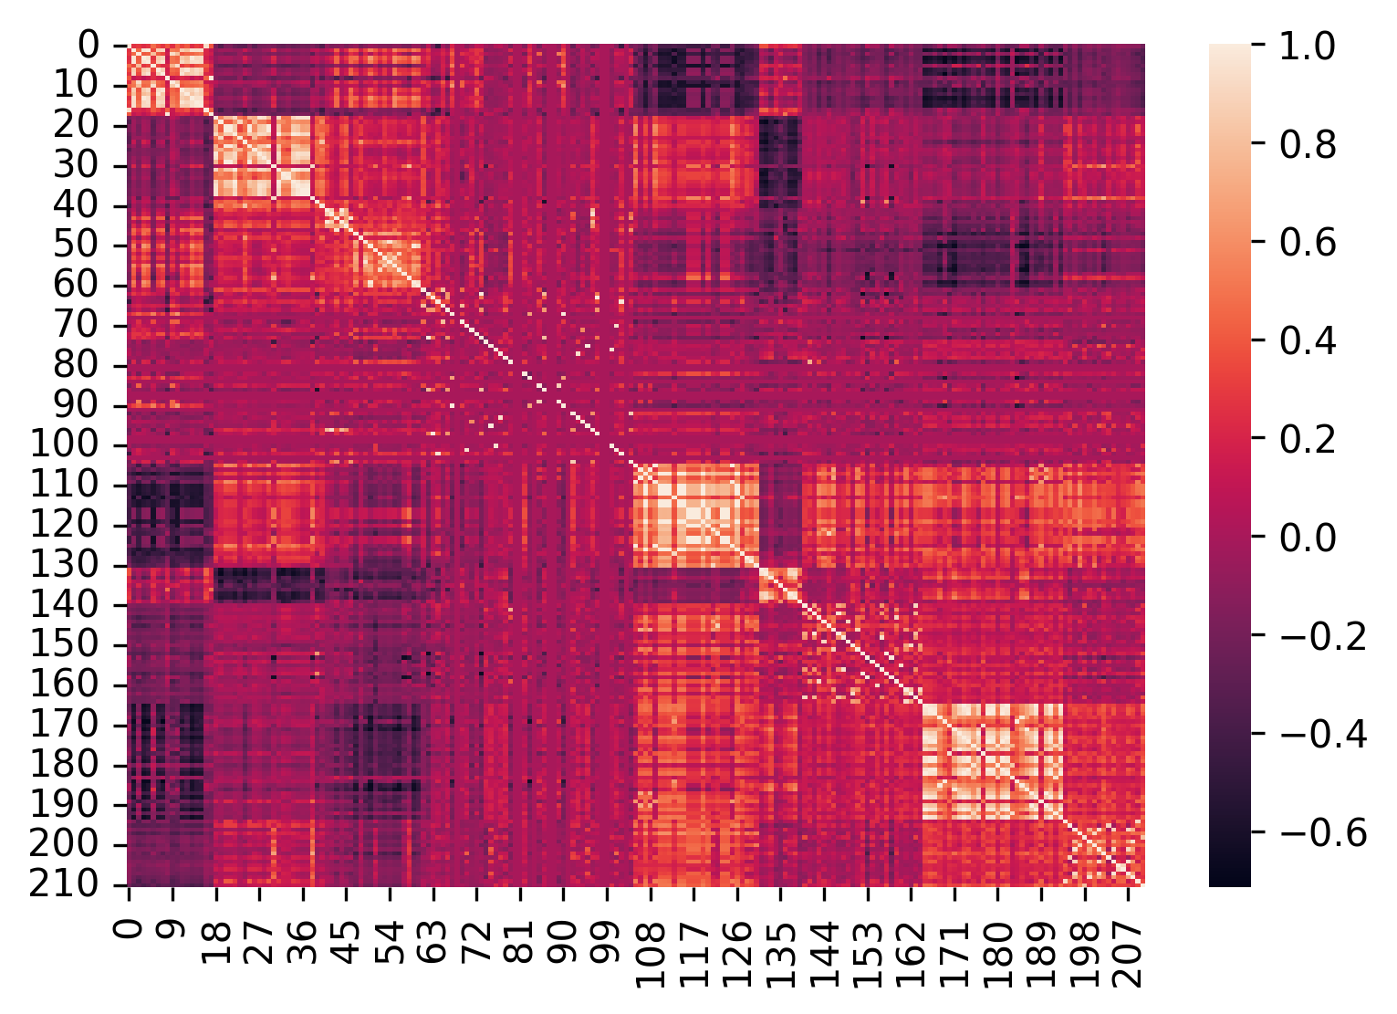
Create large feature matrix using morphometrics
Feature x feature correlation matrix

Slide 25
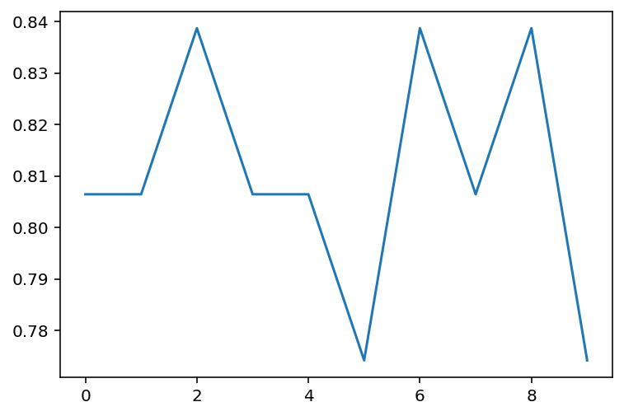
Random forest classification
accuracy
*scores on test data over 10 different splits
Training data split #

Slide 26
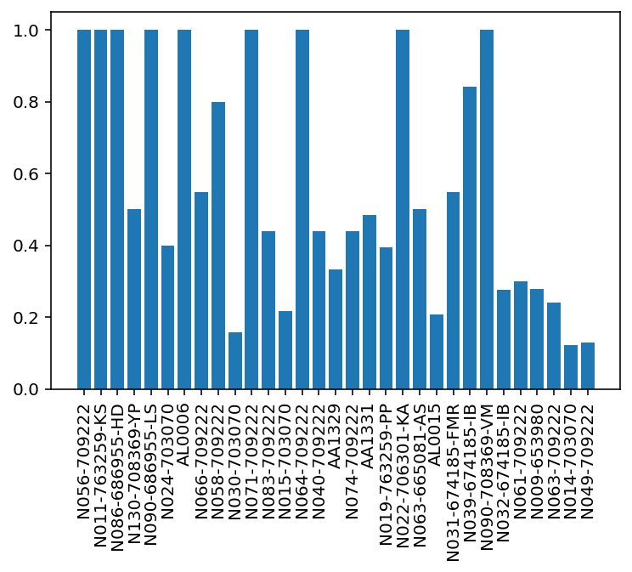
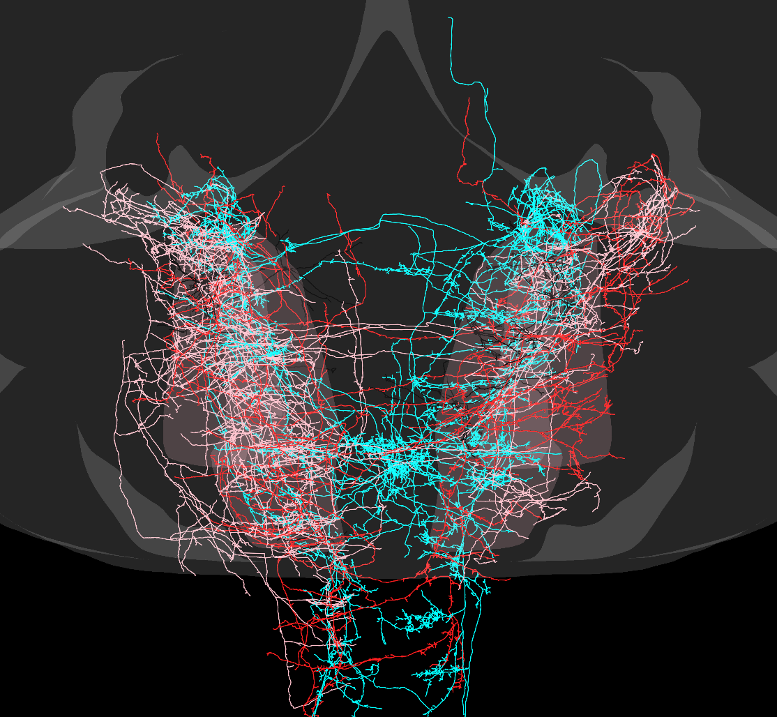
Classifier tends to get the same cells wrong
Cells wrongly classified >50% of time
% times wrongly classified

Slide 27
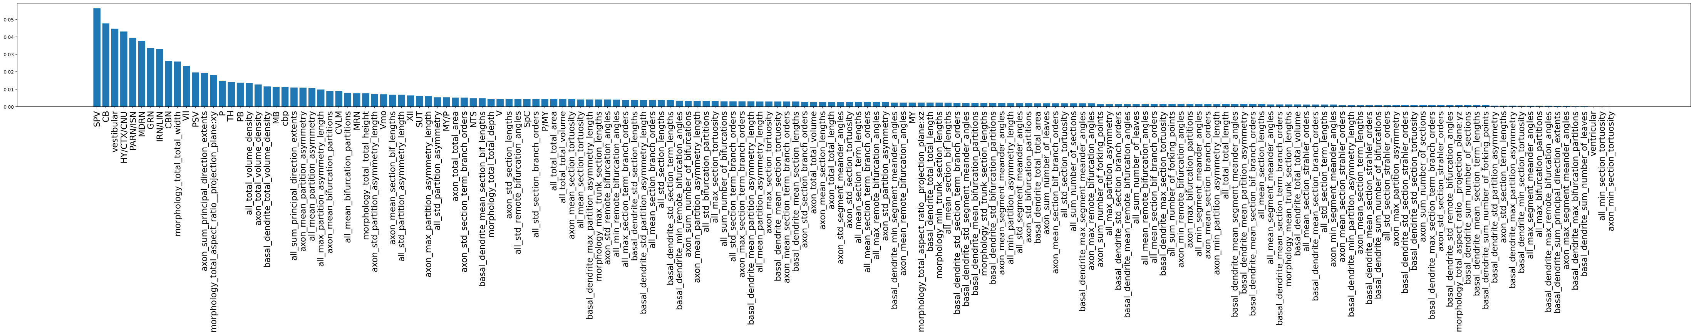
Importance of features by mean Gini entropy loss during random forest classification
- Drop all of these under MY (MY motor), begin collapsing features that measure similar or the same thing(s)

Slide 28
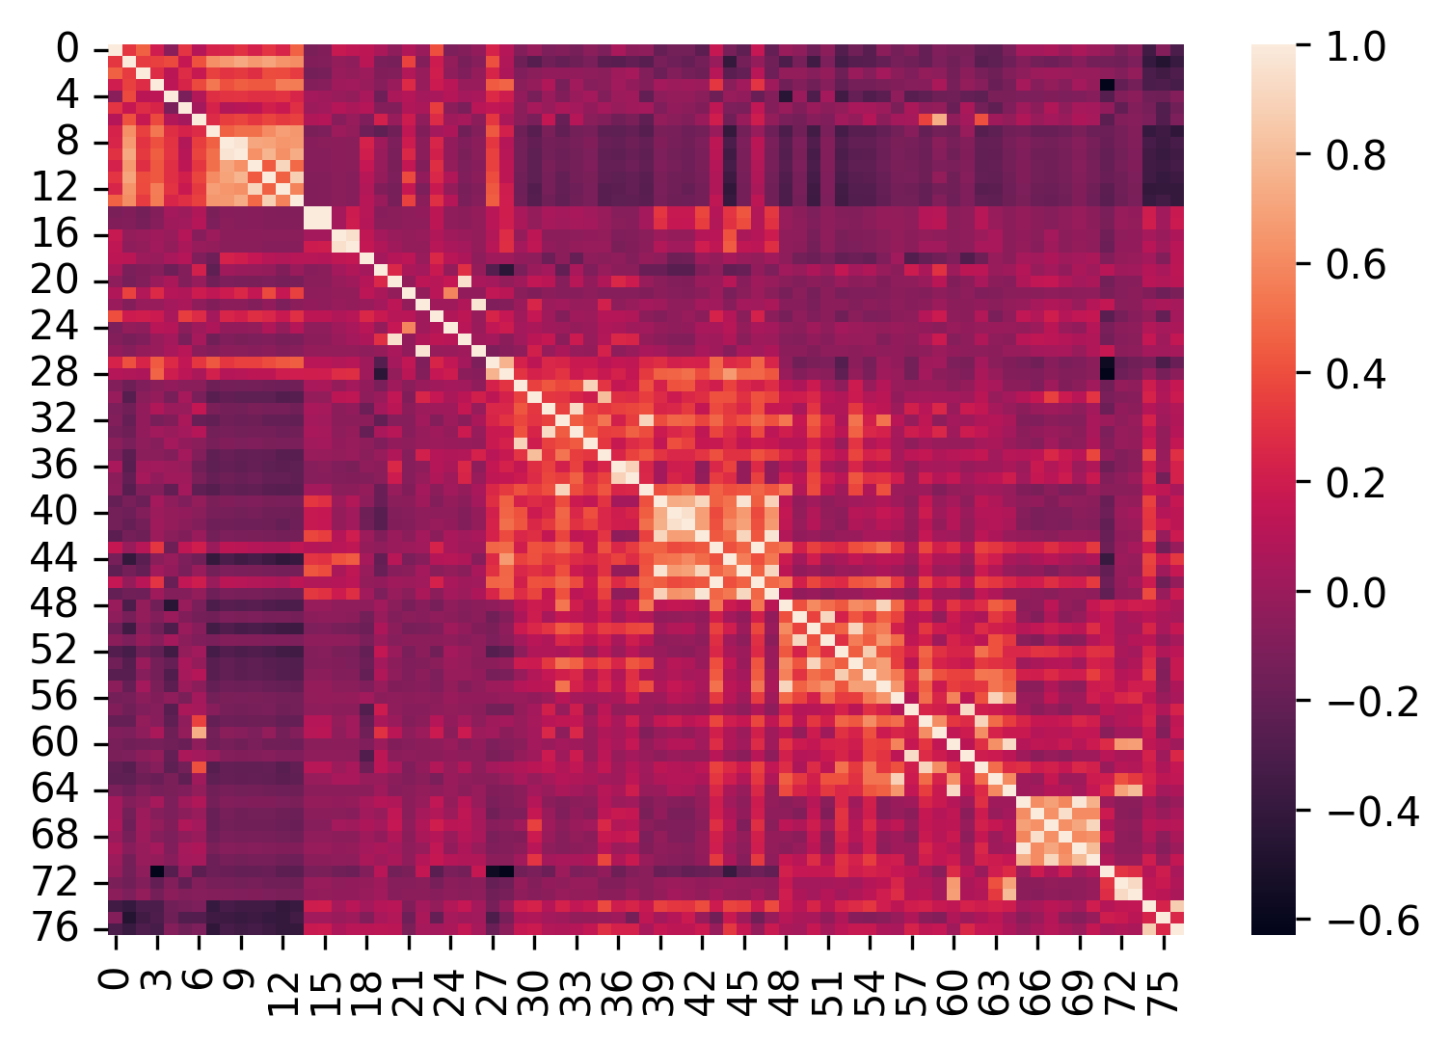
Feature x feature correlations after dropping

Slide 29
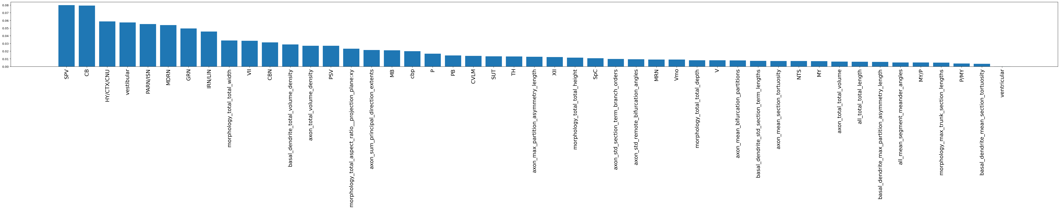
Current feature set (length and ends combined here, but not when classifying/clustering)

Slide 30
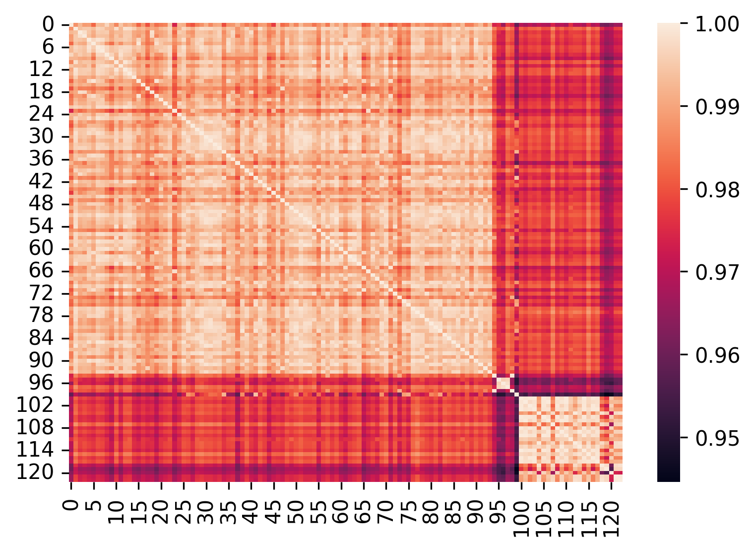
Since features are correlated, clustering on cell correlations doesn’t work
Notes:
Find better clustering method

Slide 31
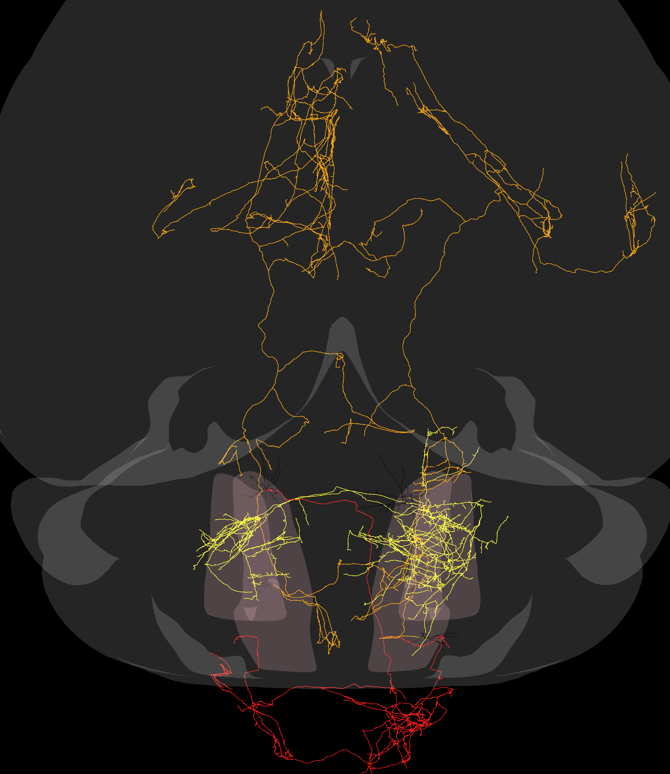
Bottom right cluster
Middle small cluster

Slide 32
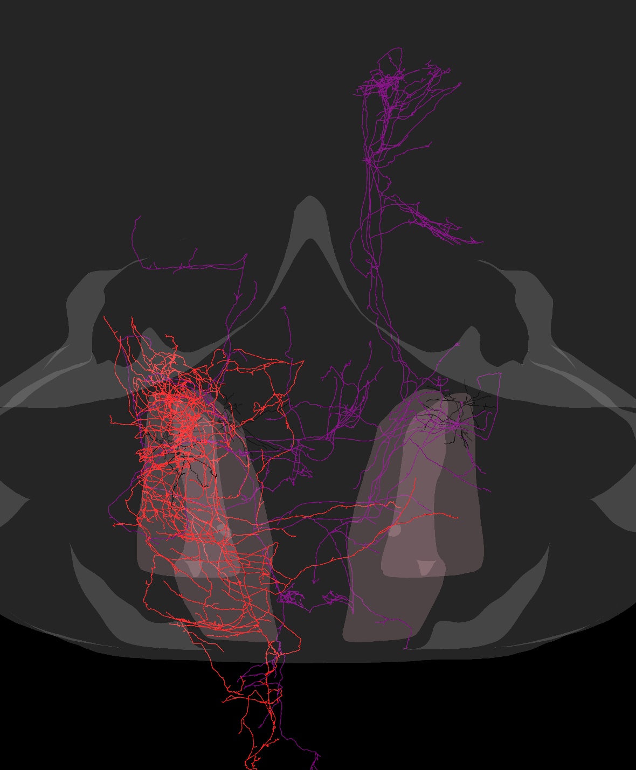
Phox2b cells (colored by assigned phenotype)

Slide 33
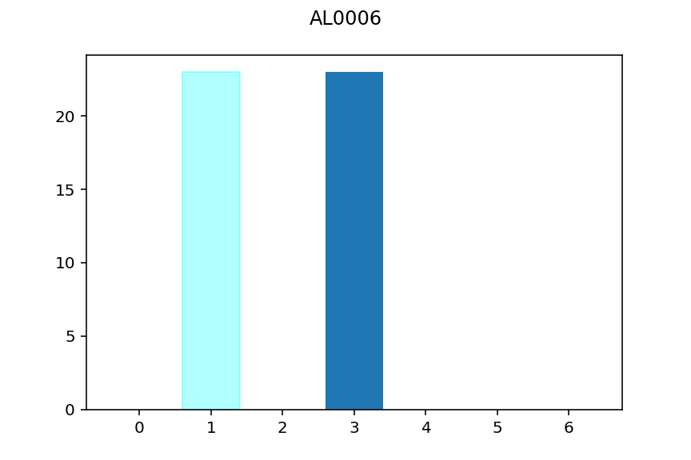
Times appeared in test set, actual label
What it was classified as when classified wrong
premotor
GRN

Slide 34
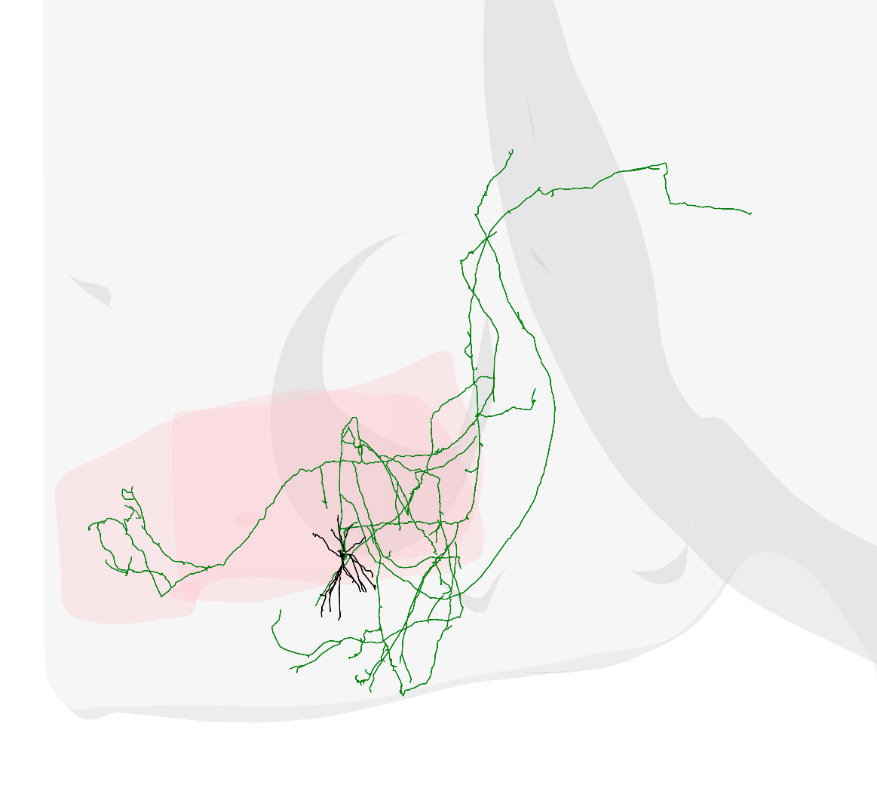
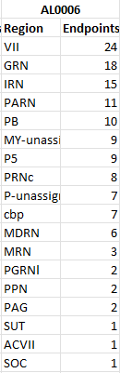
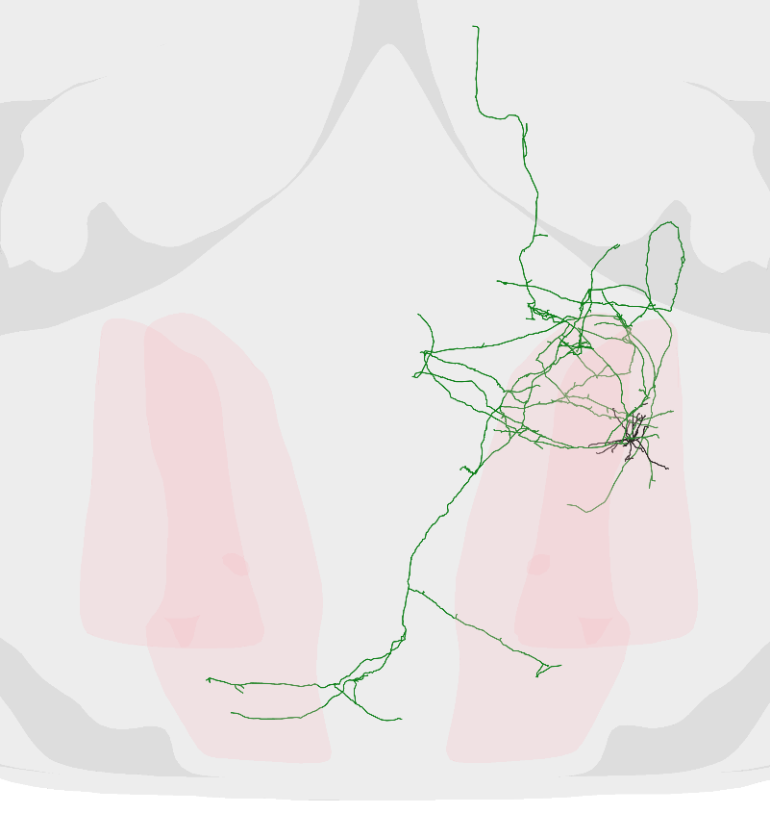

Slide 35
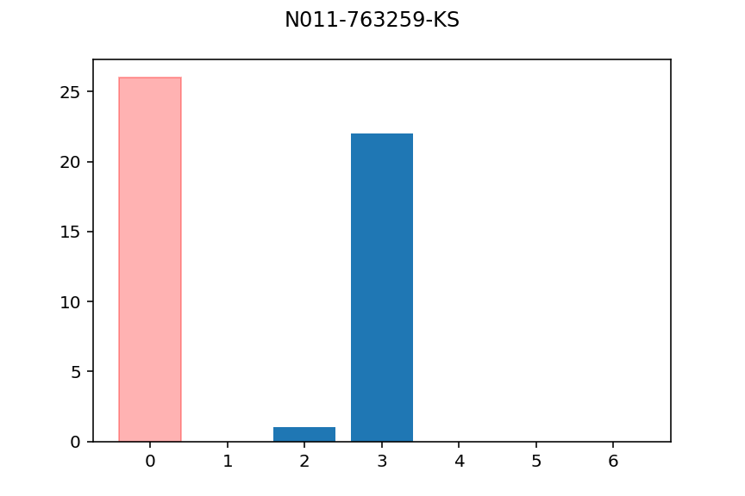
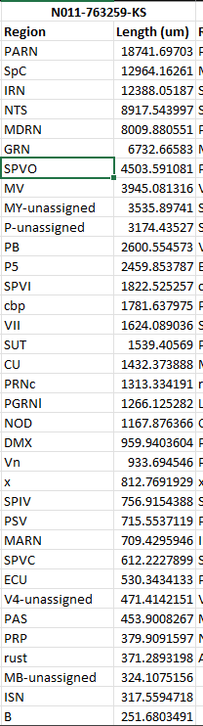
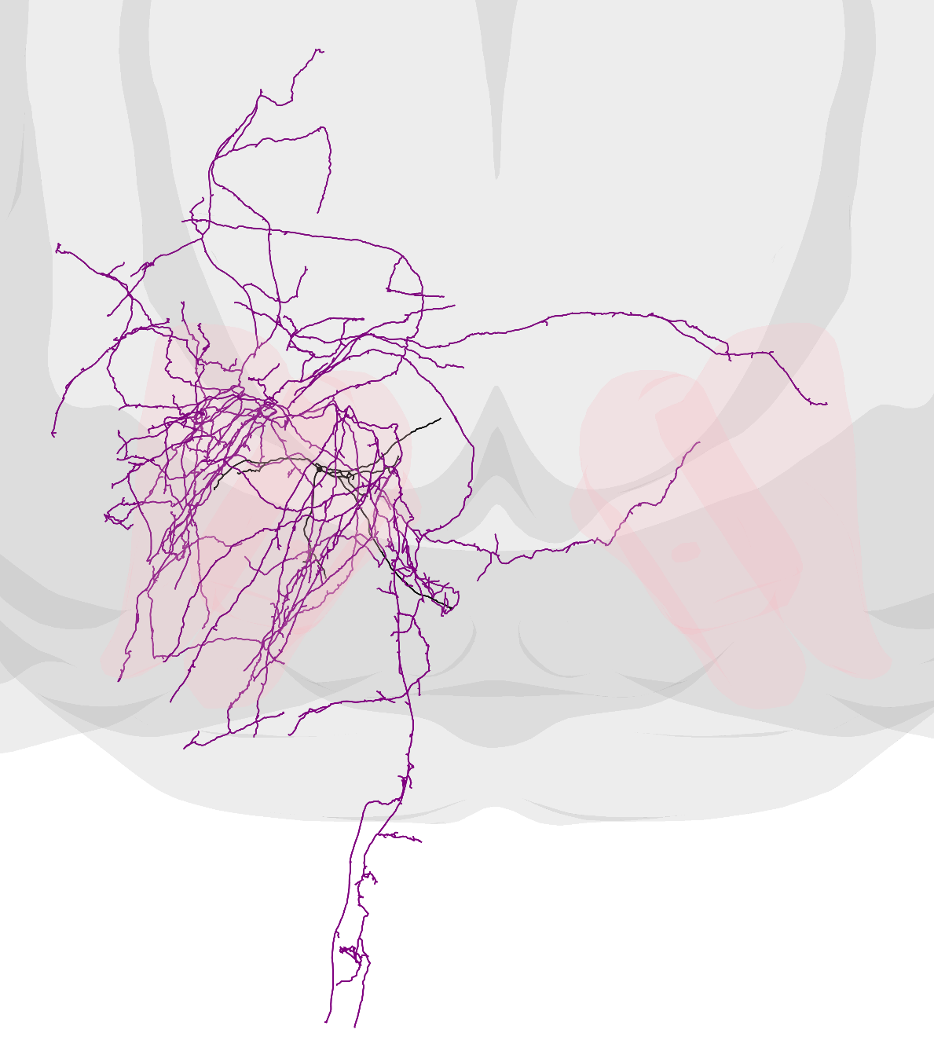

Slide 36
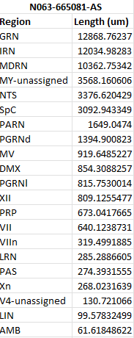
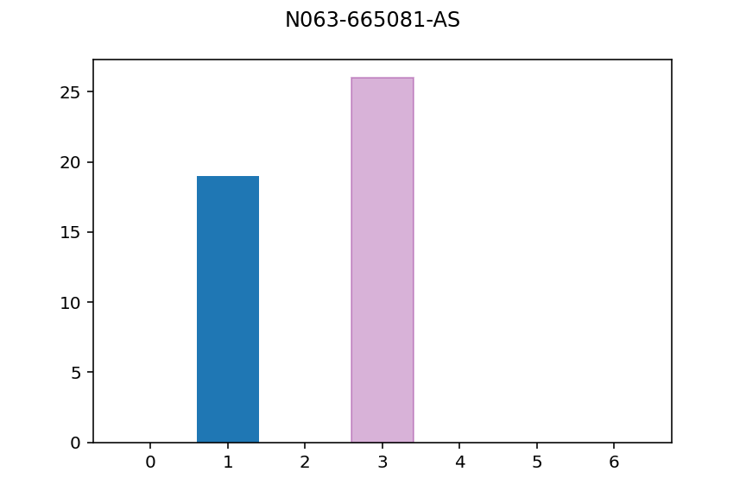

Slide 37



Slide 38

So threshold and cut regions innervated below some threshold
# regions below threshold
Threshold (avg axon length/mm^3)
Start with a threshold of 0.005 (drop regions that receive average of less than 0.005 um of axon / mm^3 of region)

Slide 39


Same thing, but calculate average for a given region from cells that project to that region
# regions below threshold
Threshold (avg axon length/mm^3)
Not as clear, maybe just thresh at like 0.06?

Slide 40

After cutting regions w/previous thresh averaging over cells that project to a given region
First 10 PCs explain 93% variance
explained variance
n components

