Slide 1
DW field-switching micromag and fitting results
updated 25/11/21

Slide 2
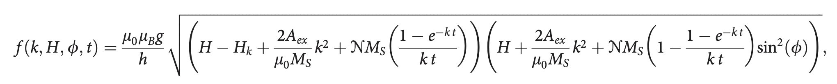
BLS notes: fitting eqn
Determined through FMR
Fitting parameters
DE → 1
BV → 0
Less valid for thicker films
Appl. Phys. Lett. 120, 112405 (2022); doi: 10.1063/5.0083583

Slide 3
Non-device ways to measure A_{ex}
Neutron scattering → gold standard
Temperature dependent magnetometry
Perpendicular standing spin waves (PSSWs)
  Brillouin light scattering (BLS)
  Ferromagnetic resonance (FMR)
Damon-Eschbach and backscattering mode dispersion
  BLS
  FMR in devices
Problem: Cannot measure in films less than 10 nm

Slide 4
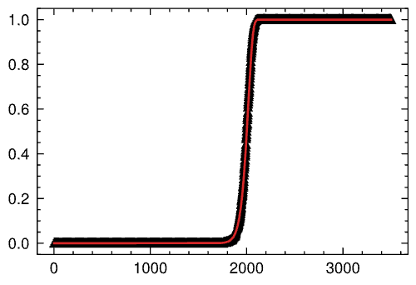
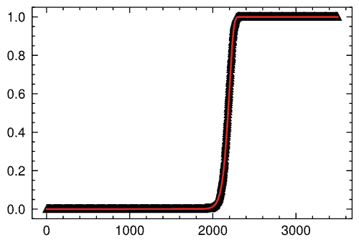
Output and fitting using equation (2 kHz sampling)
Generated:
Aex = 1.776e-06 erg/cm
w_dw = 12.7 nm
Delta = 145.95
Generated:
Aex = 2.012e-06 erg/cm
w_dw = 12.7 nm
Delta = 155.362
P(H)
P(H)
Fitted:
Aex = 1.739e-06 erg/cm
w_dw = 13.808 nm
Delta = 144.449
Fitted:
Aex = 1.929e-06 erg/cm
w_dw = 13.482 nm
Delta = 152.126
H (Oe)
H (Oe)

Slide 5
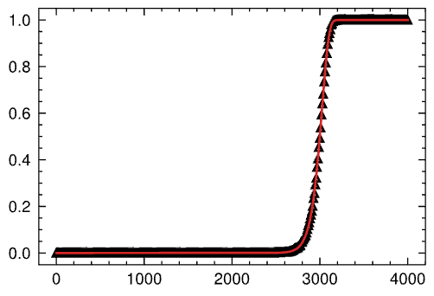
Output and fitting using equation (1 GHz sampling)
Generated:
Aex = 1.776e-06 erg/cm
w_dw = 12.7 nm
Delta = 145.95
P(H)
Fitted:
Aex = 1.711e-06 erg/cm
w_dw = 12.423 nm
Delta = 143.253
H (Oe)

Slide 6
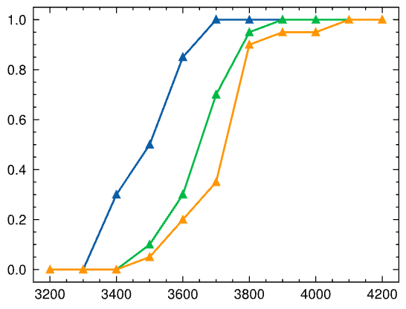
Mumax output
Mumax:
Aex = 1.776e-06 erg/cm
sampling rate = 1 GHz
Ki = 2.48 erg/cm²
Ku1 = Ki/t_fl (seems to be too large)
A_{ex}=1.6E-6
A_{ex}=1.77E-6
P(H)
A_{ex}=1.9E-6
H (Oe)

Slide 7
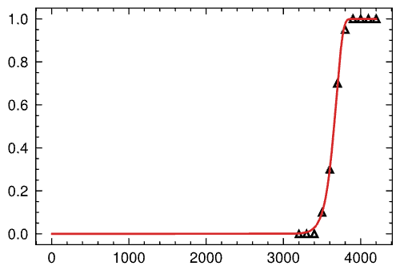
Mumax best fitting attempt (scipy)
Mumax:
Aex = 1.776e-06 erg/cm
f_att = 5.079 GHz
sampling rate = 1 GHz
Ki = 2.48 erg/cm²
Ku1 = Ki/t_fl (seems to be too large)
Fitted:
Aex = 1.604e-06 erg/cm
w_dw = 11.340 nm
Delta = 173.071
f_att = 5.079 GHz
Hk = 2817.147 Oe
P(H)
Fitting variables:
Aex
delta (w_dw = |diameter*delta|)
f_att
Hk
H (Oe)

Slide 8
Next (10/18/2025)
Error propagation for fitting
  Look into more advanced fitting packages (lmfit)
Domain wall length calculation
Physical measurements

Slide 9
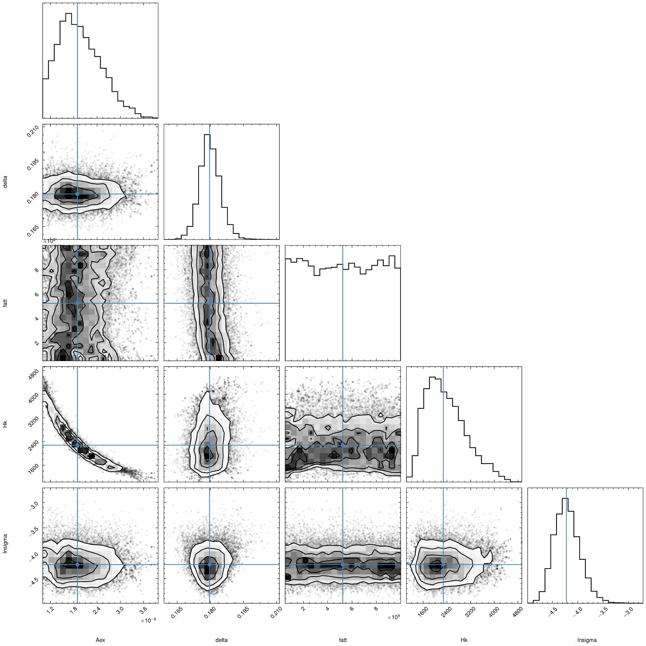

Mumax fitting attempt (lmfit)
Mumax:
Aex = 1.776e-06 erg/cm
f_att = 5.079 GHz
sampling rate = 1 GHz
Ki = 2.48 erg/cm²
Ku1 = Ki/t_fl (seems to be too large)
Fitting variables:
Aex
delta (w_dw = |diameter*delta|)
f_att
Hk
Fitted:
Aex = 1.604e-06 erg/cm
w_dw = 11.340 nm
Delta = 173.071
f_att = 5.079 GHz
Hk = 2817.147 Oe
P(H)
H (Oe)

Slide 10

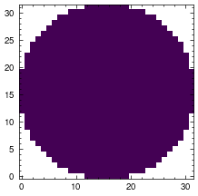
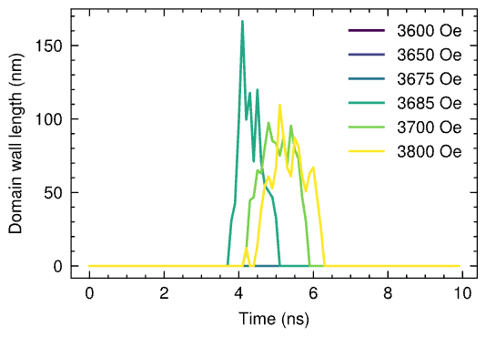
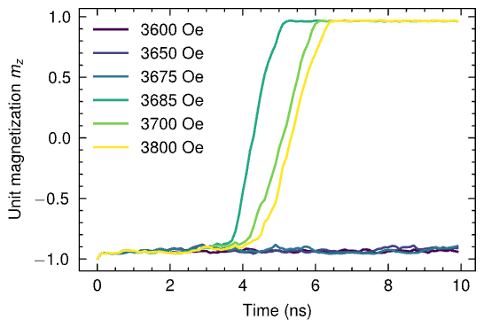
DW length results

