Slide 1

Python Marathon Data Analysis
By Sam Lawson

Slide 2
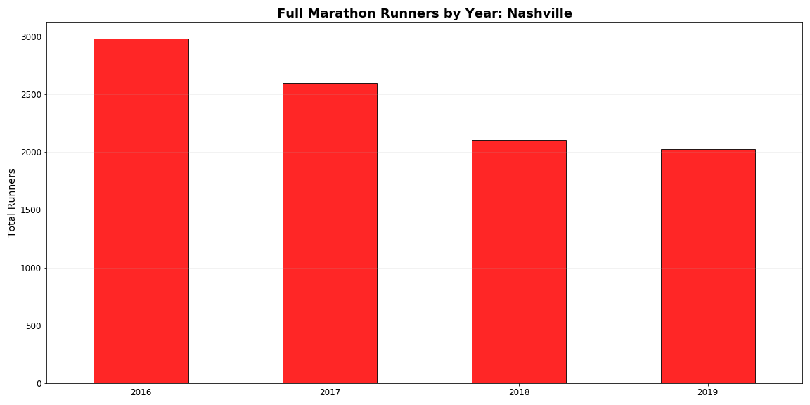
Marathons on The decline in Nashville

Slide 3
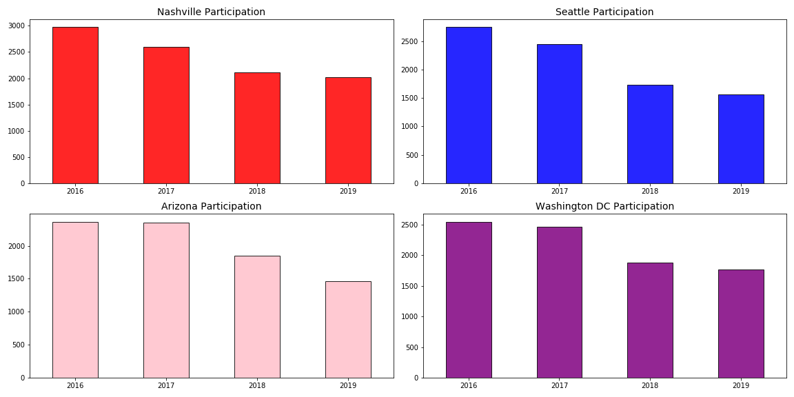
Across the country, the trend is the same

Slide 4
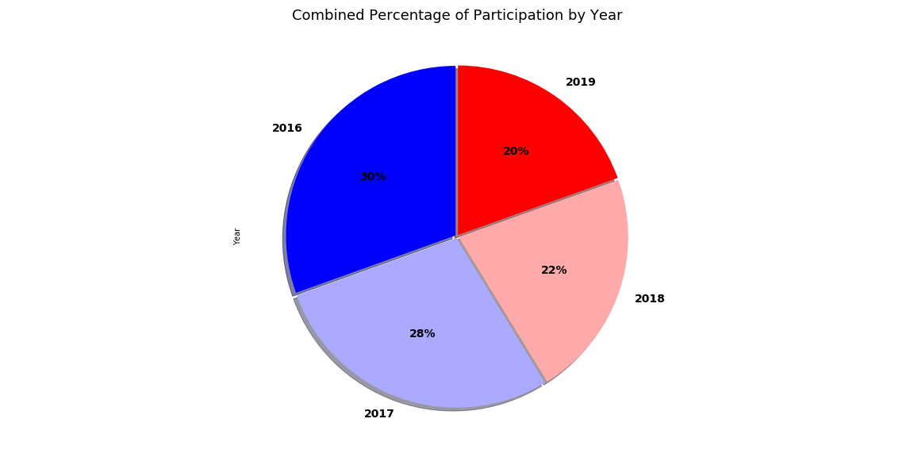
WHY THE DECLINE ?

Slide 5
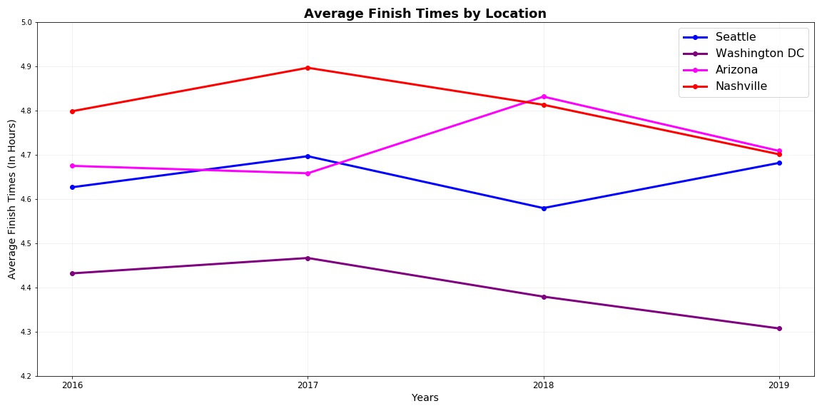
Washington DC Has the Fastest Average Finish Time 2016 - 2019
Washington DC: 4.41 hours
Seattle: 4.64 hours
Arizona: 4.71 hours
Nashville: 4.81 hours

Slide 6
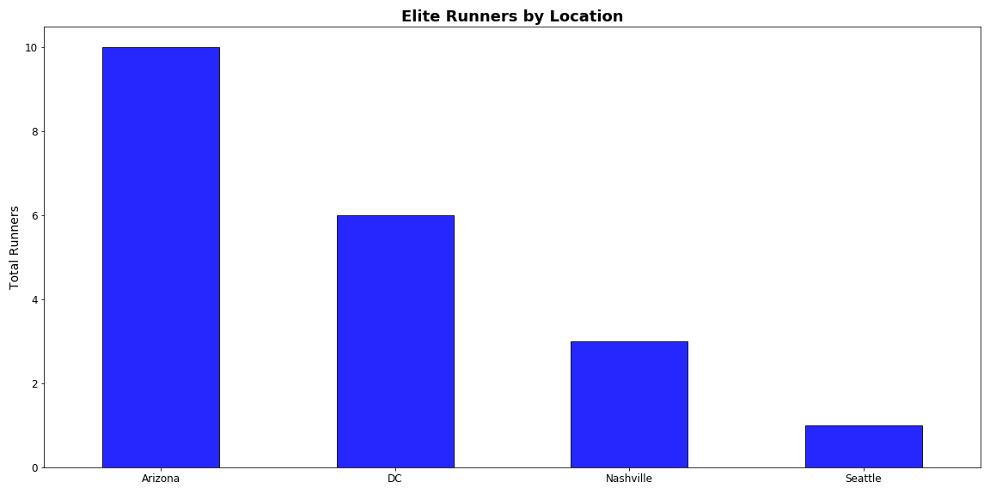
Arizona has the highest amount of Elite runners
An elite marathon time is less than 2.5 hours

Slide 7
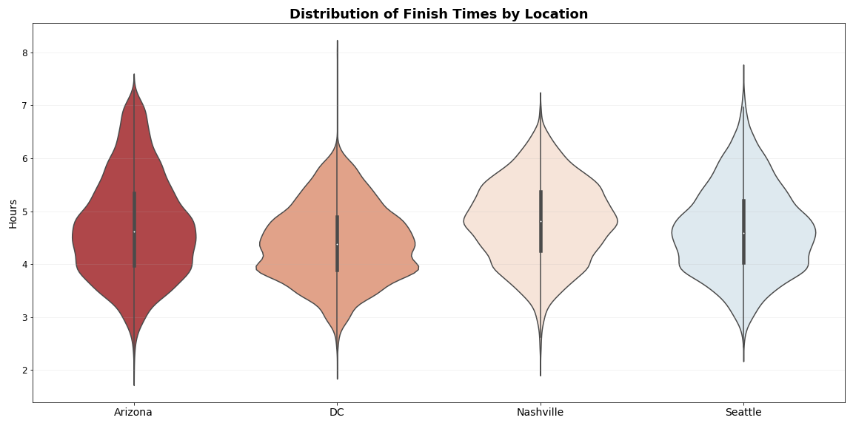

Slide 8
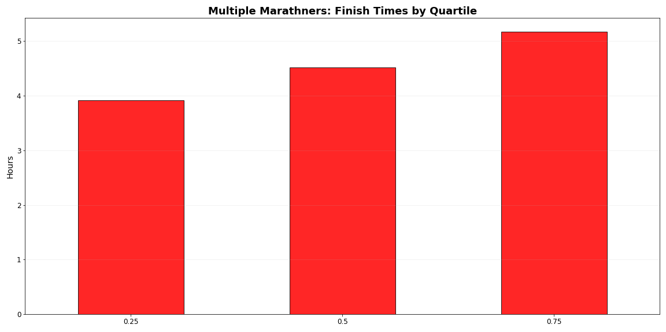
25th Percentile: 3.92 Hours 50th Percentile: 4.52 Hours 75th Percentile: 5.17 Hours

